Slide 1
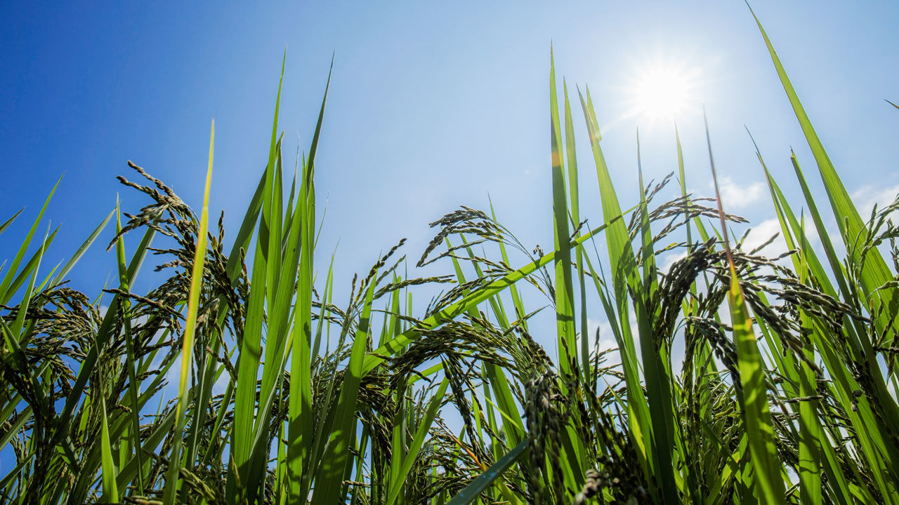
Opportunities and Challenges of
Accelerated Breeding
Cambodia
Ouk Sothea
Plant Breeding Division
Cambodian Agricultural Research and Development Institute (CARDI)

Slide 2
Cambodia's climate over the past 50 years
1. Cambodia Context:
Average daily temperature range
1920-1970: 23-33⁰c
2000-2009: 23-35⁰c
2014-2015: 22-37⁰c
Climate
April : Hottest
December: Coolest
Evaporation: 2230mm/year
  September : Lowest
  March : Highest
Rainfall ranges: From 1250mm to 2500mm
Day length: 11h – 13h
- December : Shortest
- June : Longest
Monsoon climate:
Dry season: November to April
Wet season: May to October

Slide 3
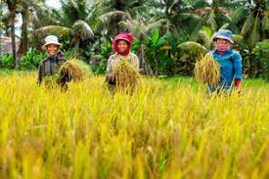
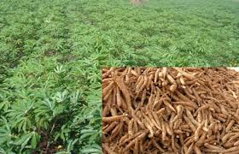
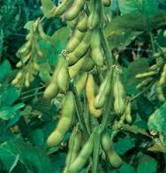
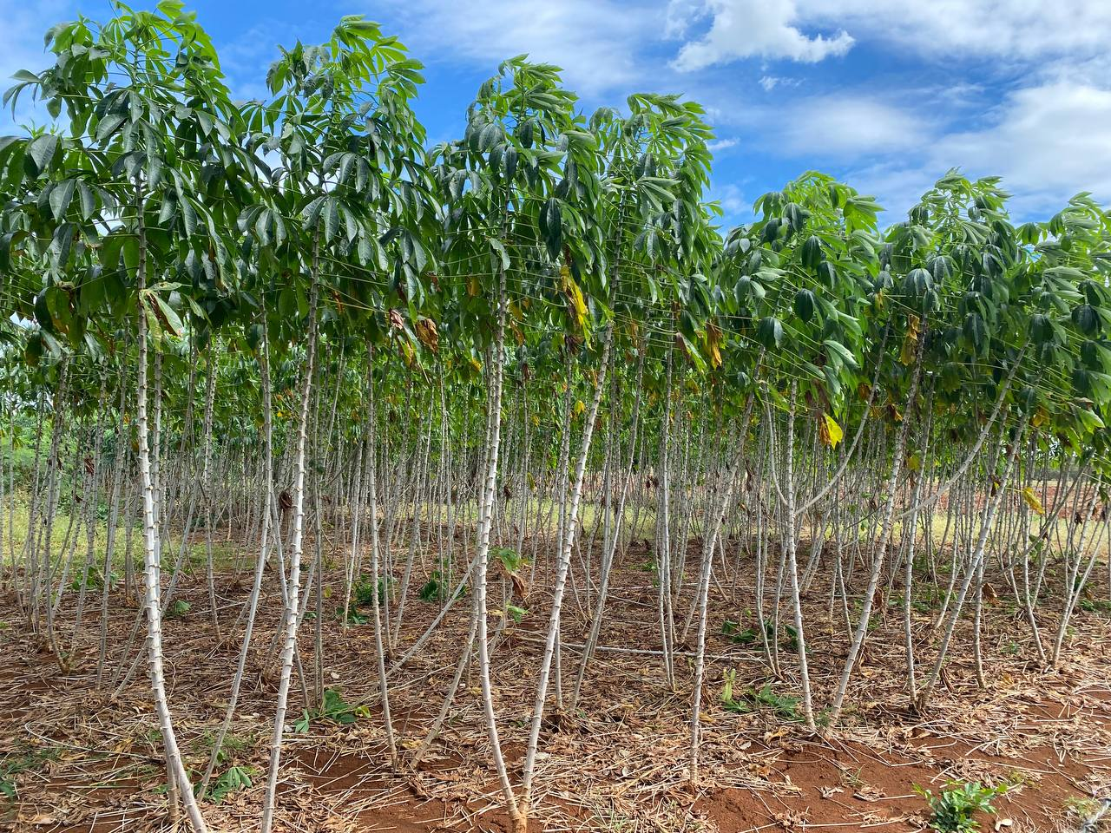
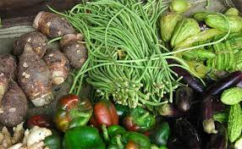
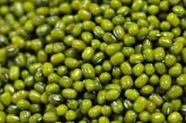
Crop production status in Cambodia
Crop | Planting area (ha) | Percentage(%)
Rice | 3,856,326 | 77.13
Cassava | 773,150 | 15.46
Maize | 197,361 | 3.95
Vegetable | 76,153 | 1.52
Sugarcane | 16,528 | 0.33
White corn | 16,149 | 0.32
Mung bean | 15,488 | 0.31
Soybean | 11,436 | 0.23
Sesame | 8,426 | 0.17
Watermelon | 5,829 | 0.12
Tobacco | 4,482 | 0.09
Peanut | 4,455 | 0.09
Sweet potato | 4,330 | 0.09
Lotus | 3,490 | 0.07
Chilli | 1,307 | 0.03
Jute | 63 | 0.001
Other crops | 4,835 | 0.10
Total | 4,999,808 | 100.0
Source: MAFF, 2025

Slide 4
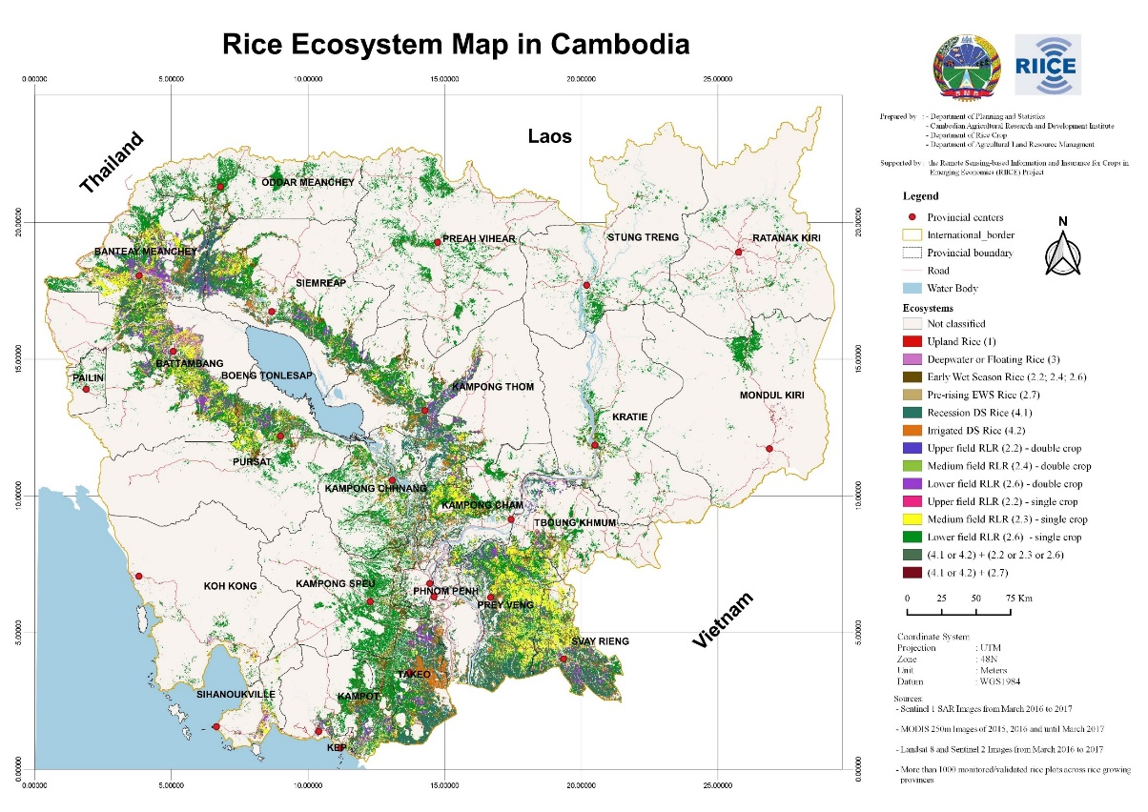

Slide 5
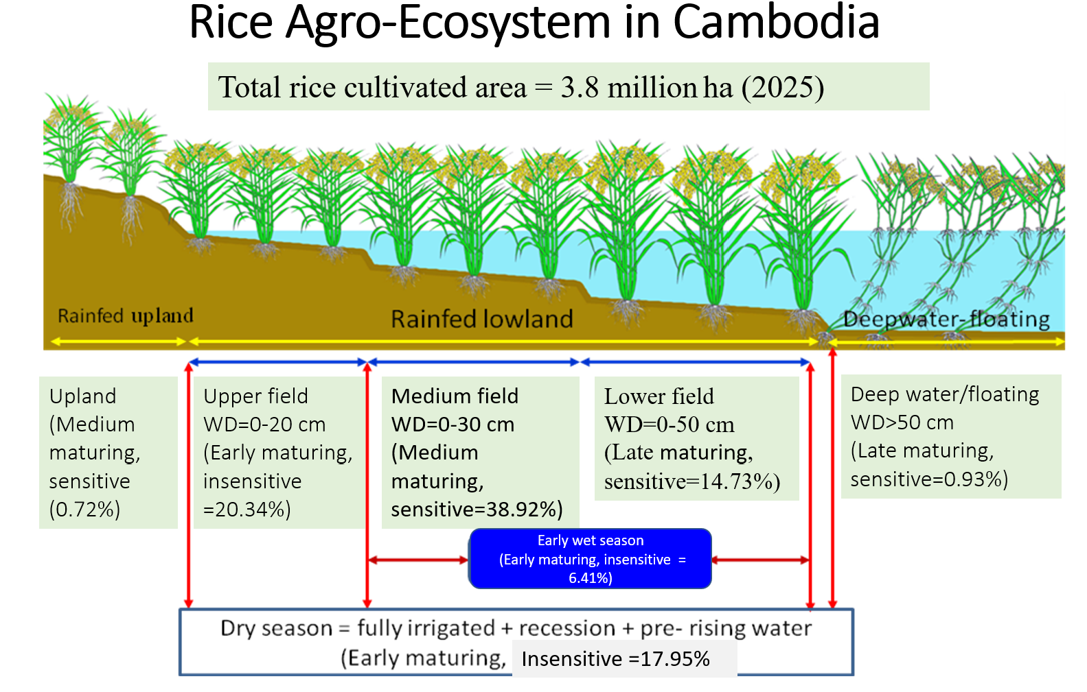

Slide 6
Rice production status from 1989-2023

Slide 7
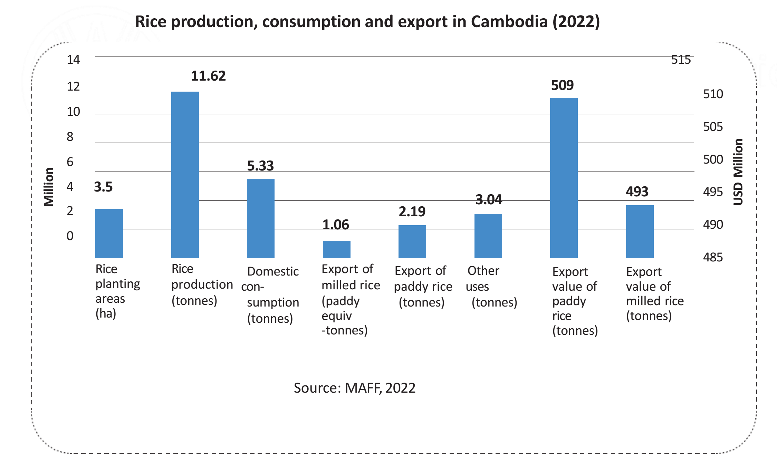
Rice production, consumption and exports, Cambodia 2022

Slide 8
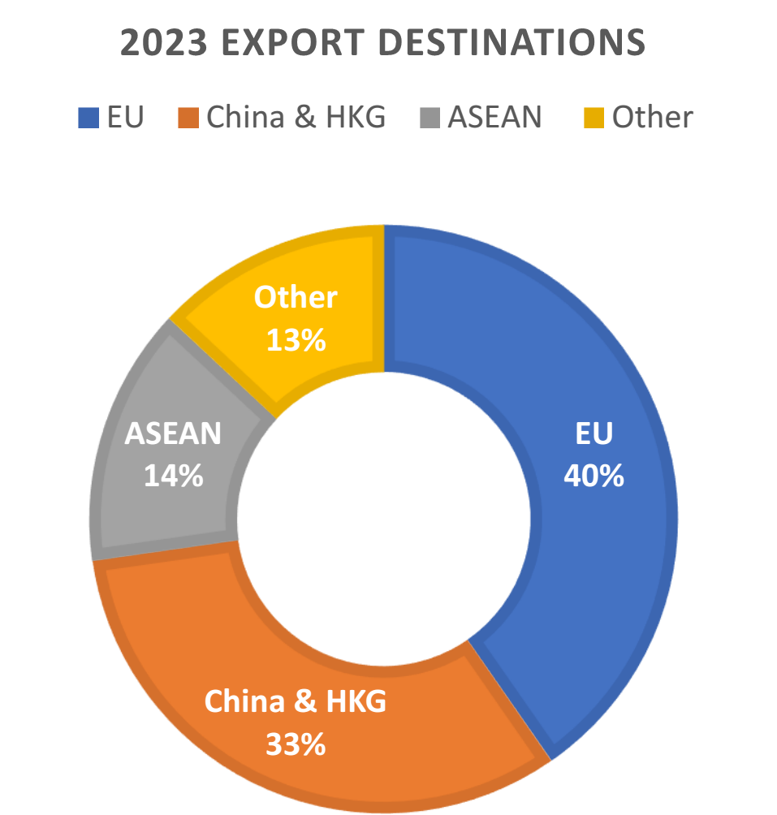
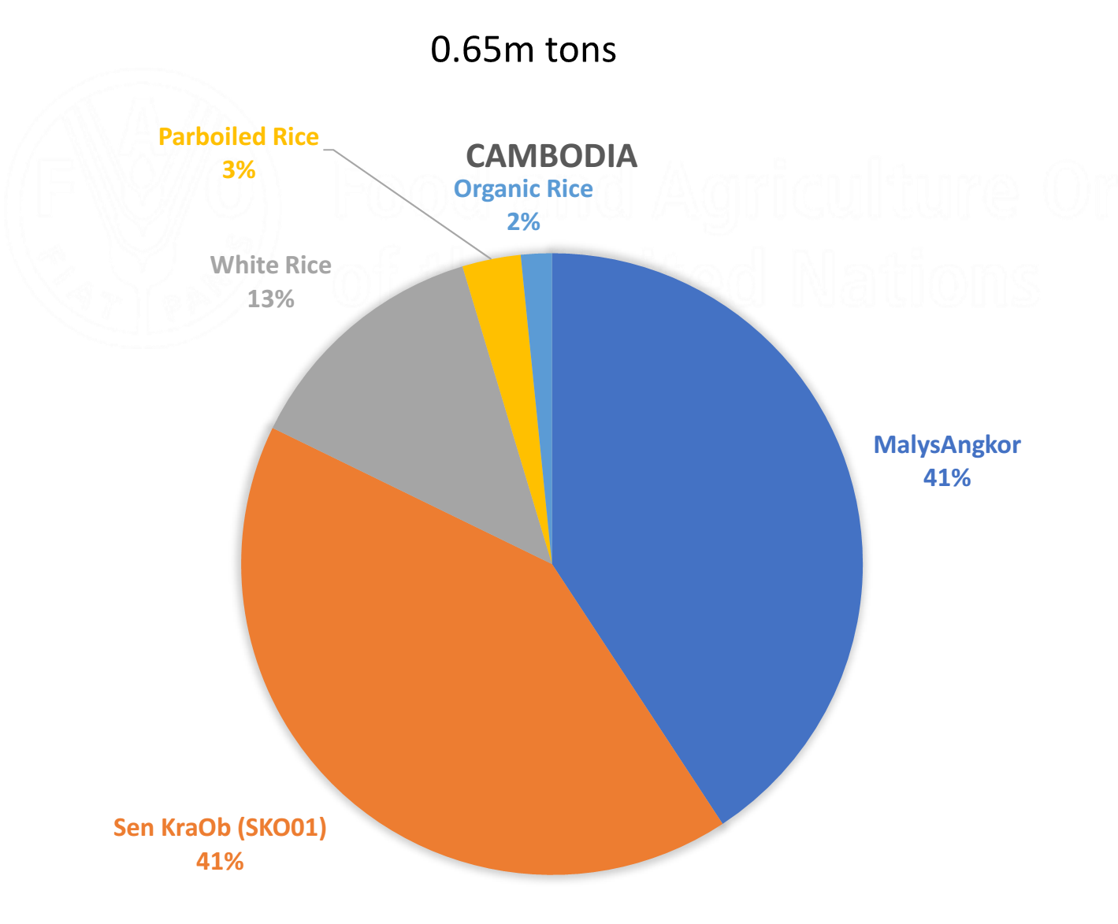
82%
are fragrant rice

Slide 9
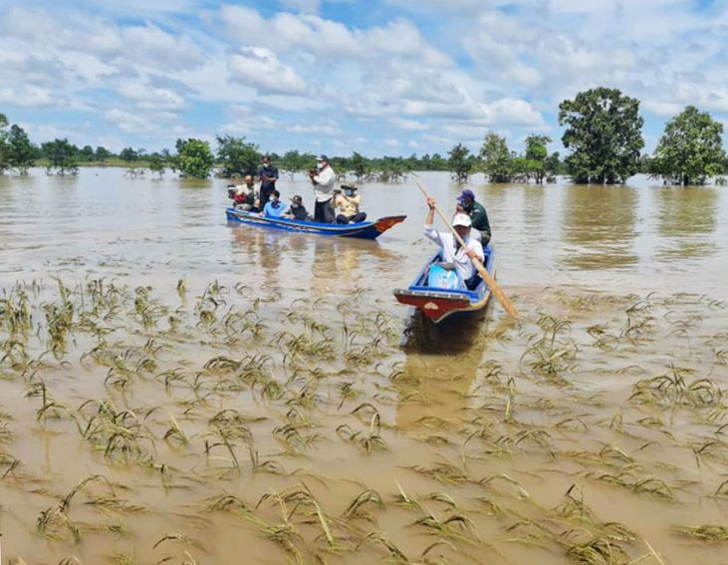
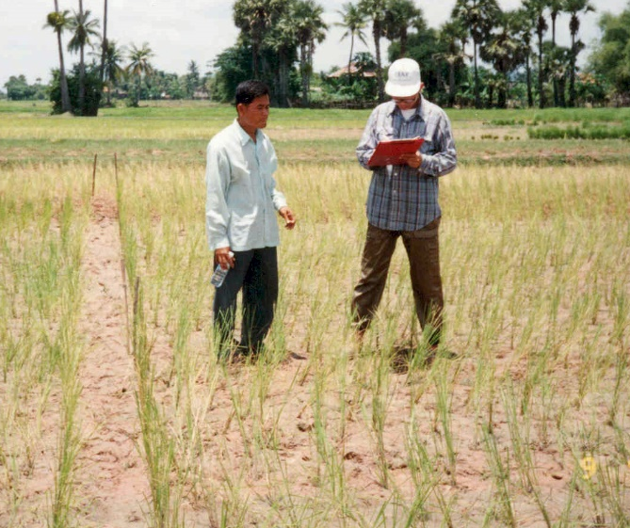
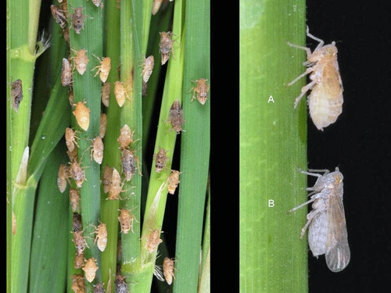
Impact of floods, droughts, diseases and pests on Rice crops, 1996 to 2021

Slide 10
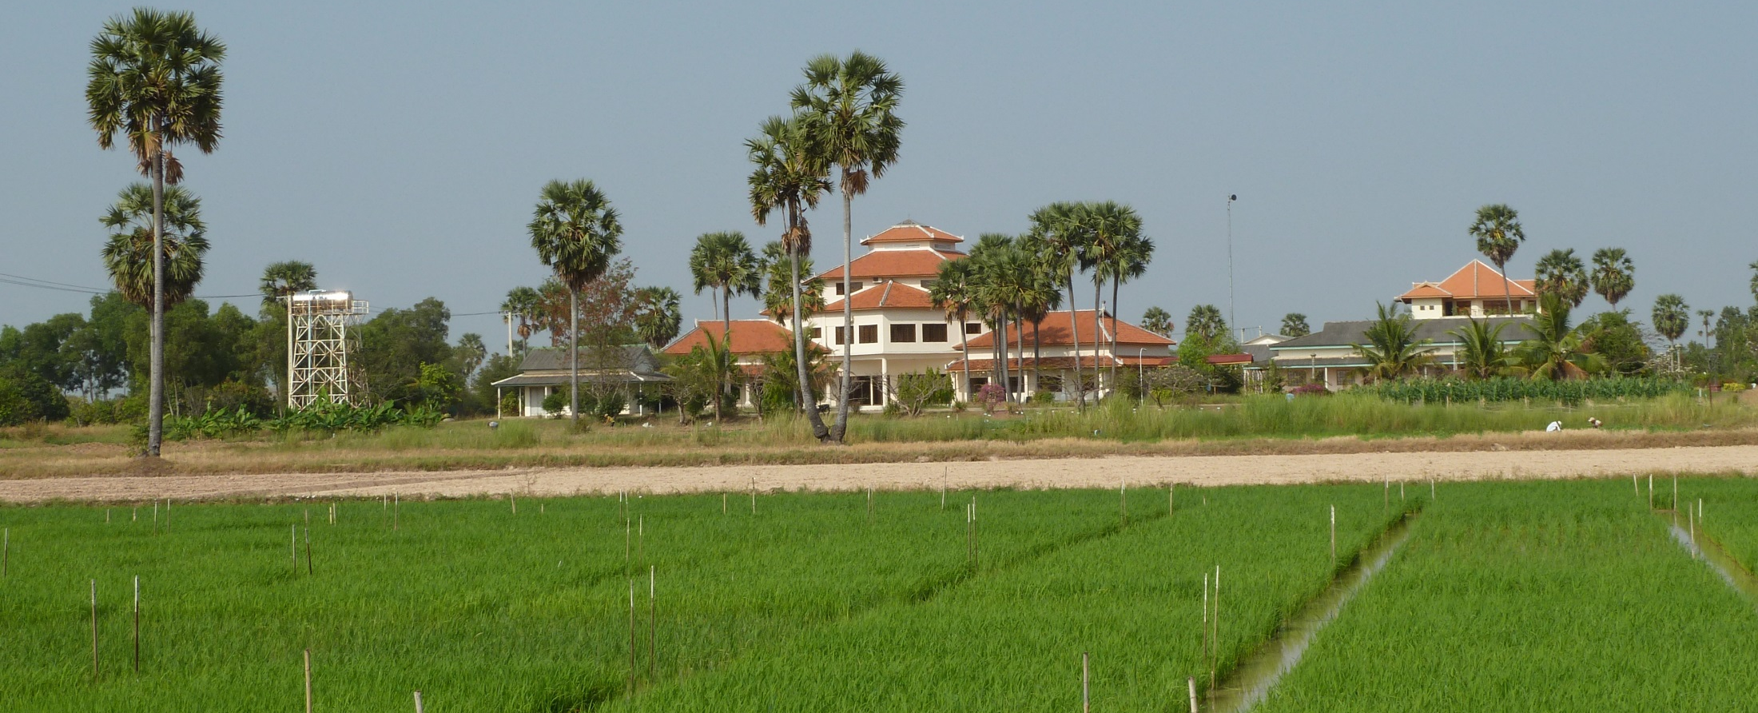
Cambodian Agriculture Research and development Institute (CARDI)
2. Status of Breeding Programs:

Slide 11
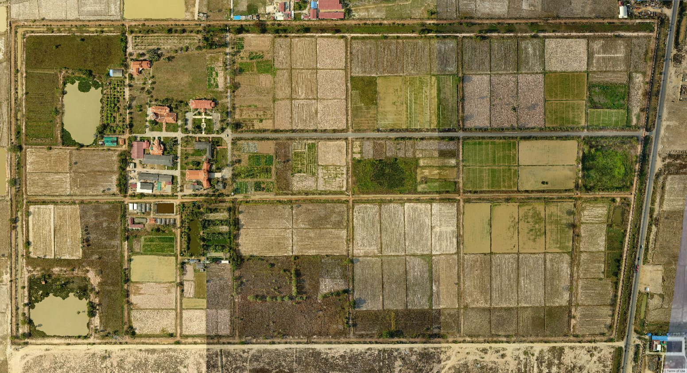
Total Land area: 70 ha for experimental field and seed production.

Slide 12
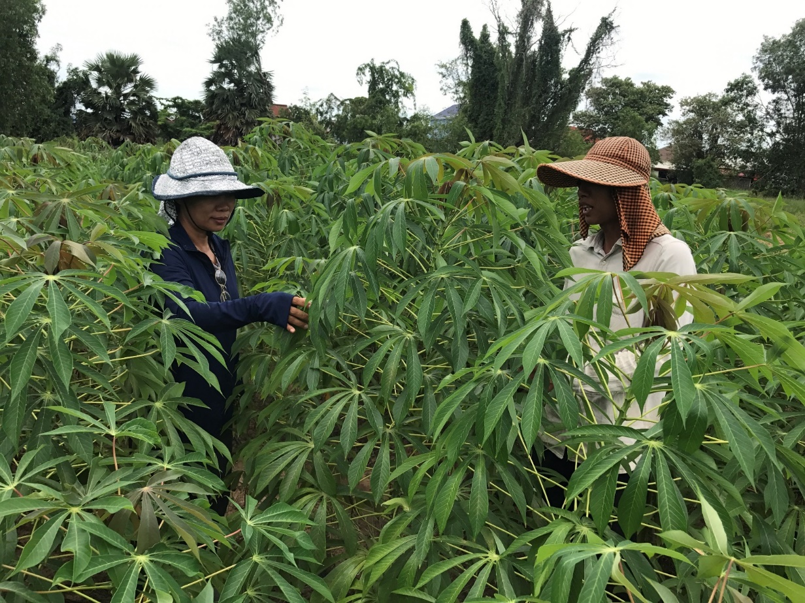
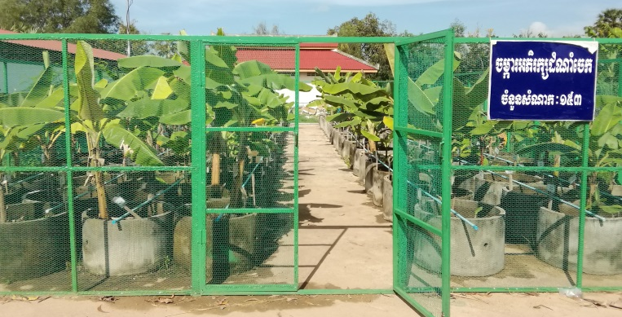
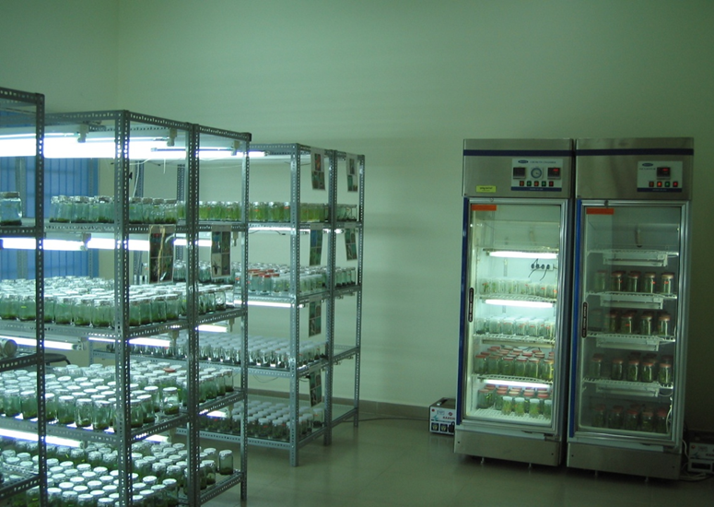
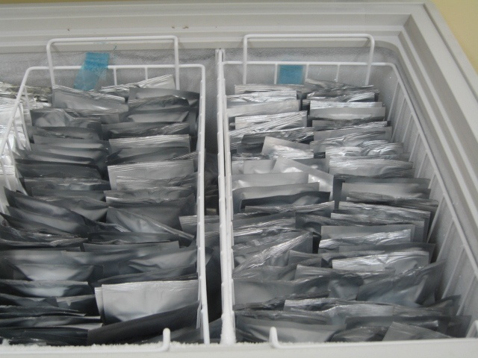
Facility for PGR Management
A total of 9,111 accessions/samples (2020) of 38 crops were collected and conserved at CARDI and its partners (IRRI and RDA):
Type of conservation:
- In-vitro: Ornamental plant, banana, potato
- Seed bank: Cereal, Legume and Vegetable
- On-field: Fruit tree and root crops
On-field
In-vitro
On-field
Seedbank

Slide 13
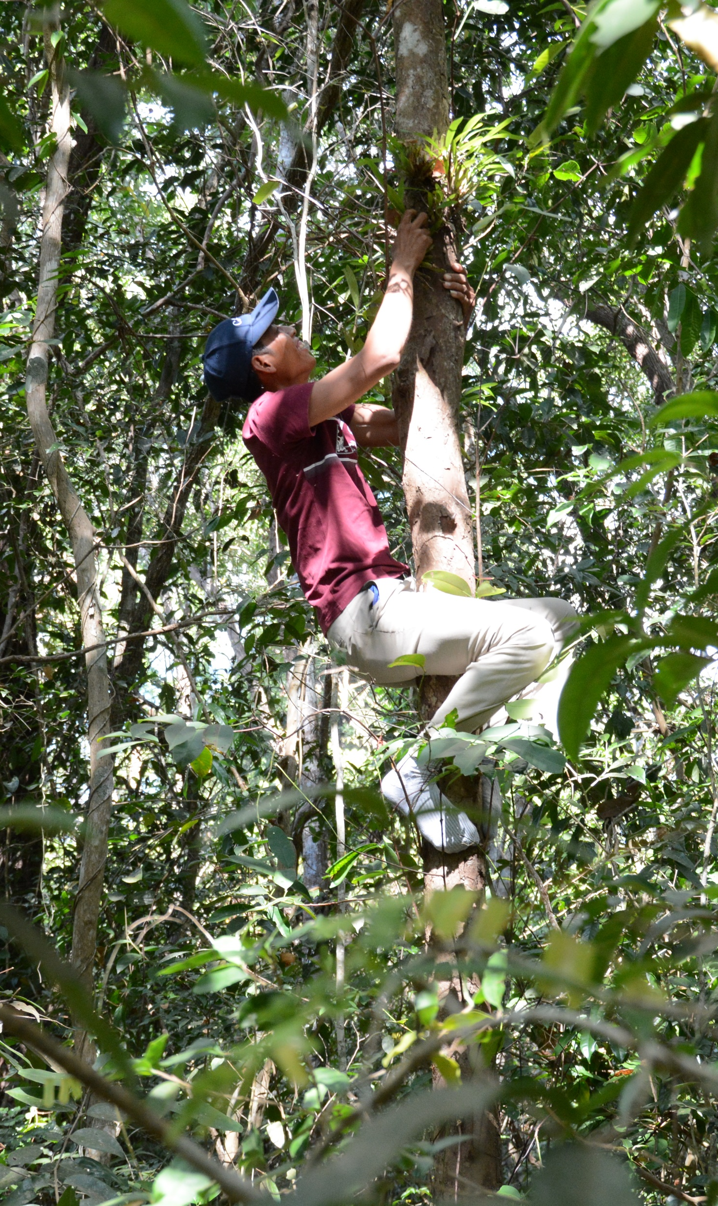
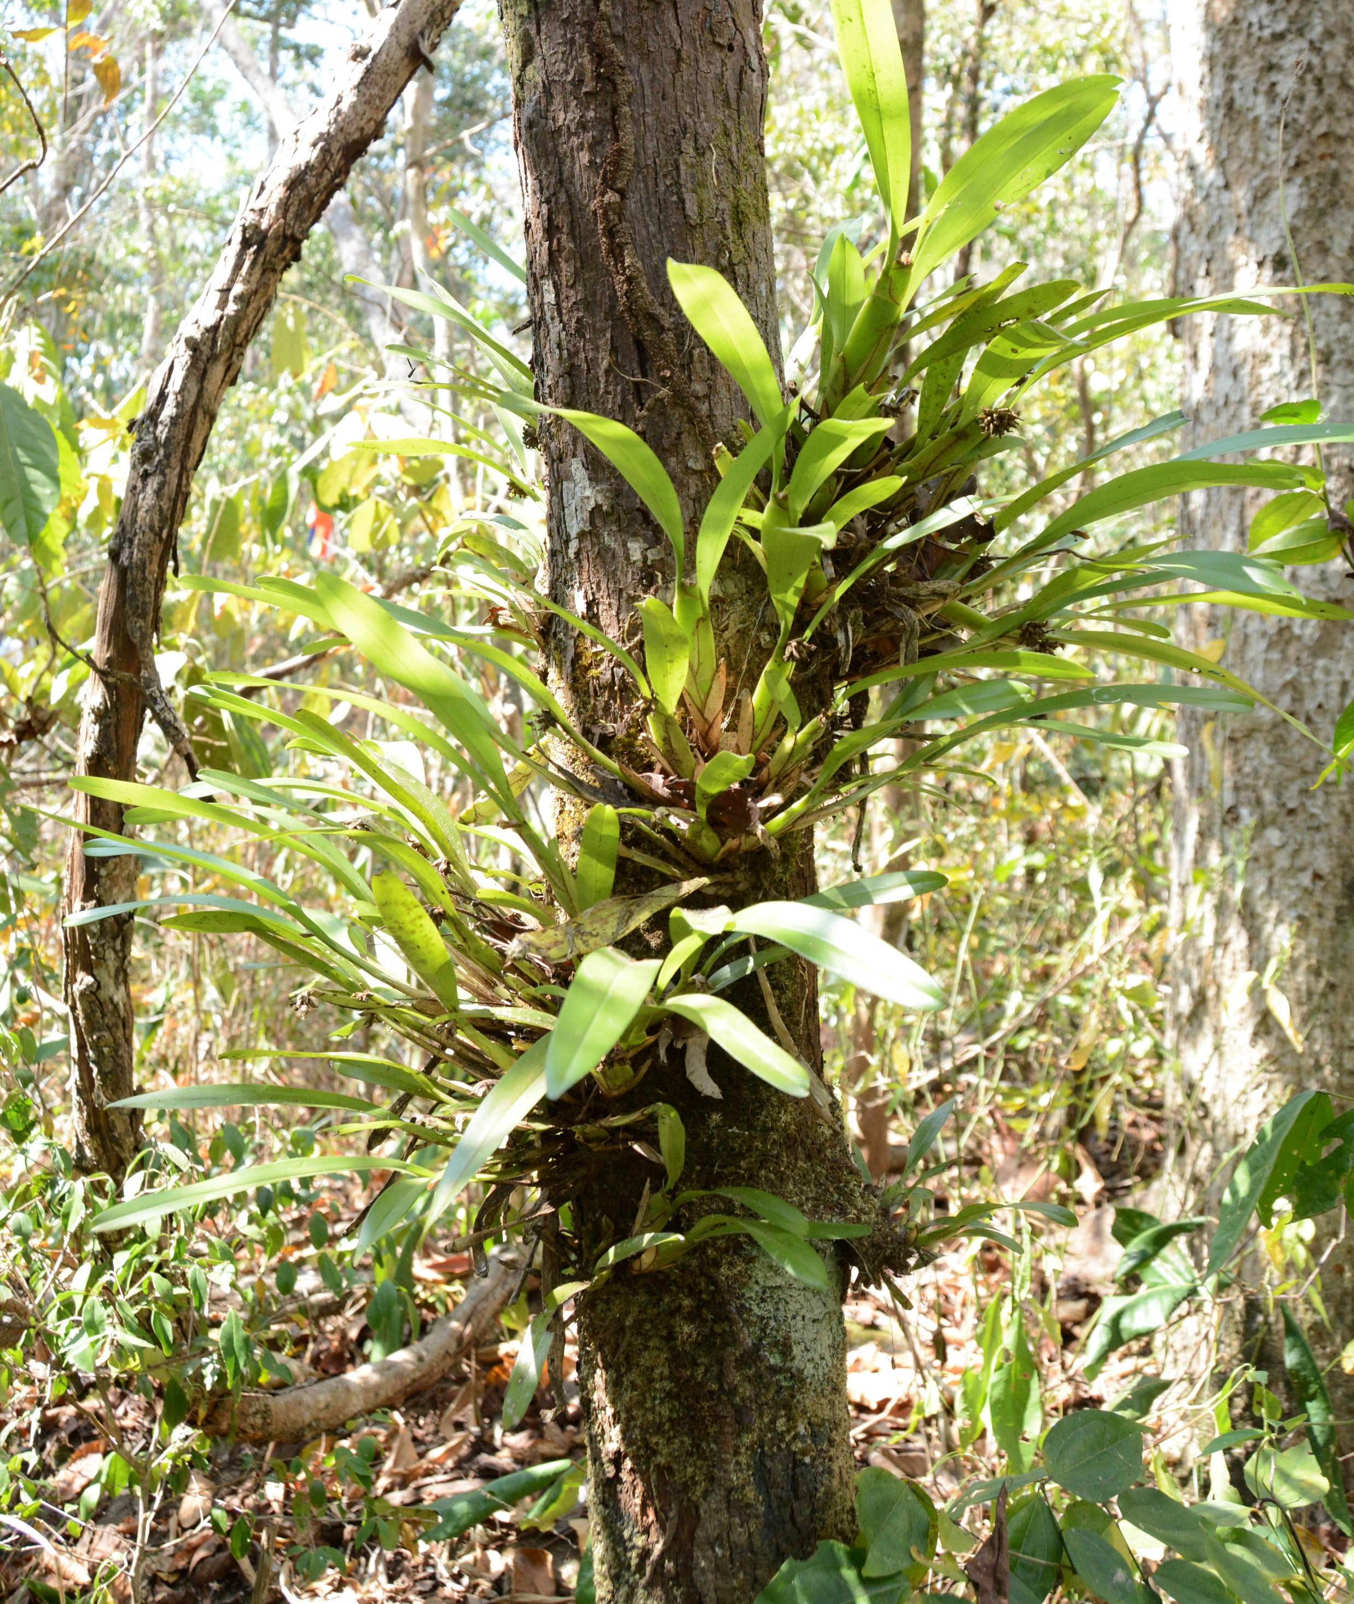
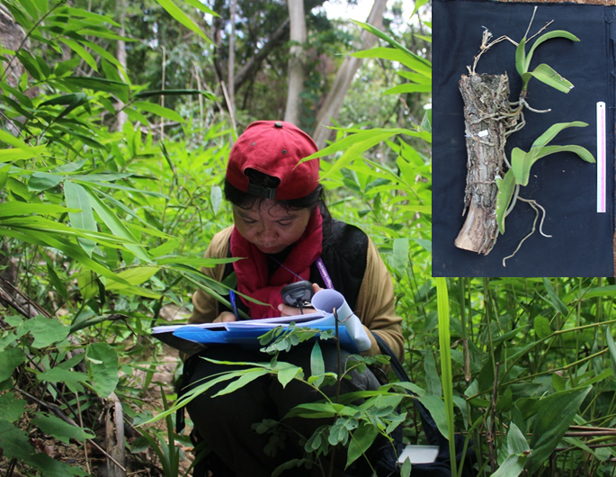
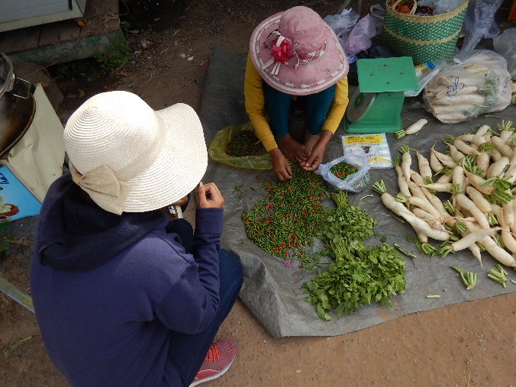
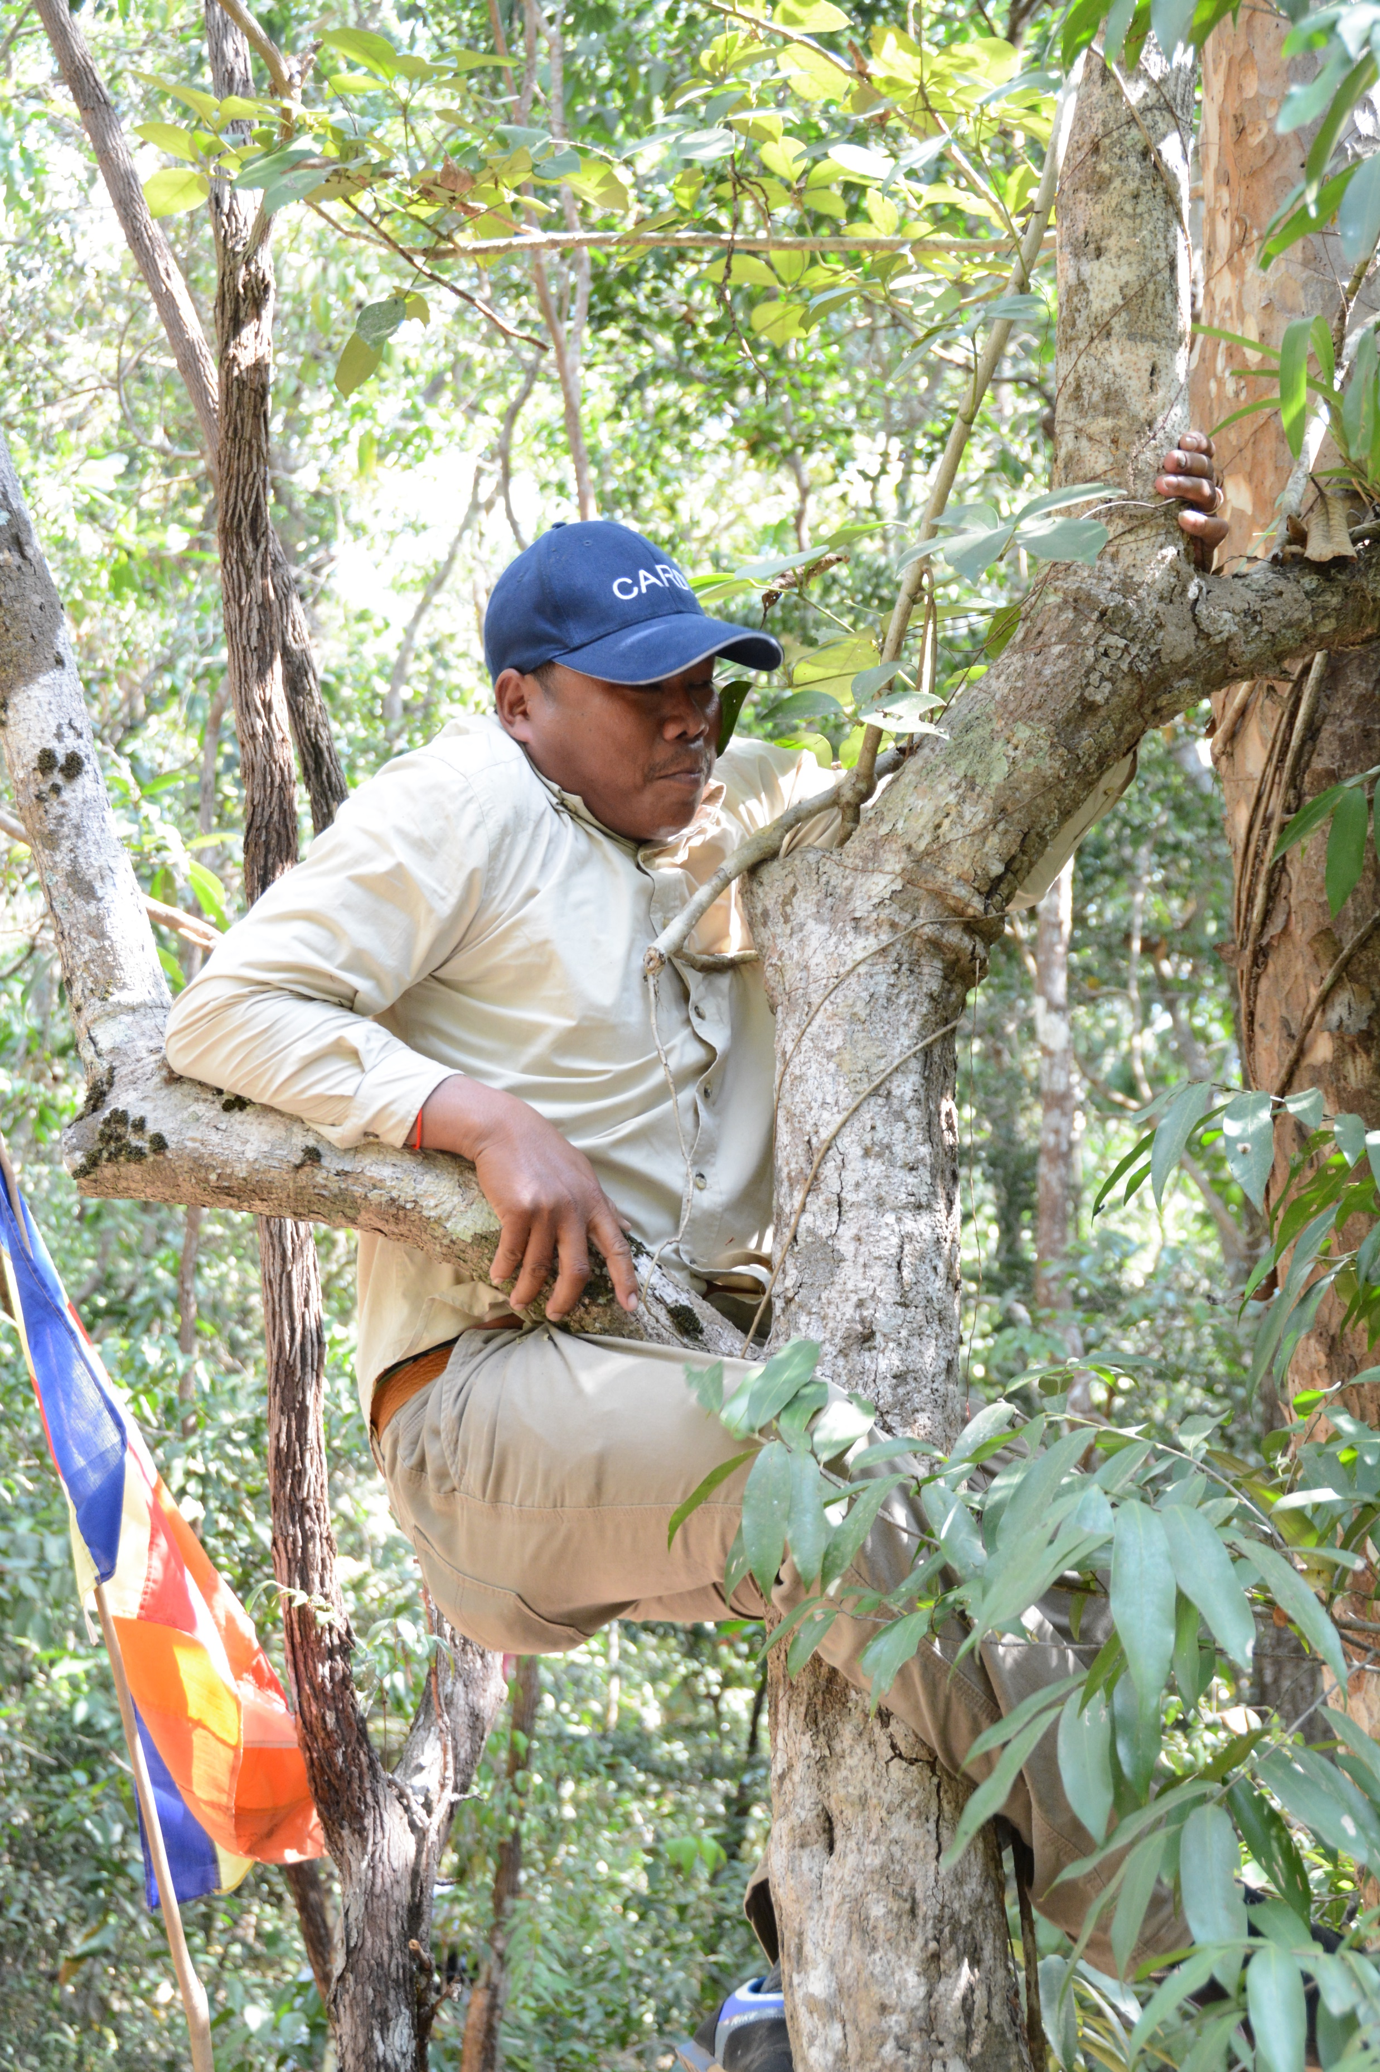
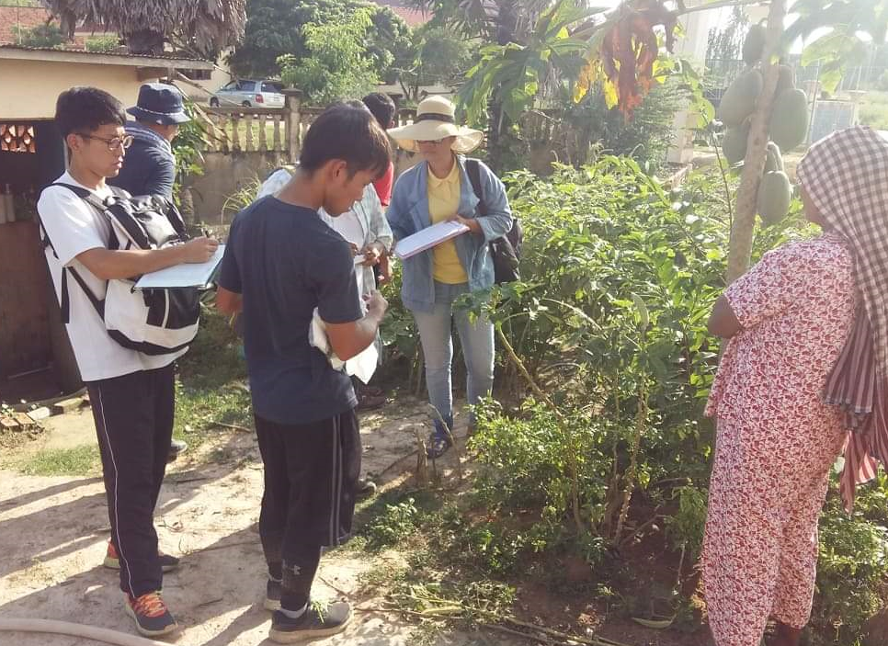
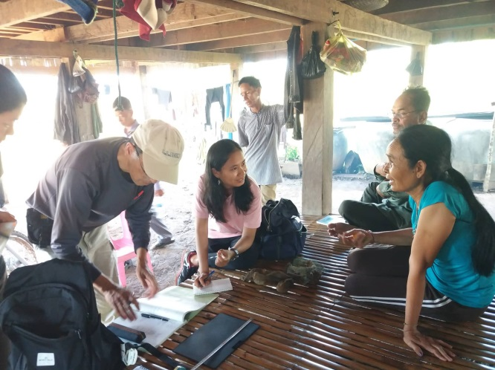
Germplasm collection activities

Slide 14
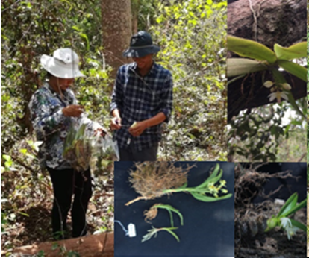
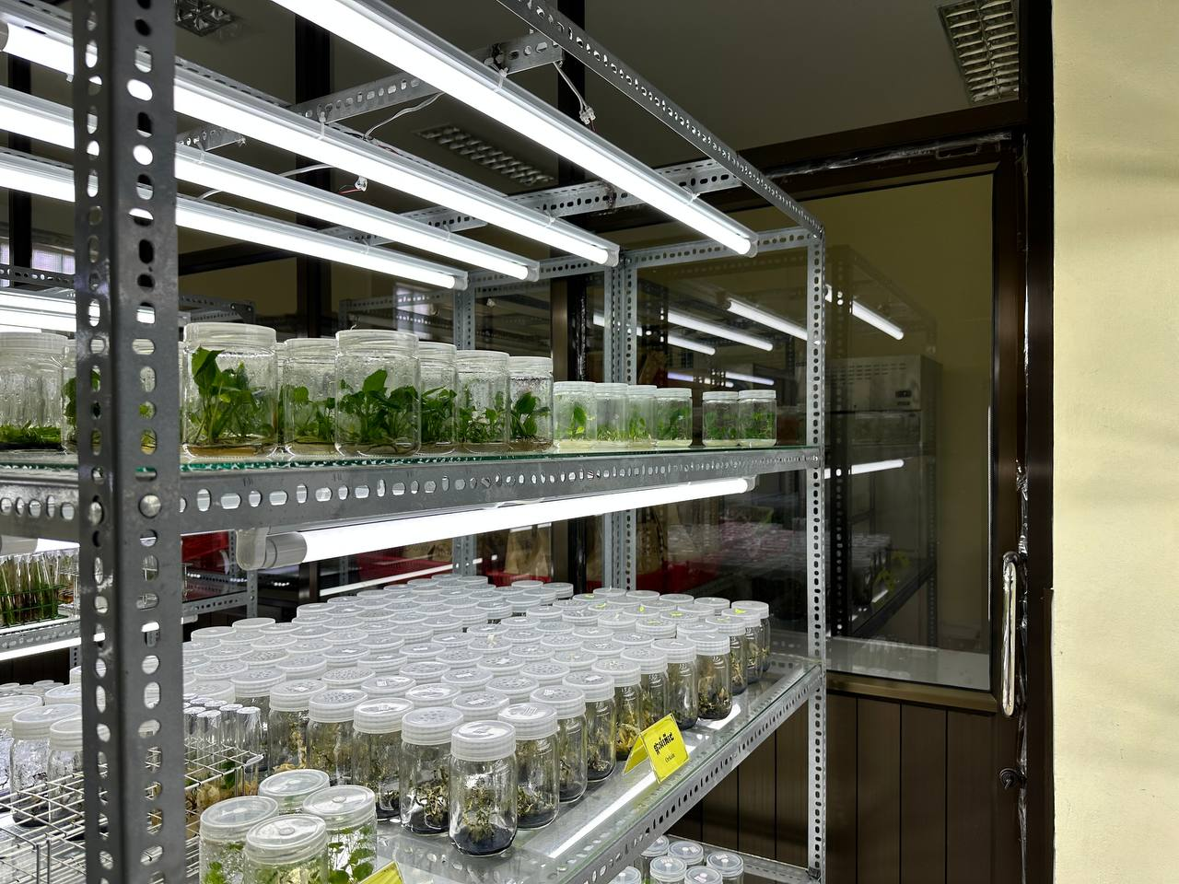
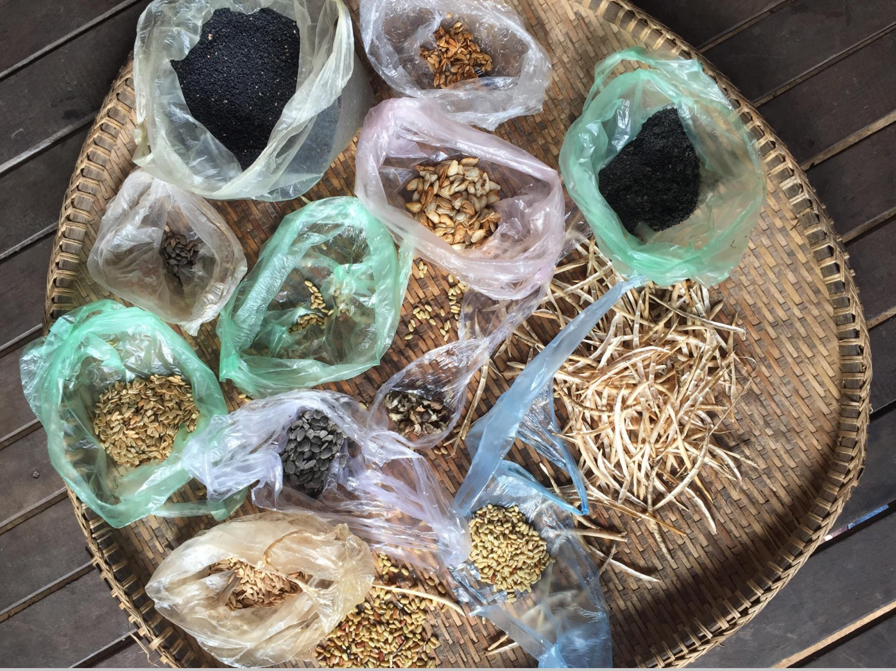
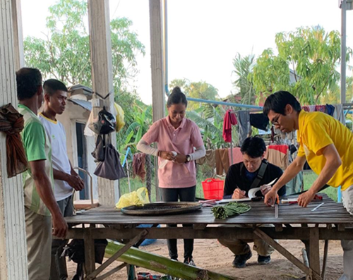
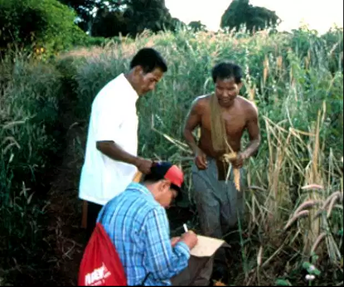
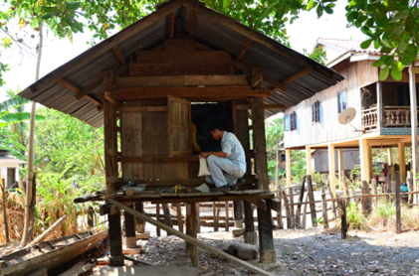
Germplasm collection, characterization and conservation
Crop | No. of | Germplasm | Type of conservation
(39 species) | Species | conservation | Genebank | Field | In-vitro
Rice | 1 | 6776 | 6776 | - | -
wild rice | 4 | 296 | 296 | - | -
Vegetable | 12 | 1381 | 1381 | - | -
Fruit tree | 5 | 244 | - | 244 | -
Field crop | 14 | 359 | 231 | 128 | 28
Other | 6 | 237 | - | - | -
Total (acc.) | 42 | 9293 | 8684 | 372 | 28
(CARDI,2023)

Slide 15
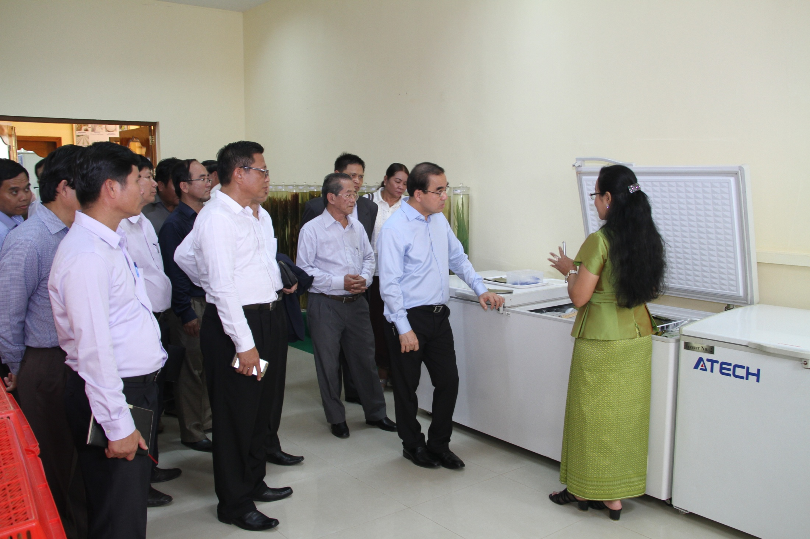
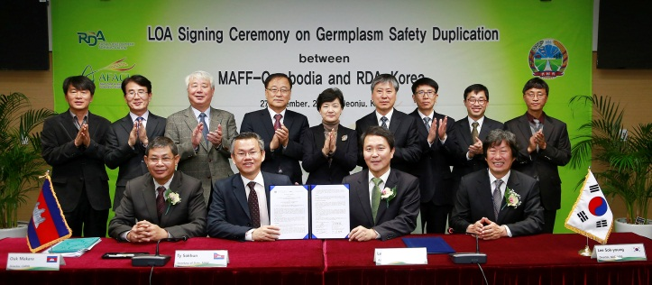
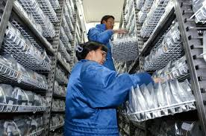
Rice germplasm collection, conservation
Collecting year | No. of Accession | Storage |  |  | Catalog
 |  | CARDI | IRRI | RDA
1972 to 1973 | 765 | - | 765 | -
1989 to 1990 | 1,270 | 1,270 | 1,270 | - | Catalog I
1990 to 1991 | 348 | 348 | 348 | - | Catalog II
1992 to 1997 | 939 | 939 | 939 | - | Catalog III
2012 to 2015 | 293 | 293 | - | - | Catalog IV
2015 to 2016 | 67 | 67 | - | 214
Total | 3,682 | 2,917 | 3,322 | 214

Slide 16
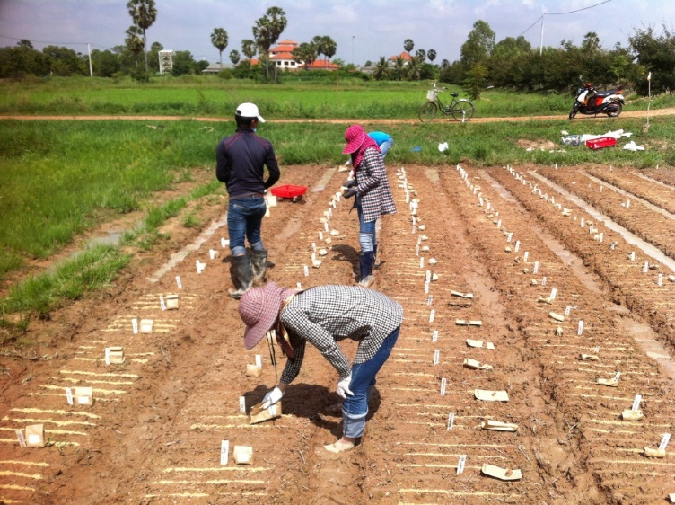
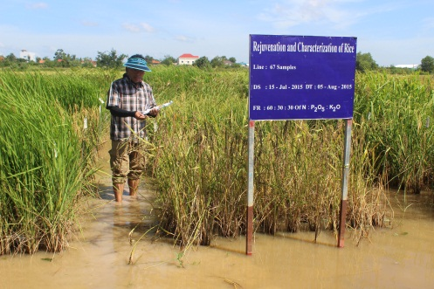
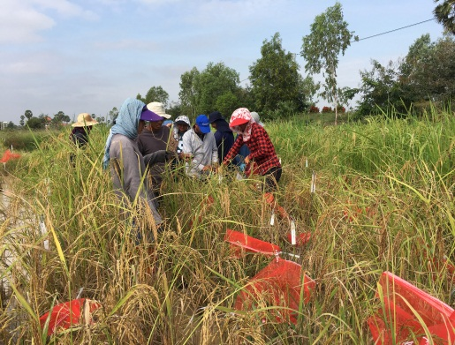
Rice Germplasm Rejuvenation and Characterization.

Slide 17
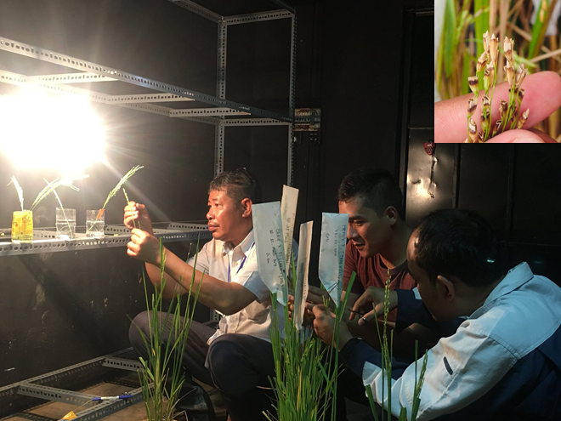
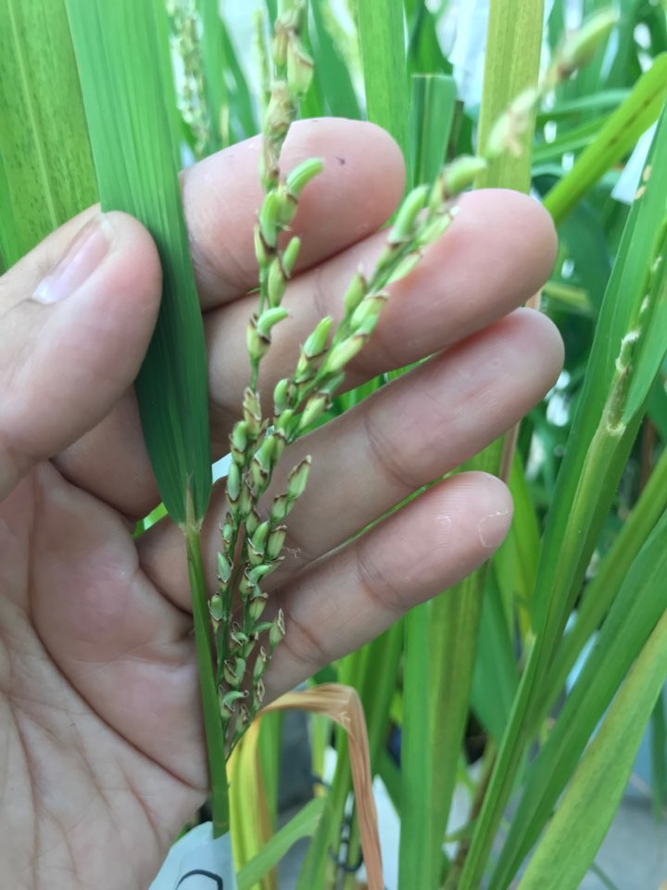
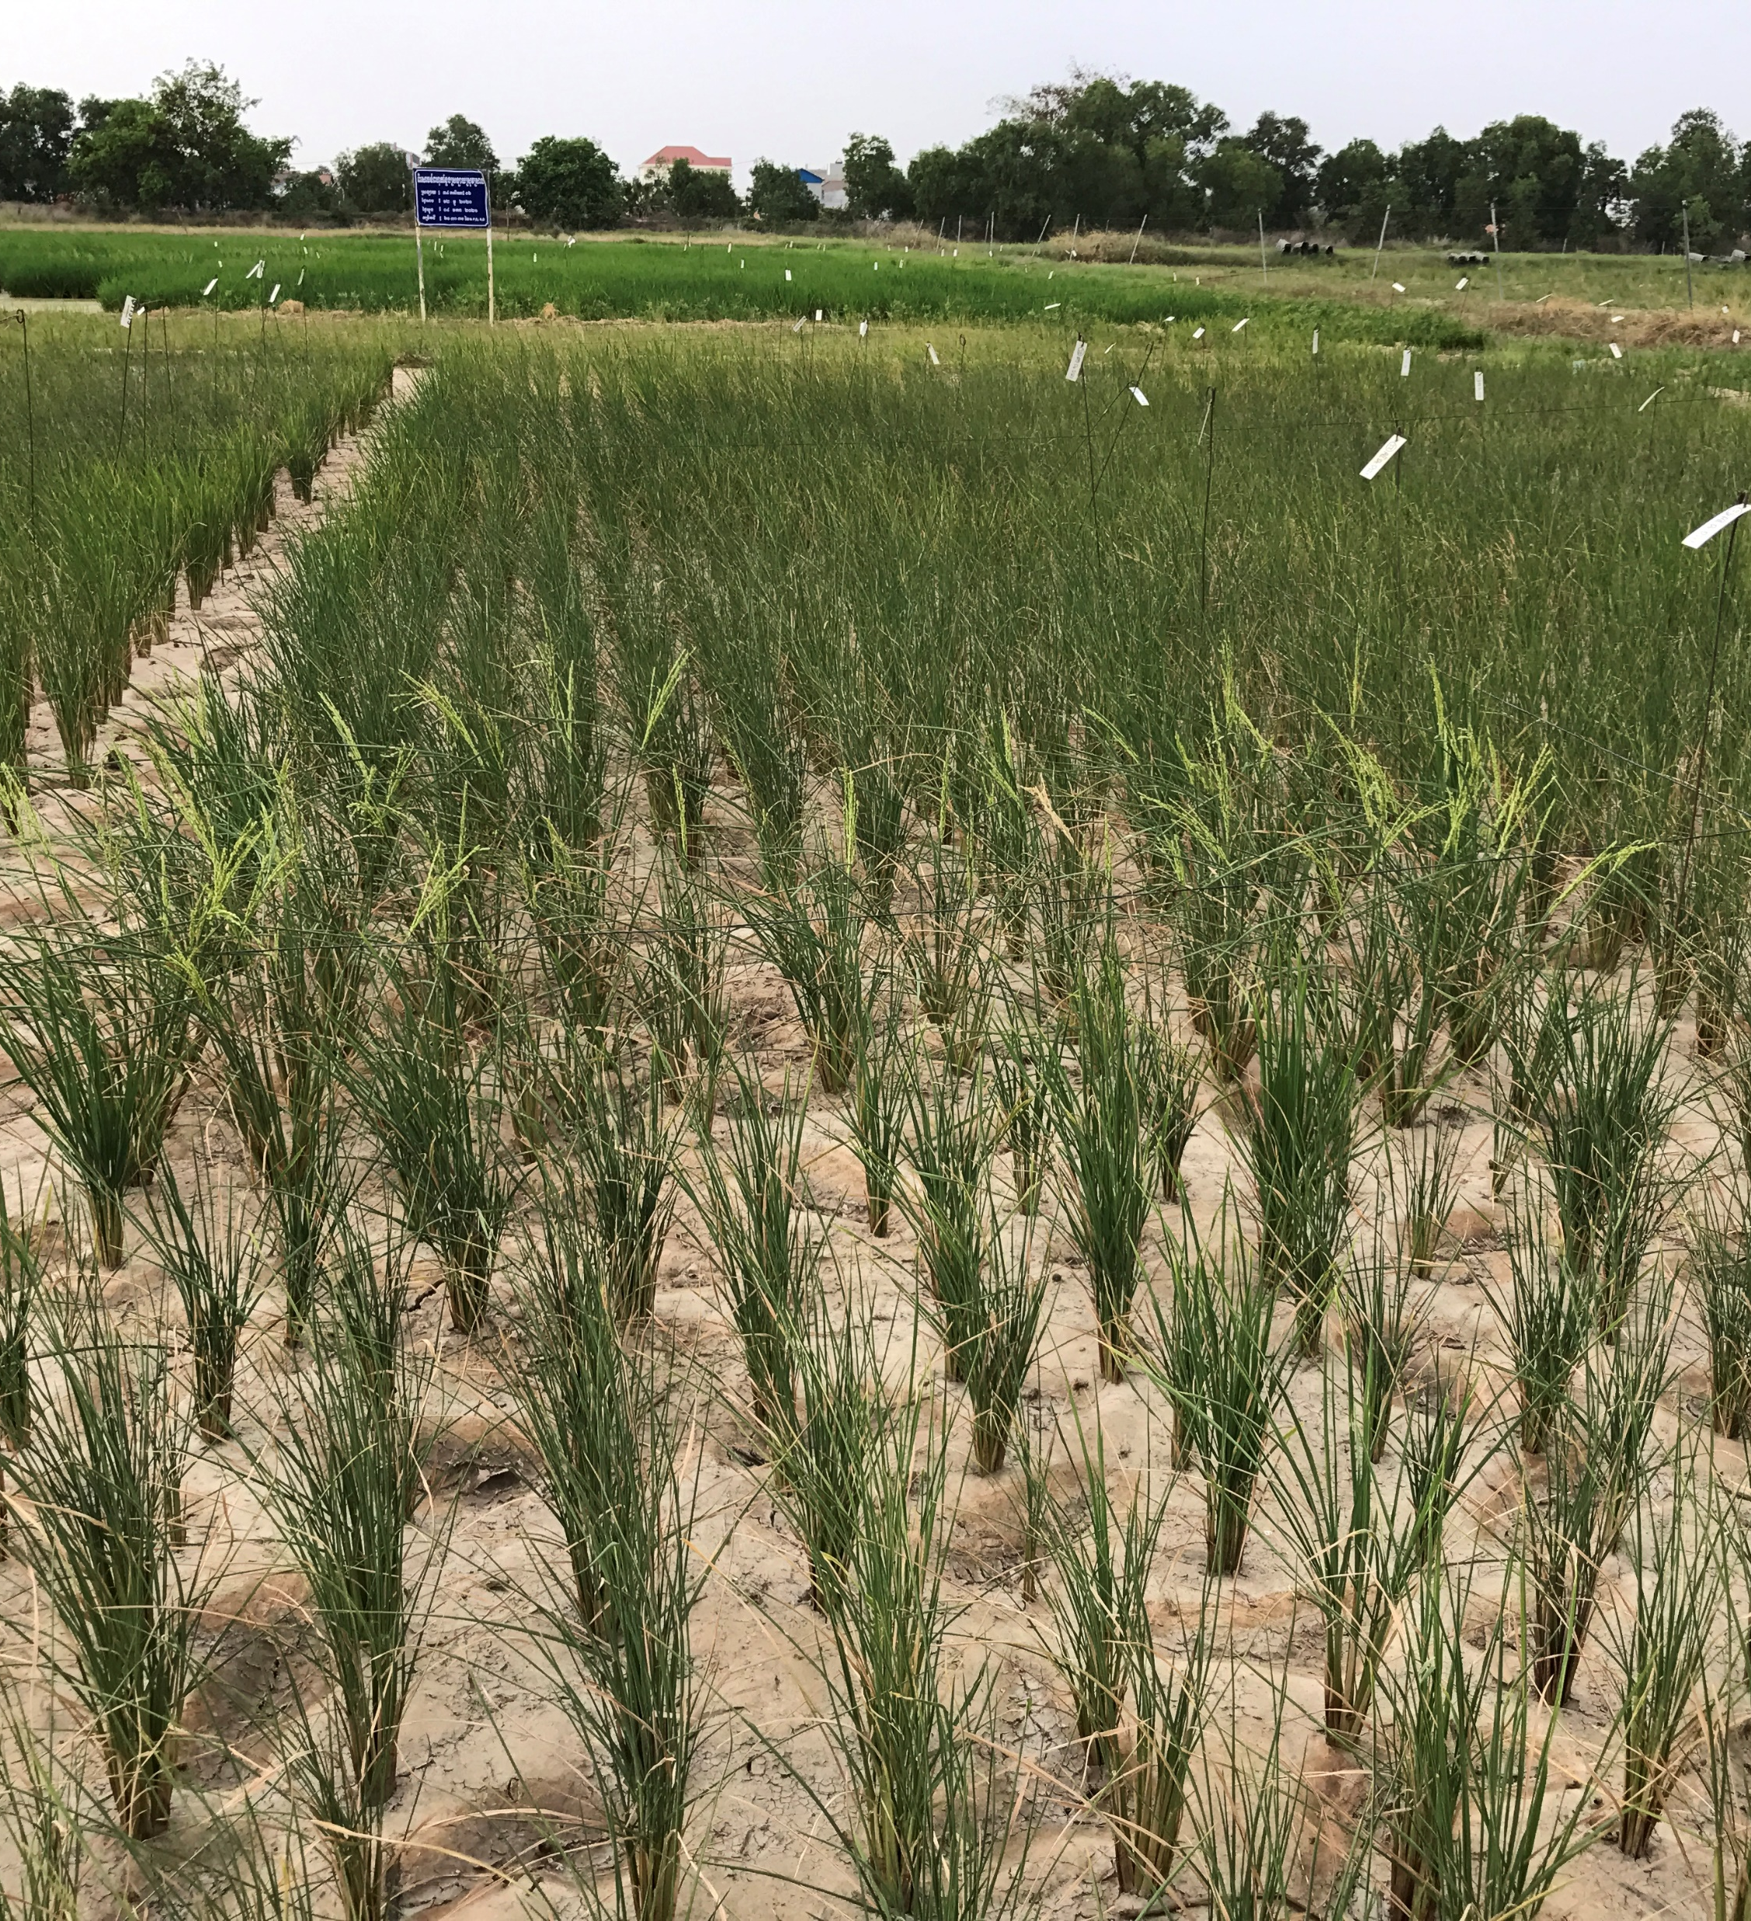
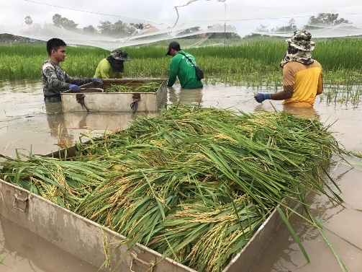
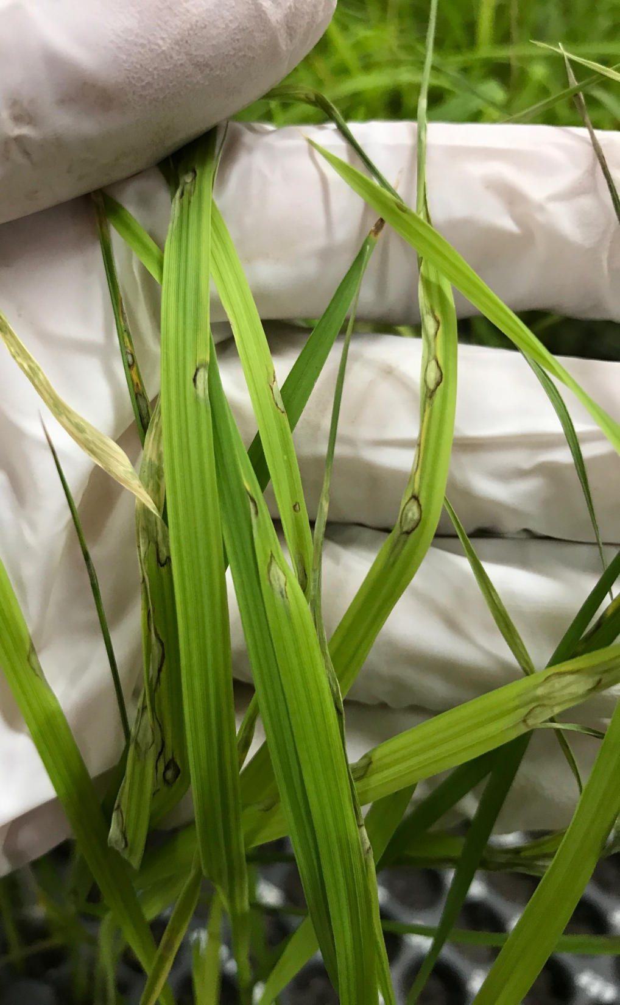
Our status rice breeding program focus:
Yield and quality
Photoperiod insensitivity (Aromatic)
Biofortification (high Zn content)
Bio/abio stress tolerance
Water use efficiency and suitable for direct seeding.

Slide 18
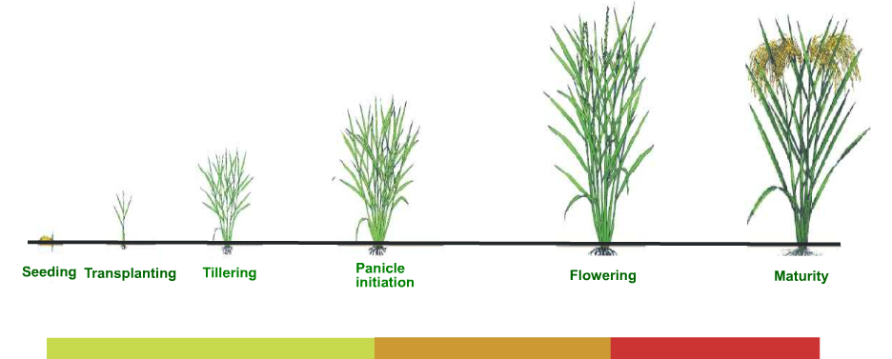
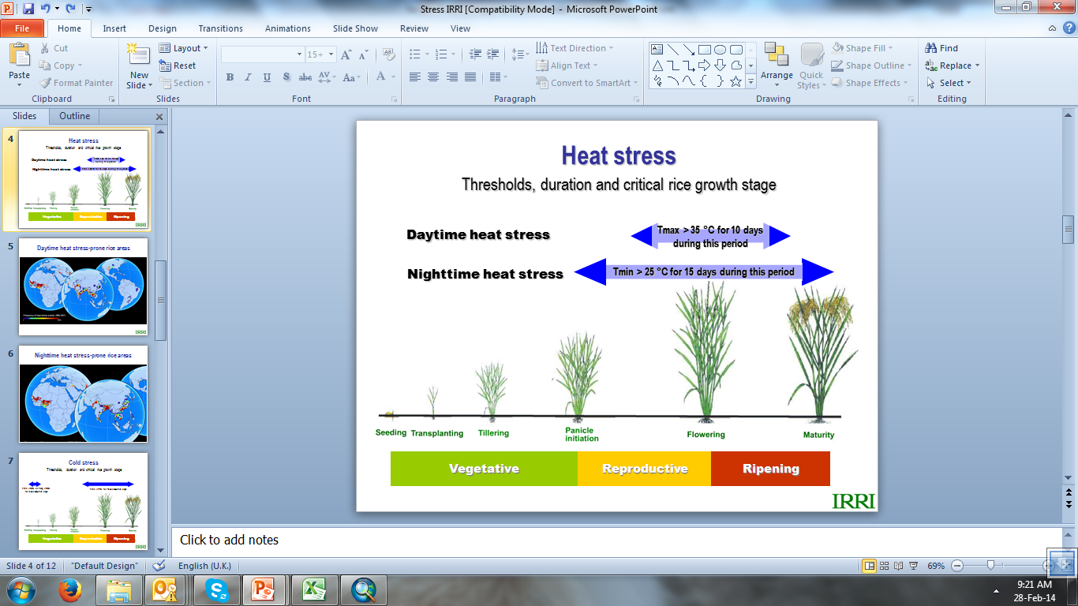
Heat stress
Thresholds, duration and critical rice growth stage
Daytime heat stress
Tmax > 35 °C for 10 days during this period
Nighttime heat stress
Tmin > 25 °C for 15 days during this period
Vegetative
Reproductive
Ripening

Slide 19
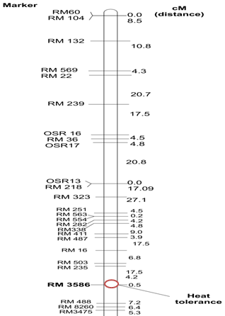
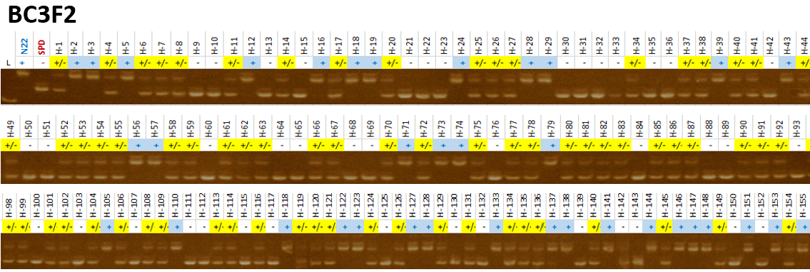
RM3586 is a molecular marker on Chr.3, used to identify QTLs associate with heat tolerance during flowering stage.
Application: Helps in identifying and selecting rice germplasm that show higher seed set rates under high-temperature stress (37-40oC)
RM3586 is a valuable tool for rice breeders looking to improve grain filling under high-temperature conditions, particularly in changing climates.

Slide 20
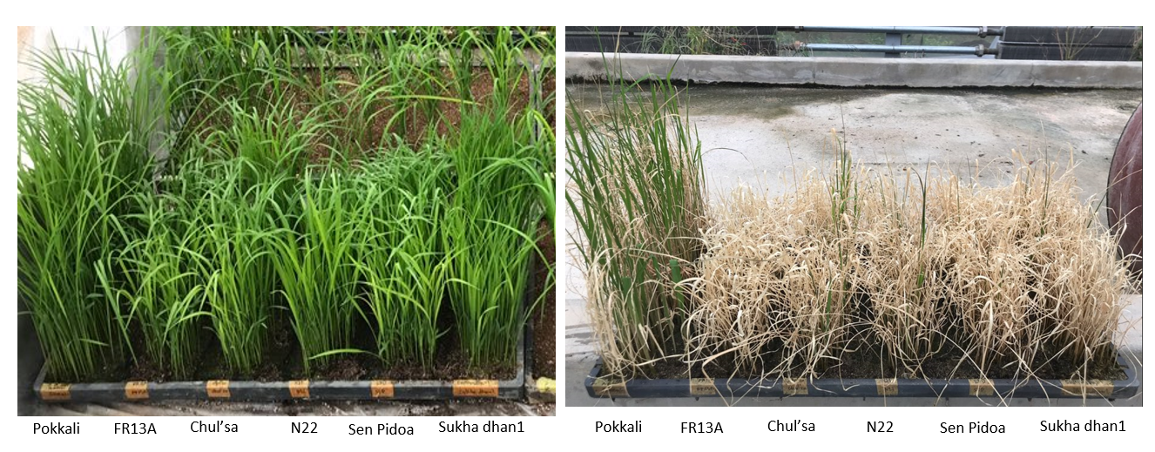


BC3F2 population were used for salinity screening (NaCl: 150mM)

Slide 21

No | Line Designation | Before stress | Survival plants | DNA | RM3412
 |  | No of Plants | No of Plants | Samples | +/- | + | - | Missing(0)
1 | CIR04-42-3-4 | 50 | 22 | 22 | 11 | 5 | 5 | 1
2 | CIR04-42-3-6 | 61 | 31 | 29 | 17 | 6 | 6 | 0
3 | CIR04-42-3-8 | 82 | 48 | 28 | 10 | 8 | 10 | 0
4 | CIR04-42-3-10 | 102 | 12 | 12 | 5 | 4 | 3 | 0
5 | CIR04-42-3-16 | 69 | 25 | 23 | 14 | 4 | 5 | 0
6 | CIR04-263-13-1 | 90 | 14 | 14 | 8 | 3 | 3 | 0
7 | CIR04-52-1-2 | 77 | 9 | 8 | 3 | 5 | 0 | 0
8 | CIR04-52-1-3 | 96 | 39 | 37 | 20 | 15 | 2 | 0
9 | CIR04-52-1-10 | 60 | 3 | 4 | 3 | 0 | 1 | 0
10 | CIR04-77-3-8 | 89 | 22 | 22 | 10 | 9 | 3 | 0
11 | CIR04-77-3-10 | 75 | 16 | 16 | 9 | 5 | 2 | 0
12 | CIR04-77-3-24 | 58 | 17 | 16 | 8 | 5 | 3 | 0
13 | CIR04-77-3-26 | 40 | 26 | 25 | 16 | 7 | 1 | 1
14 | CIR04-191-2-24 | 67 | 9 | 9 | 5 | 3 | 1 | 0
15 | CIR04-191-2-32 | 91 | 22 | 21 | 12 | 6 | 3 | 0
16 | CIR04-191-2-33 | 102 | 15 | 15 | 6 | 9 | 0 | 0
Total: |  | 1209 | 330 | 301 | 157 | 94 | 48 | 2

Slide 22

Non-Fragrance
Fragrance

Slide 23



Slide 24



Marker Assisted Selection (MAS) on rice progenies using allele specific marker

Slide 25



Current approaches of breeding
Using Conventional method

Slide 26






Multi-Location Trials and On-farm trials
of selected/promising lines

Slide 27
Farmer participatory in varietal selection
Before nominating for release, the promising lines were tested on farmers’ field at least 35 sites for two seasons.

Slide 28
3. Current Breeding Pipeline
It takes 6-10 years to release one variety
Collection
Conservation
(Field/GB)
Pure line selection
Evaluation & Documentation
Hybridization
(Crossing)
Multi-location Trial
Performance screening
Breeder, NARES
On-farm adaptive trial
VRC
Release
Seed Production
Source: Dr. Ouk Makara

Slide 29
Current Breeding Pipeline (cont.)
Total generation per year: two cycle/year for short maturity and one cycle/year for photoperiod sensitive population.
Key bottlenecks :
Generation advance: Growing only one or two generations per year in the field makes the pipeline slow.
Phenotyping: Evaluating complex traits—such as drought tolerance, submergence resilience, Yield and grain quality—at a single research station often fails to account for environmental variability across different ecosystems. Consequently, robust multi-location trials are essential, though they require significant resource allocation.

Slide 30
4. Accelerated Breeding (Perspective)
Increased genetic gain: Aiming for a 2% to 5% more productive than the last.
Why it is importance ?
Climate Resilience: This is critical for Cambodia’s rainfed lowlands, where a farmer might face a Heat stress in dry season, flood in the early season and a drought in the late season.
New pest outbreaks happen very fast while conventional breeding take long time to solve.
Food security and productivity: Ensure yield stability and prevents price spikes in local markets.

Slide 31
5. Technologies in Use
Indicate level of adoption:
Speed Breeding – climate control: Low (Only short-day treatment)
Doubled Haploids (DH): No
Marker-Assisted Selection (MAS): Yes ( Some specific alleles)
Genomic Selection (GS): No
Digital phenotyping: Yes (Imaging, S21)

Slide 32
6. Infrastructure and Capacity
Facility
Labs: Biotechnology lab, grain quality and tissue culture lab.
Field facilities: Experimental field equips with basic irrigation system.
growth chambers: one growth chamber.
Skilled human resources
Staffs: Government and contracted staff
Universities: No university involved in Breeding program .
Data storage infrastructure, systems and tools: Excel worksheet.

Slide 33
8. Opportunities
Government support: Royal Government of Cambodia project (RGC).
Development partner: CAVAC, IRRI, AFACI
Climate-smart agriculture demand: climate resilience varieties and grain quality.

Slide 34
9. Challenges
Funding limitations: RGC have provide just basic research that may not cover all the process of breeding program.
Infrastructure gaps: Old infrastructure need renovation and improvement.
Pest and insect: Birds, BPH, BLB, Blast.
Human resources/Capacity limitations: limitation of human resource on modern breeding method.

Slide 35

10. Policy and Regulatory Environment
Varieties release system

Slide 36

Rice seed production, certification and distribution in Cambodia
Produce by CARDI
GDA, Private company, Farmers

Slide 37
Policy towards biotechnology products
Well integrated and connected with mechanism with five key players, namely researchers, producers, traders, inspectors and users.
Management of seed sector: established Seed Management Unit (SMU). National Seed Council (NSC).
Variety Development: National Genebank, CARDI, Private Company.
Variety Testing and registration: National Variety Release Committee (NVRC), National list of varieties.
Plant Variety Protection: to comply with the requirement of WTO. Request for UPOV membership.
Transgenic varieties: Shall be open to the testing and use of this technology.

Slide 38

Investment trends
Seed demand and the use of certified seeds of rice

Slide 39

Expansion of Seed Production Supply

Slide 40
11. Collaboration and Private Sector
International partnerships: IRRI, ACIAR, AFACI, CIRAD, IRD
Public-private partnerships: Amru Rice, Modern Agriculture Community, Seed trader, rice miller.
Key Trends and Demand Drivers:
Quality & Variety Shift: Demand is moving away from low-quality, high-yield varieties towards premium aromatic varieties such as Phka Rumduol, which are in high demand in export markets.
Climate Resilience: There is increasing demand for climate resilience and early-maturing varieties.
Organic Movement: Growing consumer demand for healthier options is driving a steady increase in organic rice farming.
Private Sector Growth: Smallholder farmers are shifting toward purchasing certified seeds from trusted sources like CARDI, GDA, and Modern Agriculture Community.

Slide 41
12. Future Vision (10 Years)
12.1. Target improvements in breeding speed
Reduction in Variety Development Time: A target to reduce the breeding cycle from the traditional 9–12 years down to 5–7 years.
Rapid Generation Advance (RGA): Implementation of RGA techniques to produce up to 3–4 generations per year.
Increased Yield: Aiming for a 2% to 5% more productive than the last.

Slide 42
12.2. Technology Adoption Goals
MAS & Genomic selection: To identify climate-resilient traits and quality at the seedling stage.
High-Throughput Phenotyping: Utilizing drones (UAVs) and sensors to collect real-time data on plant health, water stress, and growth rates across multi-location trials.
Direct-Seeded Rice (DSR) Optimization: Developing specific varieties optimized for mechanized direct seeding to address increasing labor shortages in rural Cambodia.

Slide 43
12.3. Strategic Priorities
Capacity building on genomic selection by collaboration with international partner.
Develop training population for specific breeding pipeline
Key player for variety development: CARDI, National Genebank, Private Company.
Transgenic varieties: Shall be open to the testing and use of this technology.

Slide 44
National Level Recommendations
CASA, CARDI and GDA: Establish regulatory and operational pipeline to ensure new varieties reach farmers faster.
Infrastructure for RGA: Invest in Rapid Generation Advance (RGA) facilities (greenhouses with controlled photoperiods).
Seed System Integration: Strengthen the link between research and the private sector. Recommendations include incentivizing private seed companies to take “Foundation Seeds" from CARDI and scale them into "Certified Seeds.

Slide 45
2. International & Regional Level (ASEAN)
Harmonized Standards: All ASEAN member should have standard protocol for speed breeding to reduce technology gap among the member country.
International cooperation and Networking
IRRI: Capacity building and germplasm exchange.
AFACI, CIRAD, ACIAR, IRD: fund support for research and capacity building.
Asia and Pacific Seed Association (APSA): Regulatory and policy.

Slide 46
3. Capacity Building Recommendations
Short term training: Data analysis on Genomic selection
Specialized Technical Training: Foster partnerships with institutions like CIRAD, UPLP and IRRI for PhD and Master’s level training in Genomic Selection and Gene Pyramiding.
Farmer-Led Adaptive Trials: Expand On-Farm Adaptive Trials (OFAT). Capacity building isn't just for scientists; it includes training local agricultural extension officers to help farmers evaluate new lines in their own ecosystem.

Slide 47
Research Priorities
. Multi-Stress Tolerance: Breeding for submergence + drought tolerance in a single variety. This is essential for the rainfed lowlands of Cambodia, which often face both extremes in a single season.
Direct-Seeded Rice (DSR) Traits: 90% of Cambodian rice is now direct-seeded, research must prioritize varieties with Early Vigor and short maturity.
Biofortification and high value: High-Zinc, Low-GI , and Premium Fragrant varieties.

Slide 48






Happy Khmer New Year, we wish to all participant's here the best wish

Slide 49



Thank You for Attention

