Slide 1

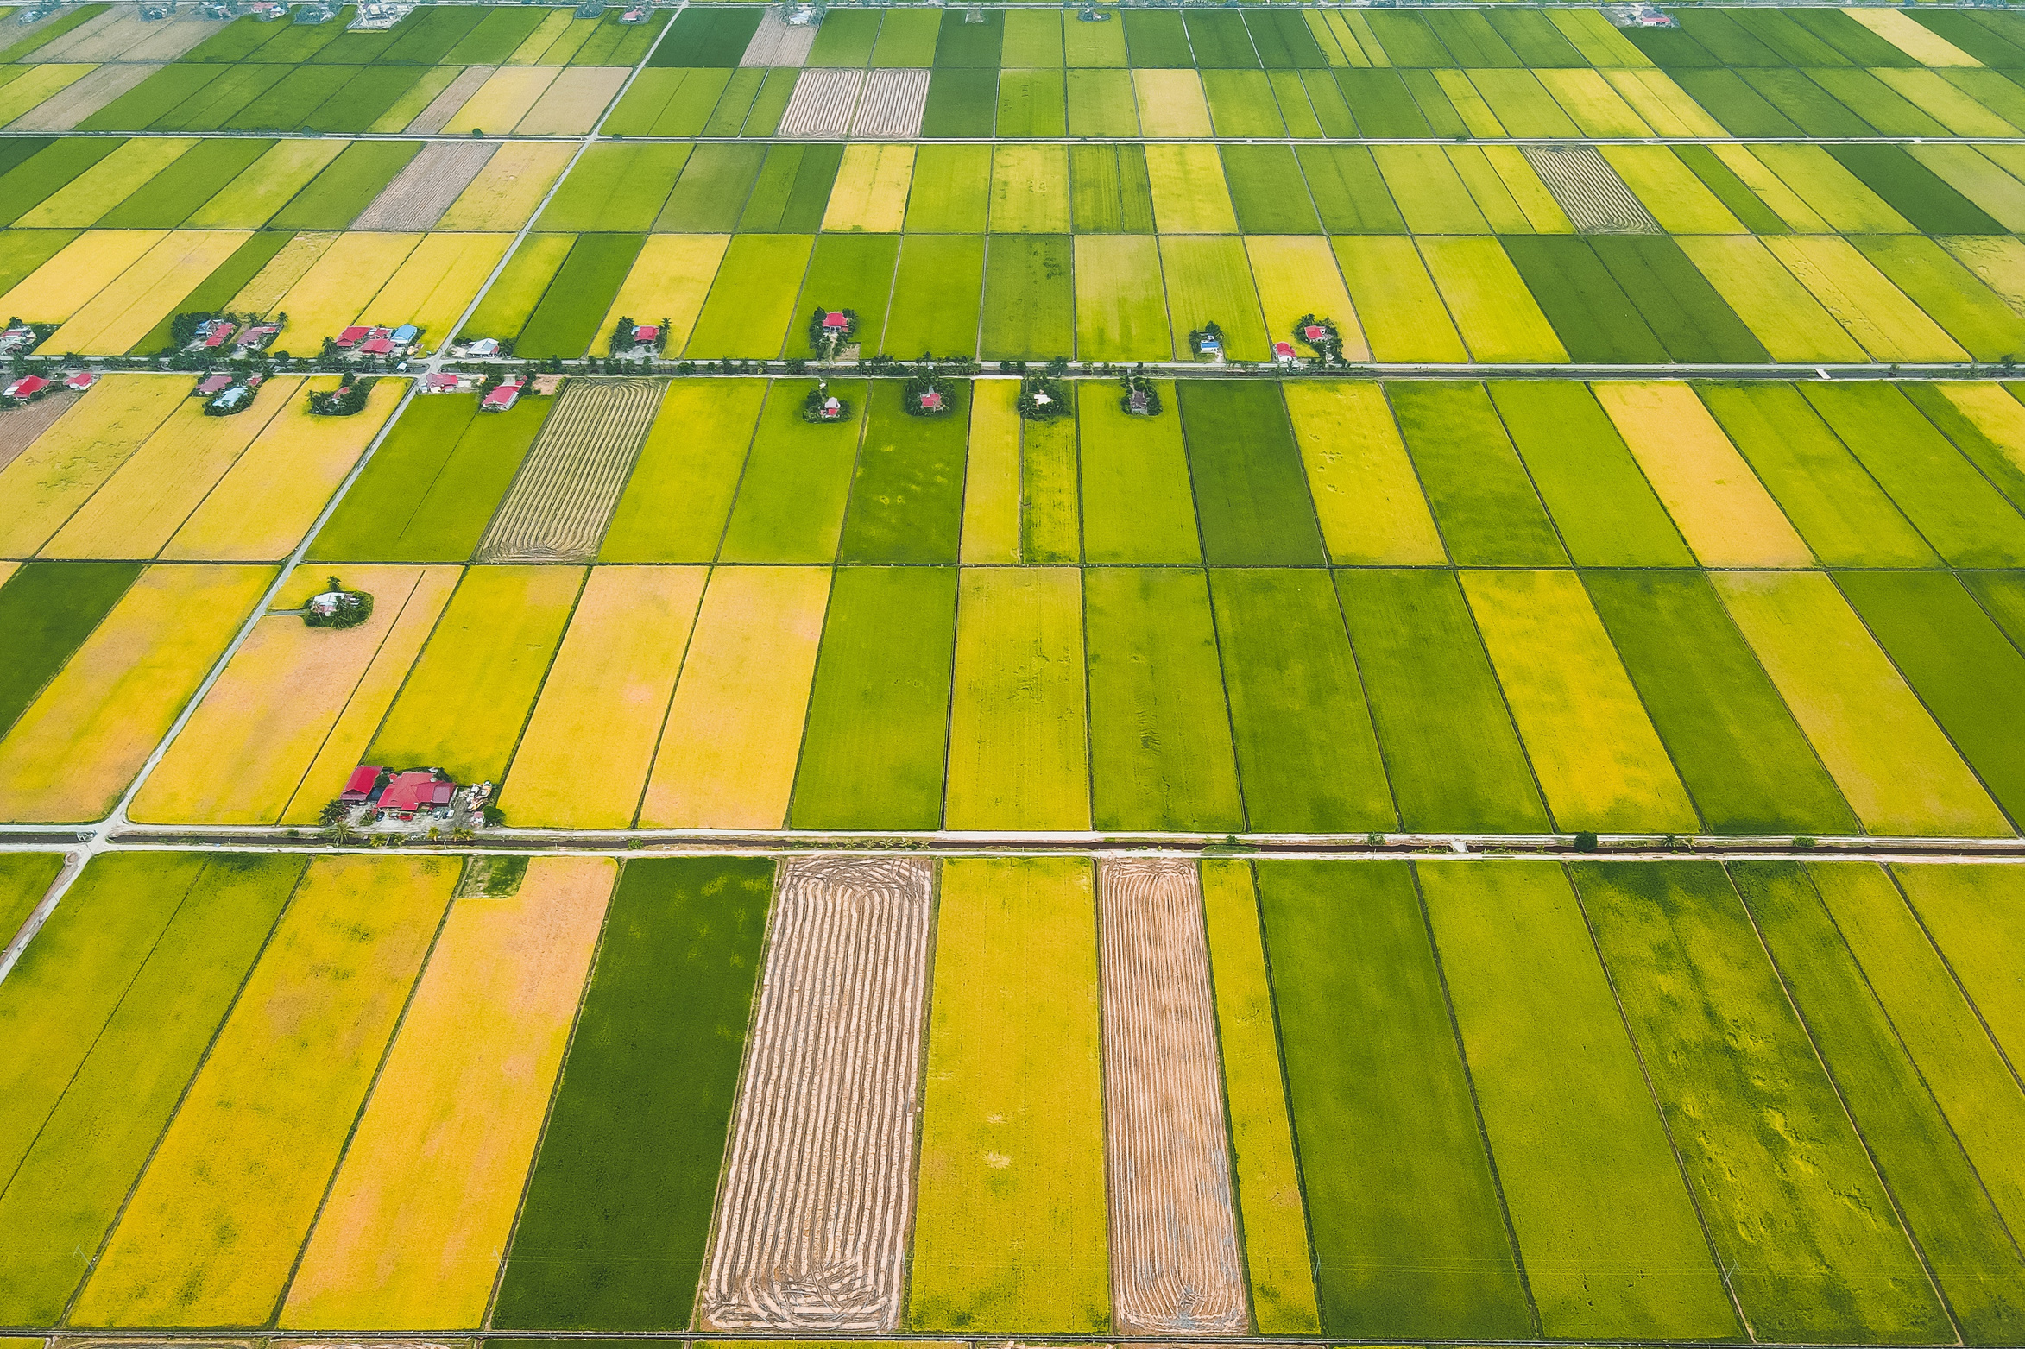




OPPORTUNITIES AND CHALLENGES OF ACCELERATED BREEDING IN RICE
Case of Malaysia
MALAYSIAN AGRICULTURAL RESEARCH INSTITUTE MALAYSIA (MARDI)
UNIVERSITI PUTRA MALAYSIA (UPM)

Slide 2





Malaysian Geographic, Climate Context & Agricultural Economy
Geographical Division
Tropical Climate
Key Commodities
Peninsular Malaysia and East Malaysia (Sabah and Sarawak in Borneo Island) operate within tropical climate zones.
Consistent temperatures between 21°C and 32°C with high annual rainfall averaging 2,540 mm.
  Rice (security commodity, 65-70% SSL target)
  Oil palm (industrial exports)
  Durian, pineapple (high-value crops)
Notes:
2

Slide 3


RICE
MALAYSIAN
INDUSTRY
52.9 %
Self Sufficiency Level (SSL)
277,124 ha
579,706 ha
Percel Area
Cultivated Area
1.362 mill. mt
1.500 mill. mt
Rice Production
Total Imports
3.552 ton/ha
3.934 ton/ha
2.855 ton/ha
National Average Yield
Granary Average Yield
Non-granary Average Yield
Source: KPKM 2025

Slide 4

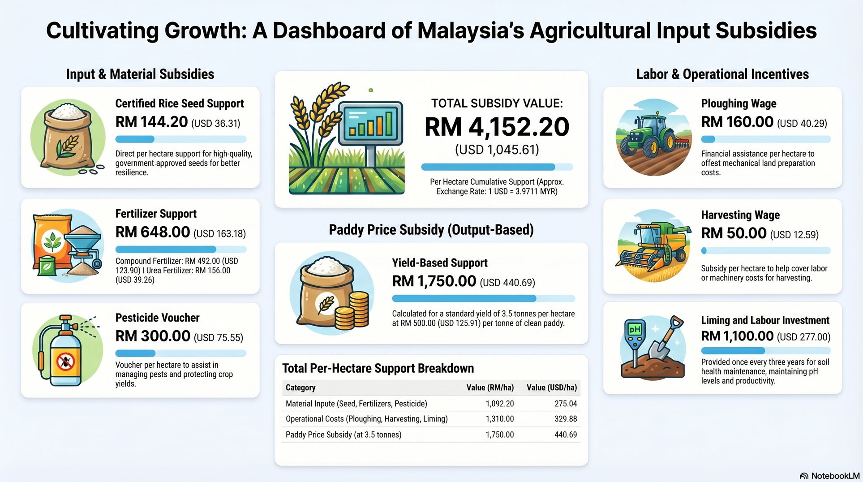
Policy in Rice Industry
Agricultural Input Subsidies and Incentives for Rice Industry in Malaysia
Notes:
3

Slide 5
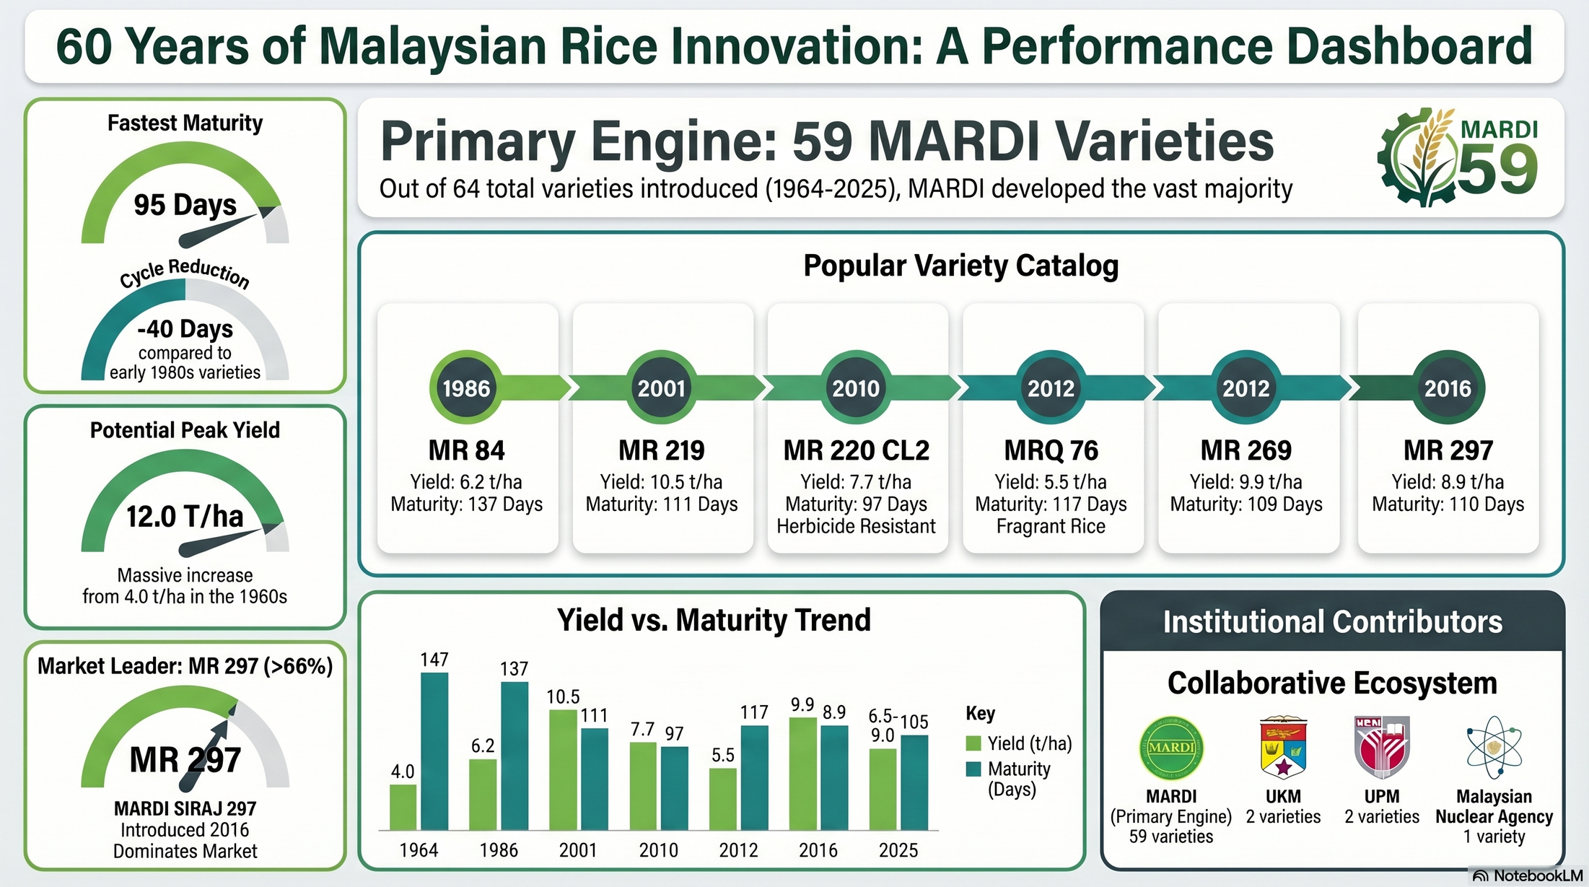

RICE VARIETIES IN MALAYSIA
64 MALAYSIAN RELEASED VARIETIES
Popular Varieties

Slide 6
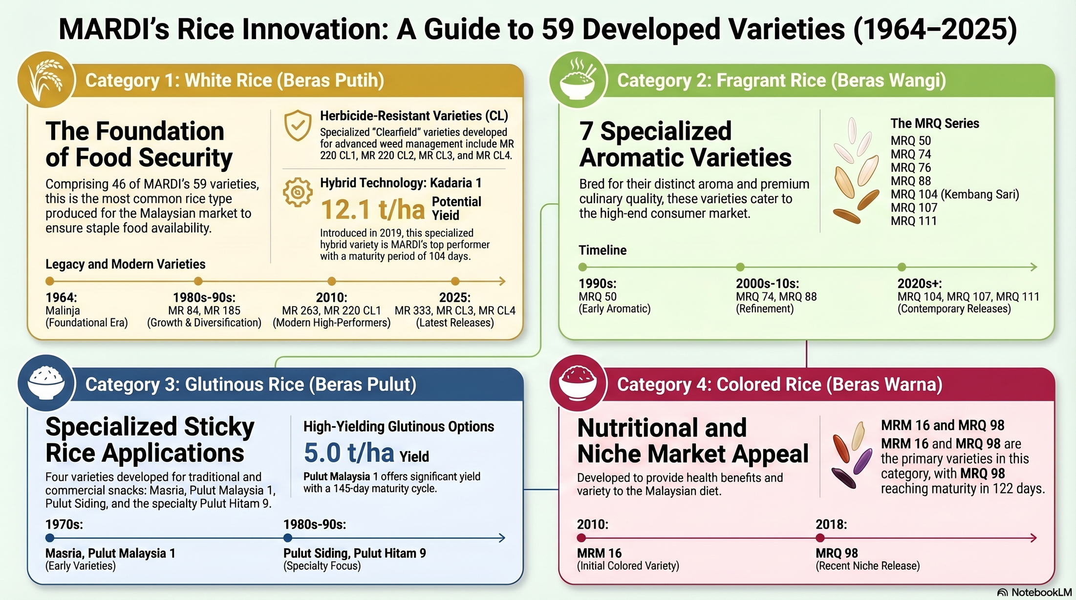

RICE BREEDING FOCUS
8
MRQ 103 (low GI)
2000s:
MRQ 74, MRQ 76 & MRQ 88
MRQ 103, MRQ 104, MRQ 107 & MRQ 111
MR 219, MR 297

Slide 7
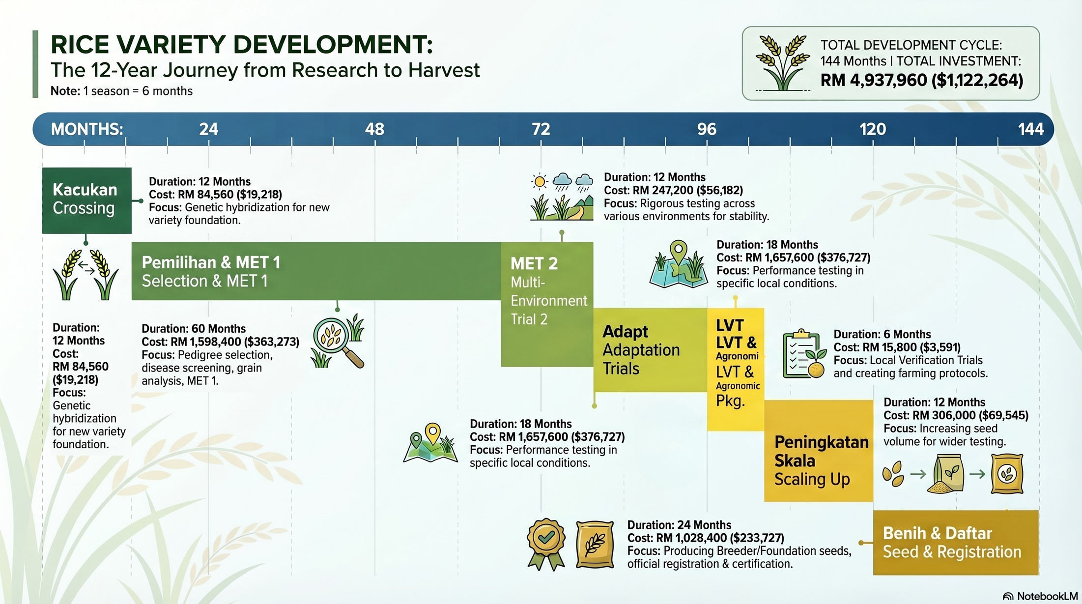


VARIETAL DEVELOPMENT TIMELINE
Crossing
Selection and MET 1
LVT
Up-scaling
Main breeding objectives:
  High yield
  Improved grain quality and consumer acceptability
  Broad adaptation across Malaysian rice-growing environments
  Enhanced resistance to major pests and diseases
Seed Production
Notes:
5

Slide 8
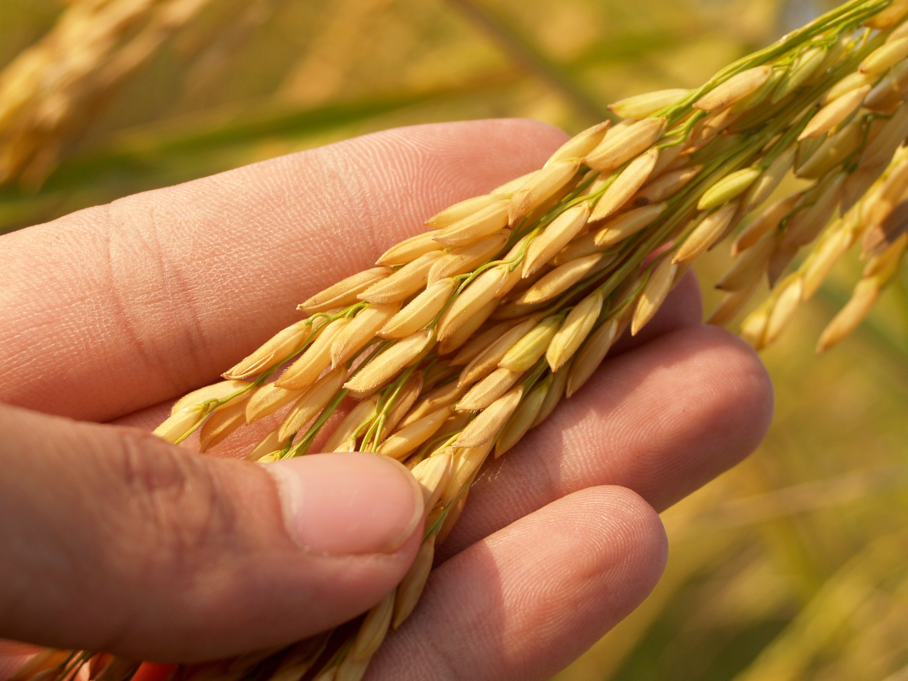
CURRENT BREEDING APPROACHES
CONVENTIONAL BREEDING
MOLECULAR BREEDING
For varietal development and pedigree selection
For targeted trait introgression and precise selection
HYBRID BREEDING
For development of three-lines hybrid rice systems

Slide 9
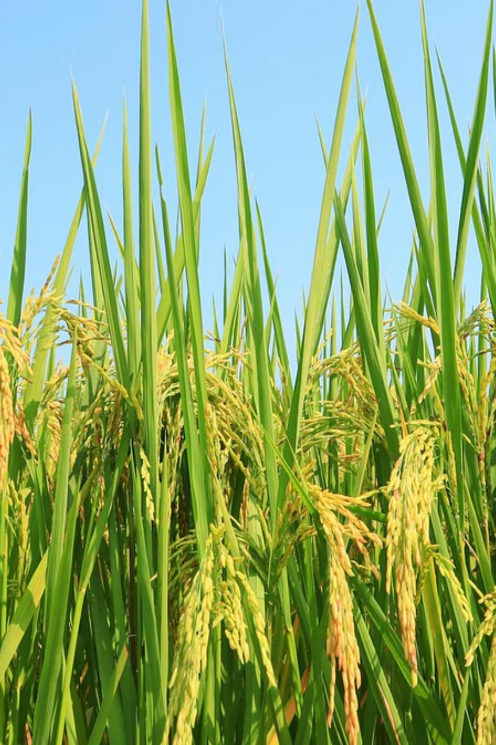
Why Malaysia Needs Speed Breeding?
01
Climate Resilience
02
Food Security
Respond quickly to drought, flooding, salinity, and temperature variability affecting rice production.
Reduce dependence on rice imports and strengthen resilience in granary areas.
03
Biotic Constraints
04
Economic Impact
  Address bacterial leaf blight, blast, sheath blight, and brown planthopper more rapidly.
  Reduce reliance on chemical pesticides
Improve farmer profitability and ensure timely replacement of vulnerable varieties.

Slide 10
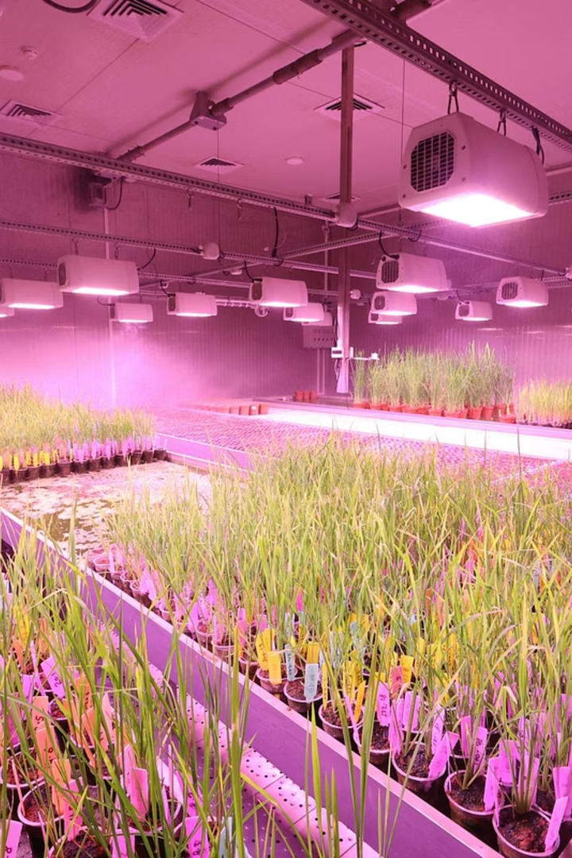
TECHNOLOGIES IN USE
Marker-Assisted Selection
High adoption. Routinely used to introgression of resistance genes for abiotic and biotic resilience in rice
Gene Editing
Emerging adoption. MARDI and UPM are applying these technologies to improve resistance to major rice diseases, especially bacterial leaf blight (BLB) and blast, while extending their application to horticultural crops such as tomato.
Speed Breeding
Emerging adoption. UPM initiated a preliminary study using high-intensity LED growth chambers to shorten the rice generation cycle and enable more breeding cycles per year.
Notes:
7

Slide 11
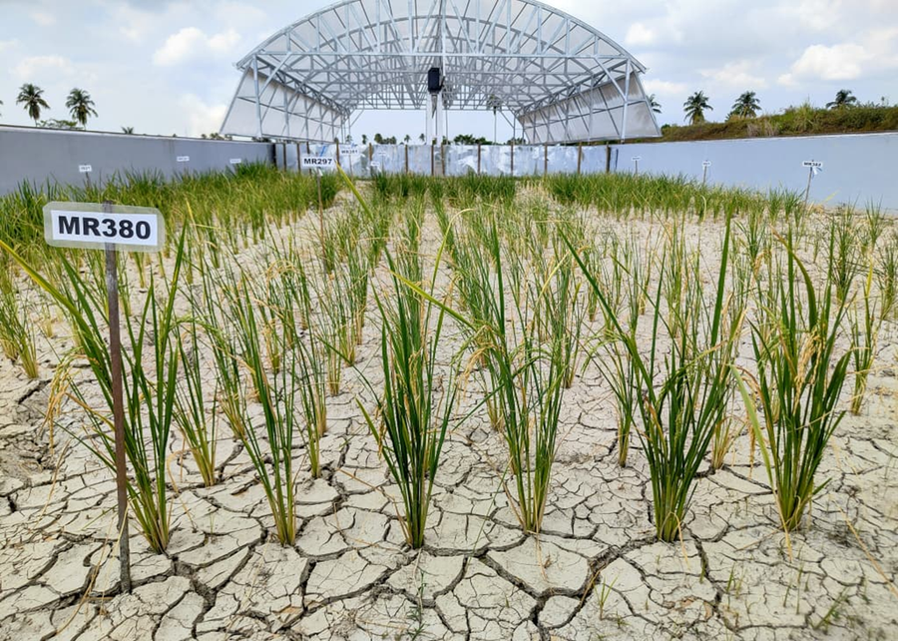
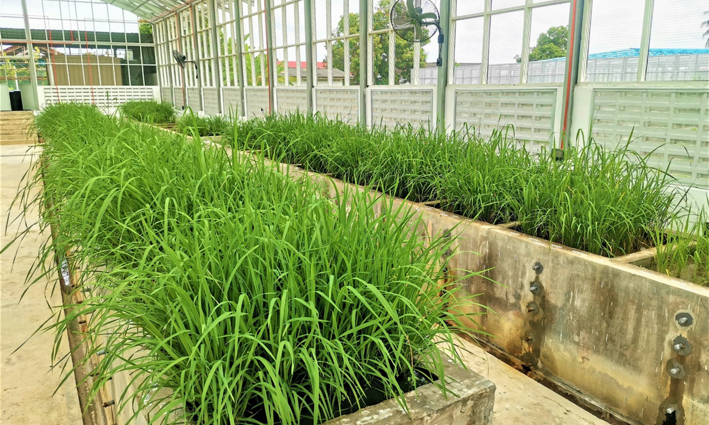
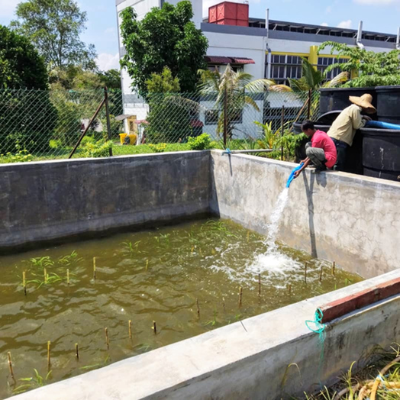
Case Studies : Climate-Resilient Rice Development using MAS
Drought Tolerance
Salinity Tolerance
Submergence Tolerance
QTLs for grain filling during reproductive stage and deep rooting genes.
Saltol QTL incorporated into elite varieties for reproductive-stage stress.
Sub1 gene enables recovery after 2 weeks of flash floods during vegetative stage.
Notes:
10

Slide 12

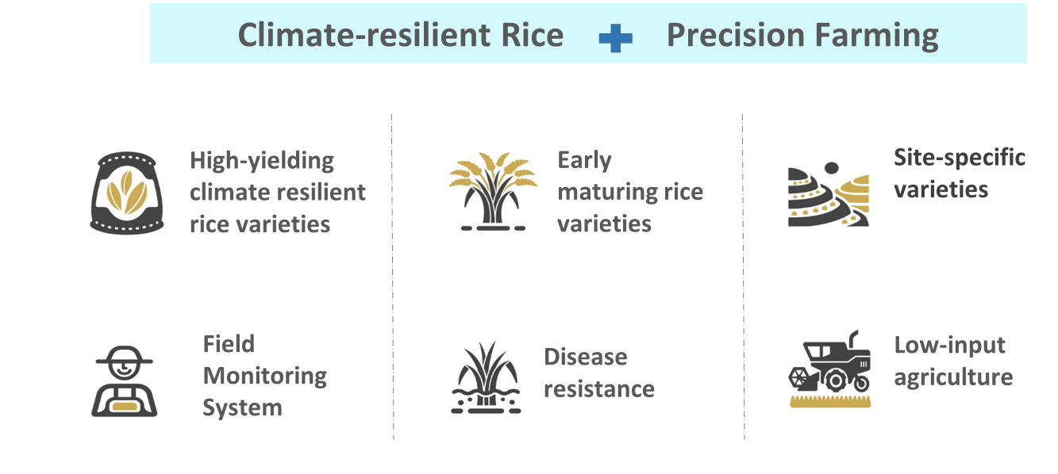

Slide 13
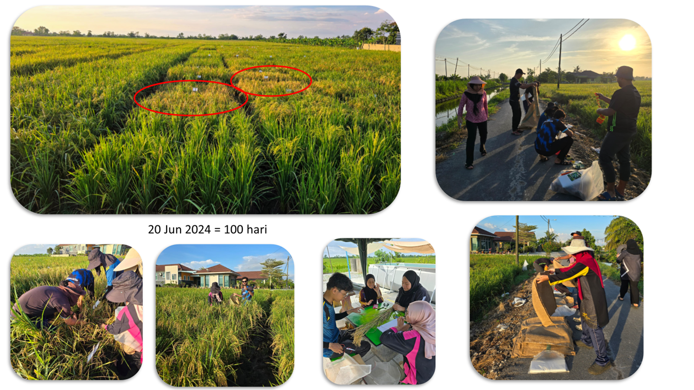
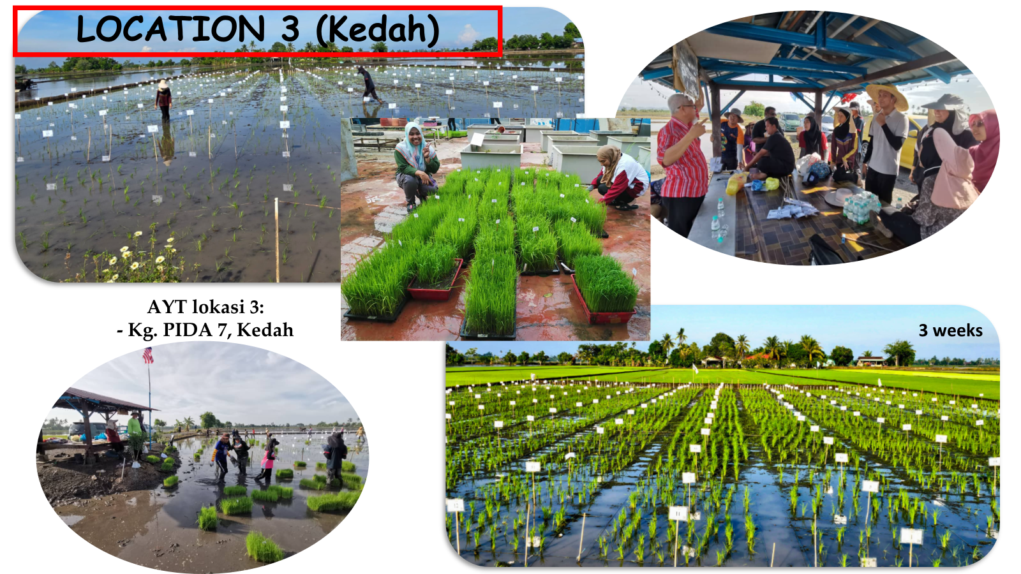
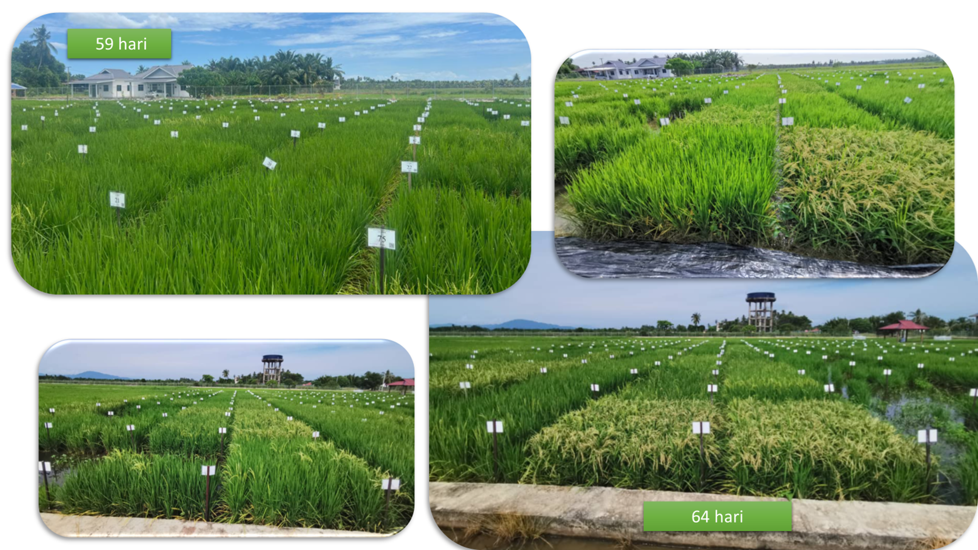
LOCATION 1
Activities: Advanced Yield Trial (AYT)
LOCATION 3
LOCATION 2

Slide 14
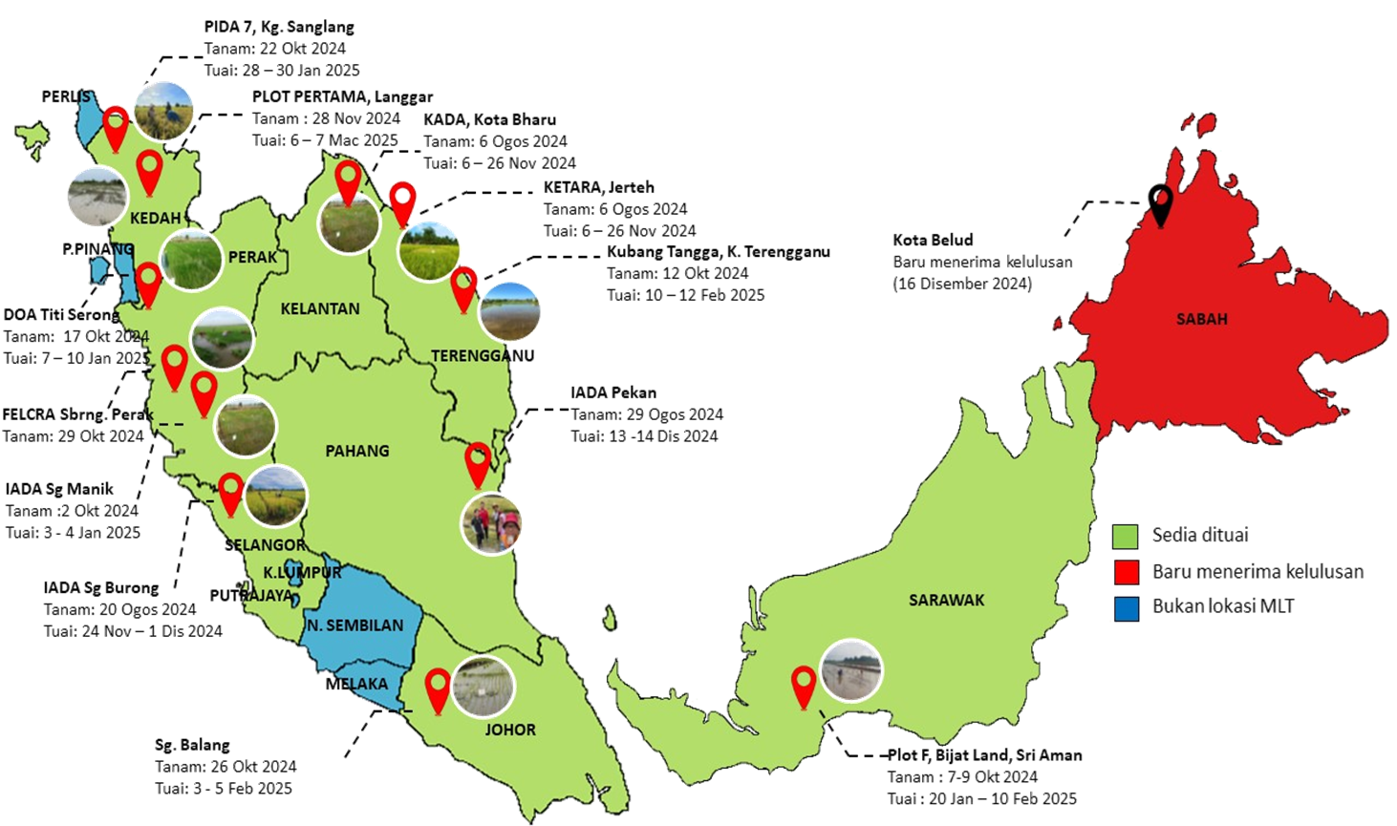
Activities: Multi Location Trial (MLT)

Slide 15
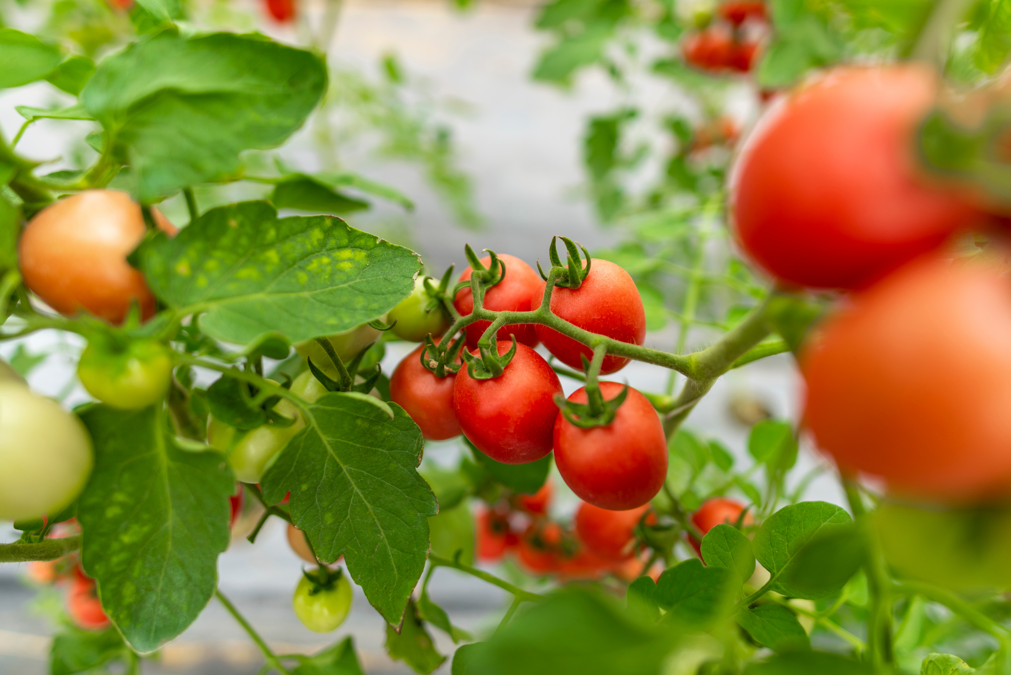
Case Studies -
Gene Editing
01
02
CRISPR/Cas9 gene knockdown of NCED and DET1 in tomato was successful, leading to higher fruit yield and improved stress tolerance, particularly in DET1-edited plants.
Gene editing efficiency was high, but issues such as off-target effects and frameshift mutations highlighted the need for better sgRNA design and validation.
03
Future work should improve editing precision by using high-fidelity Cas9, studying NCED–DET1 regulatory interactions, and analysing metabolites such as lycopene to better understand the molecular effects.
Notes:
8

Slide 16
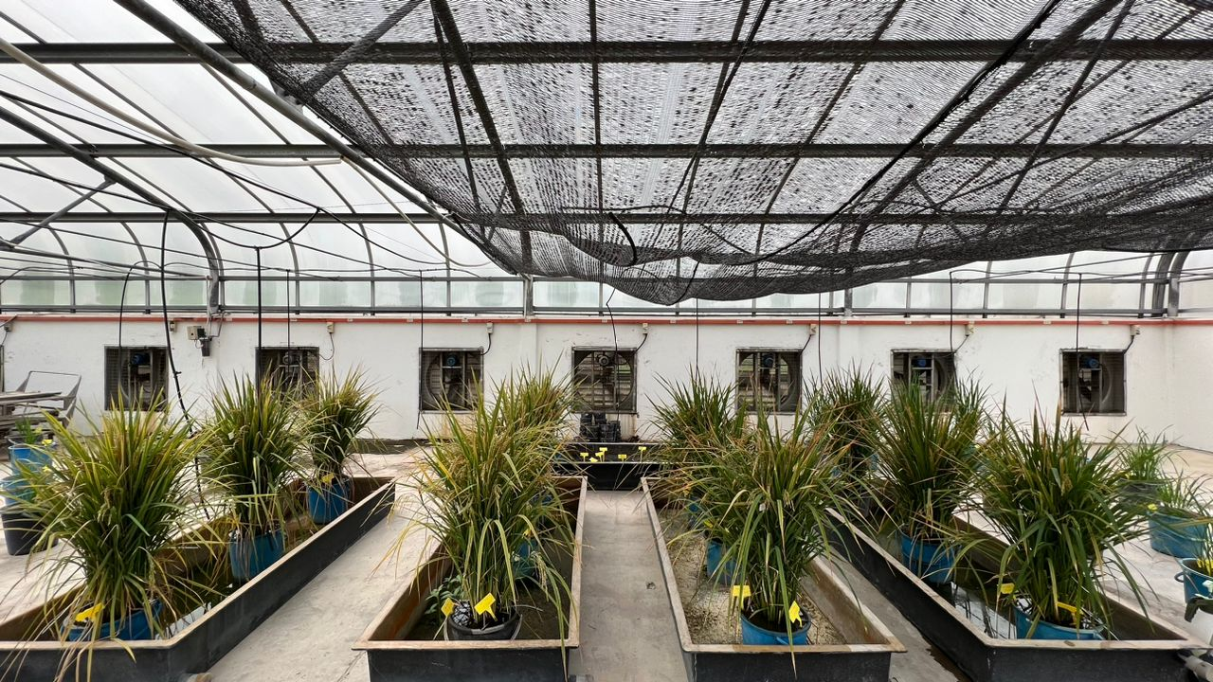
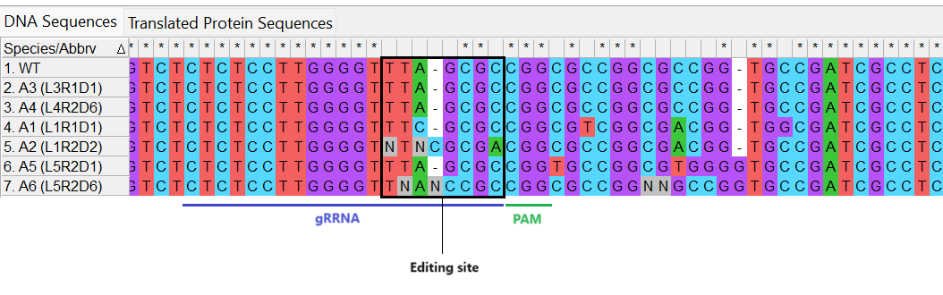
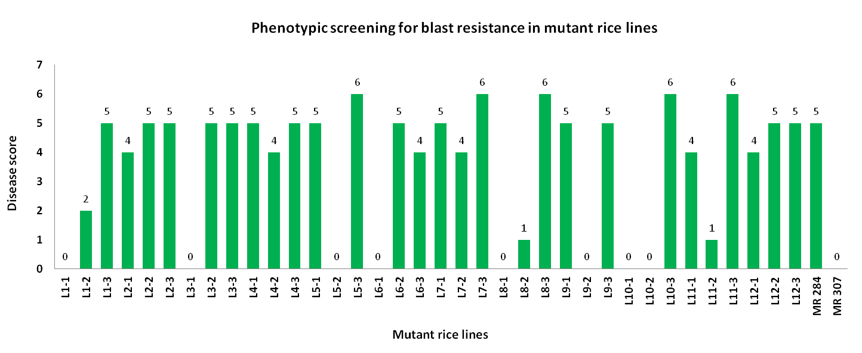
Case Study: Gene Editing
Transformation of MR 284 Rice with the Ethylene Response Factor Gene Cassette (ERF922)
T1 generation screening
Analisis Jujukan DNA
Notes:
9

Slide 17
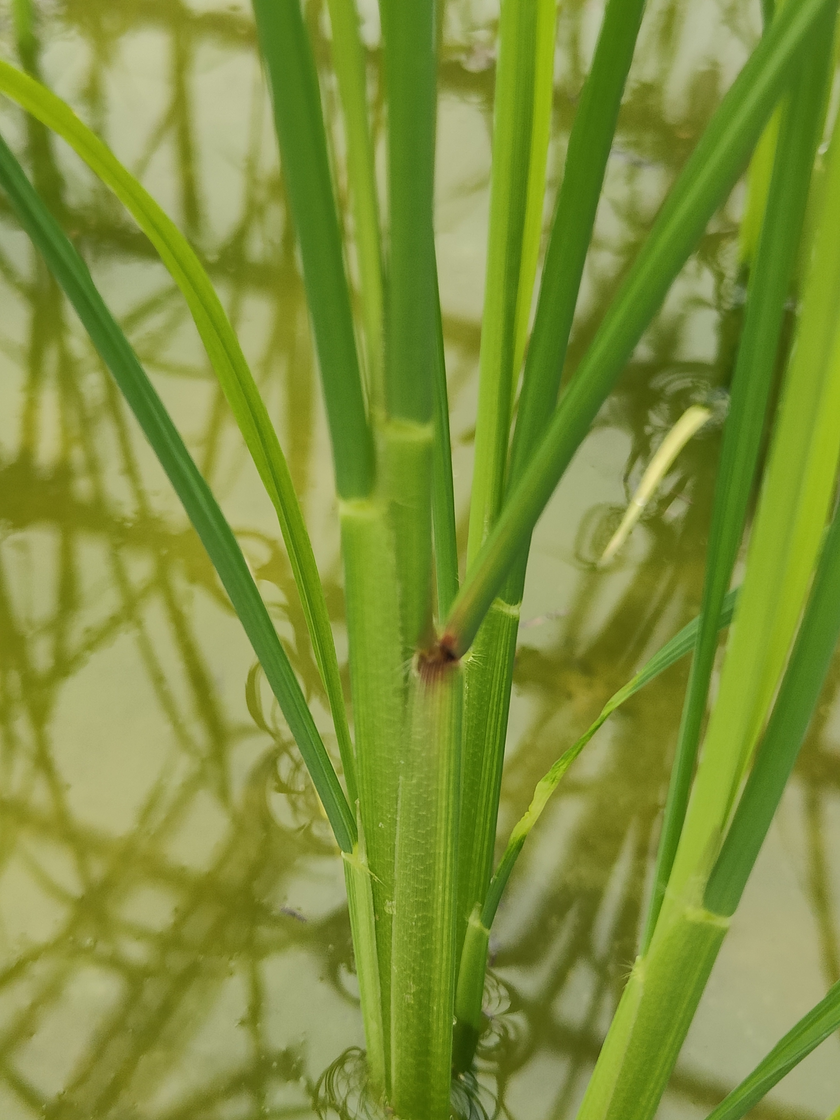
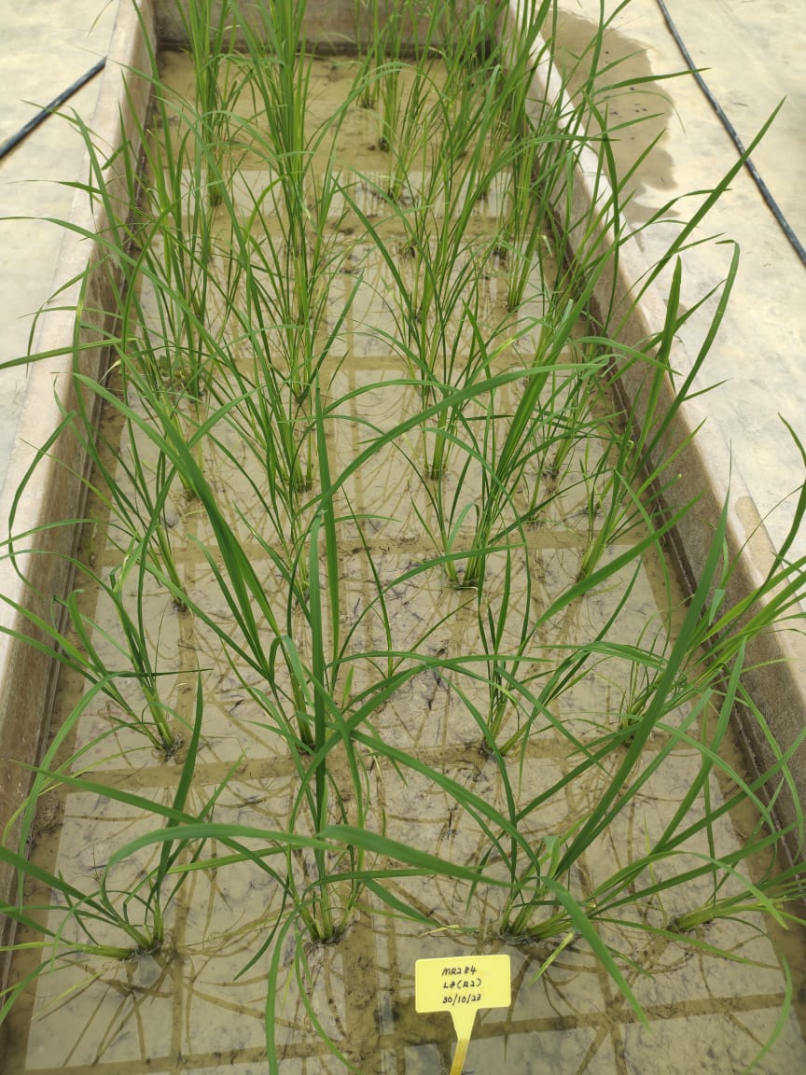
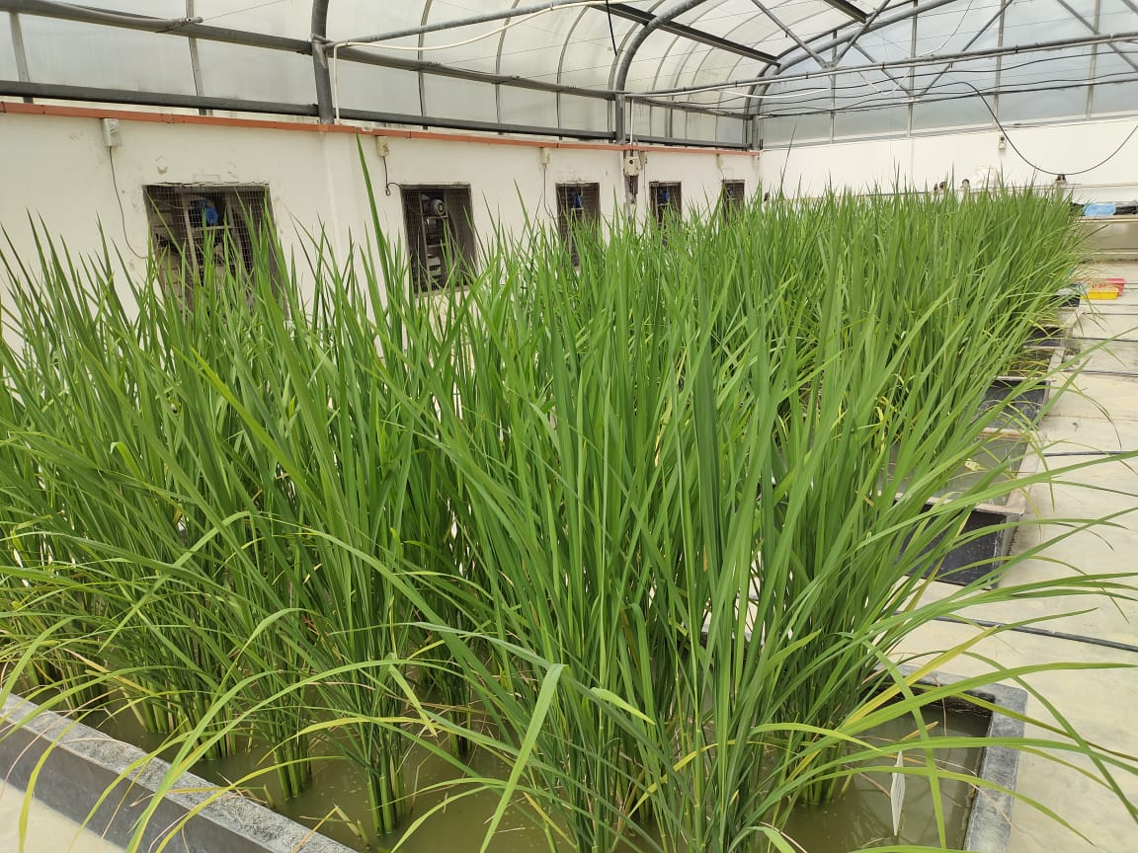
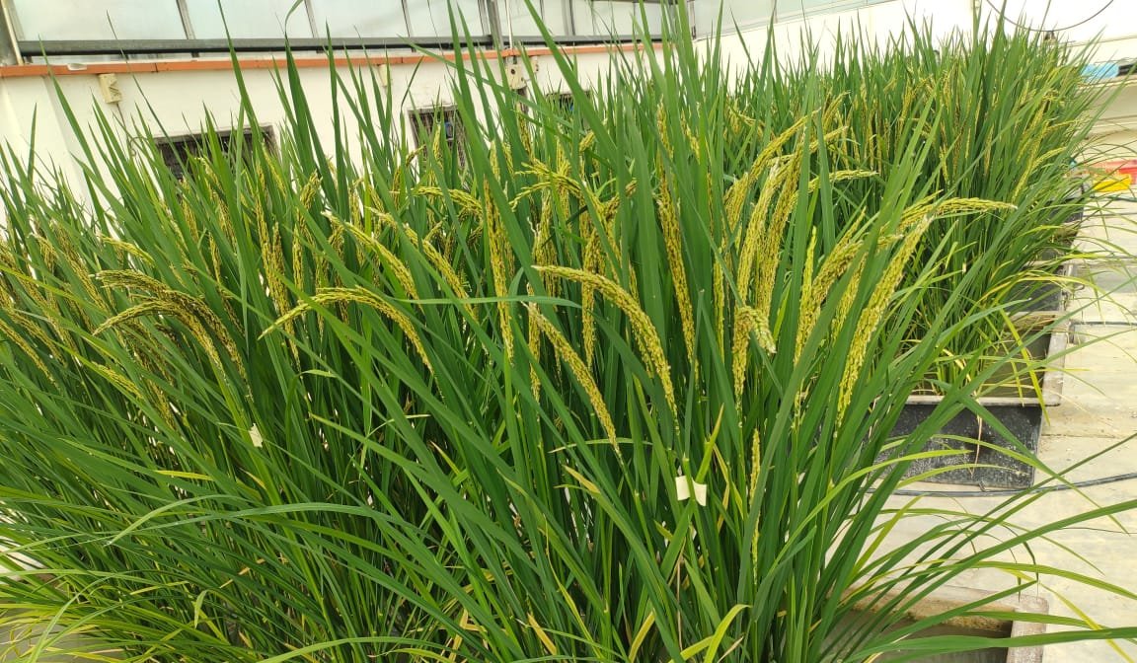
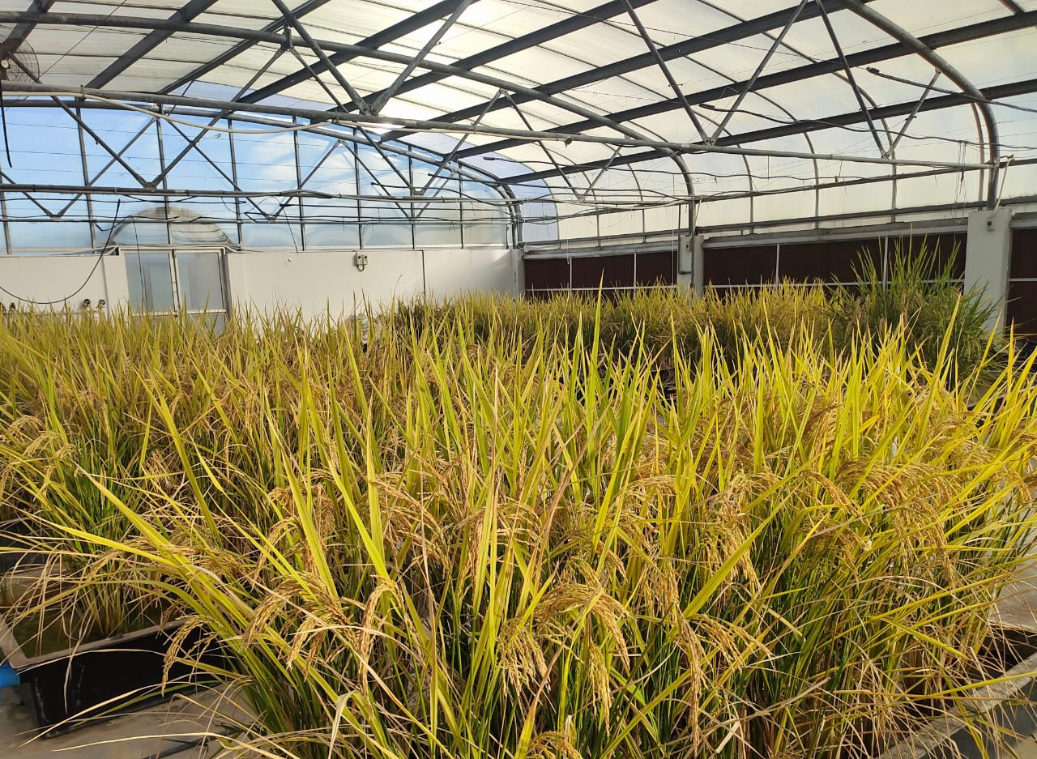
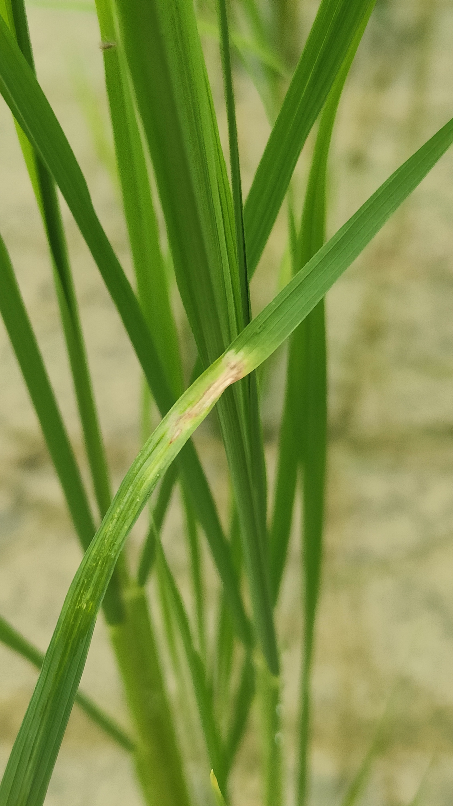
Case Study: Gene Editing
Transformation of MR 284 Rice with the Ethylene Response Factor Gene Cassette (ERF922)-cont
T2 generation screening
Notes:
9

Slide 18
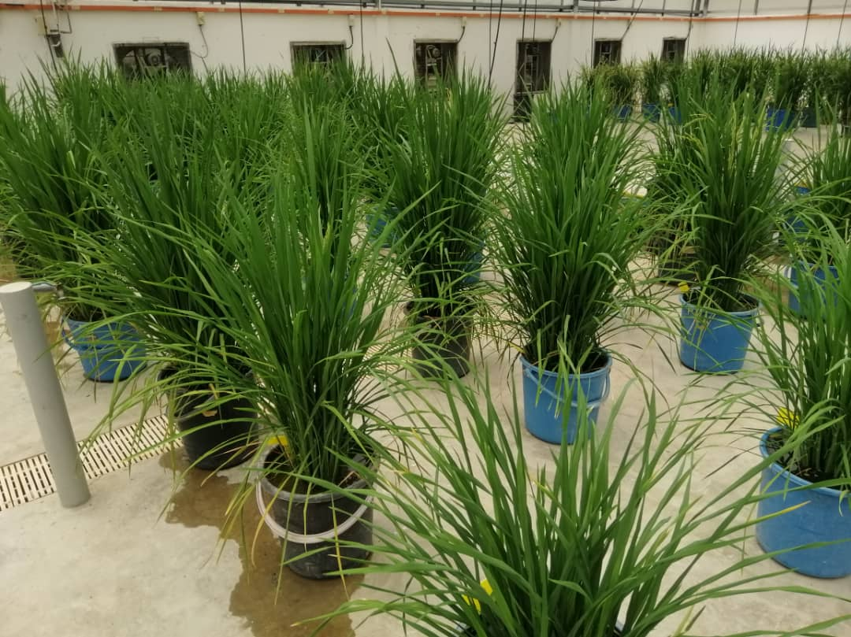
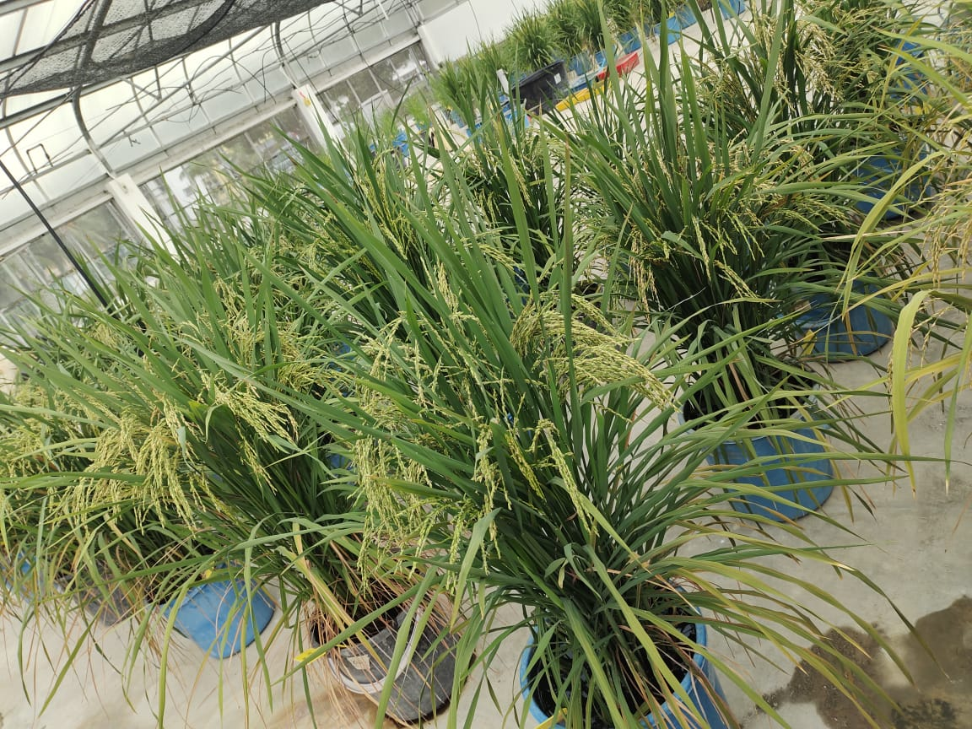
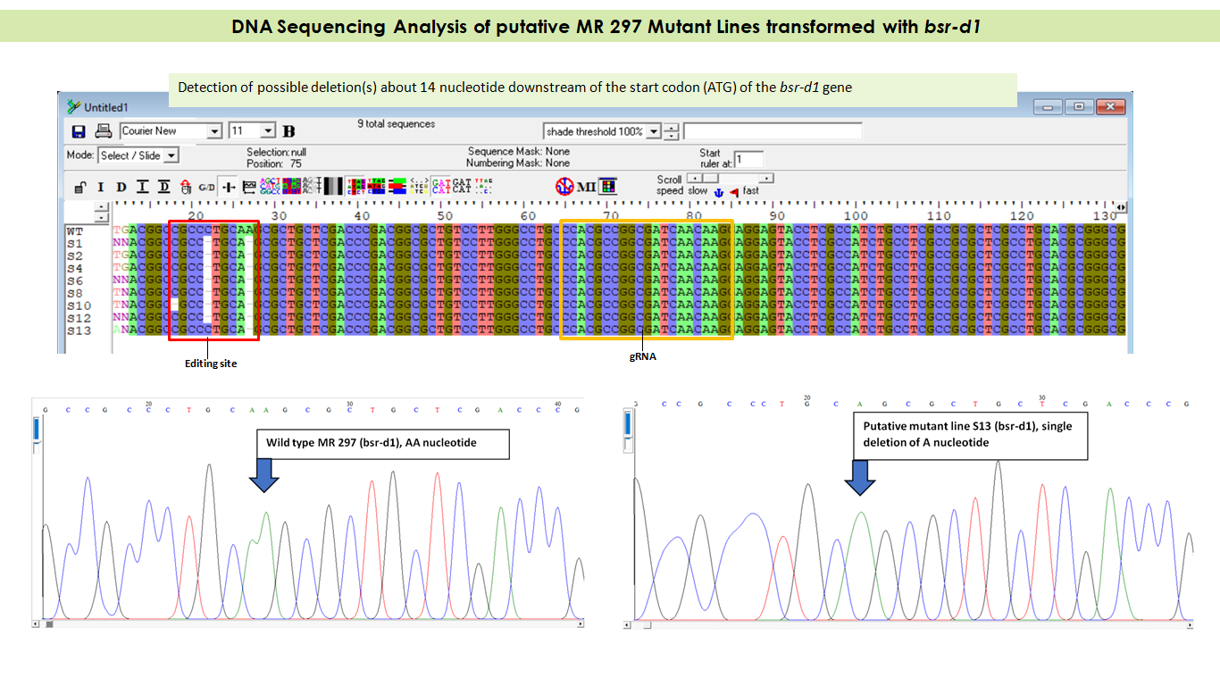
Case Study: Gene Editing
Transformation of MR 297 Rice with the Broad-Spectrum Resistance Gene Cassette Digu 1 (bsr-d1)
T1 generation screening
Notes:
9

Slide 19
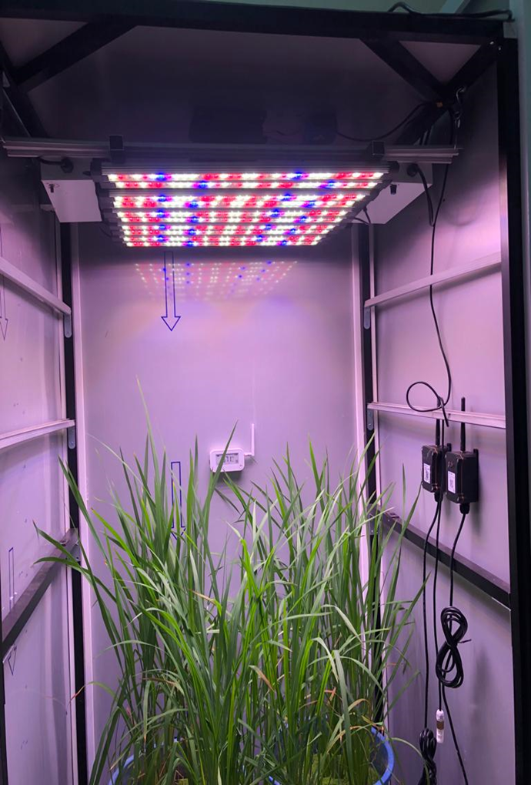
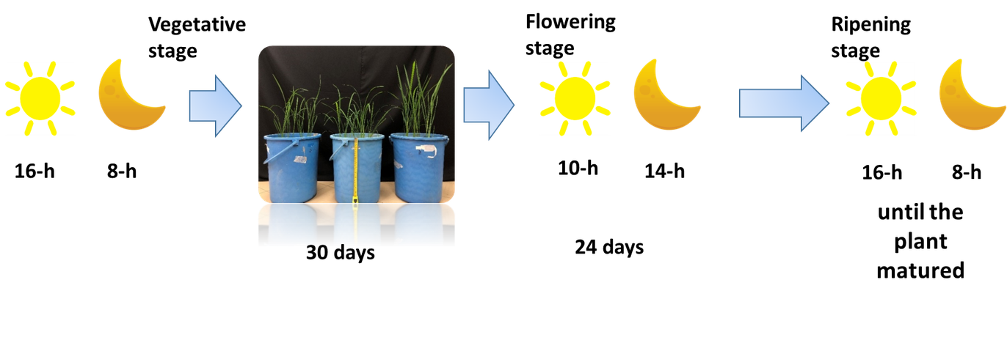
Case Studies -
Evaluation on growth performances under SB condition for genotype MR220CL2, MR297 and MR315
Condition
•Temperature:30/25°C light/dark
•RH: 70%
•Light intensity:500 μmol m^-2s^-1
(Rana et al., 2019)
Among the three all varieties experimented, only genotype MR220-CL2 were shown a positive reaction towards given photoperiod (start flowering 2 weeks later compared to the same genotype in the glass house).
Notes:
6

Slide 20
INFRASTRUCTURE AND
CAPACITY

Slide 21
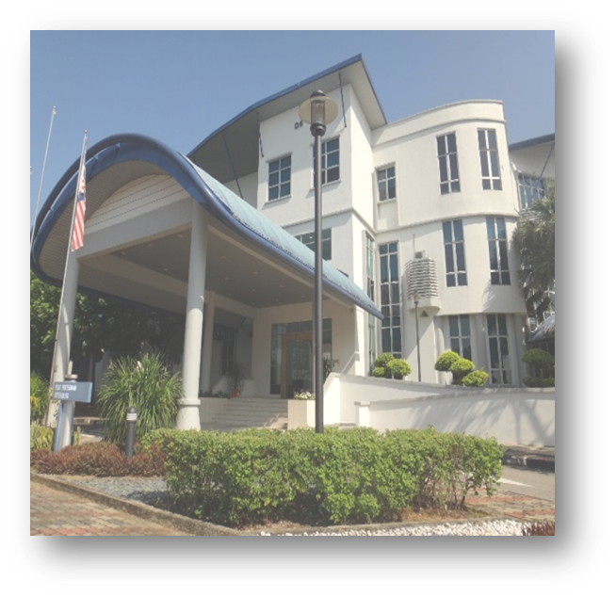

CENTRE FOR MARKER DISCOVERY AND VALIDATION (CMDV)
01
02
CMDV was established through a collaboration betweenMARDI and Malaysian Biotechnology Corporation (BiotechCorp).
Signed the Custodian Agreement to acquire MAS technology from DNALandmarks, Canada in 2009
03
04
Part of EPP14 members under agriculture NKEA from 2011: Development of seed industries
Start operating on August 2011 at Biotechnology and Nanotechnology Research Centre.

Slide 22
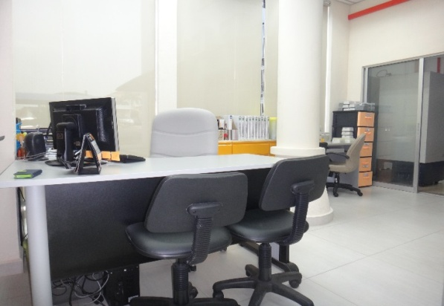
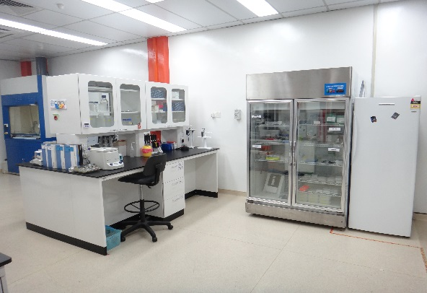
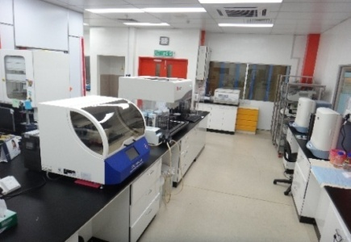
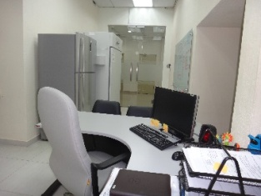
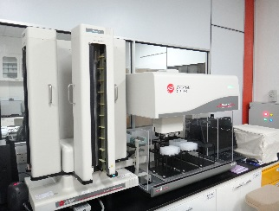
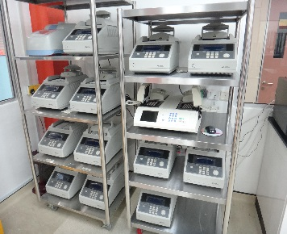
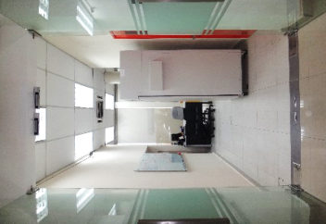
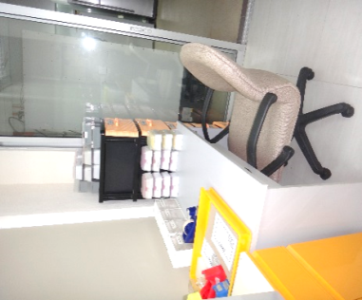
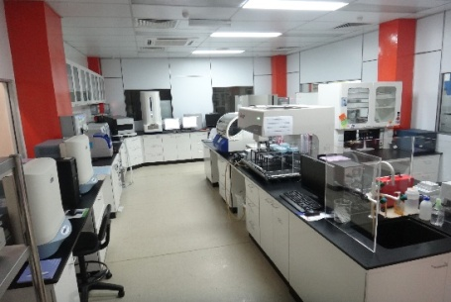
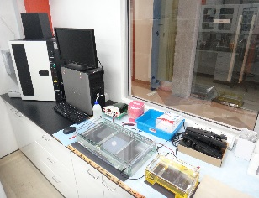
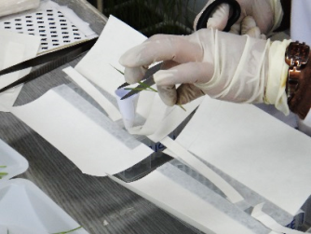
CMDV
Gatekeeper Room
Pre-PCR Room
Post-PCR Room

Slide 23
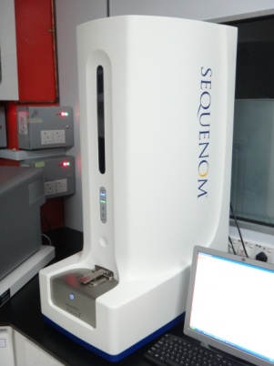
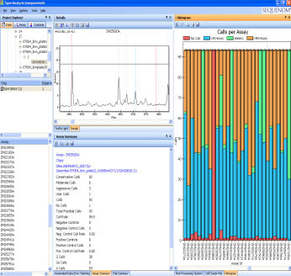
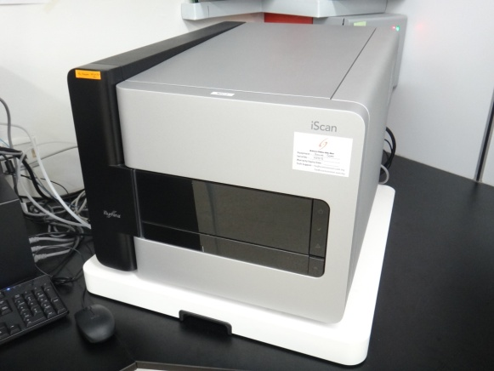
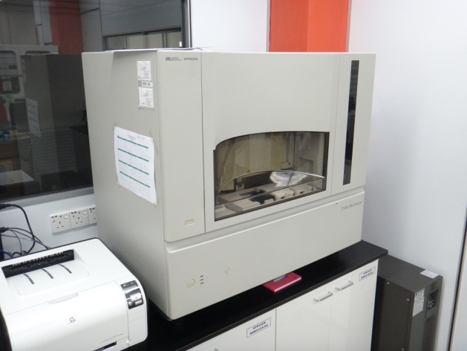
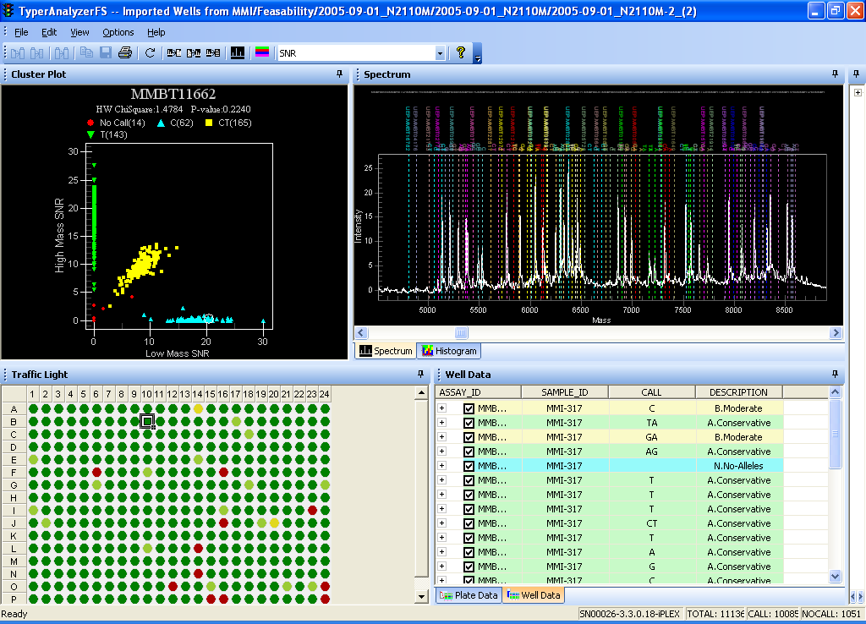
CMDV: HIGH THROUGHPUT GENOTYPING PLATFORM
Illumina iScan: SNP detection
AgenaTM MassArray
ABI 3730xl: Simple Sequence Repeat (SSR)

Slide 24
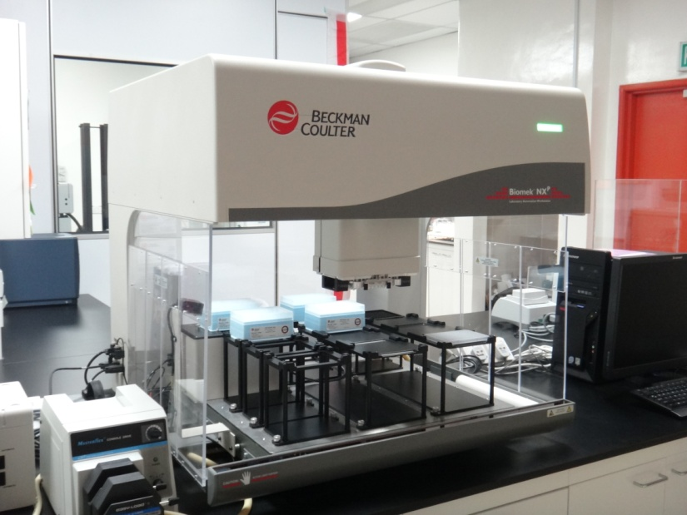
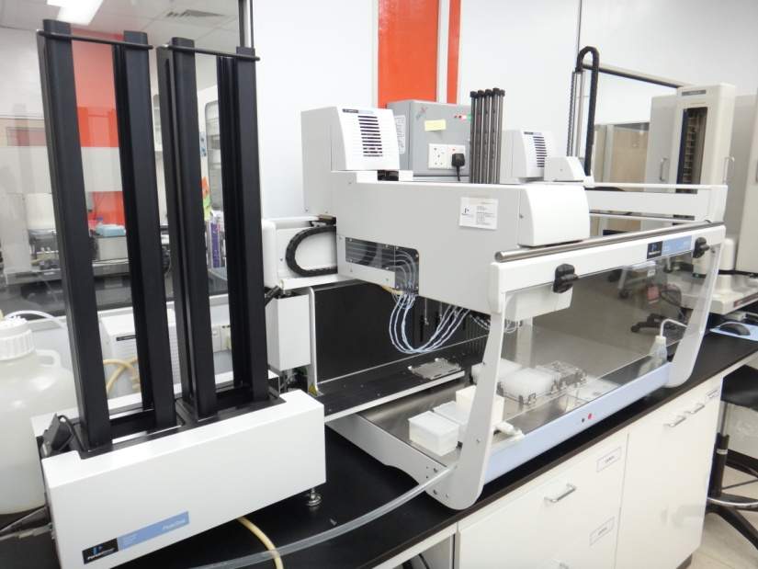
CMDV-ROBOTIC EQUIPMENT
Beckman Coulter:
Automated liquid handler machine
Perkin Elmer Janus: Automated DNA handler machine

Slide 25



CMDV-BIOINFORMATICS FACILITIES
Server – Data storage and process
Bioinformatics analysis

Slide 26


TISSUE CULTURE LAB

Slide 27

TRANSGENIC GLASSHOUSE

Slide 28

TRANSGENIC GLASSHOUSE

Slide 29


TRANSGENIC GLASSHOUSE

Slide 30


PLANT FACTORY

Slide 31



PLANT FACTORY

Slide 32
POLICY AND REGULATORY ENVIRONMENT
OPPORTUNITIES
CHALLENGES
  Food security concerns have created clear policy justification for increasing domestic rice productivity and resilience.
  Funding limitations
  Infrastructure gaps
  Rice varietal release is governed by an established standard operating procedure (SOP)
  Gene-edited products are currently regulated under the GMO framework
  Peninsular Malaysia has an established and systematic seed certification and distribution system
  In Sarawak, a seed production system is planned following the approval of RM2.3 million to support its establishment

Slide 33
BASF
Collaboration on development of Clearfield RIce variety and other herbicide tolerant rice system
COLLABORATION AND PRIVATE SECTOR
12 Seed Producer Companies
Appointed by the Ministry to produce registered and certified seed, supported by a subsidy of RM 1.03/kg, with a total annual production of 72,000 MT.
Germplasm Exchange
Strengthening germplasm exchange through international collaborative projects

Slide 34

SPEED TARGETS
Achieving a standard 5-year development cycle for rice
FUTURE VISION
(5–10 YEARS)
OPEN FIELD TRIAL FOR GENE EDITING PRODUCT
Exemption for < 20 bp: Gene-edited products with an integration of less than 20 nucleotides (20 bp) are exempt from the standard requirements of the National Biosafety Act 2007

Slide 35




Recommendations
National Level:
Establish a centralized National Speed Breeding Center to provide year-round accelerated generation services for all public breeding programs.
Regional Level:
Rapid exchange of climate-resilient germplasm among ASEAN countries

Slide 36

KEY TAKEAWAYS
  To improve the national Self-Sufficiency Level (SSL), Malaysia must transition from a cycle-based breeding mindset to a time-based one.
  This requires a total technological shift: moving away from seasonal field nurseries toward centralized, climate-controlled Speed Breeding centers that can force 4–5 generations of rice per year.

Slide 37
THANK YOU

