Slide 1


RESILIENT-ASEAN
Rapid Enhancement of Sustainable and Inclusive Livelihoods through Equitable New Technologies in Rice and Soybean Systems in ASEAN.
High-Level Partners’ Meeting – Concept Consolidation
Presented by:
Dr. Bunyamin Taran
Professor, Department of Plant Science
University of Saskatchewan
Notes:
fdfdfdfdfdfd

Slide 2
PROPOSED INITIATIVE FOR PARTNER CONSIDERATION
PROPOSED PROJECT TITLE:
RESILIENT-ASEAN
Rapid Enhancement of Sustainable and Inclusive Livelihoods through Equitable New Technologies in Rice and Soybean Systems
PURPOSE:
A multi‑country initiative to strengthen food security, climate resilience, and inclusive livelihoods of rice‑ and soybean‑based farming systems across ASEAN through accelerated breeding, resilient seed systems, and equitable technology access.
PROPOSAL AT A GLANCE
Submission Type: Unsolicited Concept Proposal
Proposed Donor: Global Affairs Canada (GAC)
Project Duration: 5 years (2027–2031)
Total Funding Requested: CAD 8 million
Cost Sharing: Minimum 5% (in‑kind and co‑financing by partners)

Slide 3
DEVELOPMENT CHALLENGES IN ASEAN
ASEAN Food Systems Under Growing Risk
Food security at risk: Rice and soybean underpin food security and incomes for hundreds of millions across ASEAN, but productivity and reliability are stagnant, if not declining.
Climate shocks rising: Drought, floods, salinity, heat, and pests are outpacing response capacity.
Conventional breeding and delivery systems are too slow: Variety development takes 8–12 years; Need new approach to enhance genetic gain, improve weak breeding–seed–delivery links.
Unequal access: Poor, remote farmers -especially women - lack access to quality seed and services.

Slide 4
RESILIENT - SOLUTION
RESILIENT-ASEAN: A Scalable, Inclusive Response for ASEAN
Accelerated breeding: Use genomic and speed breeding to cut release time by 30–50% and deliver climate-resilient rice and soybean.
Inclusive seed systems: Link breeding directly with seed multiplication and distribution for sustained farmer access.
Gender equality (GE-03): Engage women as farmers, decision-makers, and seed entrepreneurs.
ASEAN regional public goods: Share genetic resources, data, and innovations for scale and resilience.
Capacity strengthening: Train breeders to institutionalize accelerated breeding.
Expected result: Improved food security, climate resilience, and livelihoods for poor and marginal farmers.

Slide 5
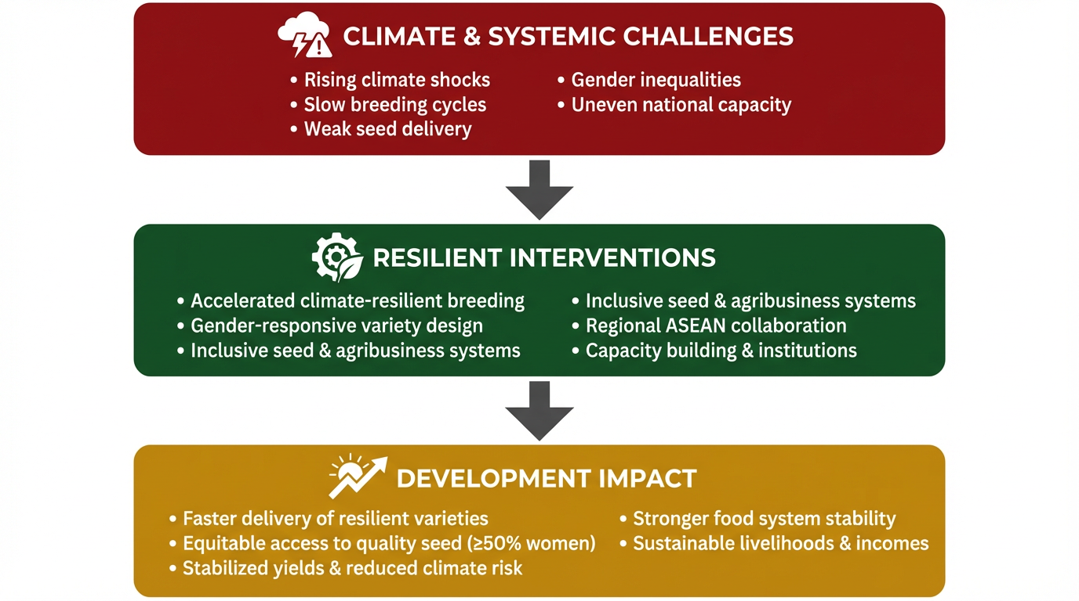
RESILIENT ASEAN – CHALLENGES, SOLUTION, IMPACT

Slide 6
THE CONCEPTUAL MODEL –RESILIENT PROJECT
RESILIENT-ASEAN
INPUTS & ENABLERS
Global Affairs Canada funding
University of Saskatchewan, IRRI, & Crop Trust as Co-leads
National research systems in ASEAN
Participating Universities in ASEAN Countries
Seed companies & Ministries of Agriculture
Gender analysis & field experiments with farmers
CONTEXT & CHALLENGE
Climate change (drought, floods, salinity)
Slow breeding cycles (8–12 years)
Weak seed systems & gender inequality
PILLAR 1:
Accelerated climate-resilient breeding
PILLAR 2:
Gender responsive seed & food systems
PILLAR 3:
Enabling value chain, markets & policy environment
INTERMEDIATE OUTCOME 1
Accelerated delivery of improved varieties to farmers
INTERMEDIATE OUTCOME 2
Equitable access (GE-03 gender equality)
INTERMEDIATE OUTCOME 3
Stability and Food availability via inclusive seed and food markets
ULTIMATE OUTCOME
Improved food security, climate resilience, and livelihoods of poor & marginal farmers

Slide 7

LEAD & CONSORTIUM PARTNERS
LEAD INSTITUTION:
University of Saskatchewan (USask), Canada
PROPOSED CO‑LEADS:
  International Rice Research Institute (IRRI)
  Global Crop Diversity Trust
PROPOSED IMPLEMENTING PARTNERS:
  National Agricultural Research Systems (NARS) across ASEAN
  Selected universities in ASEAN countries
  Seed sector, Ministries of Agriculture, and farmer organizations

Slide 8
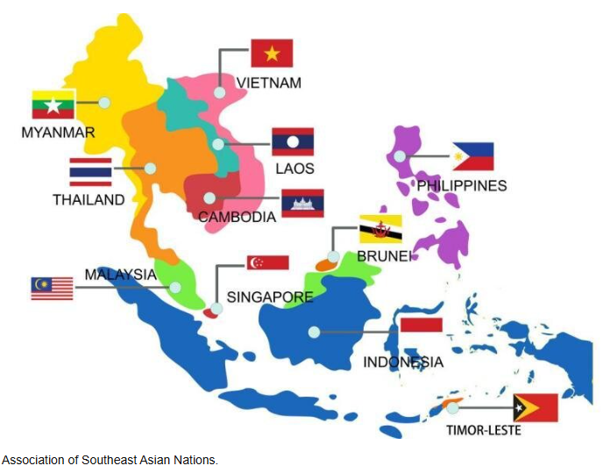
GEOGRAPHIC SCOPE
GEOGRAPHIC SCOPE
Regional Coverage: All ASEAN member states
Focus: Rice‑ and soybean‑based farming systems, with priority to climate‑vulnerable and low‑income farming communities

Slide 9

CORE VALUE PROPOSITION FOR PARTNERS
Accelerates delivery of climate‑resilient rice and soybean varieties
Strengthens regional breeding and seed‑system capacity
Embeds gender equality and inclusive livelihoods as central objectives
Generates regional public goods through coordinated ASEAN collaboration
Aligns with Food Systems, Climate Adaptation, and Inclusive Growth priorities

Slide 10

INVITATION TO PARTNERS
This partners’ meeting seeks to:
Align on technical and geographic priorities
Confirm co‑leadership and implementation roles
Explore co‑financing, leveraging, and policy engagement opportunities
Strengthen a shared regional vision for resilient ASEAN food systems

Slide 11

THANK YOU
Questions?
Notes:
Meghna

