Slide 1


Opportunities and challenges of
accelerated (Rice) breeding in ASEAN: Case of Indonesia
Yudhistira Nugraha
Aris Hairmansis, Bambang S Purwoko,
National Research and Innovation Agency (BRIN)
IPB University

Slide 2
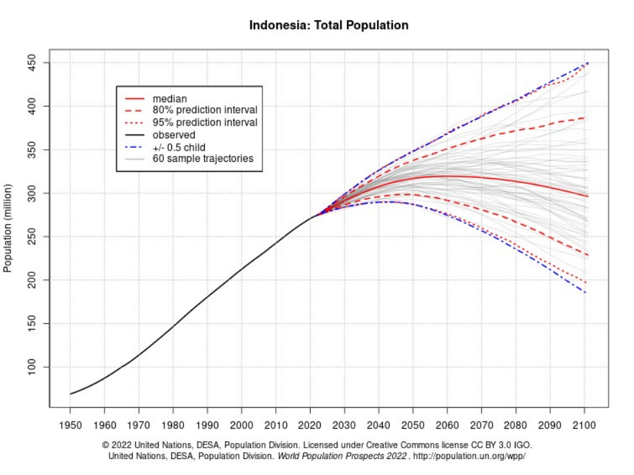
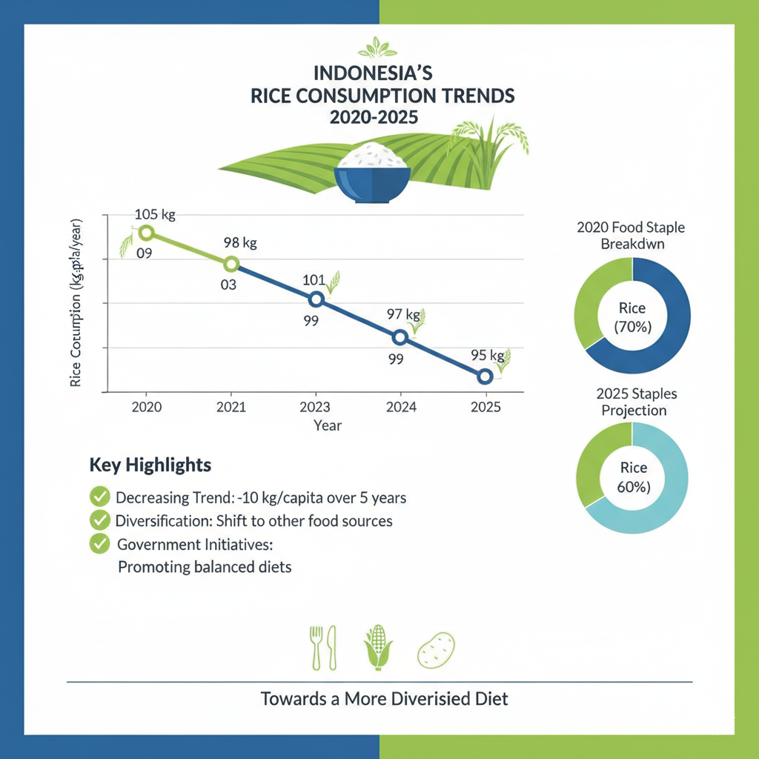
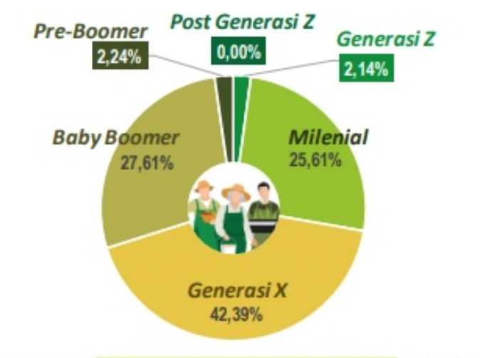
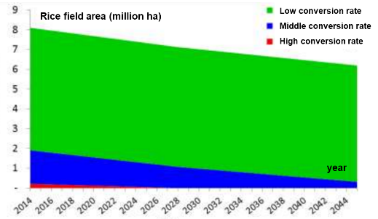
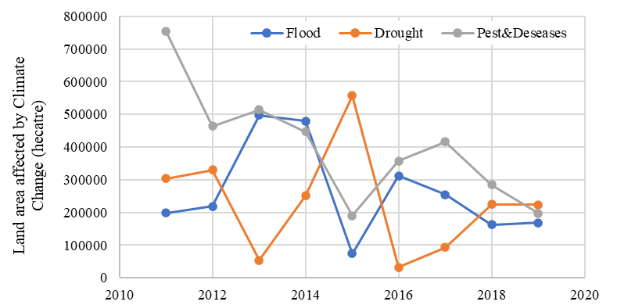
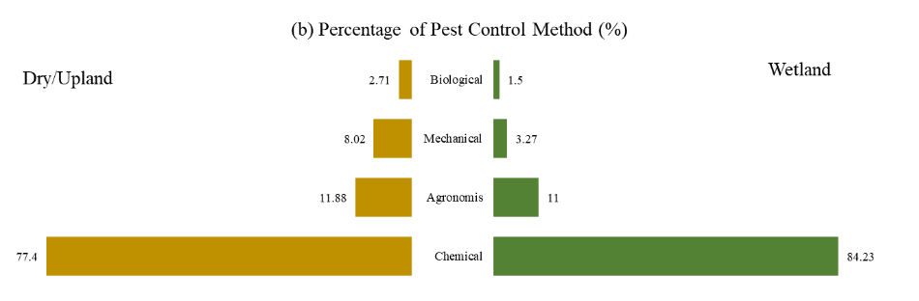
Rice Production Challange in Indonesia
Growth of population ( 2030 = ~300 million people)
need additional production
Decreasing trend -10 kg/years but still contribute more >50% of daily calory intake
Ageing and decline in the number of farmers
Arable land converstion ~200 thousand ha per years
Climate Change treats the production
Degraded land due to overuse chemical and Environmental issue
Organisasi Riset Pertanian dan Pangan - BRIN
Email: orpp@brin.go.id
Notes:
This slide is critical as it outlines the 'why' behind our work. We are facing a growing population that needs more food, rice remains the absolute cornerstone of our nation's diet, still contributing more than 50% of all daily caloric intake. Therefore, the total aggregate demand for rice will inevitably continue to rise. pitted against a system constrained by stagnant productivity, an ageing workforce, shrinking farmland, climate change, and environmental degradation. This is the critical problem-set that our Research Organization for Agriculture and Food is dedicated to solving.

Slide 3
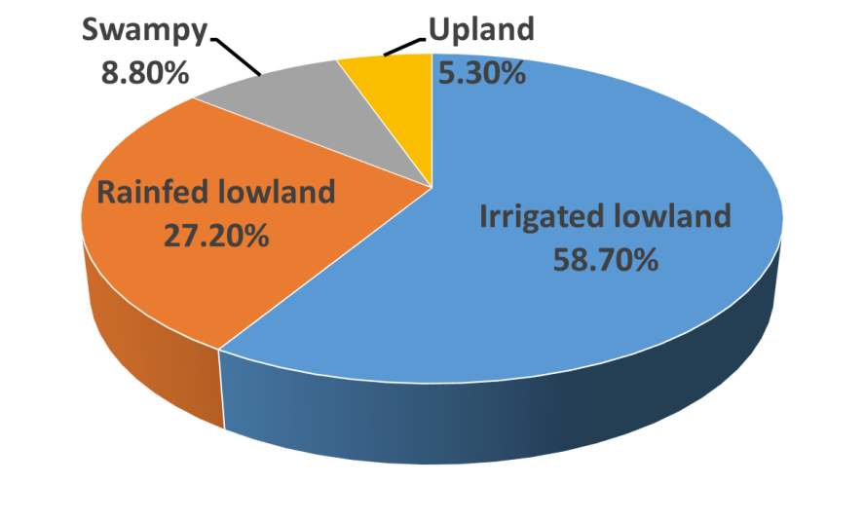
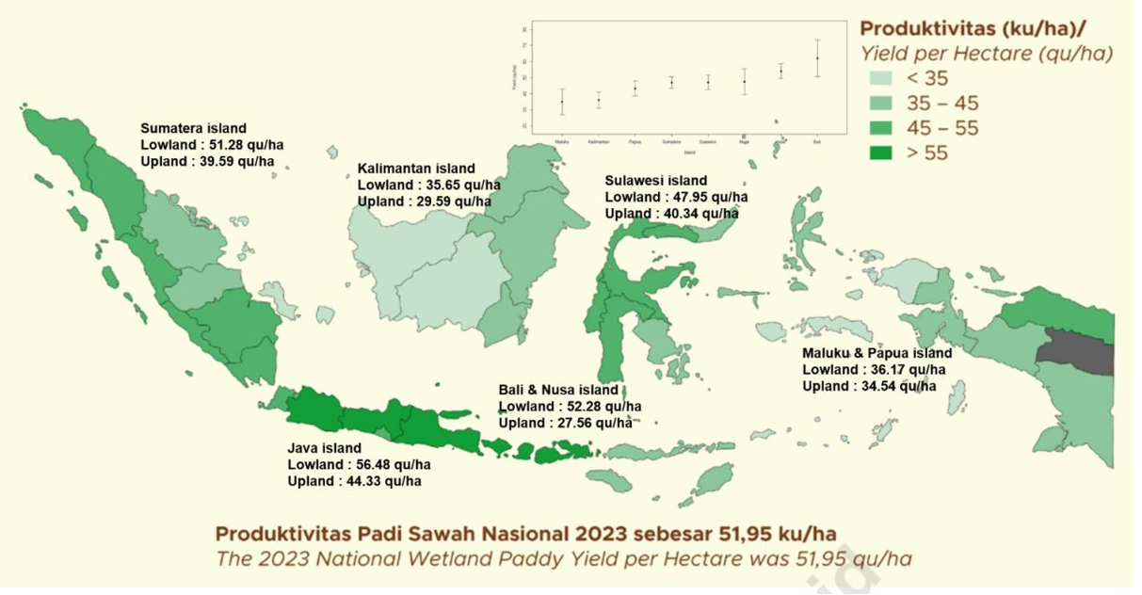
Distribution of Rice Agroecological Zone in Indonesia
RICE PRODUCTIVITY IN INDONESIA
Constraints:
Irrigated: BPH, BLB, Stem borer, Rat, Blast, RTV, Saline, Submergence
Rainfed : Drought, AG, Saline, Submergence, BPH, BLB, Blast, low soil fertility, weeds
Swampy : acidic sulfate, Fe toxicity, AG, Sub/SF, Saline, Neck Blast, RTV
Upland : Blast, Weed, Al toxicity, low soil fertility and organic compound
Trias et al 2025; Journal of Crop Improvement
Notes:
This slide drills down into the specific Distribution of Rice Agroecological Zones in Indonesia. This is critical because Indonesia is not one uniform rice field; we have diverse environments, each with its own potential and problems. We grow rice in different agroecosystem the widest rice ecosystem is irrigated lowland which is predominantly in northern part of java island in this agroecosystem rice can be planted 3 times a years, rainfed lowland which is the land dependent with rainfall in some area only one season a year and the others can be twice depending to distribution and availability , swampy rice land
This complexity directly translates to the 'Rice Productivity' map on the right. We can see a wide variation in yield across the archipelago.
Java remains our most productive region, with lowland yields over 56 quintals per hectare. Other islands, like Kalimantan and Maluku & Papua, show much lower productivity, in the 30s or 40s. The 2023 national average for wetland paddy yield was 51.95 quintals per hectare. This shows we have high-performing regions, but also huge potential for improvement if we can solve the specific, localized constraints in our less productive zones.

Slide 4
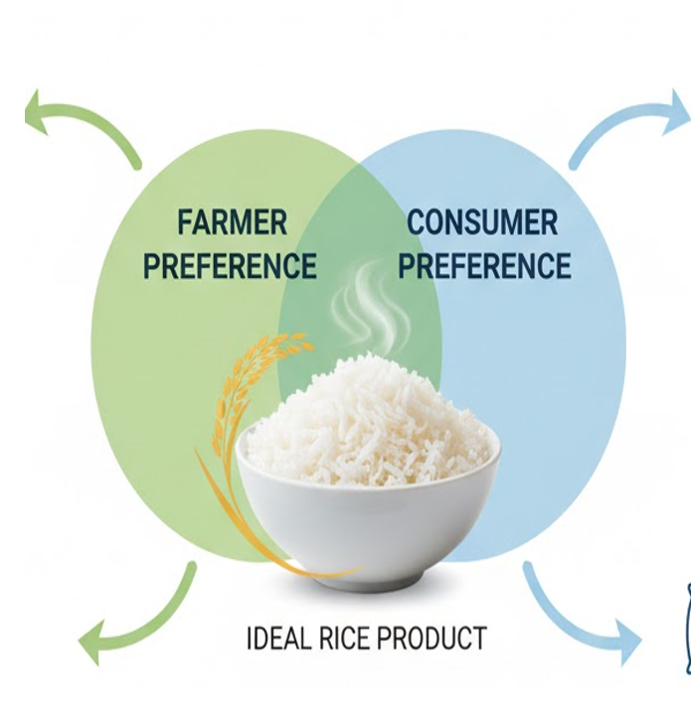
Rice Product Profile Based for Farmer and Consumer Preference
Maturity :
  Early maturity: 105 – 124 das
  Very early maturity: < 90 das
Plant height: ≈ 100-110 cm
Resistance to Major Pest and Diseases : Brown Planthopper, Bacterial Leaf Blight, Blast, Viruses (Tungro, Grassy Stunt, Yellow Grassy Stunt)
Tolerance to abiotic stress : drought, salinity, flood, metal tocixity (Fe, Al)
Scatter resistance : moderate, while in some area who thresh by hand preffering easy to scatter
Consumer Preference :
  Taste :
  Java: soft rice, aromatic, slender
  Sumatera : slender, hard rice
  Kalimantan : small (siam type), hard rice, sometime soft rice
  Sulawesi : soft rice without aroma
  Specialllity Rice : Pigmented Rice, Japonica Rice, Jasmine Rice, Basmati Rice
  Physical quality: shape (long slender), milling recovery (66%), crystal translucent
Notes:
his slide defines the 'Ideal Rice Product' as the precise intersection of two distinct sets of priorities: Farmer Preferences and Consumer Preferences.
From the Farmer's perspective, the ideal profile is based on agronomic performance. This includes varieties with early or very early maturity—less than 124 days—and a manageable plant height of 100-110 cm. Critically, it must possess strong resistance to major pests like the Brown Planthopper and diseases like Bacterial Leaf Blight, alongside robust tolerance for abiotic stresses such as drought, salinity, and floods. Finally, it needs moderate scatter resistance to balance easy threshing with minimal yield loss.
From the Consumer's perspective, preference is driven by quality and taste, which varies significantly by region. While the general physical quality standard includes a long slender shape, high milling recovery, and translucence, specific tastes differ: Java prefers soft and aromatic rice, Sumatra and Kalimantan prefer harder rice, and Sulawesi prefers soft, non-aromatic types. There is also a distinct market for specialty rices like Pigmented, Japonica, and Basmati.
Therefore, the challenge in rice breeding is to develop a single product that is both highly resilient and productive for the farmer, while simultaneously meeting the specific, and often different, sensory demands of the end consumer."

Slide 5
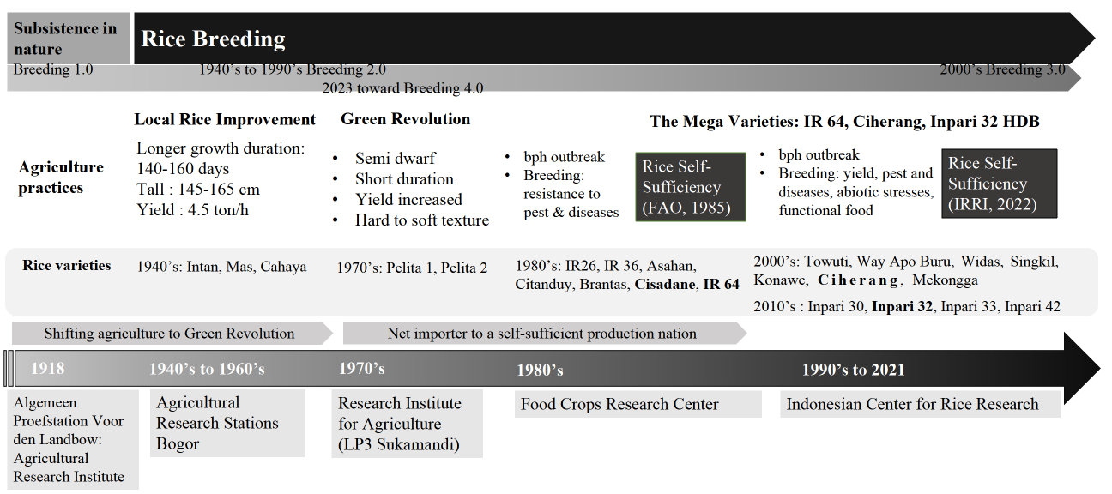
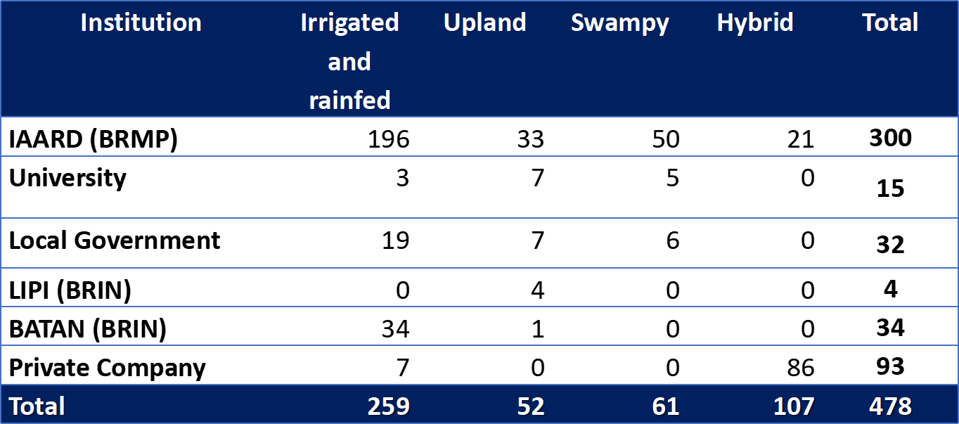
Rice Breeding History in Indonesia
NUMBER OF RELEASED RICE VARIETY 1950-2022
Directorate General of Food Crops, MoA (2022)
Sitaresmi et al 2025; Journal of Crop Improvement

Slide 6
Adoption Rice Variety
Adoption 2023
No. | Varietas | Area (ha) | %
1 | Inpari 32 HDB | 2.990.073 | 28,26
2 | Ciherang | 2.114.063 | 19,98
3 | Mekongga | 1.026.062 | 9,70
4 | Inpari 42 | 460.248 | 4,35
5 | IR 64 | 445.213 | 4,21
6 | Inpari 30 Ciherang Sub 1 | 189.537 | 1,79
7 | Situ Bagendit | 228.387 | 2,16
8 | Nutri Zinc | 219.604 | 2,08
9 | Ciliwung | 247.235 | 2,34
10 | Other varieties | 2.184.131 | 20,64
11 | Local varieties | 475.212 | 4,49
TOTAL |  | 10.579.765 | 100,00
Directorate Food Crops MoA (2024)
Adoption over the last five years. Data from (Directorate of Food Crop Seeds 2019; 2020; 2021; 2022; 2023).
Sitaresmi et al 2025; Journal of Crop Improvement
Notes:
This slide provides a quantitative analysis of rice variety adoption in Indonesia, based on 2024 data from the Ministry of Agriculture.
Looking first at the 2023 snapshot on the left, we see a total monitored area of 10.58 million hectares. The data reveals a significant market concentration. The Inpari 32 HDB variety is now dominant, occupying 2.99 million hectares, which translates to a 28.26% market share.
The long-standing variety, Ciherang, holds the second position at 19.98%. Conversely, "Local varieties" (4.49%) and the "Other varieties" category (20.64%) together still account for a quarter of all plantings.
The stacked area chart on the right visualizes the five-year trend from 2018 to 2023. This chart provides the critical dynamic context the aggressive adoption of Inpari 32 HDB (the large blue area). This explosive growth has come at the direct expense of older mega-varieties. You can simultaneously observe the clear and steady decline in the market share of both Ciherang (red) and Mekongga (yellow) over this same period.
In summary, the data shows a clear market shift: new-generation Inpari varieties, led by Inpari 32, are actively displacing the previous generation of dominant varieties like Ciherang."

Slide 7
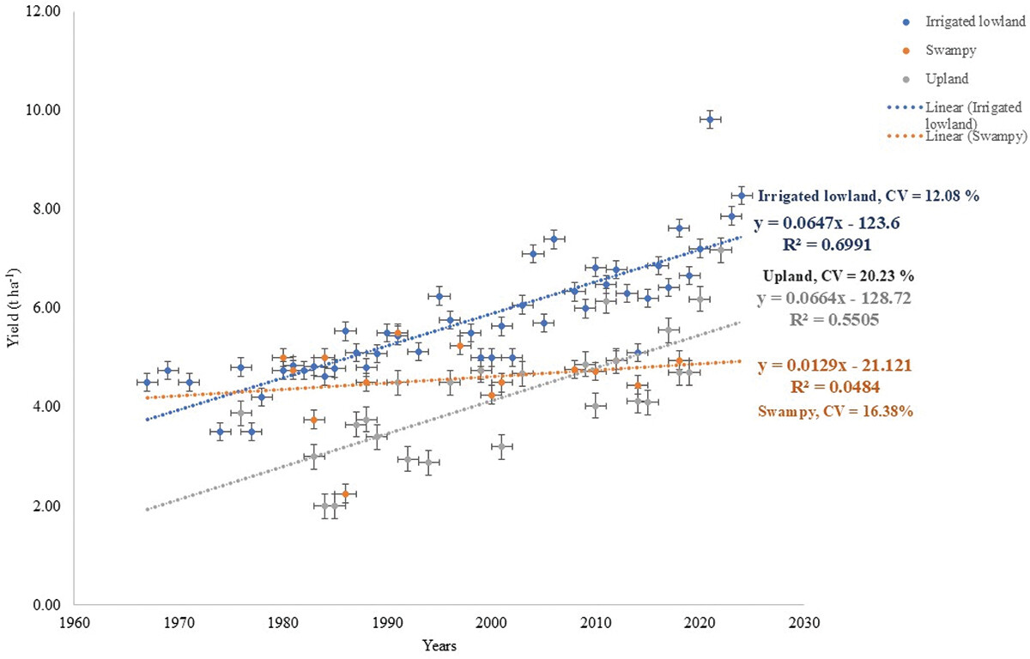
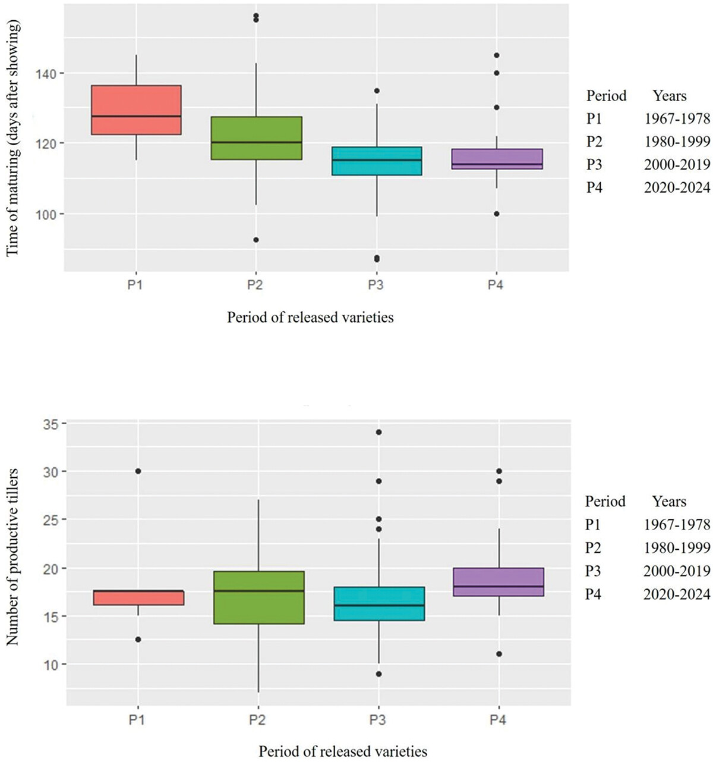
Trends in Yield and Agronomic Traits of Rice Varieties (1965-2024)
Grain yield of Indonesian rice varieties released for irrigated, swampy, and upland ecosystems from 1965 to 2024 (N=356)
Distribution of growth duration and number of tillers of Indonesian rice varieties released from 1965 to 2024
Sitaresmi et al 2025; Journal of Crop Improvement
Notes:
On the left, we see the change in grain yield for 450 rice varieties released between 1965 and 2024, broken down by three major ecosystems.
Significant Gains in Irrigated Lowlands: The most prominent trend, shown by the blue data points, is the consistent and significant increase in grain yield for irrigated lowland varieties. Stagnation in Upland and Swampy Ecosystems: In sharp contrast, the progress for upland (orange) and swampy (gray) ecosystems has been minimal.
Changes in Plant Characteristics (Right Charts)
The two box plots on the right help explain how these yield gains were achieved by showing changes in plant traits over time, grouped into four periods Indonesian rice breeding has been highly successful in developing high-yielding, early-maturing varieties for irrigated lowlands. However, it also points to a significant challenge and opportunity for future research: accelerating genetic gains for the more difficult upland and swampy environments.

Slide 8
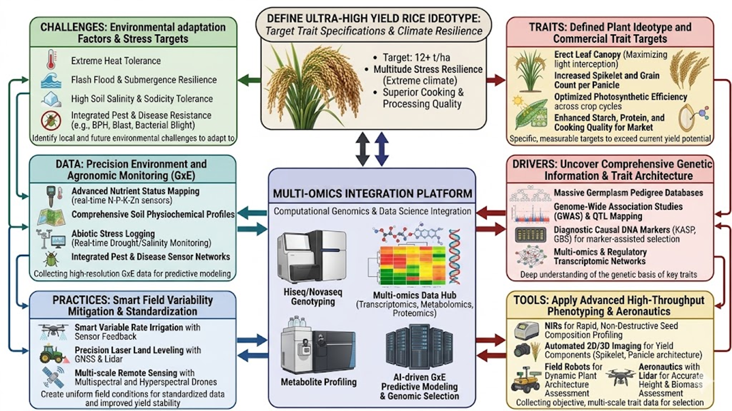
Integrated Rice Breeding Approach

Slide 9
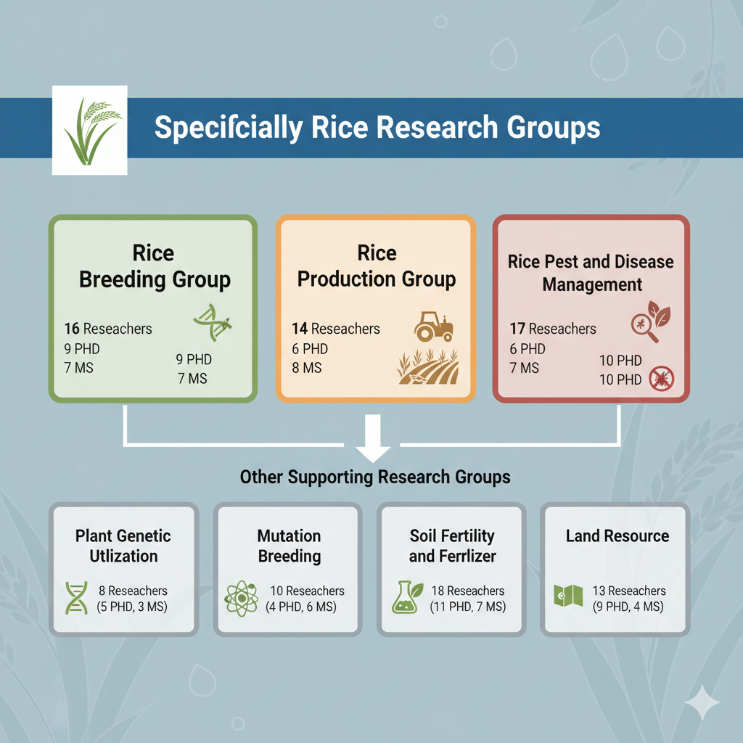
Rice Research Team in BRIN
Total Number of Researcher 96 (50 PhD and 46 MS)

Slide 10
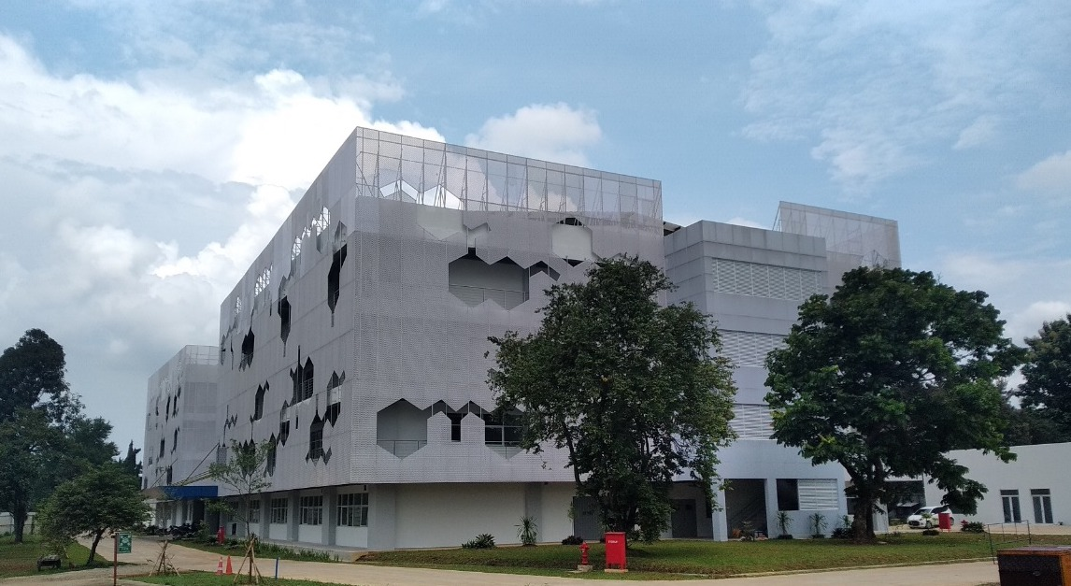
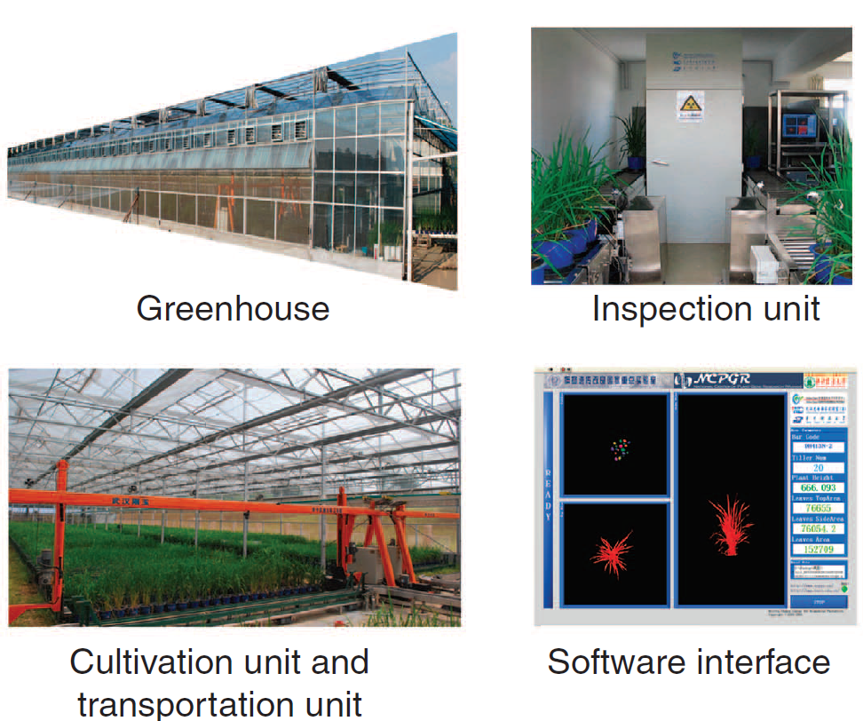
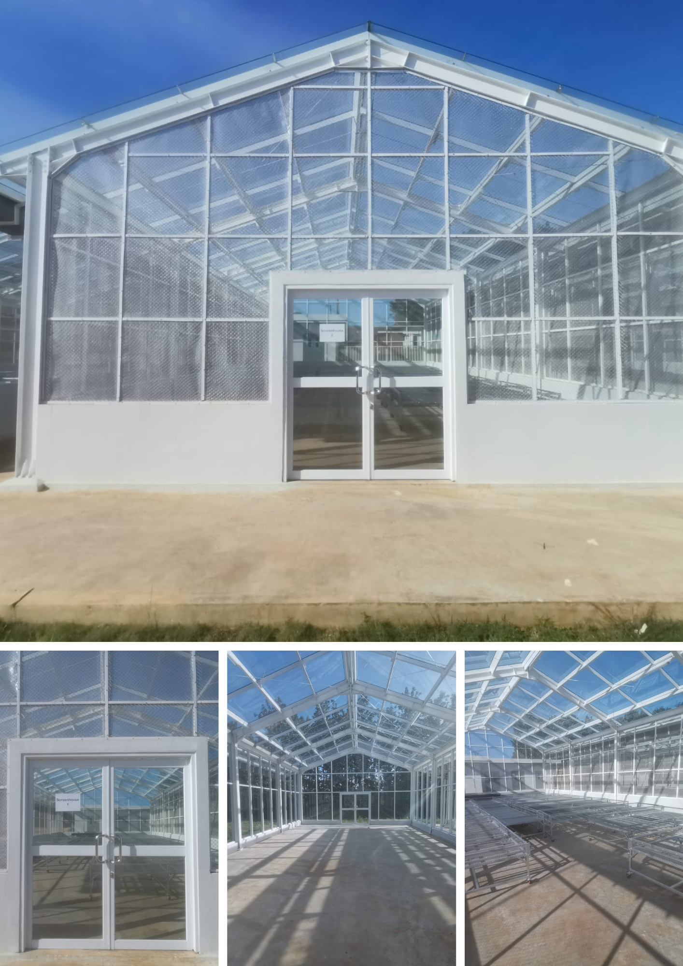

BRIN Research Facilities at Ir. Soekarno Science Center Cibinong Bogor
Facilities under provision:
Field Experiment
Plant Phenomics facility
Somatic Cell Nuclear Transfer
Facilities for genomic research in BRIN
Notes:
This slide show our commitment to building the infrastructure for 'Breeding 4.0.' By combining cutting-edge genomics (to find the traits) with high-throughput phenomics (to test the traits), we can dramatically shorten the time it takes to develop, validate, and deliver the superior rice varieties that Indonesia needs.
Inside this building, we conduct advanced molecular work—like genetic sequencing and marker-assisted selection—to rapidly find the specific genes responsible for traits we want, such as drought tolerance, pest resistance, or better-tasting grain. We are implementing advanced Greenhouse systems with automated cultivation and transportation units. Our capabilities are still expanding. As noted, we are in the process of provisioning:

Slide 11
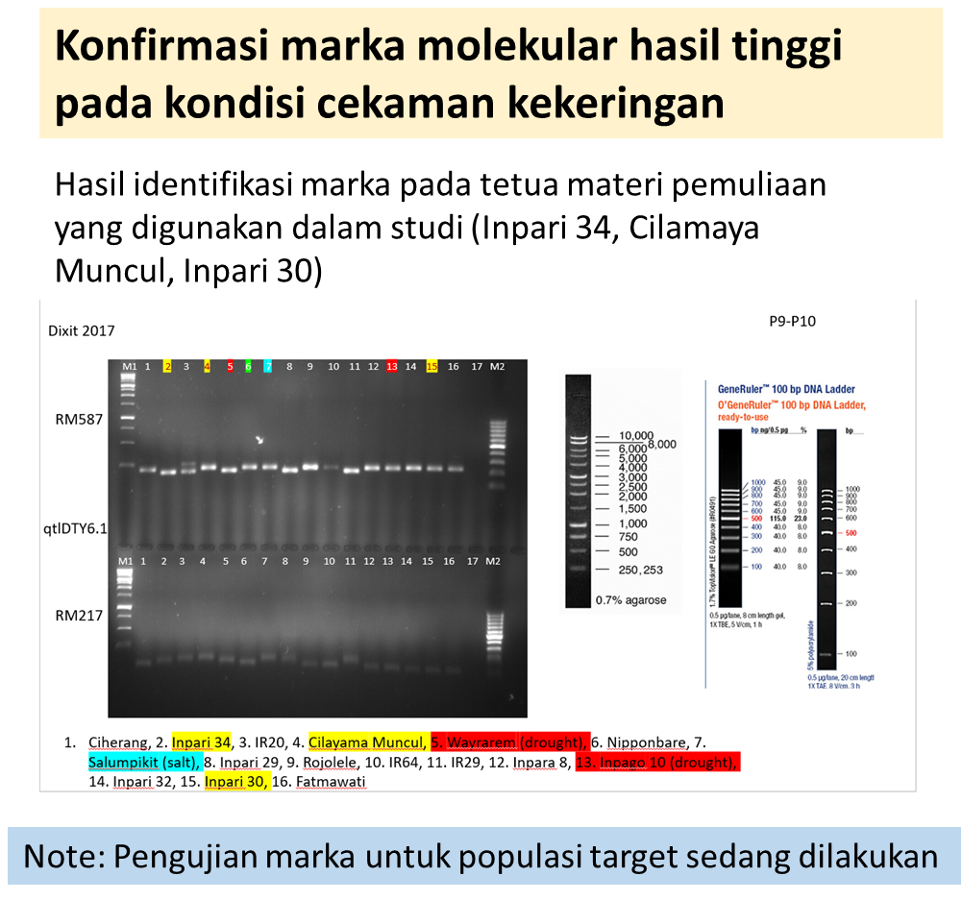
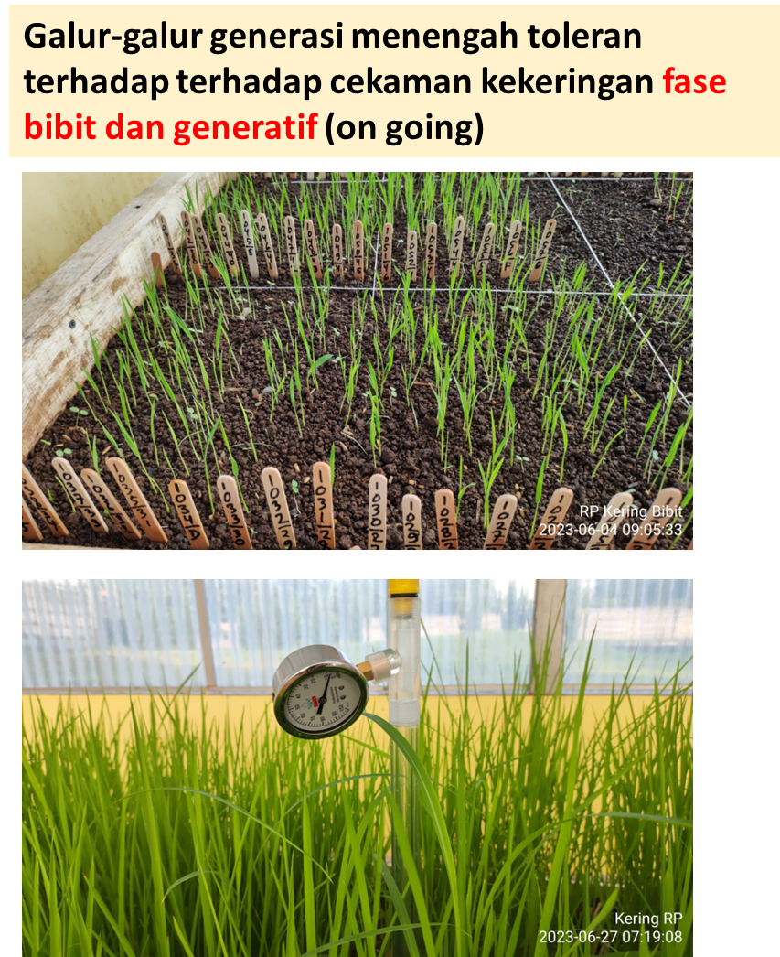
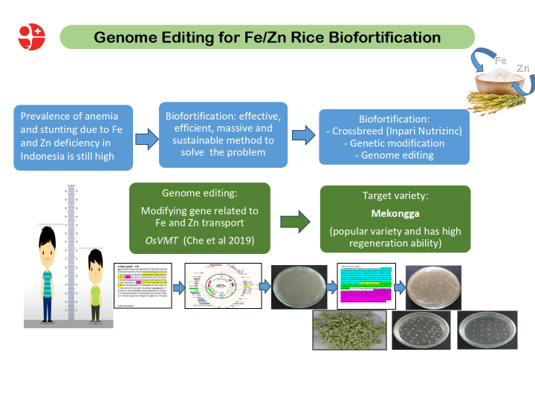
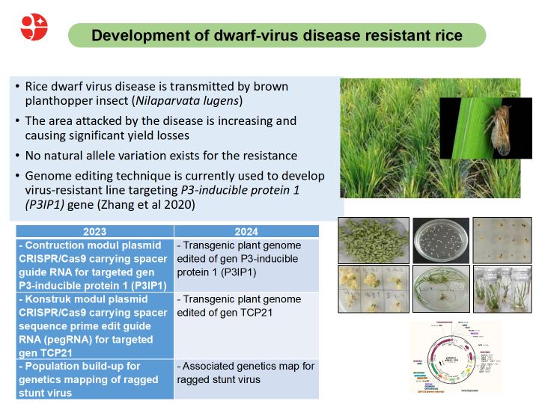
Rice Breeding Research Status in BRIN
No | Targeted Trait | Periode | Year | Stage | Partner
1 | Paddy Rice (Lowland) | Multi-tolerant to abiotic stress and adaptive to climate change (salinity, drought, submergence) | 2022–2026 | Multilocation | Sipetapa, CV Semi
2 | Hybrid Rice (2 & 3 lines) | High yield potential, resistant to pests and diseases | 2023–2027 | Early Generation | Benih Central Asia
3 | Hybrid Rice (3 Lines) | High yield potential, resistant to pests and diseases | 2023–2027 | Observation–DHP (Double Haploid) | Adi Jaya, CV Semi
4 | Biofortification Rice | Zinc Bio-fortification (Genome editing) | 2022–2027 | Early Generation | Harvest Plus, IAEA
5 | Pest and Diseases Resistance | Resistant to dwarf virus (via genome editing) | 2023–2027 | Early Generation | SIPETAPA
6 | Swamp Rice (Padi Rawa) | Tolerant to Fe toxicity, resistant to pests and diseases | 2022–2027 | Observation | SIPETAPA
7 | Upland Rice (Padi Gogo) | Resistant to blast disease, tolerant to acid soil | 2023–2027 | Proposed for release | JIRCAS
8 | Perennial Rice | High yield potential, resistant to pests and diseases, one planting for several harvests | 2023–2029 | Introduction | BGI - SHS
Notes:
This slide details the current research and development pipeline for rice breeding at BRIN, outlining eight key programs. It's a strategic overview of what's coming next.
The table shows a portfolio that balances near-term goals with advanced, long-term technology.
For near-term impact, Program 1 shows lowland paddy varieties focused on multi-abiotic stress tolerance (salinity, drought) which are already in the final 'Multilocation' trial stage. Program 7, Upland Rice for blast resistance, is also at the 'Proposed for release' stage in partnership with JIRCAS.
A major strategic thrust is Hybrid Rice (Programs 2 & 3), a long-term project running to 2027 to develop high-yield potential lines with various partners.
Looking at advanced science, we see a clear focus on cutting-edge techniques. Program 4 is developing Zinc Biofortified Rice in collaboration with the IAEA. Program 5 is using Genome Editing to create resistance to dwarf virus. And most notably, Program 8 marks the 'Introduction' of research into Perennial Rice, aiming for high yield with a single planting for multiple harvests, in partnership with BGI.
Finally, the pipeline also targets critical marginal environments, with programs for Swamp Rice (Program 6) to tolerate iron toxicity and Upland Rice for acid soil.
The images at the bottom provide visual evidence of the high-tech work supporting this pipeline, showing active molecular marker confirmation, greenhouse screening, genome editing workflows, and the development of disease-resistant lines.

Slide 12
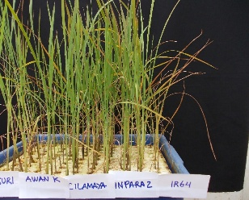
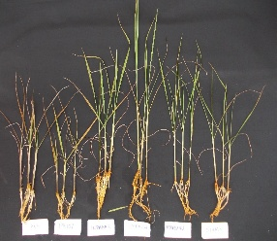
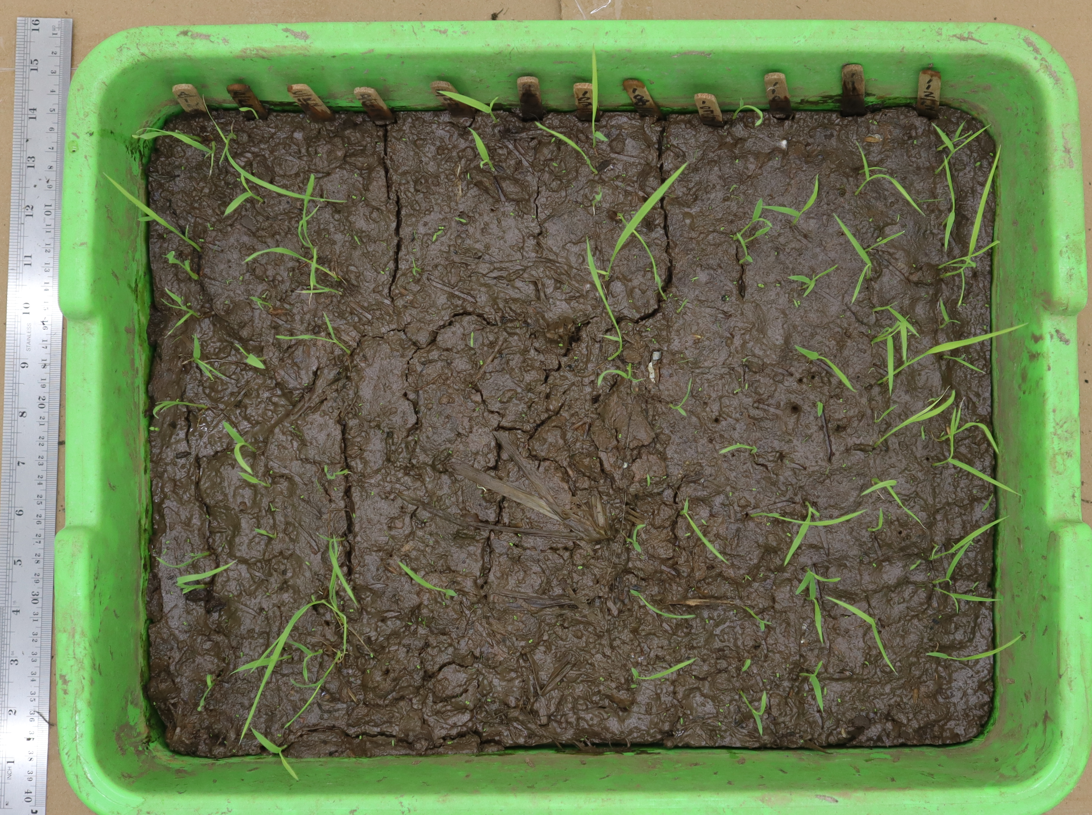
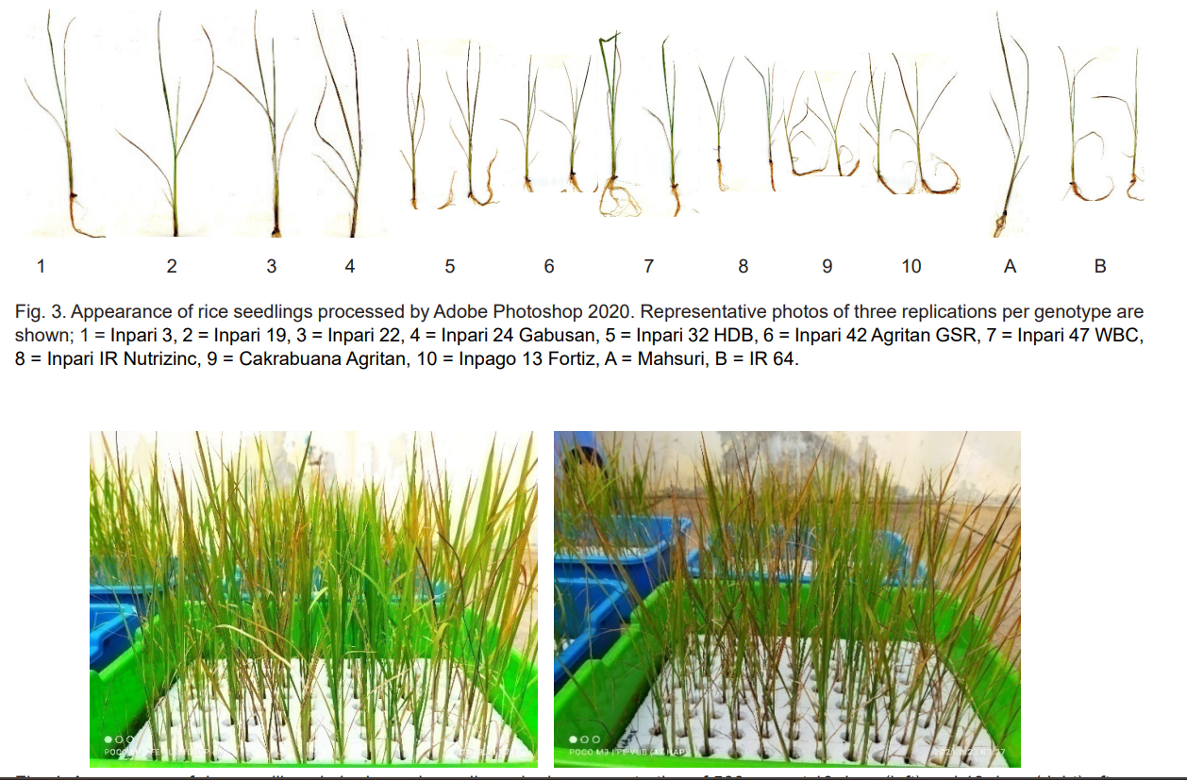
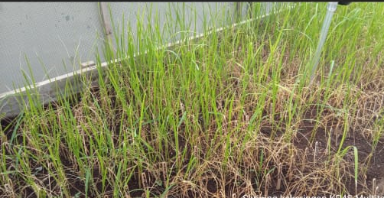
Current Status of Digital Phenotyping In Rice Breeding For Abiotic Stresses
Iron toxicity tolerance: to select tolerant breeding materials based on leaf bronzing (G/RGB)
An-aerobic germination + Submergence tolerance: to select tolerant breeding materials based on survival rate (G/RGB)
Camera/Scanner Capture
Image processing
Adobe Photoshop
Image J
Visual observation (scoring)
Quantitative data
Intensity of Red, Green, Blue
Ratio of Green per RGB
Qualitative data
Drought tolerance: to select tolerant breeding materials based on dry leaves (G/RGB)
Leaf bronzing of iron toxicity in hydroponic screening (Nugraha 2016; Sitaresmi 2022)
Tolerant and sensitive genotypes

Slide 13
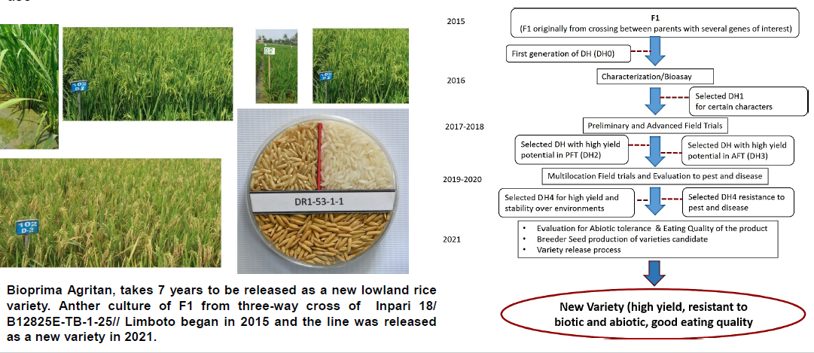
DH accelerating variety release

Slide 14
The Released of New Rice Varieties Developed
By Doubled Haploid Breeding
No. | Rice Variety | Year | Type | Ministerial Decree
1. | Bioemas Agritan | 2021 | Lowland | SK Mentan RI No. 171/HK.540/C/09/2021
2. | Bioprima Agritan | 2021 | Lowland | SK Mentan RI No. 171/HK.540/C/09/2021
3. | IPB 10G Tanimar | 2022 | Upland | SK Mentan RI No. 1830/HK.540/C/07/2022
4. | IPB 11S Bepe | 2023 | Lowland | SK Mentan RI No. 1235/HK.540/C/04/2023

Slide 15
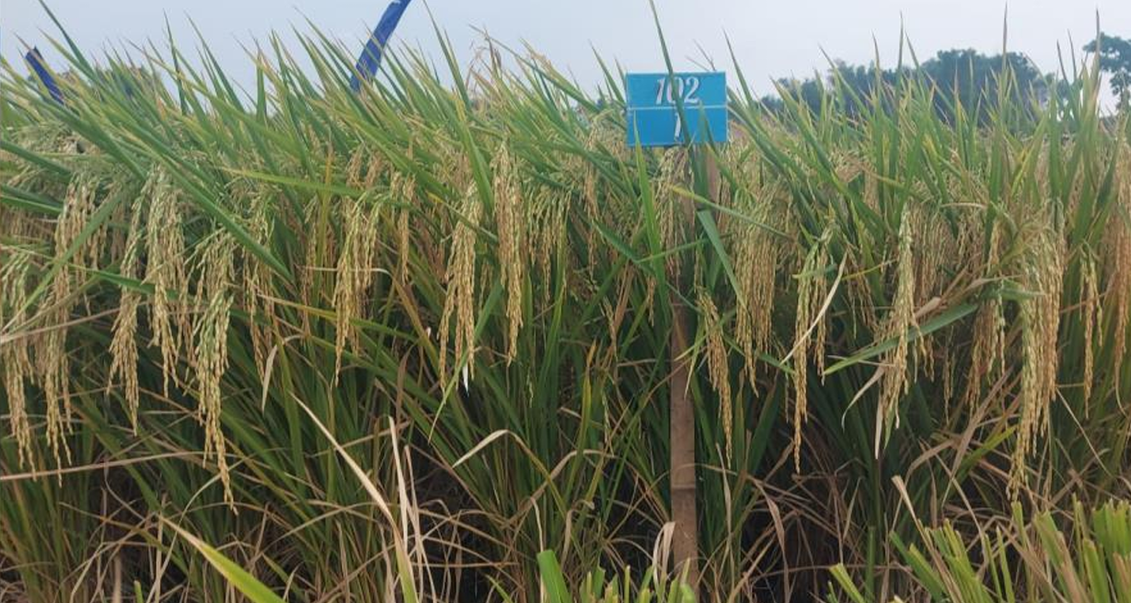
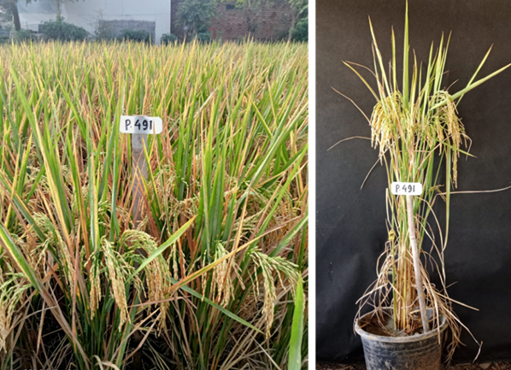
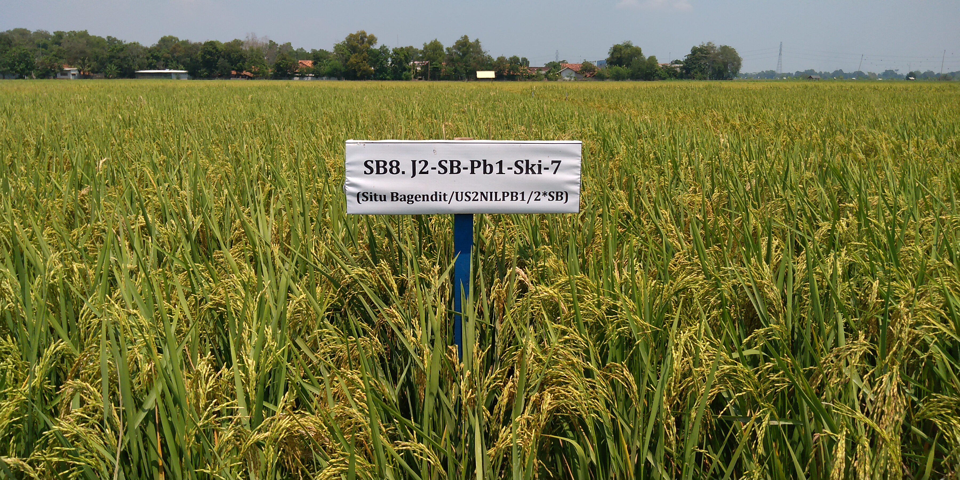
Anticipating Climate Extremes: Breeding Material Pipeline Release (2026-2027)
Super BRIN
Advantages : yield Potential: 10 t/ha, drought, salinity, submergence tolerances
Partner : West Java Seed Breeders Association (Asosiasi Penangkar Benih Jawa Barat).
Funding Sources : RIIM 3# (Research and Innovation for Advanced Indonesia, Batch 3), (Rumah Program 2024).
Padi Tahan Wereng Coklat
(Pareng)
Advantages : yield potential 10 t/ha (tons per hectare), resistant to the Brown Planthopper (BPH). Technology: Developed/engineered using DNA marker-assisted selection for the Bph6
Partner : PT Adi Jaya
Funding Source : Rumah Program 2023–2025.
Padi Ampibi Tahan Blas Leher (PaBlas)
Advantage : Yield Potential 10 t/ha. Resistant to neck blast disease (caused by Magnaporthe oryzae).Technology: Developed using DNA marker-assisted selection for the Pb1 gene (Panicle blast 1).
Partners: MoA, JIRCAS
Super BRIN
Pareng BRIN1
Pablas BRIN1

Slide 16
The legal basis that "covers why every variety should be released officially by the Ministry of Agriculture" is Law No. 22 of 2019 on Sustainable Agricultural Cultivation System, specifically Articles 22, 23, and 24.
This law aims to protect farmers, ensure food security, maintain quality, and prevent plant pest and disease spread.
Law No. 29/2000 (PVP Act) governs breeder's rights but does not mandate variety release; that mandate comes from the cultivation system law.
Policy and Regulatory Environment
Downstream Regulation for Food Crops Variety Release System :
Defines the requirements and procedures for a new variety to be officially released by the government.
Specifies that release is granted by the Minister of Agriculture upon recommendation from the Plant Variety Release Assessment Team (Tim Penilai Pelepasan Varietas).
Sets criteria for release: distinctness, uniformity, stability (DUS), and value for cultivation and use (VCU) – i.e., agronomic and economic merit.
Lists required documents (e.g., breeding history, description, test results).
Governs the timeframe for release decisions.

Slide 17
Breeder of Institution Releasing Variety : BRIN, Seed company, University, Local Government, Agency of Assemblies and Modernization(BRMP) - Ministry Agriculture
Nucleus Seed
If Breeding institution has seed production unit, they can produce breeder seed
Government institution use governmental budget (APBN)
If the institution doesn’t have seed production unit such as BRIN, some Universities, and some local governments. They make contractual agreements with professional seed grower, don’t use governmental budget
Breeder seed
Seed unit of Institution Releasing variety : Seed company, University, Agency of Assemblies and Modernization(BRMP) - Ministry Agriculture
Professional Seed Grower : Seed Grower company Class #1, Agency of Assemblies and Modernization (BRMP) - Ministry Agriculture, local government seed unit (BBI)
If Breeding institution has seed production unit they can produce Foundation seed
Government institution use governmental budget (APBN)
Institution Releasing variety : Private, University, Local Government or
Seed Grower Company Tier#1
Seed Grower Company Tier #1
Foundation seed
Seed Grower Company Tier# 1 or #2
Seed Grower Company Tier#1 or #2
Stock Seed
Seed Grower Company Tier#1, #2, #3
Extension Seed
Free Market/Commercial Seed (₋90%)
Buy/occupied by the Government for Seed Aid Program (₋10%)
Farmers

Slide 18
Growth Catalyst for Accerated Rice Breeding In Indonesia
Opportunity
Challenge
Definition within the Program
Government support | Strong political will from the Ministry of Agriculture, BRIN, and Universtiy through national food security programs and presidential directives on food security (AstaCita).
Regional collaboration (ASEAN) | Leverage ASEAN Plus Three (China, Japan, Korea) and ASEAN–IRRI cooperation for shared germplasm, genotyping platforms, and capacity building.
Private sector engagement | Partnerships with local seed companies (eg: Fiona, Adijaya , Semi) for commercial scale-up, distribution, and royalty-based licensing of elite lines.
Climate-smart agriculture demand | Rising farmer and consumer demand for climate smart variety– creating ready markets for accelerated outputs.
Definition within the Program
Funding limitations | Insufficient long-term, flexible budget for high-throughput genotyping, phenotyping, and speed breeding facilities
Infrastructure gaps | Controlled-environment growth chambers (for speed breeding), automated phenotyping platforms, and reliable cold chain for germplasm storage outside Java. (BRIN Under Provision)
Regulatory constraints | Biosafety hurdles for genome-edited varieties not covered by existing GMO regulations.
Human resources/Capacity limitations | Shortage of skilled plant breeders, bioinformaticians, and molecular biologists
Seed system issues | Poor adoption of new varieties beyond pilot areas.

Slide 19
Take Home Massage
Breed faster, release smarter — Cut variety development from 8–12 years to 3–5 years using modern tools (marker-assisted selection, speed breeding, gene editing).
Unlock partnerships, fix bottlenecks — Leverage government, ASEAN, and private sector support while addressing funding, infrastructure, and regulatory constraints.
Bridge lab to land — Strengthen seed systems to ensure climate-resilient, high-yielding rice reaches every farmer's field — at scale and on time.

Slide 20
Thank you

