Slide 1
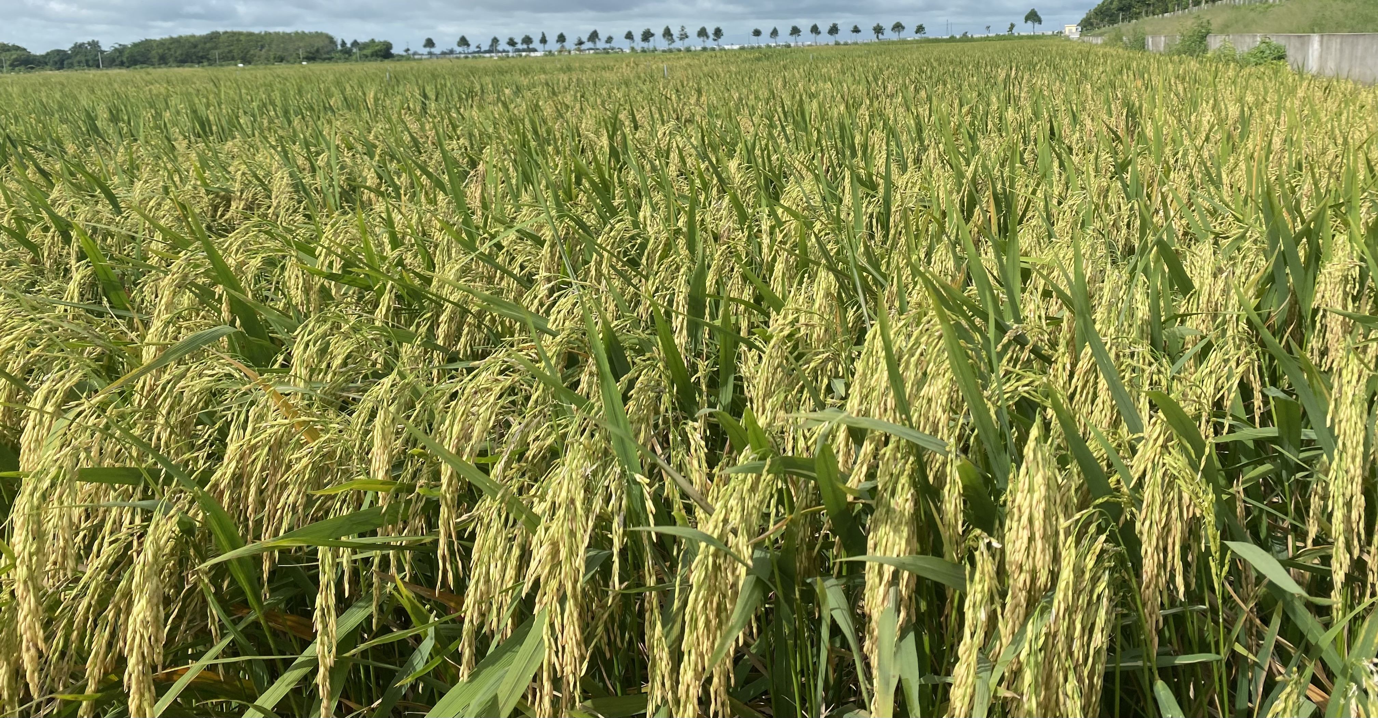
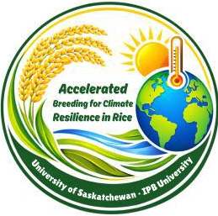
Accelerated Crop Breeding for Climate Resilience in Rice: Challenges and Opportunities
Opportunities and Challenges of Accelerated Breeding: the Case of Viet Nam
Presented by
Viet Nam Team
Bogor, 13-17/04/2026

Slide 2
Contents of presentation
  1. Viet Nam’s Current Context
  2. Status of Breeding Programs in Viet Nam
  3. Current Breeding Pipeline
  4. Accelerated Breeding
  5. Technologies in Use
  6. Infrastructure and Capacity
  7. Case Studies: Cuu Long Delta Rice Research Institute
  8. Opportunities
  9. Challenges
  10. Policy and Regulatory Environment
  11. Collaboration and Private Sector
  12. Future Vision (Toward 2030)
  13. Recommendations
  14. Key Takeaways

Slide 3
1. Viet Nam’s Current Context

Slide 4
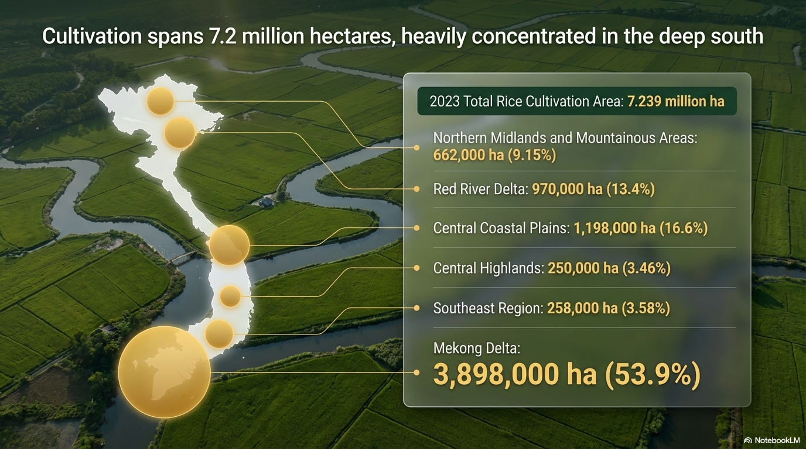
Agro-ecological zones
06 major agro-ecological zones
Viet Nam:
Spans over 1,650 km from North to South.
Divided into 6 major agro-ecological zones:
  Each zone presents distinct temperature regimes, rainfall patterns, soil types, and growing seasons.
  The Mekong Delta and Red River Delta are the two primary rice bowls.
  Central Highlands specializes in industrial crops such as coffee, pepper, and cashew.
1. Northern Midlands and Mountainous Areas
Northern Midlands and Mountainous Areas
2. Red River Delta
3. Central Coastal Plains
4. Central Highlands
5. Southeast Region
6. Mekong Delta
Notes:
Viet Nam spans over 1,650 km from north to south, creating diverse agro-ecological conditions.
The country is divided into 06 major agro-ecological zones: (1) Northern Midlands and Mountains, (2) Red River Delta, (3) Central Coastal Plains, (4) Central Highlands, (5) Southeast Region, and (6) Mekong River Delta.
Each zone presents distinct temperature regimes, rainfall patterns, soil types, and growing seasons.
The Mekong Delta and Red River Delta are the two primary rice bowls, while the Central Highlands specializes in industrial crops such as coffee, pepper, and cashew.

Slide 5


Major crops
Rice:
  >7.5 million hectares of cultivated area annually.
  Mekong Delta produces approximately 55-60% of the country's total rice output, yield of 5.5-6.3 t/ha.
Soybean: 50,000 hectares, average yield of 1.5-2.0 t/ha, major growing regions: Central highland, Southaest area, Mekong River Delta
Maize: 1.1 million hectares, concentrated in Northern Highlands and Central Coast.
Coffee: 650,000 hectares, primarily in Central Highlands.
  Viet Nam is the world's second-largest coffee exporter.
Cashew, pepper, and rubber: Significant export commodities.
Notes:
Major crops (focus on rice and other key commodities)
Rice is the most dominant crop, accounting for over 7.5 million hectares of cultivated area annually. The Mekong Delta alone produces approximately 55-60% of the country's total rice output, with an average yield of 5.5-6.0 tonnes per hectare. Beyond rice, major commodities include:
Maize: 1.1 million hectares, concentrated in northern highlands and Central Coast
Coffee: 650,000 hectares, primarily in Central Highlands (Viet Nam is the world's second-largest coffee exporter)
Cashew, pepper, and rubber: Significant export commodities
Vegetables and beans: Grown throughout the country, with increasing emphasis on high-value crops

Slide 6

Role of agriculture in economy
Food security: Viet Nam is a leading rice exporter, ranking among the top three globally.
Export earnings: Agricultural exports exceed $50 billion annually.
Rural livelihoods: Over 60% of the rural population depends directly on agricultural production.
Climate resilience: Agriculture is both vulnerable to and a solution for climate change impacts.
Notes:
Role of agriculture in economy
Agriculture remains a cornerstone of Viet Nam's economy, though its share of GDP has declined from nearly 40% in the 1990s to approximately 12-14% in 2025. However, the sector employs nearly 30-35% of the labor force, with smallholder farmers (average landholding of only 0.12-0.2 hectares per capita) constituting the majority. Agriculture is critical for:
Food security: Viet Nam is a leading rice exporter, ranking among the top three globally
Export earnings: Agricultural exports exceed $50 billion annually
Rural livelihoods: Over 60% of the rural population depends directly on agricultural production
Climate resilience: Agriculture is both vulnerable to and a solution for climate change impacts

Slide 7
2. Status of Breeding Programs in Viet Nam
Notes:
Key institutions involved in rice and other crop breeding (public and private)
Public Sector Institutions:
Viet Nam Academy of Agricultural Sciences (VAAS) : The premier national agricultural research institution, overseeing multiple specialized institutes
Field Crops Research Institute (FCRI) : Leads research on hybrid rice, biotechnology applications, and field crop breeding
Institute of Crops Research and Development (ICRD) , Viet Nam National University of Agriculture: Specializes in super hybrid rice varieties, high-quality inbred rice lines, and TGMS (thermo-sensitive genic male sterile) line development
Agricultural Science Institute for Southern Coastal Central (ASISOV) : Focuses on breeding rice, peanuts, beans, sesame, mango, cashew, and vegetables for coastal conditions
Cuu Long Delta Rice Research Institute (CLRRI) : Leading rice research institute in the Mekong Delta
Provincial agricultural extension centers and universities (Can Tho University, Hue University, Thai Nguyen University)

Slide 8
Key institutions involved in rice and other crop breeding
Public Sector Institutions:
Cuu Long Delta Rice Research Institute (CLRRI) : Leading rice research institute in the Mekong Delta, with total of 180 varieties released. OM18 (>1 million hectares), OM4900, OM8 are cultivated popular in Mekong Delta.
Field Crops Research Institute (FCRI) : Leads research on hybrid rice, biotechnology applications, and field crop breeding
Provincial agricultural extension centers and universities (Nong Lam University, Can Tho University, ...).
Notes:
Key institutions involved in rice and other crop breeding (public and private)
Public Sector Institutions:
Viet Nam Academy of Agricultural Sciences (VAAS) : The premier national agricultural research institution, overseeing multiple specialized institutes
Cuu Long Delta Rice Research Institute (CLRRI) : Leading rice research institute in the Mekong Delta
Field Crops Research Institute (FCRI) : Leads research on hybrid rice, biotechnology applications, and field crop breeding
Institute of Crops Research and Development (ICRD) , Viet Nam National University of Agriculture: Specializes in super hybrid rice varieties, high-quality inbred rice lines, and TGMS (thermo-sensitive genic male sterile) line development
Agricultural Science Institute for Southern Coastal Central (ASISOV) : Focuses on breeding rice, peanuts, beans, sesame, mango, cashew, and vegetables for coastal conditions
Provincial agricultural extension centers and universities (Can Tho University, Hue University, Thai Nguyen University)
Private Sector Institutions:
ThaiBinh Seed Group : One of Viet Nam's leading seed enterprises, with 33 plant varieties granted protection certificates and 28 varieties recognized as national varieties
Loc Troi Group : Major player in rice seed production and distribution
Syngenta Viet Nam, Bayer, and other multinational corporations active in hybrid seed development
Numerous small-to-medium seed companies (e.g., Trang Nong Seed, Vinaseed)
Rice breeding focus
Rice breeding in Viet Nam prioritizes the following traits:
High yield potential (targeting >8 tonnes/ha in Mekong Delta)
Grain quality (long-grain, aromatic varieties for export markets, e.g., Jasmine, ST25)
Biotic stress resistance (brown planthopper, blast disease, bacterial leaf blight)
Abiotic stress tolerance (salinity, drought, submergence/flooding)
Low-emission rice (varieties suited for sustainable, reduced-methane production systems)

Slide 9
Key institutions involved in rice and other crop breeding
Private Sector Institutions:
ThaiBinh Seed Group : One of Viet Nam's leading seed enterprises, with 28 varieties recognized as national varieties.
Loc Troi Group : Major player in rice seed production and distribution, e.g. OM5451, Lộc Trời 1, Lộc Trời 28,...
Southern Seed Corporation (SSC): DT8, OMCS2000, OMCS21,...
Notes:
Key institutions involved in rice and other crop breeding (public and private)
Public Sector Institutions:
Viet Nam Academy of Agricultural Sciences (VAAS) : The premier national agricultural research institution, overseeing multiple specialized institutes
Cuu Long Delta Rice Research Institute (CLRRI) : Leading rice research institute in the Mekong Delta
Field Crops Research Institute (FCRI) : Leads research on hybrid rice, biotechnology applications, and field crop breeding
Institute of Crops Research and Development (ICRD) , Viet Nam National University of Agriculture: Specializes in super hybrid rice varieties, high-quality inbred rice lines, and TGMS (thermo-sensitive genic male sterile) line development
Agricultural Science Institute for Southern Coastal Central (ASISOV) : Focuses on breeding rice, peanuts, beans, sesame, mango, cashew, and vegetables for coastal conditions
Provincial agricultural extension centers and universities (Can Tho University, Hue University, Thai Nguyen University)
Private Sector Institutions:
ThaiBinh Seed Group : One of Viet Nam's leading seed enterprises, with 33 plant varieties granted protection certificates and 28 varieties recognized as national varieties
Loc Troi Group : Major player in rice seed production and distribution
Syngenta Viet Nam, Bayer, and other multinational corporations active in hybrid seed development
Numerous small-to-medium seed companies (e.g., Trang Nong Seed, Vinaseed)
Rice breeding focus
Rice breeding in Viet Nam prioritizes the following traits:
High yield potential (targeting >8 tonnes/ha in Mekong Delta)
Grain quality (long-grain, aromatic varieties for export markets, e.g., Jasmine, ST25)
Biotic stress resistance (brown planthopper, blast disease, bacterial leaf blight)
Abiotic stress tolerance (salinity, drought, submergence/flooding)
Low-emission rice (varieties suited for sustainable, reduced-methane production systems)

Slide 10
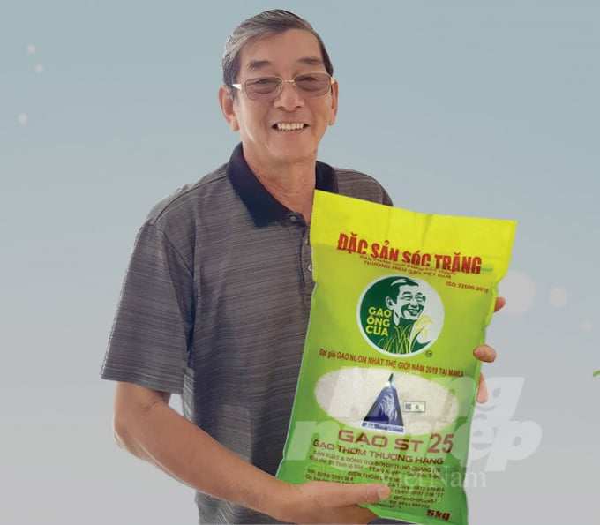
Key institutions involved in rice and other crop breeding
Small/medium seed companies: The ST25 (Wolrd’s Best Rice, 2019) was developed by a research team led by Ho Quang Cua through long-term breeding and selection programs in the Mekong Delta of Vietnam (Soc Trang province), and series of ST’s varieties start at ST10 (2000).
Long, slender grain; soft, slightly sticky texture after cooking; naturaly fragrant.
Notes:
Key institutions involved in rice and other crop breeding (public and private)
Public Sector Institutions:
Viet Nam Academy of Agricultural Sciences (VAAS) : The premier national agricultural research institution, overseeing multiple specialized institutes
Cuu Long Delta Rice Research Institute (CLRRI) : Leading rice research institute in the Mekong Delta
Field Crops Research Institute (FCRI) : Leads research on hybrid rice, biotechnology applications, and field crop breeding
Institute of Crops Research and Development (ICRD) , Viet Nam National University of Agriculture: Specializes in super hybrid rice varieties, high-quality inbred rice lines, and TGMS (thermo-sensitive genic male sterile) line development
Agricultural Science Institute for Southern Coastal Central (ASISOV) : Focuses on breeding rice, peanuts, beans, sesame, mango, cashew, and vegetables for coastal conditions
Provincial agricultural extension centers and universities (Can Tho University, Hue University, Thai Nguyen University)
Private Sector Institutions:
ThaiBinh Seed Group : One of Viet Nam's leading seed enterprises, with 33 plant varieties granted protection certificates and 28 varieties recognized as national varieties
Loc Troi Group : Major player in rice seed production and distribution
Syngenta Viet Nam, Bayer, and other multinational corporations active in hybrid seed development
Numerous small-to-medium seed companies (e.g., Trang Nong Seed, Vinaseed)
Rice breeding focus
Rice breeding in Viet Nam prioritizes the following traits:
High yield potential (targeting >8 tonnes/ha in Mekong Delta)
Grain quality (long-grain, aromatic varieties for export markets, e.g., Jasmine, ST25)
Biotic stress resistance (brown planthopper, blast disease, bacterial leaf blight)
Abiotic stress tolerance (salinity, drought, submergence/flooding)
Low-emission rice (varieties suited for sustainable, reduced-methane production systems)

Slide 11
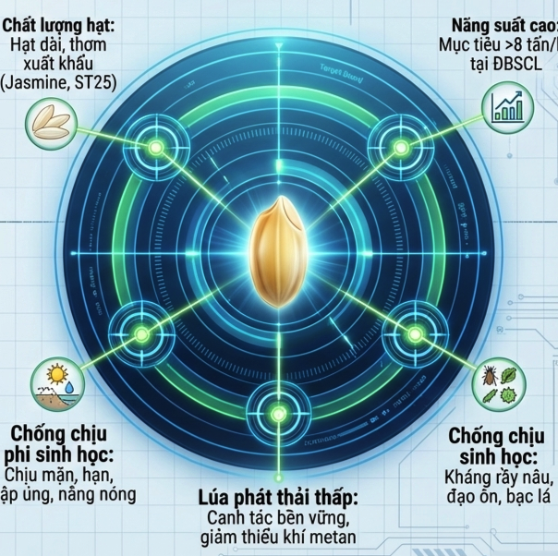
Rice breeding focus
1. High yield potential:
Targeting >8 t/ha in Mekong Delta
5. Low-emission rice:
varieties suited for sustainable, reduced-methane production systems
CH4
4. Abiotic stress tolerance:
Salinity, drought, submergence, heat
2. Grain quality:
long-grain, aromatic varieties for export markets
(Jasmine, ST25).
3. Biotic stress resistance:
Brown planthopper, blast disease, bacterial leaf blight
Notes:
Key institutions involved in rice and other crop breeding (public and private)
Public Sector Institutions:
Viet Nam Academy of Agricultural Sciences (VAAS) : The premier national agricultural research institution, overseeing multiple specialized institutes
Cuu Long Delta Rice Research Institute (CLRRI) : Leading rice research institute in the Mekong Delta
Field Crops Research Institute (FCRI) : Leads research on hybrid rice, biotechnology applications, and field crop breeding
Institute of Crops Research and Development (ICRD) , Viet Nam National University of Agriculture: Specializes in super hybrid rice varieties, high-quality inbred rice lines, and TGMS (thermo-sensitive genic male sterile) line development
Agricultural Science Institute for Southern Coastal Central (ASISOV) : Focuses on breeding rice, peanuts, beans, sesame, mango, cashew, and vegetables for coastal conditions
Provincial agricultural extension centers and universities (Can Tho University, Hue University, Thai Nguyen University)
Private Sector Institutions:
ThaiBinh Seed Group : One of Viet Nam's leading seed enterprises, with 33 plant varieties granted protection certificates and 28 varieties recognized as national varieties
Loc Troi Group : Major player in rice seed production and distribution
Syngenta Viet Nam, Bayer, and other multinational corporations active in hybrid seed development
Numerous small-to-medium seed companies (e.g., Trang Nong Seed, Vinaseed)
Rice breeding focus
Rice breeding in Viet Nam prioritizes the following traits:
High yield potential (targeting >8 tonnes/ha in Mekong Delta)
Grain quality (long-grain, aromatic varieties for export markets, e.g., Jasmine, ST25)
Biotic stress resistance (brown planthopper, blast disease, bacterial leaf blight)
Abiotic stress tolerance (salinity, drought, submergence/flooding)
Low-emission rice (varieties suited for sustainable, reduced-methane production systems)

Slide 12
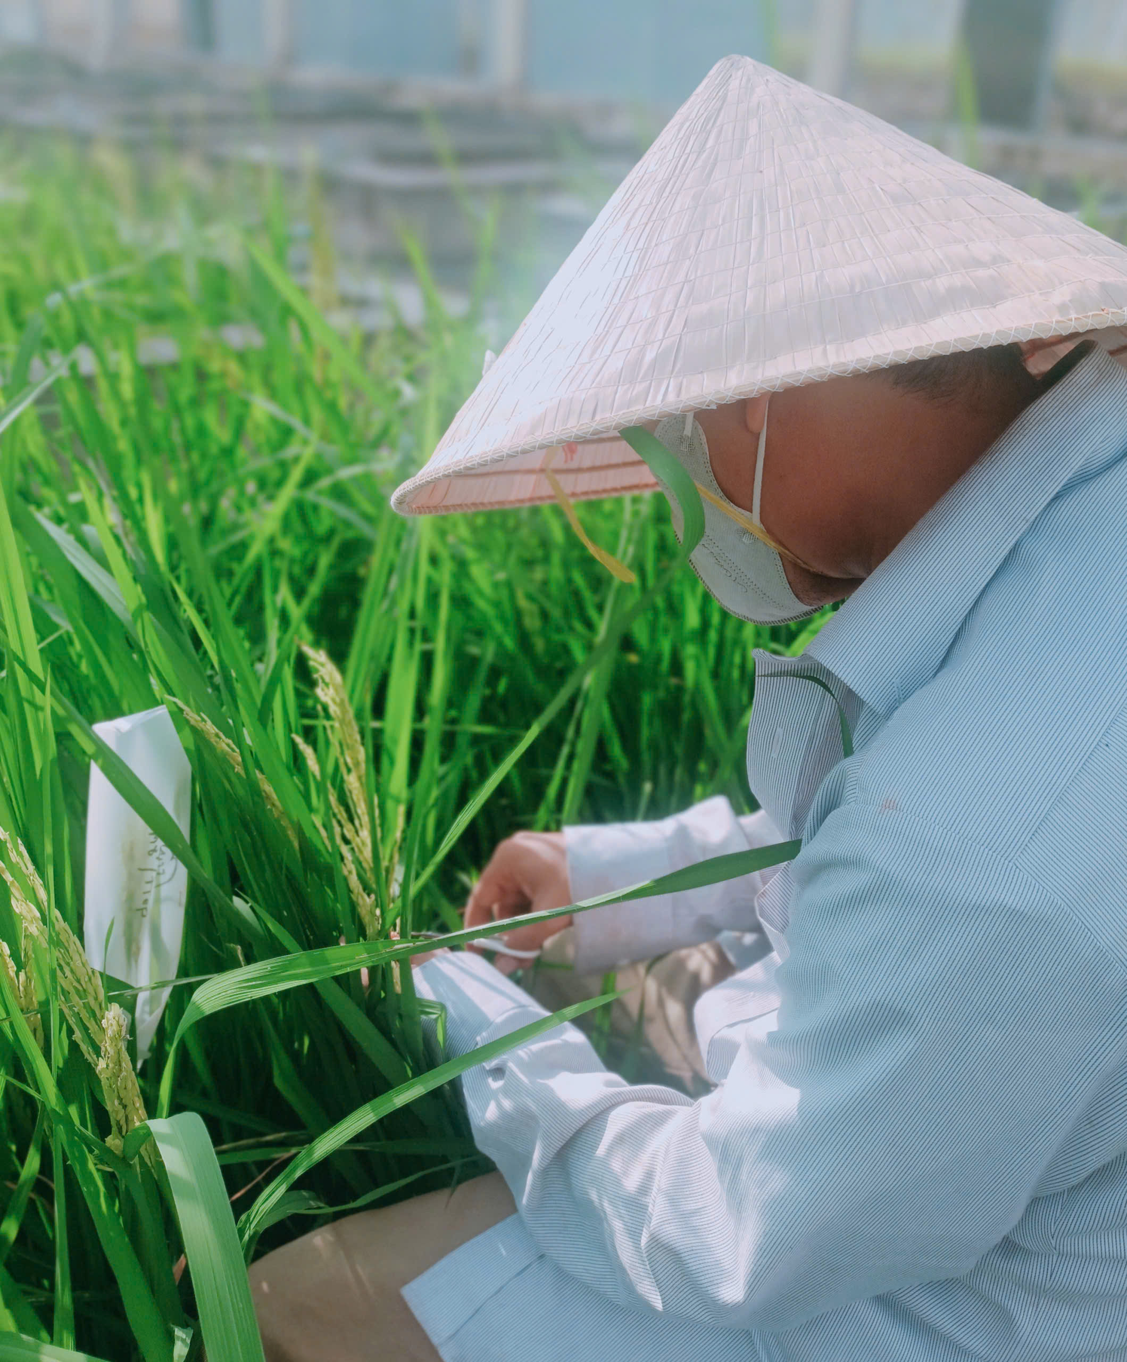

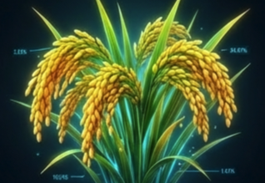
Current approaches of breeding
Conventional Breeding (dominant approach):
  Most breeding programs (cross-hybridization, pedigree, Bulk, SSD).
  Generation cycles typically take 6-7 years from crossing to release.
Molecular Approaches (Widespread used):
  MAS and MABC are increasingly used.
  Adoption remains limited to well-funded programs.
Hybrid Rice Technology (significant success):
  Viet Nam has made substantial progress in hybrid rice, with two-line and three-line hybrid systems developed locally.
Notes:
Current approaches of breeding (conventional, molecular, hybrid)
Conventional Breeding (dominant approach) : Most breeding programs still rely primarily on traditional methods including cross-hybridization, pedigree selection, and bulk population breeding. Generation cycles typically take 8-10 years from crossing to variety release.
Molecular Approaches (limited but growing) : Marker-Assisted Selection (MAS) and Marker-Assisted Backcrossing (MABC) are increasingly used, particularly in public research institutes for introgressing major genes (e.g., salinity tolerance, blast resistance). However, adoption remains limited to well-funded programs.
Hybrid Rice Technology (significant success) : Viet Nam has made substantial progress in hybrid rice, with two-line and three-line hybrid systems developed locally. ICRD has released numerous hybrid varieties including TH3-3, TH3-4, Viet Lai 20, and Viet Lai 50. Hybrid rice accounts for an estimated 25-30% of total rice area in favorable regions.

Slide 13
3. Current Breeding Pipeline

Slide 14
Variety development timeline
Stage | Duration (year) | Description
Crossing and F1 generation | 1st | Parental selection and hybridization
F2-F5 generation (segregating populations) | 2-3th | Pedigree selection, line fixation
Preliminary yield trials | 4th | Multi-location testing (3 sites, 2 crops)
National Testing System (NTS) |  | Official testing across 1-3 sites/1 ecological zone
DUS (Distinctness, Uniformity, Stability) testing | 5-6th | 2 crops the same season
VCU (Value for Cultivation and Use) testing | 5-6th | 3 crops-Replicated field trials 2 crops-On-farm test 1 crop-Control test (Brown planthopper, Bacterial leaf blight, Rice blast disease)
Variety release and certification | 7th year | Review and approval by MAE
Notes:
Variety development timeline
The conventional breeding pipeline in Viet Nam typically follows this timeline:
StageDurationDescriptionCrossing and F1 generation1 yearParental selection and hybridizationF2-F5 generation (segregating populations)3-4 yearsPedigree selection, line fixationPreliminary yield trials1-2 yearsMulti-location testing (2-3 sites)National Variety Testing (NVT)2-3 yearsOfficial testing across 4-6 ecological zonesDUS (Distinctness, Uniformity, Stability) and VCU (Value for Cultivation and Use) testing1-2 yearsConcurrent with NVTVariety release and certification1 yearReview and approval by Ministry of MARD
Total: 8-10 years from initial cross to commercial release under optimal conditions.

Slide 15
Minimum number of trial sites per region
Agro-ecological zones | Replicated field trials | On-farm test
1. Northern Midlands and Mountainous | 2 | 2
2. Red River Delta | 2 | 2
3. Central Coastal Plains | 2 | 2
4. Central Highlands | 2 | 2
5. Southeast Region | 1 | 1
6. Mekong Delta | 3 | 3
Notes:
Variety development timeline
The conventional breeding pipeline in Viet Nam typically follows this timeline:
StageDurationDescriptionCrossing and F1 generation1 yearParental selection and hybridizationF2-F5 generation (segregating populations)3-4 yearsPedigree selection, line fixationPreliminary yield trials1-2 yearsMulti-location testing (2-3 sites)National Variety Testing (NVT)2-3 yearsOfficial testing across 4-6 ecological zonesDUS (Distinctness, Uniformity, Stability) and VCU (Value for Cultivation and Use) testing1-2 yearsConcurrent with NVTVariety release and certification1 yearReview and approval by Ministry of MARD
Total: 8-10 years from initial cross to commercial release under optimal conditions.

Slide 16
Variety development timeline
Stage | Duration (year) | Description
Crossing and F1 generation | 1st | Parental selection and hybridization
F2-F5 generation (segregating populations) | 2-3th | Pedigree selection, line fixation
Preliminary yield trials | 4th | Multi-location testing (3 sites, 2 crops)
National Testing System (NTS) |  | Official testing across 1-3 sites/1 ecological zone
DUS (Distinctness, Uniformity, Stability) testing | 5-6th | 2 crops the same season
VCU (Value for Cultivation and Use) testing | 5-6th | 3 crops-Replicated field trials 2 crops-On-farm test 1 crop-Control test (Brown planthopper, Bacterial leaf blight, Rice blast disease)
Variety release and certification | 7th year | Review and approval by MAE
Notes:
Variety development timeline
The conventional breeding pipeline in Viet Nam typically follows this timeline:
StageDurationDescriptionCrossing and F1 generation1 yearParental selection and hybridizationF2-F5 generation (segregating populations)3-4 yearsPedigree selection, line fixationPreliminary yield trials1-2 yearsMulti-location testing (2-3 sites)National Variety Testing (NVT)2-3 yearsOfficial testing across 4-6 ecological zonesDUS (Distinctness, Uniformity, Stability) and VCU (Value for Cultivation and Use) testing1-2 yearsConcurrent with NVTVariety release and certification1 yearReview and approval by Ministry of MARD
Total: 8-10 years from initial cross to commercial release under optimal conditions.

Slide 17
CLRRI breeding pipeline
Step 1. The best lines (Pedigree selection, line fixation)
)
Evaluation by breeders
Step 2. Preliminary assessment (2 crops)
Step 3. Multi-Environment Testing (2 crops)
Evaluation by Department of Crop Production (MAE) (2-3 years)
Step 4. VCU and DUS testing and varietal registration
VCU (small-scale: 3 crops; wide-scale: 2 crop)
Biotic stresses test (BPH, BLB, Blast) (mandatory 1 season)
DUS
(2 crops in Summer-Autumn season)
Step 5. Submitted report and certificate for releasing new varieties (1-3 months)

Slide 18
Case of CLRRI
Results:
From 1991- 2023: 81 varieties released
In 2020: 11 varieties
In 2023: 1 variety
No. | Variety Name | Year released | Key traits
 |  |  | Tolerance to Abiotic stresses | Resistance to Biotic stresses
1 | OM18 | 2019 | Salt tolerance (3-4 ‰ ) | Blast (level 2)
2 | OM9915 | 2019 | Good salinity tolerant | Blast and BPH (Level 3)
3 | OM232 | 2019 | Salt tolerance (3-4 ‰ ) | Blast (level 2)

Slide 19
Total generations/cycles per year
Conventional breeding: 1-2 generations per year in most regions.
Off-season nurseries: Some institutes utilize Winter-Spring and Summer-Autumn seasons to achieve 2 generations annually.
Speed breeding: Currently in pilot/experimental stages, not yet operational at scale.
Notes:
Total generations (cycles) per year
Conventional breeding: 1-2 generations per year in most regions
Off-season nurseries: Some institutes utilize winter-spring and summer-autumn seasons to achieve 2 generations annually
Shuttle breeding: Limited use of north-south shuttle (Hanoi to Mekong Delta) to achieve 2-3 generations
Speed breeding: Currently in pilot/experimental stages, not yet operational at scale

Slide 20
Key bottlenecks
Slow generation turnover: Only 1-2 cycles per year limits genetic gain.
Lengthy variety release system: Regulatory process adds 2-3 years beyond technical readiness.
Limited phenotyping capacity: Field evaluation relies on visual scoring rather than high-throughput digital systems.
Data management: Fragmented record-keeping, limited use of breeding software.
Underfunded public breeding programs: Insufficient operational budgets for multi-location testing.
Weak seed multiplication pipeline: Slow transition from breeder seed to certified seed.
Notes:
Total generations (cycles) per year
Conventional breeding: 1-2 generations per year in most regions
Off-season nurseries: Some institutes utilize winter-spring and summer-autumn seasons to achieve 2 generations annually
Shuttle breeding: Limited use of north-south shuttle (Hanoi to Mekong Delta) to achieve 2-3 generations
Speed breeding: Currently in pilot/experimental stages, not yet operational at scale

Slide 21
4. Accelerated Breeding

Slide 22
The strategic integration of modern technologies and optimized workflows to shorten the variety development cycle from 6-7 years to 4-5 years.

Slide 23
In Viet Nam’s context
This encompasses:
Rapid generation advancement (speed breeding, off-season nurseries).
Molecular precision (MAS, genomic selection).
Digital phenotyping (remote sensing/drone, automated data capture).
Streamlined regulatory pathways (simplified testing for gene-edited varieties).
Notes:
Definition in country context. Consideration of accelerated genetic gain.
In Viet Nam's context, accelerated breeding refers to the strategic integration of modern technologies and optimized workflows to shorten the variety development cycle from 8-10 years to 4-6 years while simultaneously increasing the rate of genetic gain for priority traits. This concept encompasses:
Rapid generation advancement (speed breeding, off-season nurseries)
Molecular precision (MAS, genomic selection)
Digital phenotyping (remote sensing, automated data capture)
Streamlined regulatory pathways (simplified testing for gene-edited varieties)
Accelerated genetic gain (ΔG = σG × i × r / L) focuses on reducing cycle length (L) and increasing selection intensity (i) and accuracy (r) through modern tools.

Slide 24
Why it is important
Climate urgency:
Faster breeding is essential to develop and deploy salinity, drought, submergence, and heat tolerant varieties in the context of severe climate change.
Food security:
In the context of the increasing population, urbanization, and industrialization. Accelerated breeding can maintain or increase productivity on less land.
Economic competitiveness:
High-quality, climate-resilient rice varieties developed faster provide a competitive edge.
Farmer livelihoods:
Smallholder farmers (0.12-0.2 ha average) need varieties that perform reliably under variable conditions to ensure income stability.
Notes:
Definition in country context. Consideration of accelerated genetic gain.
In Viet Nam's context, accelerated breeding refers to the strategic integration of modern technologies and optimized workflows to shorten the variety development cycle from 8-10 years to 4-6 years while simultaneously increasing the rate of genetic gain for priority traits. This concept encompasses:
Rapid generation advancement (speed breeding, off-season nurseries)
Molecular precision (MAS, genomic selection)
Digital phenotyping (remote sensing, automated data capture)
Streamlined regulatory pathways (simplified testing for gene-edited varieties)
Accelerated genetic gain (ΔG = σG × i × r / L) focuses on reducing cycle length (L) and increasing selection intensity (i) and accuracy (r) through modern tools.

Slide 25
5. Technologies in Use

Slide 26
Technology | Adoption Level | Status in Viet Nam
Marker-Assisted Selection (MAS) | Widespread adoption | Widespread adoption in public institutes (CLRRI, FCRI, ASISOV) for major genes (salinity tolerance Saltol, submergence Sub1, blast resistance Pi genes, BPH resistance). Private sector (ThaiBinh Seed) applying molecular biotechnology.
Digital phenotyping | Limited adoption | Early adoption. Drone technology demonstrated for seed sowing and fertilizer application. Some remote sensing research for crop monitoring. Not yet routine in breeding programs.
Doubled Haploids (DH) | Limited adoption | Limited research at institutes and some universities. Not yet integrated into mainstream breeding pipelines. Anther culture techniques available but low efficiency.
Speed Breeding – climate control | Not used/Pilot only | Experimental/pilot stage only. Few growth chambers available; no operational speed breeding protocols for rice or other crops. Major infrastructure gap.
Genomic Selection (GS) | Not used/Pilot only | Minimal adoption. Some research projects are exploring GS models, but no operational implementation.
Notes:
Indicate level of adoption (scale: 1 = Not used / Pilot only, 2 = Limited adoption, 3 = Moderate adoption, 4 = Widespread adoption, 5 = Fully integrated):

Slide 27
6. Infrastructure and Capacity

Slide 28
Labs, field facilities, growth chambers
Current status:
Centralized biotechnology laboratories with basic molecular marker capabilities.
Greenhouse, net house facilities and experimental stations at major research institutes (CLRRI, FCRI, ICRD,…).
Gaps:
Severe shortage of controlled-environment growth chambers for speed breeding.
Limited high-throughput genotyping platforms.
Minimal investment in automated phenotyping (imaging, spectral sensors, robotics).
Aging infrastructure at many public breeding stations.
Notes:
Labs, field facilities, growth chambers
Strengths:
Centralized biotechnology laboratories at VAAS, FCRI, ICRD with basic molecular marker capabilities
Greenhouse and net house facilities at major research institutes
Experimental stations totaling approximately 90 hectares at ASISOV alone
ThaiBinh Seed investing in modernized labs, net houses, and experimental areas for salinity/drought/heat screening
Gaps:
Severe shortage of controlled-environment growth chambers for speed breeding (most institutes have 0-2 chambers)
Limited high-throughput genotyping platforms
Minimal investment in automated phenotyping (imaging, spectral sensors, robotics)
Aging infrastructure at many public breeding stations
Inadequate cold storage for germplasm conservation

Slide 29
Skilled human resources
Current status:
Strong foundational training in plant breeding at universities ( Nong Lam University, Can Tho University, Hue University).
A growing number of young scientists with overseas PhD training.
Gaps:
Severe shortage of bioinformaticians, data scientists, and quantitative geneticists.
Limited expertise in genomic selection, speed breeding protocols, and advanced molecular techniques.
Brain drain from the public to the private sector and overseas.
Limited English proficiency for international collaboration.
Notes:
Labs, field facilities, growth chambers
Strengths:
Centralized biotechnology laboratories at VAAS, FCRI, ICRD with basic molecular marker capabilities
Greenhouse and net house facilities at major research institutes
Experimental stations totaling approximately 90 hectares at ASISOV alone
ThaiBinh Seed investing in modernized labs, net houses, and experimental areas for salinity/drought/heat screening
Gaps:
Severe shortage of controlled-environment growth chambers for speed breeding (most institutes have 0-2 chambers)
Limited high-throughput genotyping platforms
Minimal investment in automated phenotyping (imaging, spectral sensors, robotics)
Aging infrastructure at many public breeding stations
Inadequate cold storage for germplasm conservation

Slide 30
Data storage infrastructure, systems and tools
Current status:
Fragmented, paper-based or Excel-based record-keeping in most breeding programs.
Limited use of specialized breeding software (e.g., Fieldbook).
Gaps:
No cloud-based or shared data infrastructure across institutions.
Poor data standardization and interoperability.
Minimal investment in field data capture tools (tablets, barcode scanners).
Lack of data management policies and trained personnel.
Notes:
Labs, field facilities, growth chambers
Strengths:
Centralized biotechnology laboratories at VAAS, FCRI, ICRD with basic molecular marker capabilities
Greenhouse and net house facilities at major research institutes
Experimental stations totaling approximately 90 hectares at ASISOV alone
ThaiBinh Seed investing in modernized labs, net houses, and experimental areas for salinity/drought/heat screening
Gaps:
Severe shortage of controlled-environment growth chambers for speed breeding (most institutes have 0-2 chambers)
Limited high-throughput genotyping platforms
Minimal investment in automated phenotyping (imaging, spectral sensors, robotics)
Aging infrastructure at many public breeding stations
Inadequate cold storage for germplasm conservation

Slide 31
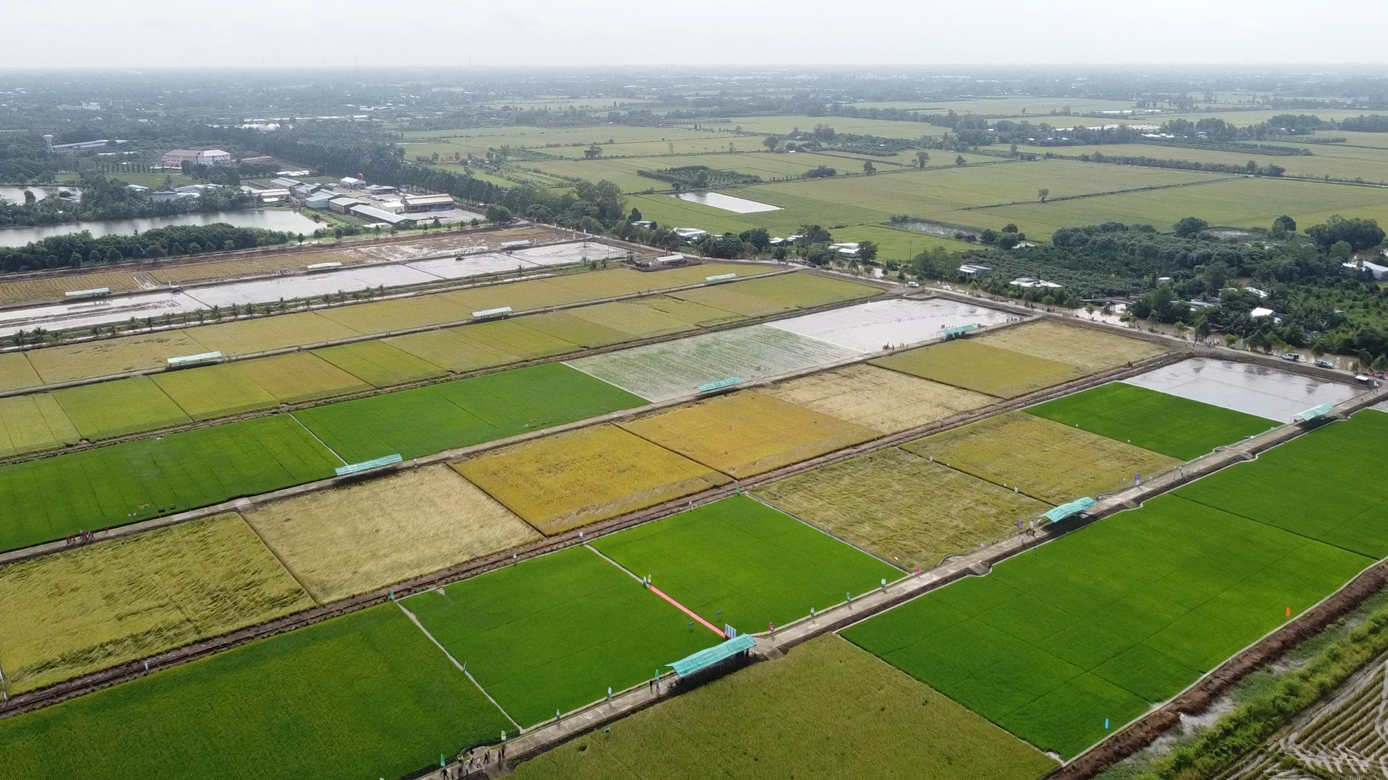
Typical example: CLRRI’s Infrastructures
Total area: 360 ha
Total: 130 official staffs
27 PhD
57 Graduates
35 Undergraduates
11 Technical staffs

Slide 32



Nong Lam University - Ho Chi Minh City
NLU-HCMC has 13 faculties
804
> 60%
Lecturers, Researchers and Office Staff
Holders of Post
graduate degree
26.000
33
Students
International partners
Humanity - Service - Innovation - Integration
nlu.edu.vn

Slide 33
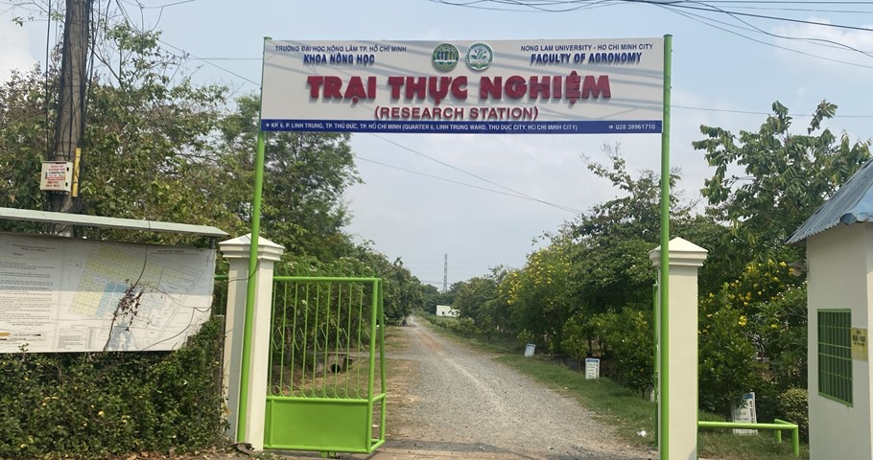
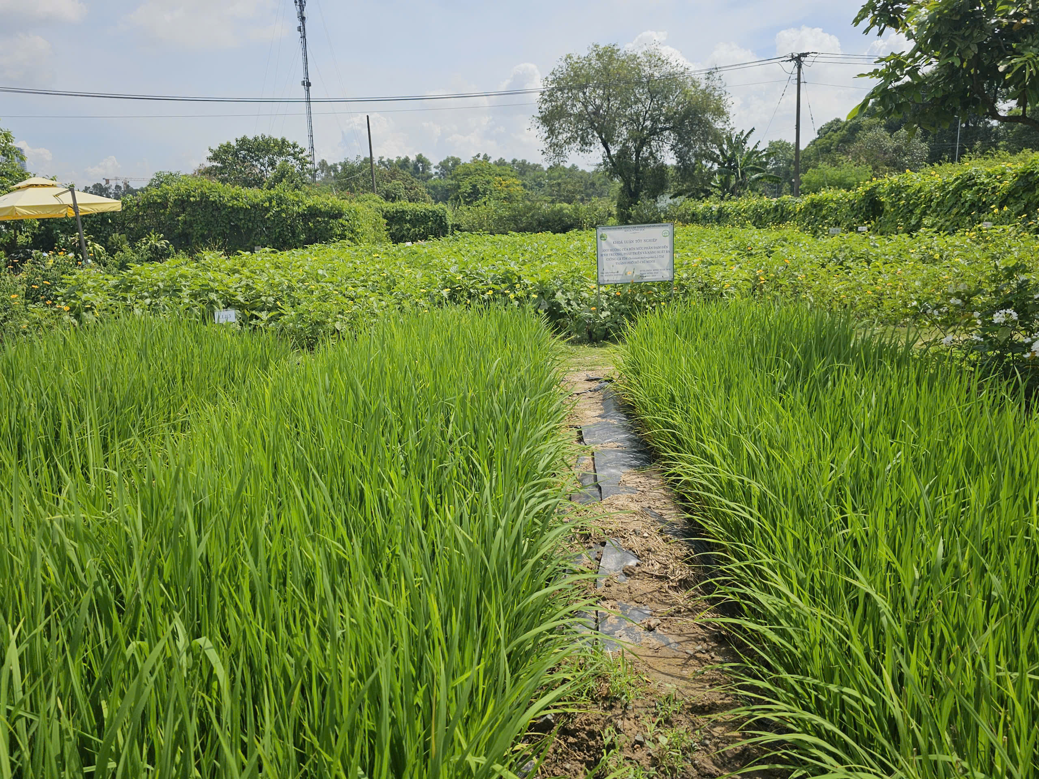
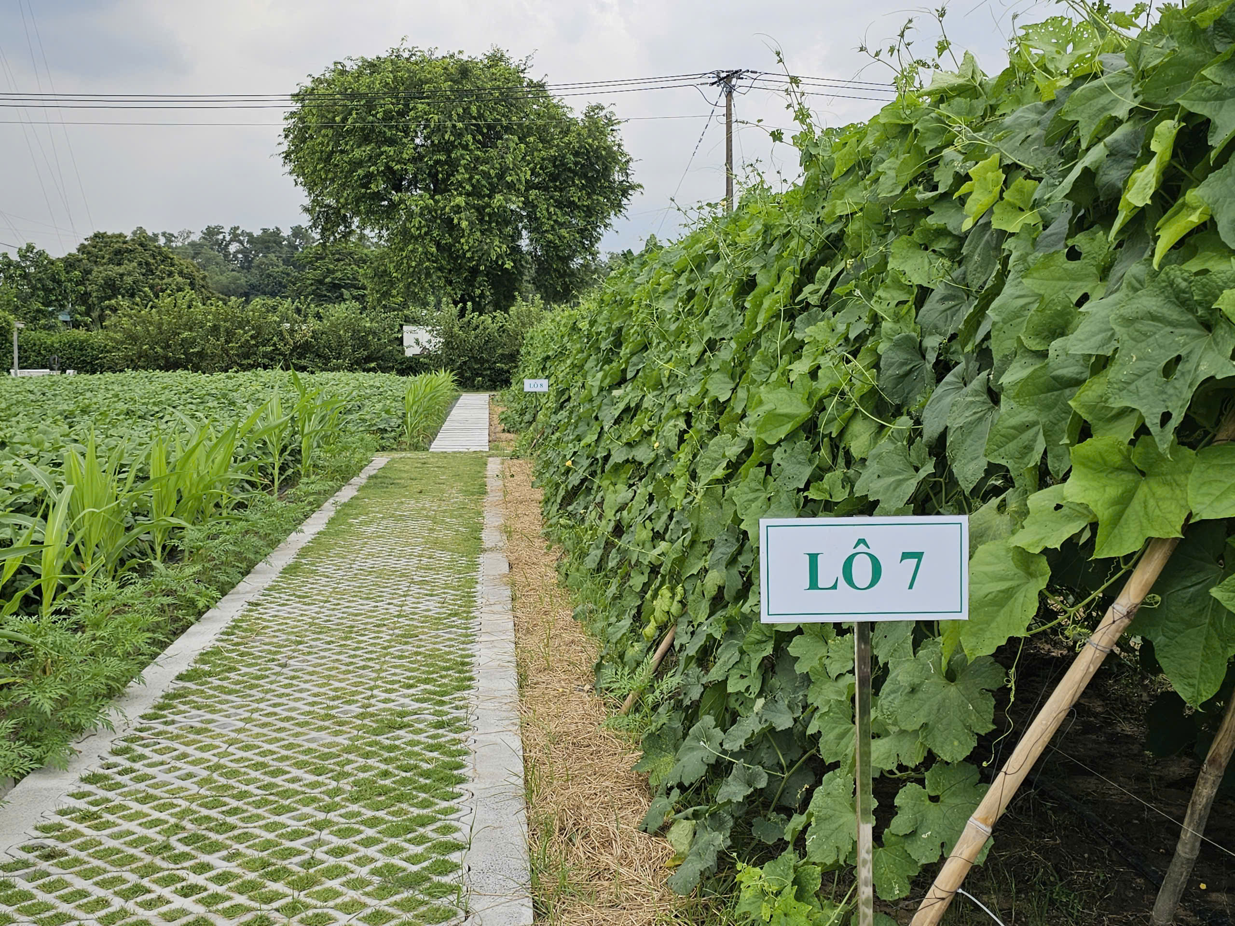
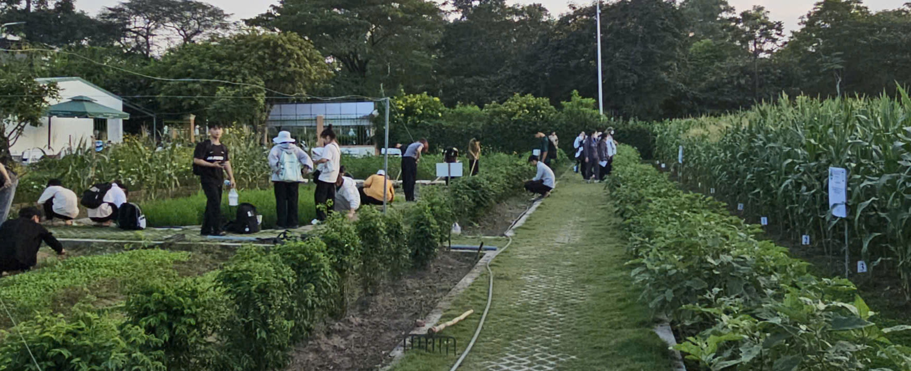
Facilities and Infrastructures of Agronomy Faculty
Crop Sciences - Plant Protection
- Total area of 10 hectares;
- 3,000 m² of high-tech greenhouse facilities;
- Breeding area;
- Organic fertilizer production area;
- Plant protection experimental area;
- And crop research trial fields.
Experimental station

Slide 34
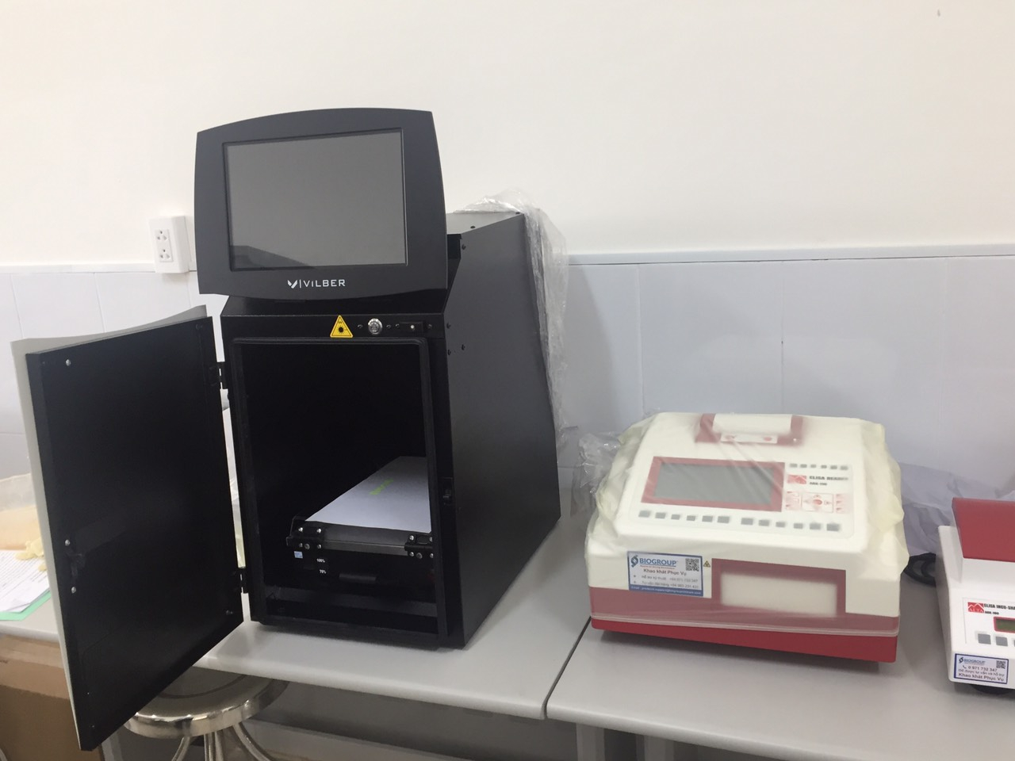
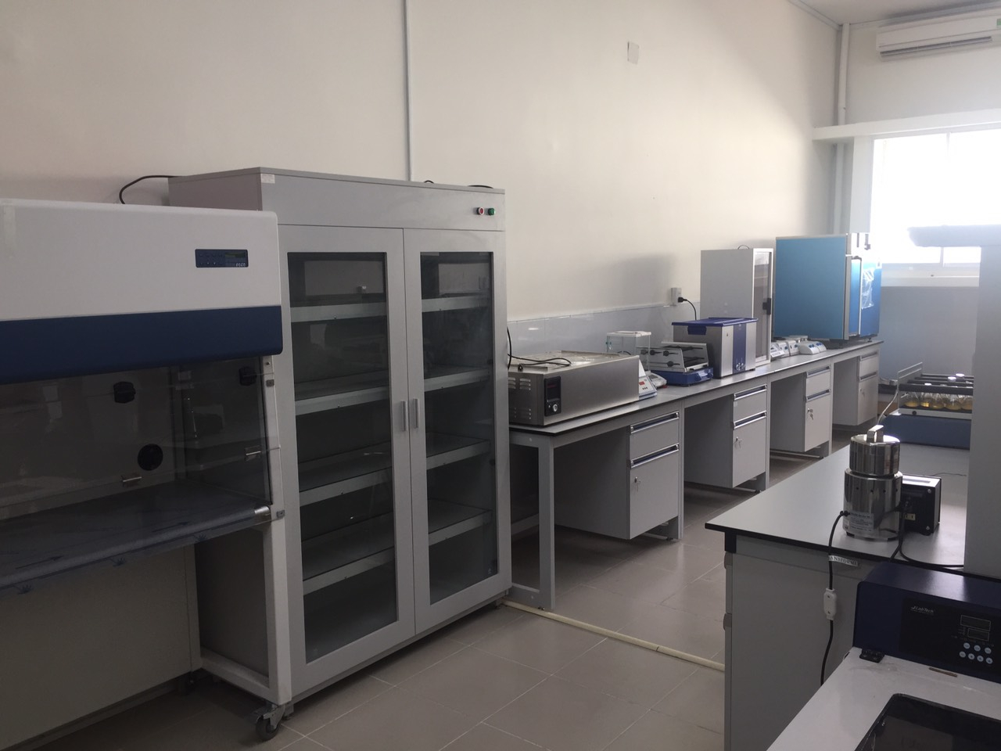
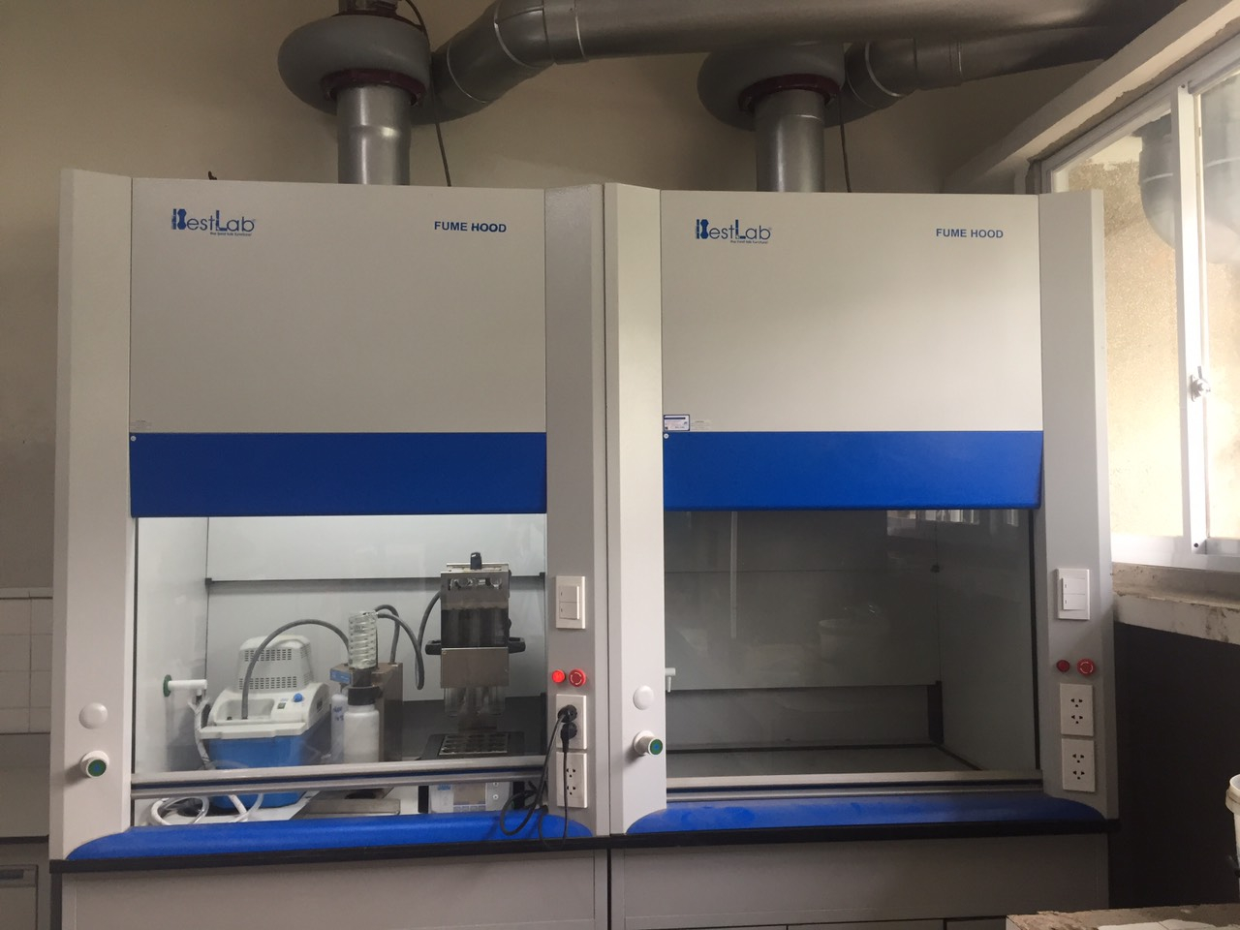
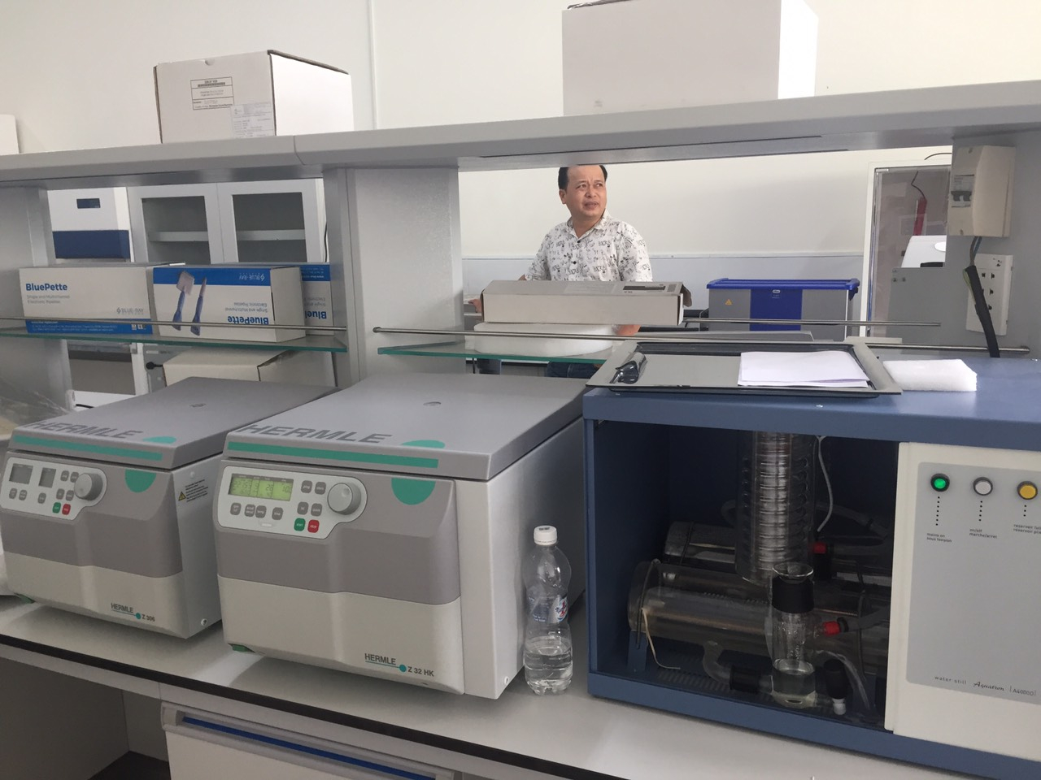
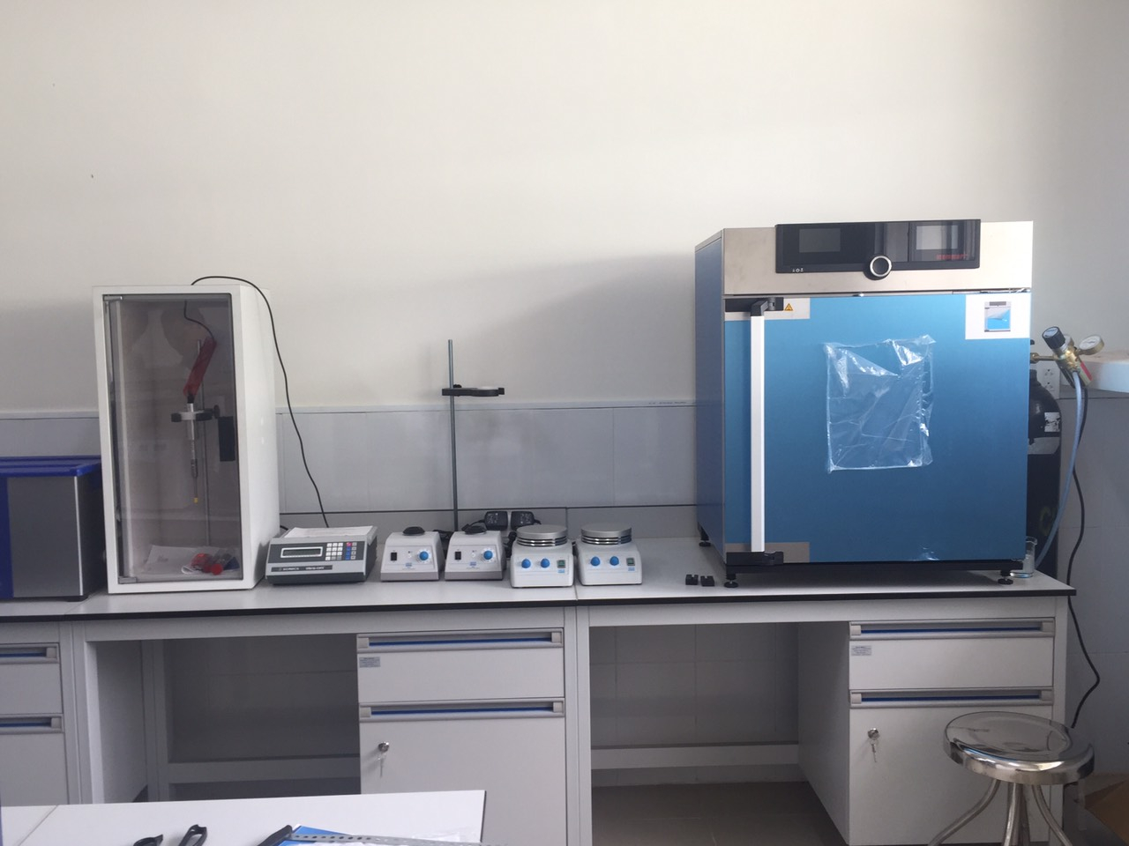
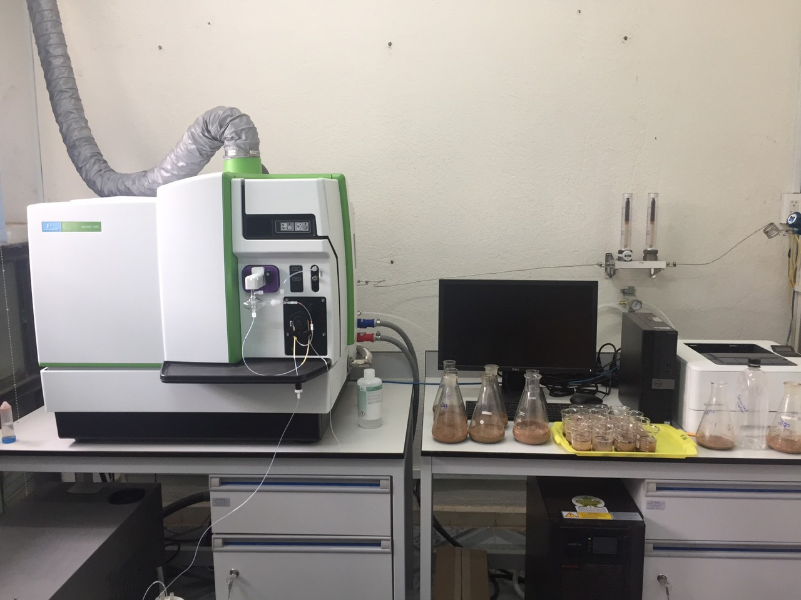
Facilities and Infrastructures
Molecular Biology Lab.

Slide 35
7. Case Studies: Breeding programs at Cuu Long Delta Rice Research Institute

Slide 36
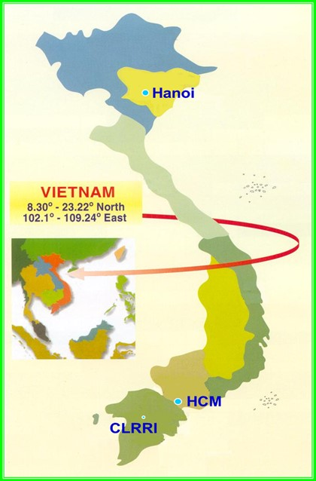
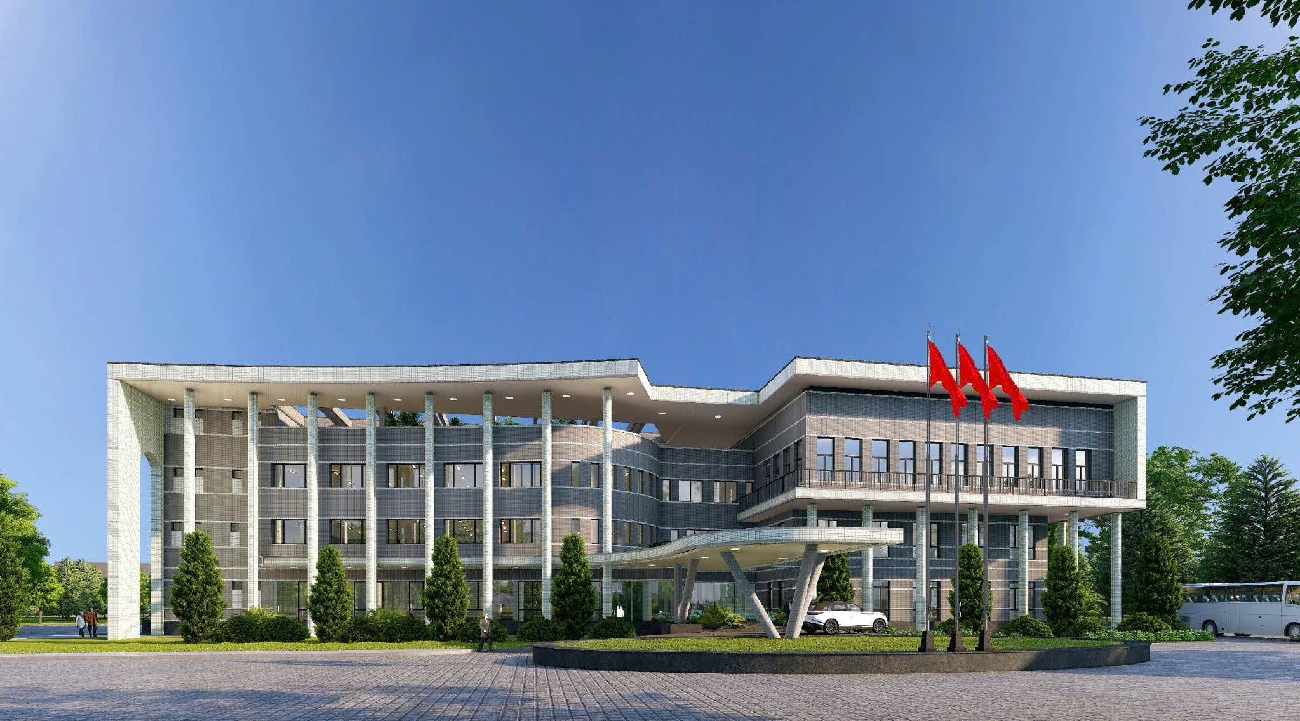
Cuu Long Delta Rice Research Institute: A major rice research institute for Mekong Delta
CLRRI’s headquarter is located at Truong Thanh Commune, Can Tho city.
NLU

Slide 37
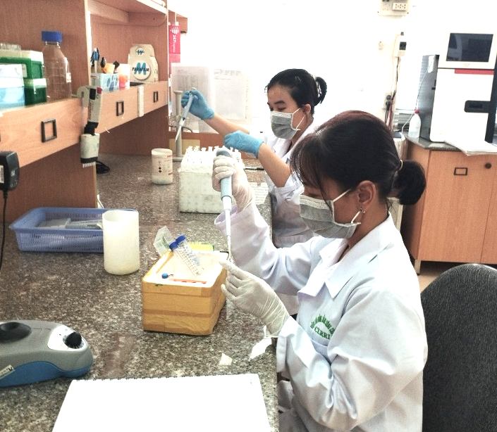
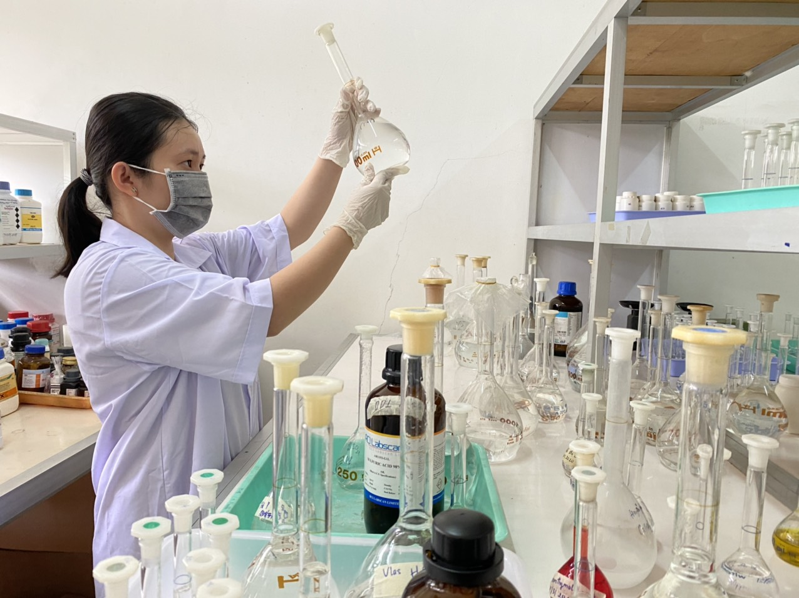
CLRRI – applied of MAS for rice breeding programs
        Time saved: saving 2-3 generations compared to conventional methods.
        New varieties: >180 rice varieties released for production and export.
Outcomes:

Slide 38

8. Opportunities
Government support: Prioritizes to invest on breakthroughs in science, technology, innovation, and digital transformation; recently low-emission rice program.
Regional collaboration: Potential for shared speed breeding facilities, genotyping services, and data platforms
Private sector engagement: Multinational seed companies (Syngenta, Bayer, Corteva) active in the development of new varieties and investment in infrastructure (labs, greenhouses, phenotyping platforms).
Climate-smart demand: International funding for climate-resilient varieties; low-emission rice programs creating market pull for suitable varieties
Notes:
Government support: Prioritizes agricultural biotechnology and modern breeding. science/tech breakthroughs); low-emission rice program.
Regional collaboration: ASEAN cooperation, potential shared facilities and harmonized variety registration.
Private sector engagement: ThaiBinh Seed, multinationals, growing agri-tech VC.
Climate-smart demand: International funding for climate-resilient varieties.

Slide 39
9. Challenges

Slide 40
Funding limitations
Public agricultural R&D spending has stagnated or declined.
Heavy reliance on donor-funded projects (time-limited, not sustainable).
Private sector R&D investment is still small compared to regional competitors (Thailand, China).
High costs for molecular markers, genotyping, and controlled-environment facilities.
Notes:
Funding limitations
Public agricultural R&D spending as percentage of AgGDP has stagnated or declined
Heavy reliance on donor-funded projects (time-limited, not sustainable)
Private sector R&D investment still small compared to regional competitors (Thailand, China)
Limited venture capital for early-stage breeding innovations
High costs for molecular markers, genotyping, and controlled-environment facilities

Slide 41
Infrastructure gaps
Severe shortage of growth chambers for speed breeding.
Limited greenhouse and net house capacity for year-round breeding.
Inadequate high-throughput genotyping and phenotyping platforms.
Poor cold storage and germplasm conservation facilities.
Notes:
Funding limitations
Public agricultural R&D spending as percentage of AgGDP has stagnated or declined
Heavy reliance on donor-funded projects (time-limited, not sustainable)
Private sector R&D investment still small compared to regional competitors (Thailand, China)
Limited venture capital for early-stage breeding innovations
High costs for molecular markers, genotyping, and controlled-environment facilities

Slide 42
Regulatory constraints
Lengthy variety release system: 3-4 years of official testing.
No clear regulatory framework for gene-edited crops (unclear if classified as GMOs).
Strict biosafety regulations for GMOs limit biotechnology applications.
Seed certification system adds time and cost.
Weak intellectual property protection discourages private investment.
Notes:
Regulatory constraints
Lengthy variety release system: 3-4 years of official testing plus DUS/VCU
No clear regulatory framework for gene-edited crops (unclear if classified as GMOs)
Strict biosafety regulations for GMOs limit biotechnology applications
Seed certification system adds time and cost
Weak intellectual property protection discourages private investment

Slide 43
Human resources/
Capacity limitations
Critical shortage of bioinformaticians, data scientists, and quantitative geneticists
Limited expertise in genomic selection, speed breeding, and digital phenotyping
Aging workforce in public breeding programs
Brain drain to private sector and overseas
Weak English proficiency for international collaboration
Notes:
Regulatory constraints
Lengthy variety release system: 3-4 years of official testing plus DUS/VCU
No clear regulatory framework for gene-edited crops (unclear if classified as GMOs)
Strict biosafety regulations for GMOs limit biotechnology applications
Seed certification system adds time and cost
Weak intellectual property protection discourages private investment

Slide 44
Seed system issues
Farmers save and exchange seed.
Limited quality assurance and certification capacity.
Poor seed storage and distribution infrastructure.
Low adoption of improved varieties by smallholders.
Notes:
Regulatory constraints
Lengthy variety release system: 3-4 years of official testing plus DUS/VCU
No clear regulatory framework for gene-edited crops (unclear if classified as GMOs)
Strict biosafety regulations for GMOs limit biotechnology applications
Seed certification system adds time and cost
Weak intellectual property protection discourages private investment

Slide 45
10. Policy and Regulatory Environment
Notes:
Variety release system
Under the Ordinance on Plant Varieties (2004) and subsequent circulars, Viet Nam operates a centralized variety registration system:
Current process:
Applicant submits variety to National Center for Plant Variety Testing
DUS testing (Distinctness, Uniformity, Stability): 1-2 years
VCU testing (Value for Cultivation and Use): 2-3 years across multiple ecological zones
National Plant Variety Release Council review and approval
Official recognition and listing
Proposed reforms (under discussion) : Industry stakeholders are advocating for:
Relaxed testing requirements for gene-edited varieties (not classified as GMOs)
Shorter VCU testing (1-2 years instead of 2-3)
Mutual recognition of testing results from other ASEAN countries
Faster appeal and review mechanisms

Slide 46
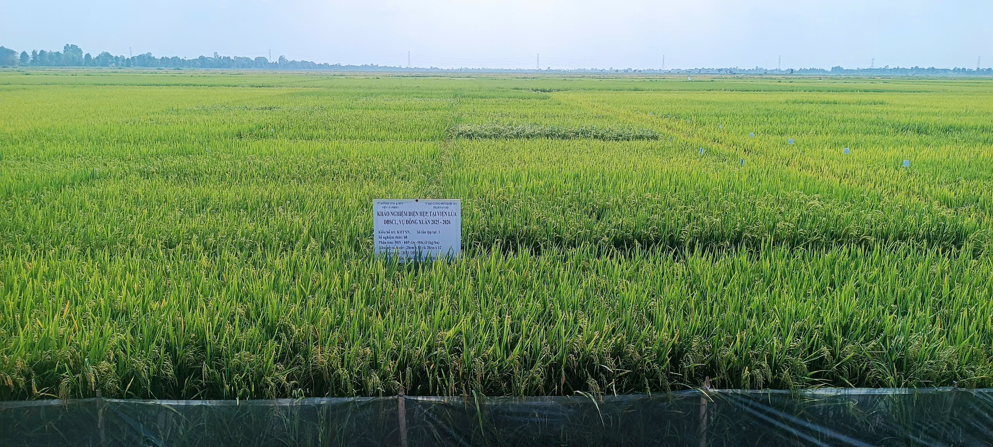
Variety release system
Viet Nam operates a centralized variety registration system:
Applicant submits variety to National Center for Plant Variety Testing.
  DUS testing (Distinctness, Uniformity, Stability): 2 years.
  VCU testing (Value for Cultivation and Use): 1-3 sites/ 1 ecological zone (2 years)
National Plant Variety Release Council review and approval.
Official recognition and listing.
Notes:
Variety release system
Under the Ordinance on Plant Varieties (2004) and subsequent circulars, Viet Nam operates a centralized variety registration system:
Current process:
Applicant submits variety to National Center for Plant Variety Testing
DUS testing (Distinctness, Uniformity, Stability): 1-2 years
VCU testing (Value for Cultivation and Use): 2-3 years across multiple ecological zones
National Plant Variety Release Council review and approval
Official recognition and listing
Proposed reforms (under discussion) : Industry stakeholders are advocating for:
Relaxed testing requirements for gene-edited varieties (not classified as GMOs)
Shorter VCU testing (1-2 years instead of 2-3)
Mutual recognition of testing results from other ASEAN countries
Faster appeal and review mechanisms

Slide 47
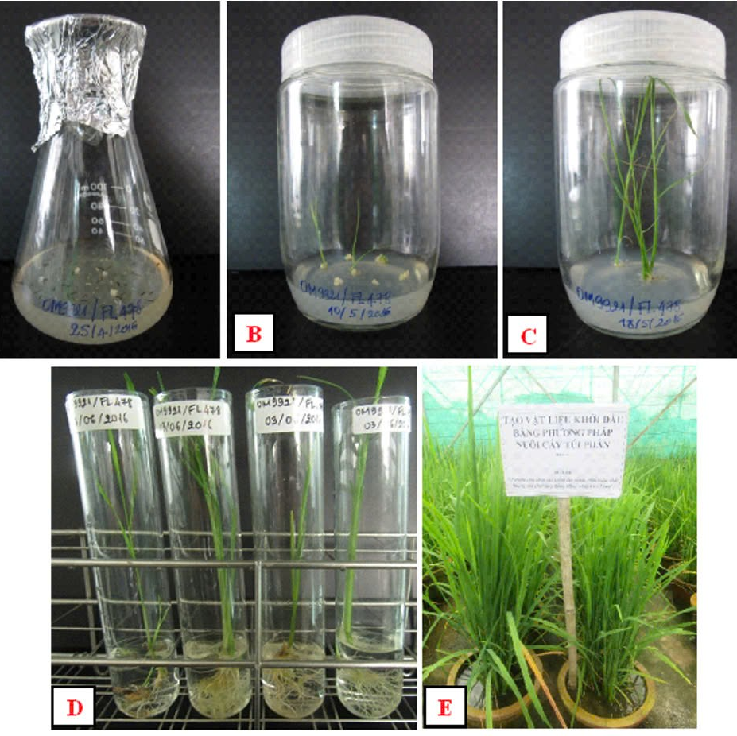
Policy towards biotechnology products
GMOs: Regulated under biosafety framework; commercial cultivation of GM crops is limited (primarily maize). Strict labeling and traceability requirements.
Gene-edited crops: Currently in regulatory gray area. Industry proposes treating gene-edited varieties as conventional if no foreign DNA inserted. No specific guidelines yet.
MAS: Not subject to special regulation; encouraged as conventional breeding tools.
Notes:
Policy towards biotechnology products
GMOs: Regulated under biosafety framework; commercial cultivation of GM crops is limited (primarily maize). Strict labeling and traceability requirements.
Gene-edited crops: Currently in regulatory gray area. Industry proposes treating gene-edited varieties as conventional if no foreign DNA inserted. No specific guidelines yet.
MAS and marker-assisted breeding: Not subject to special regulation; encouraged as conventional breeding tools.
Plant variety protection: Viet Nam is a signatory to UPOV (International Union for the Protection of New Varieties of Plants). Protection certificates available for 25 years (trees and vines) or 20 years (other crops).

Slide 48
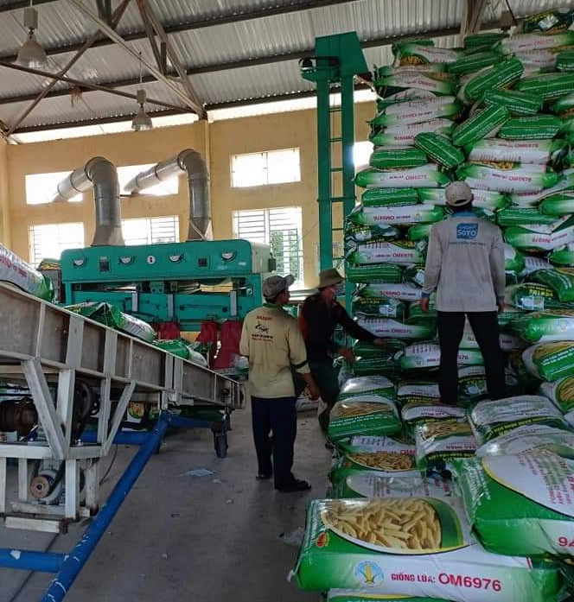
Seed certification and distribution
Certification system: Four-tier system (breeder seed, super elite seed, elite seed, certified seed) managed by MAE.
Quality control: National Center for Plant Variety Testing and provincial agricultural agencies conduct seed testing.
Notes:
Seed certification and distribution
Certification system: Three-tier system (breeder seed, foundation seed, certified seed) managed by MARD
Quality control: National Center for Plant Variety Testing and provincial agricultural agencies conduct seed testing
Challenges: Limited testing capacity, weak enforcement, high informal seed sector (estimated 30-50% of rice seed is farm-saved)
Reforms: Digital traceability systems being piloted; stronger intellectual property enforcement needed

Slide 49
11. Collaboration and Private Sector

Slide 50
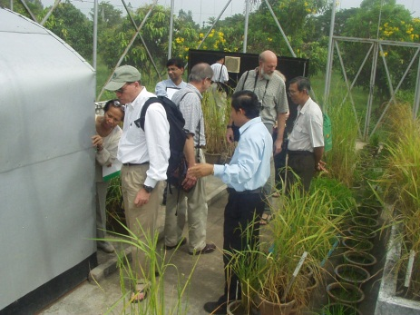
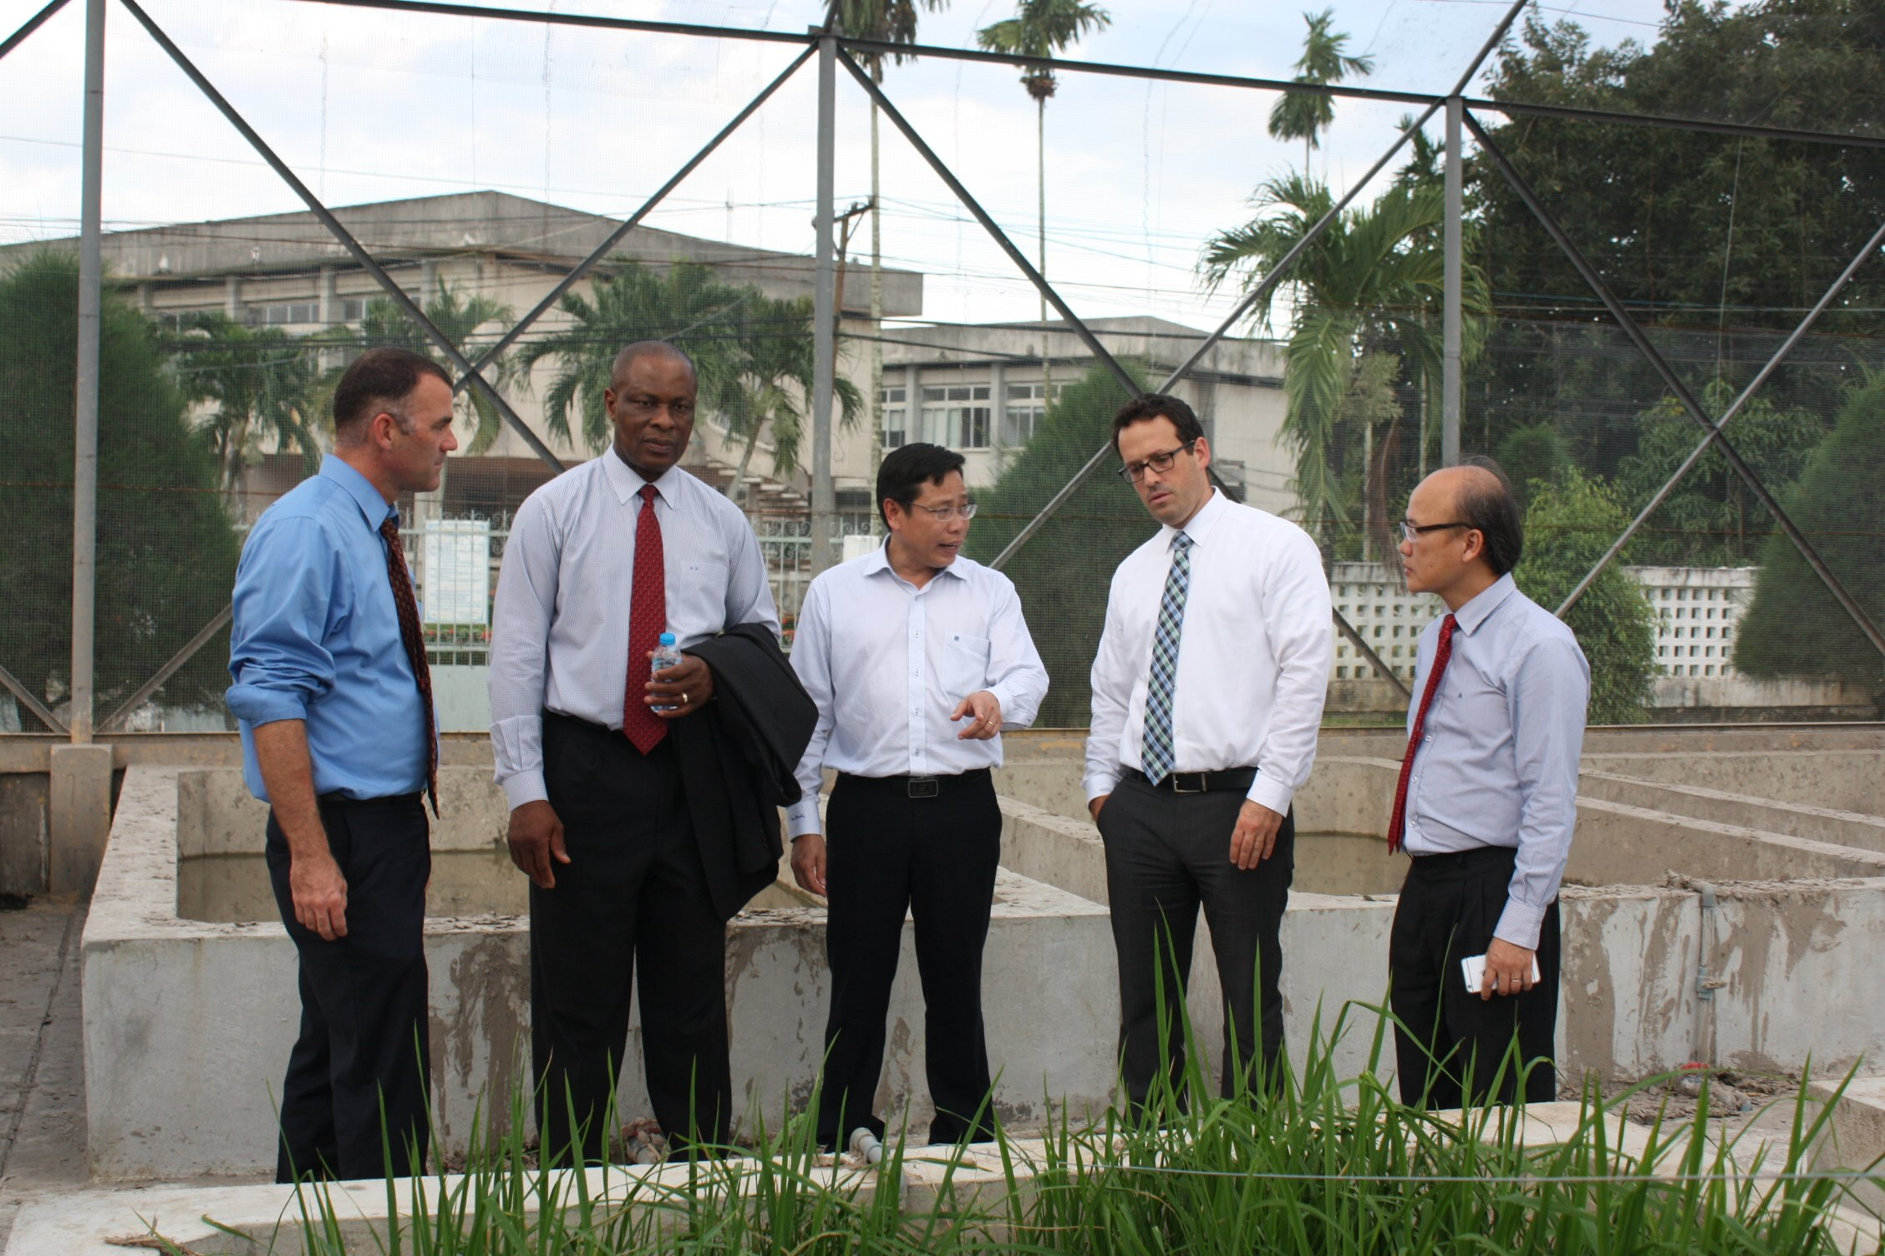
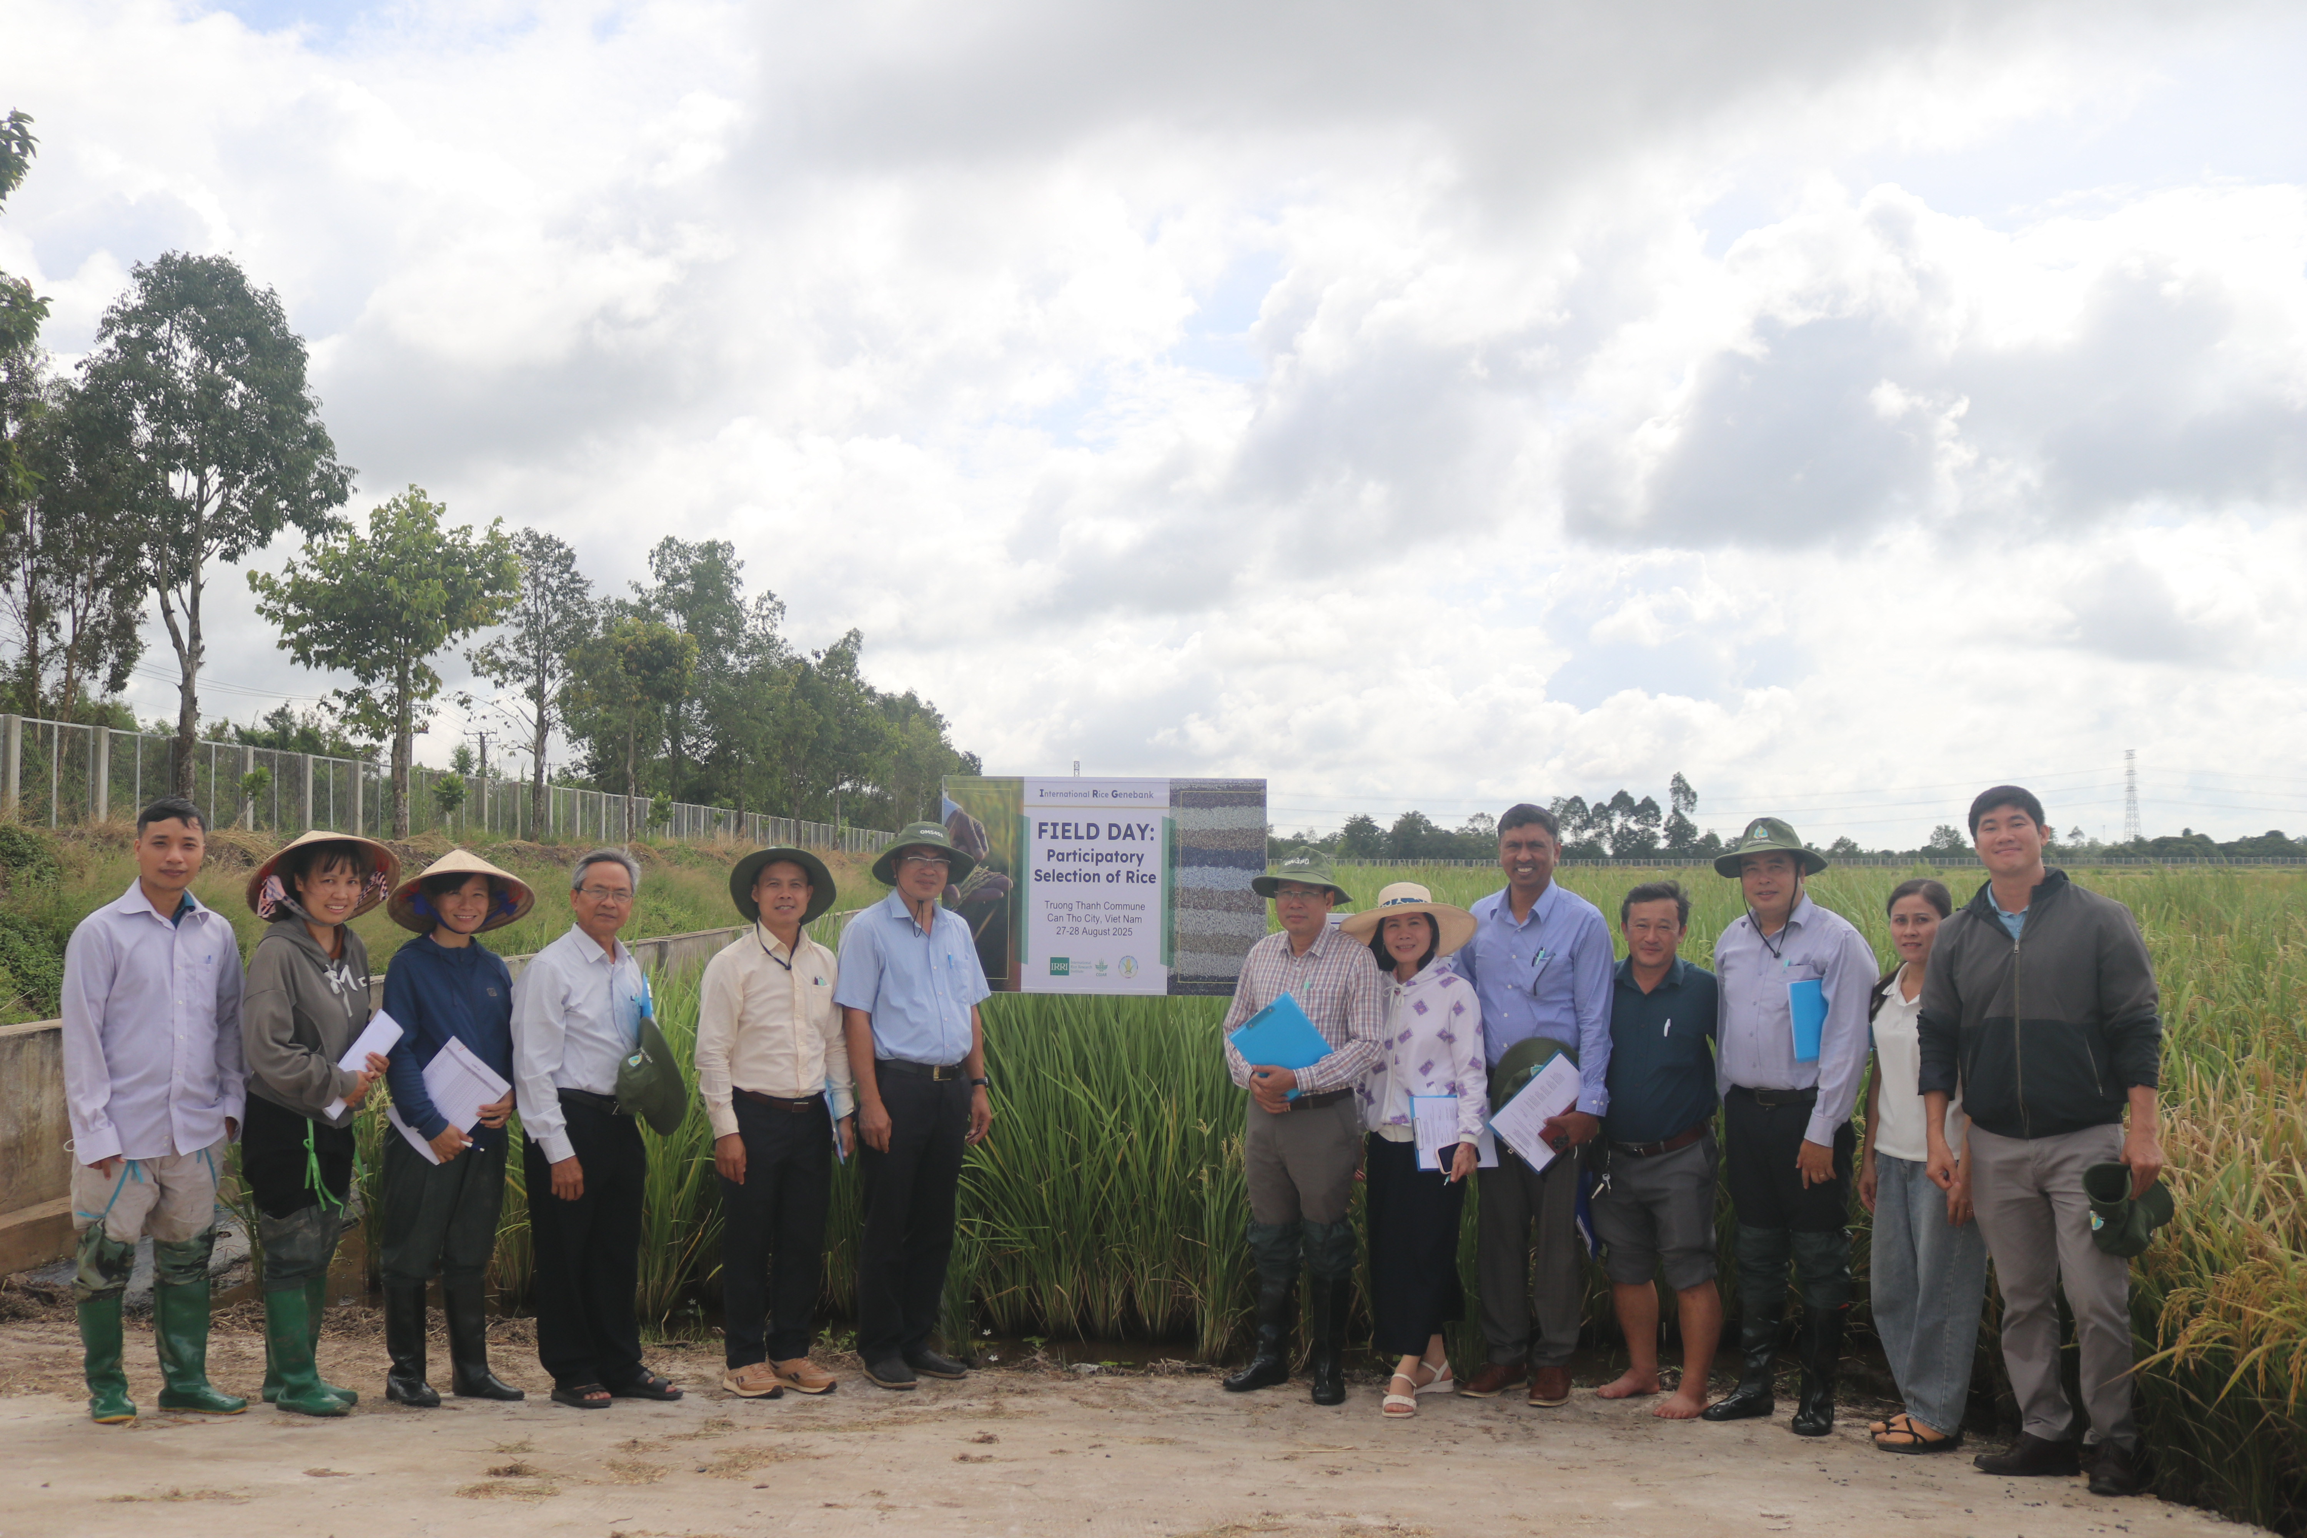
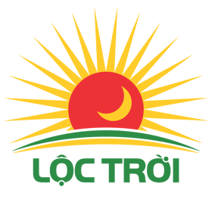


International partnership
Public-private partnerships
IRRI, ACIAR, JIRCAS, CIRAD, FAO, IAEA, the Rockefeller Foundation,….
Loc Troi Group.
Southern Seed Corporation (SSC).
ThaiBinh Seed.
Viet Nam Plant Seed Trade Association (VSTA) : 150 members including companies, research institutes, FDI enterprises, scientists.
Dr. Venuprasad Ramaiah, IRRI
Notes:
Public-private partnerships (PPPs)
Successful models:
TAP-5 Project (CIP-HZPC-Syngenta Foundation) : Integrated breeding approach combining public research capacity with private sector efficiency
ThaiBinh Seed: Private enterprise building strong R&D capacity with provincial government support
Viet Nam Plant Seed Trade Association (VSTA) : 150 members including companies, research institutes, FDI enterprises, scientists

Slide 51
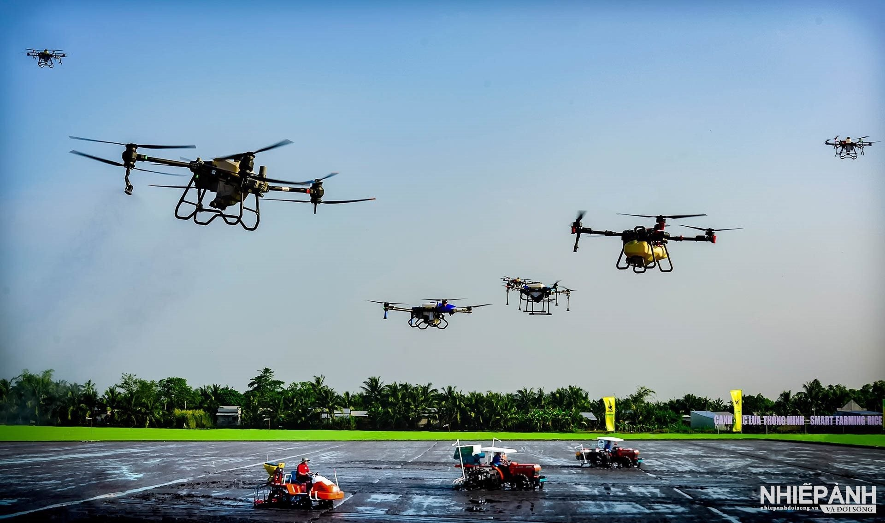
Investment trends
Collaboration with private seed companies (e.g. Loc Troi group) to breed new rice varieties according the specific orderings.
Infrastructure modernization (e.g. building growth chambers)
Expanding seed business to private sectors (e.g. share the used/explored rights of new varieties in business).
Using UAV-based equipments (e.g. drones/sensors) in the cultivation and the phenotyping.

Slide 52
12. Future Vision (Toward 2030)
Notes:
Collaboration and Innovation: Enhance (research and training) collaboration with international partners (IRRI, others...) to access and master modern technologies.
The field of integrating AI and biotechnology in rice breeding.
Smart Breeding: Apply AI and biotechnology to accelerate the development of short-duration, high-quality rice varieties with multi-stress tolerance (pests, salinity, drought) and climate change adaptation.
AI will support genomic data analysis, genomic prediction, and optimization of breeding processes.
Optimized Production: Apply advanced scientific and technological solutions, including AI, to optimize cultivation techniques, aiming to enhance yield, quality, and economic value for farmers.
AI can be used to analyze soil, weather, and crop status data, providing precise care recommendations.
Market and Digital Value Chain Development: Build rice brands and establish a market information system based on digital platforms.
AI data analysis to forecast demand and connect effective consumption.

Slide 53




Target improvements in breeding speed
Technology adoption goals
Reduce variety development timeline: From 6-7 years to 4-5 years by 2030.
Increase generations per year: From 1-2 to 3-4 generations through speed breeding and off-season nurseries.
Shorten variety release process: From 3-4 years to 2 years through streamlined testing.
Marker-assisted selection
Genomic selection
Digital phenotyping (using drones and sensors)
Breeding data management (unified national database)
Notes:
Target improvements in breeding speed
Reduce variety development timeline: From 8-10 years to 4-5 years by 2030
Increase generations per year: From 1-2 to 3-4 generations through speed breeding and off-season nurseries
Shorten variety release process: From 3-4 years to 2 years through streamlined testing
Achieve 2x genetic gain rate for priority traits (yield, salinity tolerance, grain quality)

Slide 54



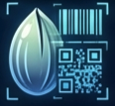

Strategic priorities
Develop human capital:
Training programs for bioinformatics, GS, and digital phenotyping.
Establish National Speed Breeding Network:
Shared growth chamber facilities at 3-4 regional hubs.
Strengthen seed systems:
Digital traceability, quality assurance, and farmer access to improved varieties.
Integrate climate resilience:
Breeding for low-emission rice, salinity, drought, heat, submergence tolerance.
Build national breeding database:
Cloud-based, interoperable platform with data standards.
Notes:
Strategic priorities
Establish National Speed Breeding Network: Shared growth chamber facilities at 3-4 regional hubs
Build national breeding database: Cloud-based, interoperable platform with data standards
Develop human capital: Training programs for bioinformatics, GS, and digital phenotyping
Strengthen PPPs: Incentivize private sector investment in breeding R&D
Advocate regulatory reform: Clear guidelines for gene-edited crops; streamlined variety release
Integrate climate resilience: Breeding for low-emission rice, salinity/drought tolerance, and flood resistance
Strengthen seed systems: Digital traceability, quality assurance, and farmer access to improved varieties

Slide 55
13. Recommendations

Slide 56




National level
Regional (ASEAN) level
Establish ASEAN Speed Breeding Network with shared access to growth chambers and phenotyping platforms.
Create a coordinated program across institute, universities, and private sector.
Invest in shared infrastructure: speed breeding chambers , high-throughput genotyping platform, digital phenotyping equipment, database.
Joint breeding programs for shared stresses (salinity in Mekong Deltas, drought in mainland SEA).
Share germplasm resource.

Slide 57

Capacity and research priorities
Invest in human capital development
Advanced training in:
  Genomic selection and quantitative genetics.
  Speed breeding protocols and management.
  Digital phenotyping and remote sensing.
  Breeding data management and bioinformatics.

Slide 58

Capacity and research priorities
Prioritize applied research on key bottlenecks
  Develop operational speed breeding protocols for rice (target 3-4 generations/year).
  Develop genomic selection models for priority traits (yield, salinity, quality) using practical data.
  Integrate drone-based high-throughput phenotyping or AI into breeding pipelines.

Slide 59
14. Key Takeaways
“Enhanced public-private collaboration is a potential pathway for accelerated breeding success”.
4
3
“Regulatory reform for variety release and gene-edited crops is critical”.
“High technology adoption (including AI) is at early stages; infrastructure and human capital are the binding constraints”.
2
1
“Accelerated breeding is essential for Viet Nam's climate resilience and food security”.
Notes:
Accelerated breeding is essential for Viet Nam's climate resilience and food security. With 8-10 year development cycles and worsening climate impacts (sea-level rise, salinity, drought), the country cannot afford conventional breeding timelines. Reducing cycles to 4-5 years is an urgent national priority.
Technology adoption is at early stages; infrastructure and human capital are the binding constraints. While MAS is moderately adopted, speed breeding, genomic selection, doubled haploids, and digital phenotyping remain at pilot levels. Viet Nam has 0-2 growth chambers nationally versus dozens in advanced breeding programs. Without strategic investment, the technology gap with regional competitors will widen.
Regulatory reform for variety release and gene-edited crops is critical. The current 3-4 year testing process adds unnecessary delay. Clear guidelines for gene-edited varieties (classifying as conventional) would unlock private sector investment and accelerate delivery of climate-resilient varieties.
Public-private partnerships offer a proven pathway for accelerated breeding success. The CIP-HZPC potato breeding PPP and ThaiBinh Seed's private sector-led model demonstrate that combining public research capacity with private sector efficiency and market focus can overcome systemic bottlenecks. Scaling such models should be a strategic priority.

Slide 60
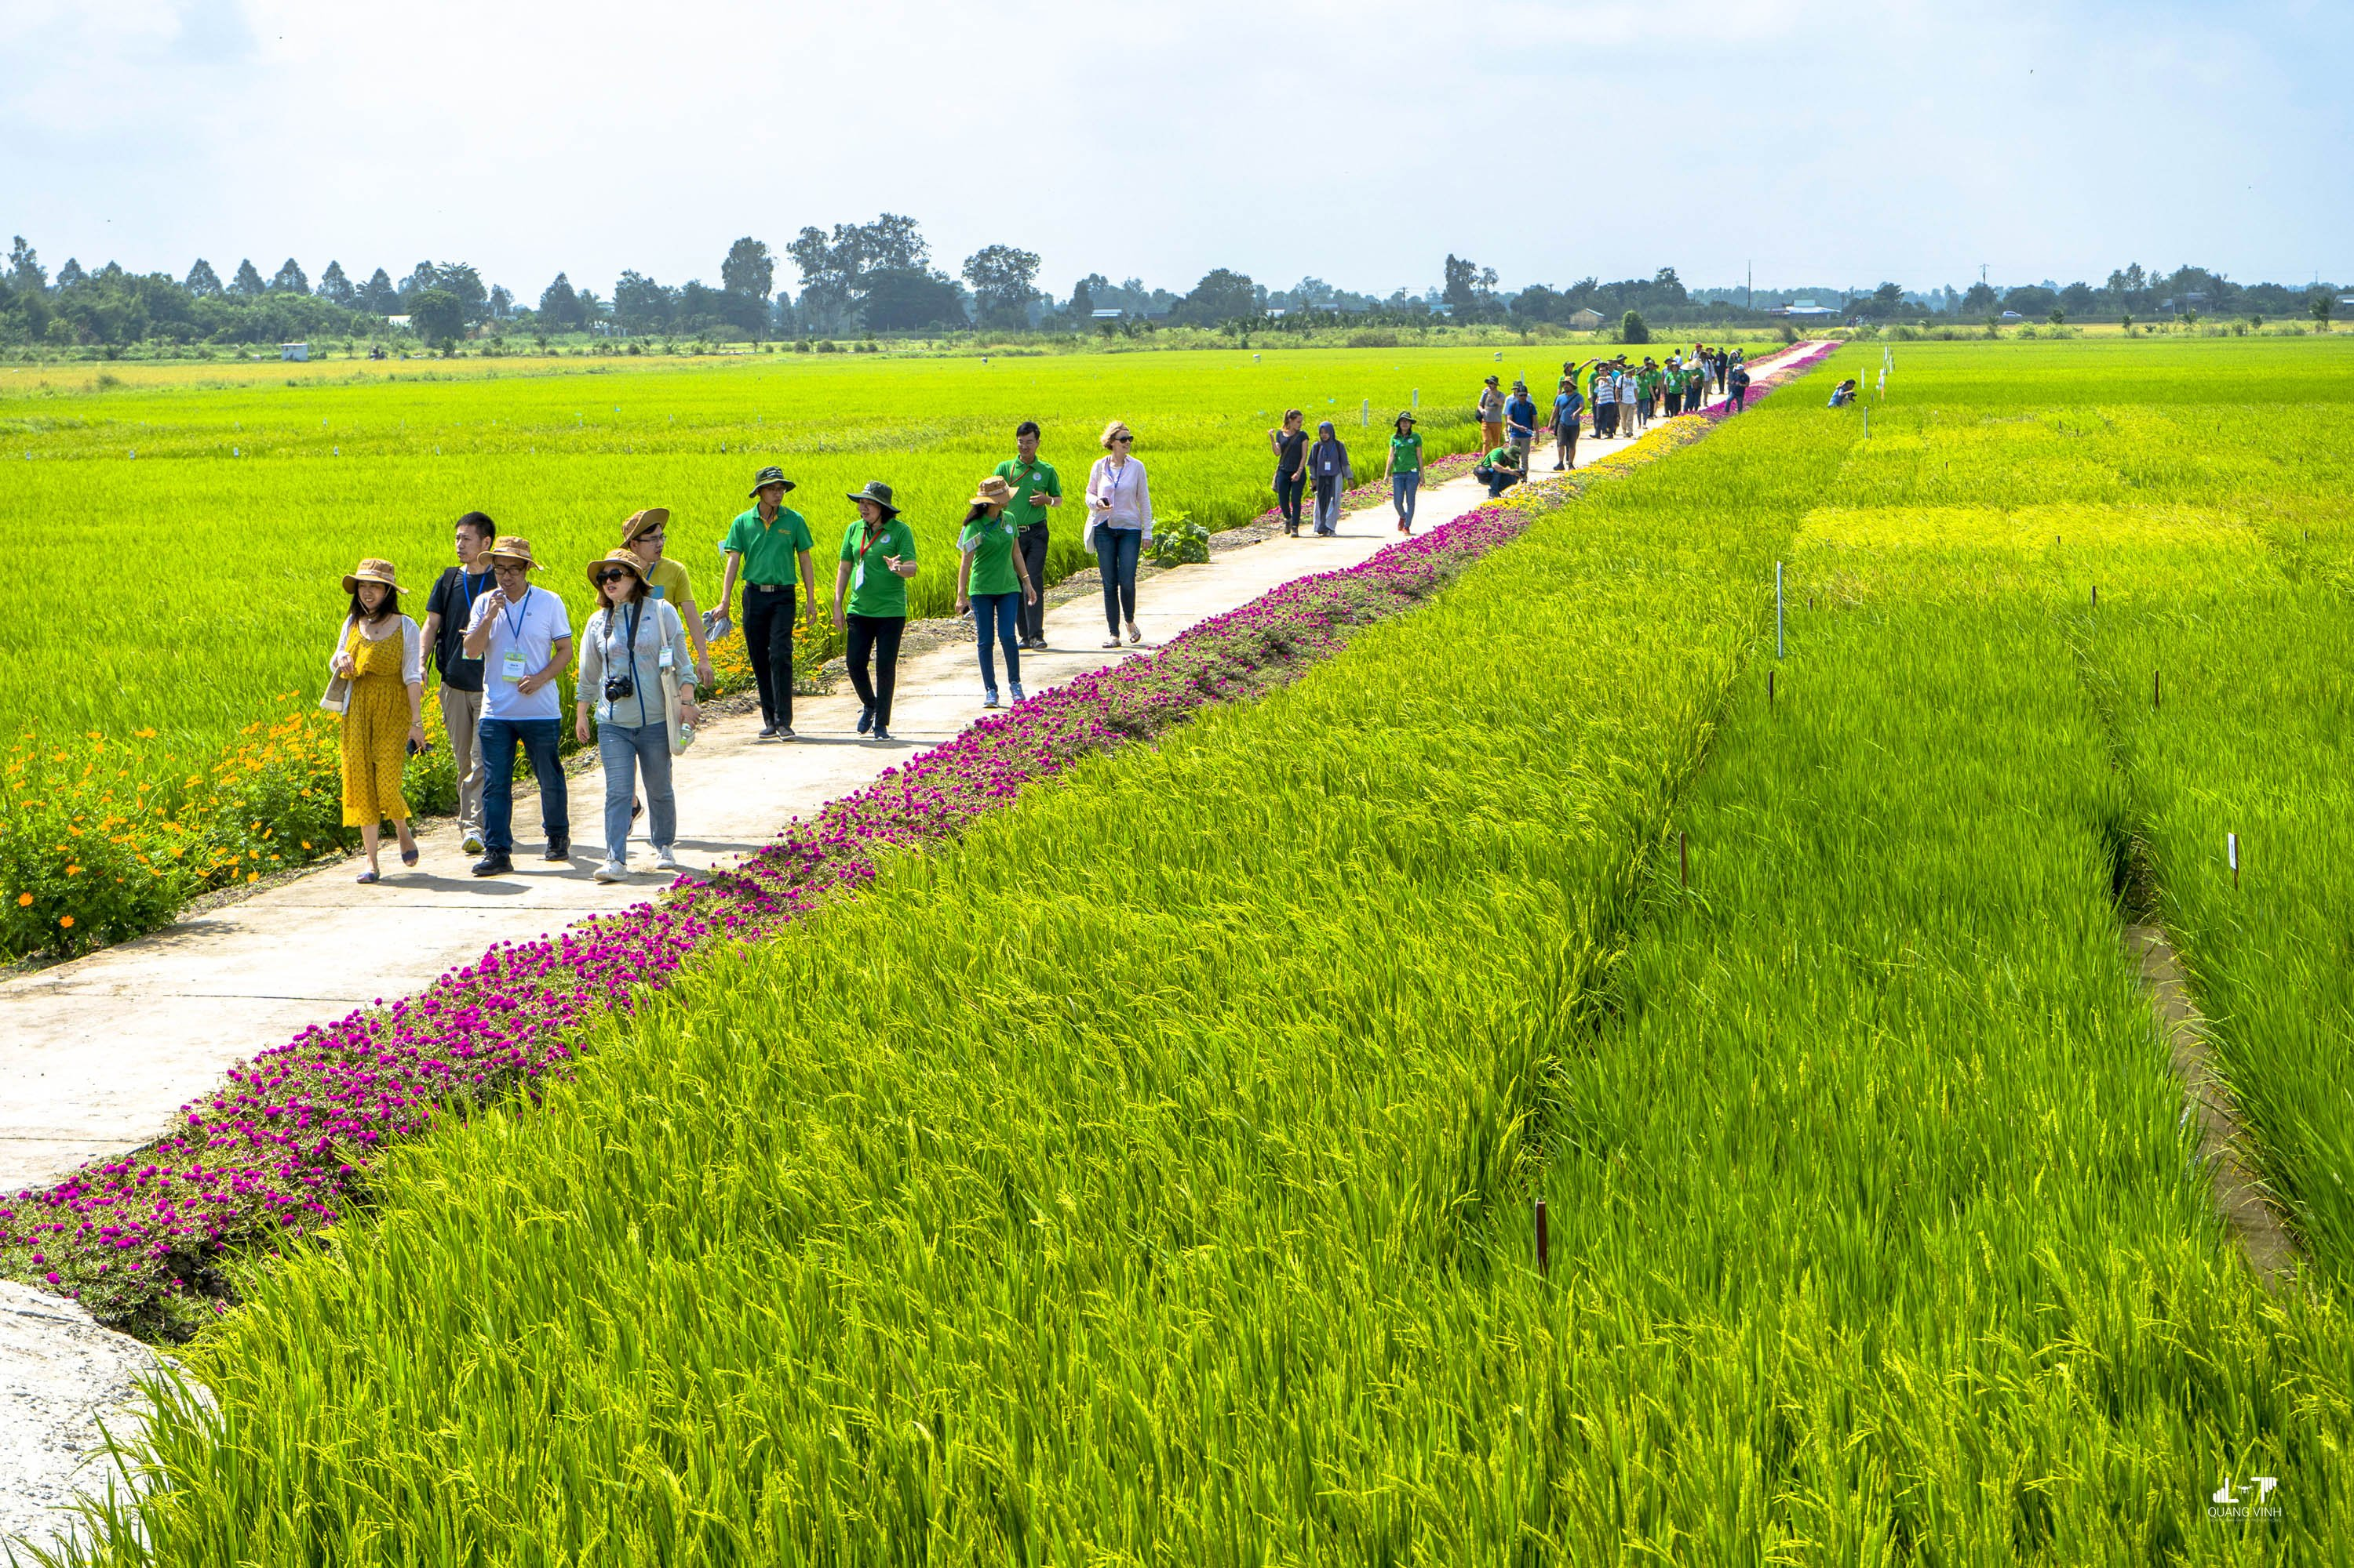
Thank you!
Terima kasih!

