Slide 1


Opportunities and Challenges
of Accelerated Breeding:
Case of Thailand
Unlocking Climate-Ready and
Nutrient-Dense Rice Innovations
Assoc. Prof. Siwaret Arikit
Director, Rice Science Center | Kasetsart University |
"Pioneering Thailand's transition to sustainable,
climate-ready, and nutraceutical rice through advanced genomics."

Slide 2
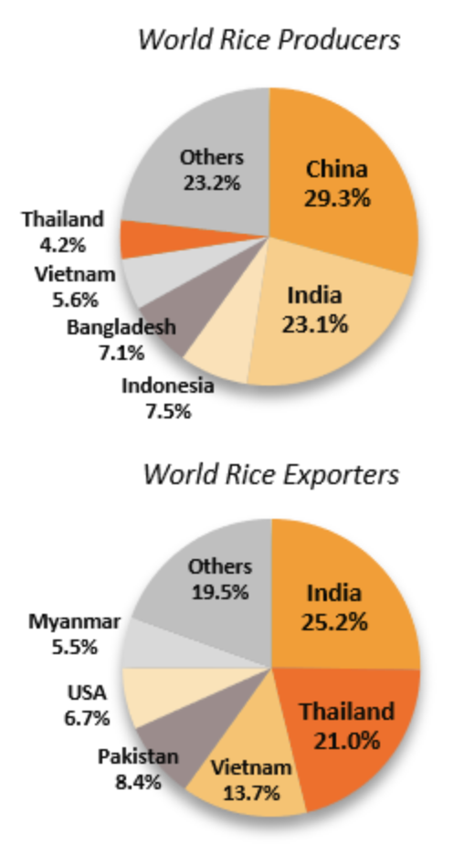
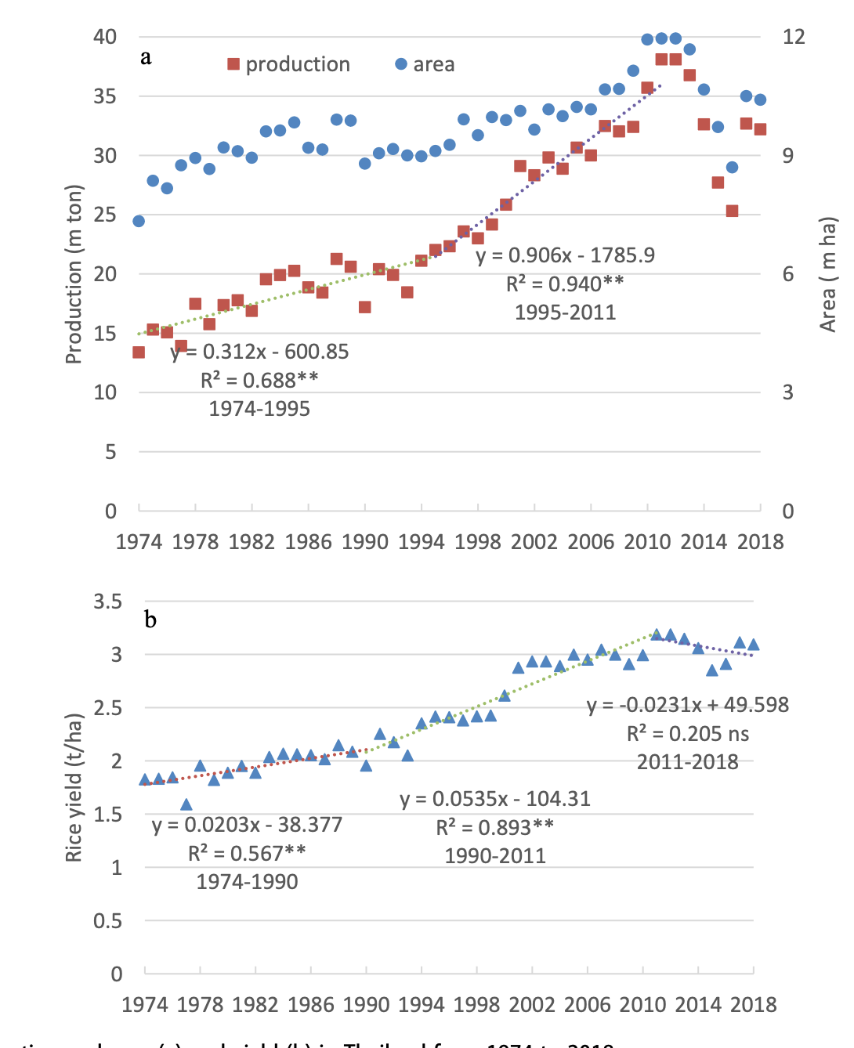
Thailand’s rice production
Factors limiting the rice production in Thailand
Envirionmental aspects
  Climate change
    Drought, flood and unpredicted rains
    Vulnarable to insect and disease severity
Growing areas
  Large of lowland rainfed production.
Rice varieties:
  The old varieties dominating rice production in Thailand.
  Farmers’ preference to grow photoperiod-sensitive rice varieties.
  Varieties with high productivity and quality needs to be developed and introduced.
Rice production increase in Thailand since 1974
Industry Outlook 2019-2021: Rice Industry (KrungSri)
https://doi.org/10.1080/1343943X.2020.1787182

Slide 3

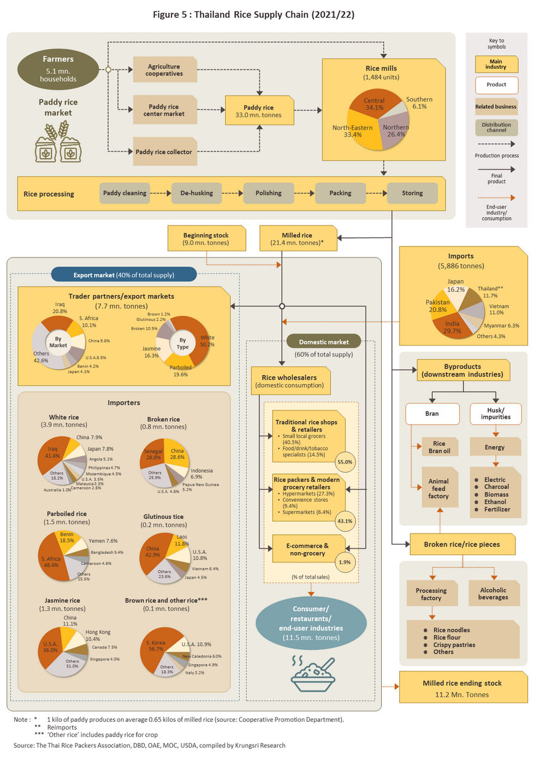

Thailand Rice Supply Chain (2021/2022)
Agriculture cooperatives
Source: The Thai Rice Packers Association, DBD, OAE, MOC, USDA, compiled by Krungsri Research
Main Insdustry
Farmers 5.1 mn
households
Paddy rice enter market
Paddy rice
33.0 mn. tonnes
Product
Paddy rice
market
Relate business
Paddy rice collector
Distribution channel
Final product
Product process
End-user industry,
consumption
Rice processing
Paddy rice
De-husking
Polishing
Packing
storing
Beginning stock (9.0 mn. tonnes)
Milled rice
21.4 mn. Tones*
By products (downstream industries)
Export market (40% of total supply)
Domestic market
Bran
Husk/impurities
(60% of total supply)
Rice wholesales
(domestic consumption)
Rice bran oil
Energy
55%
Traditional rice
shops & retailers
Small local grocers(40.5%)
Food/drink/tobacco specialists (14.5%)
Animal feed factory
Electric, Charcoal
Biomass, Ethanol, Fertilizer
Broken rice/rice pieces
Rice packers & modern grocery retailers
Hypermarkets(27.3%)
Convenience stores (9.4%)
Supermarkets (6.4%)
Processing
43%
Alcoholic beverages
Rice noodle
Rice flour
Crispy pastries
Others
1.9%
E-commerce & non-groocery
(% of total sales)
Consumer / restaurants /
end-user industries (11.5 mn. tonnes)
Milled rice ending stock
11.2 Mn. Tonnes
Notes:
Note
* 1 kilo of paddy produces on average 0.65 kilo of milled rice (source : Cooperative promotion department)
** Reimports
*** Other rice include paddy rice for crop

Slide 4

Thailand's Agricultural Footprint: The Lowland Rainfed Ecosystem
• Global Scale: Thailand hosts one of the world's
largest lowland rainfed rice ecosystems.
• Drought & Salinity: Predominant in the vast
Northeastern regions, severely limiting baseline yield.
• Flood-Prone Zones: Significant coastal and low-lying
inland areas face regular, devastating inundation.
• Adaptation Mandate: Extreme geographic variability
demands highly resilient, specialized rice cultivars.

Slide 5
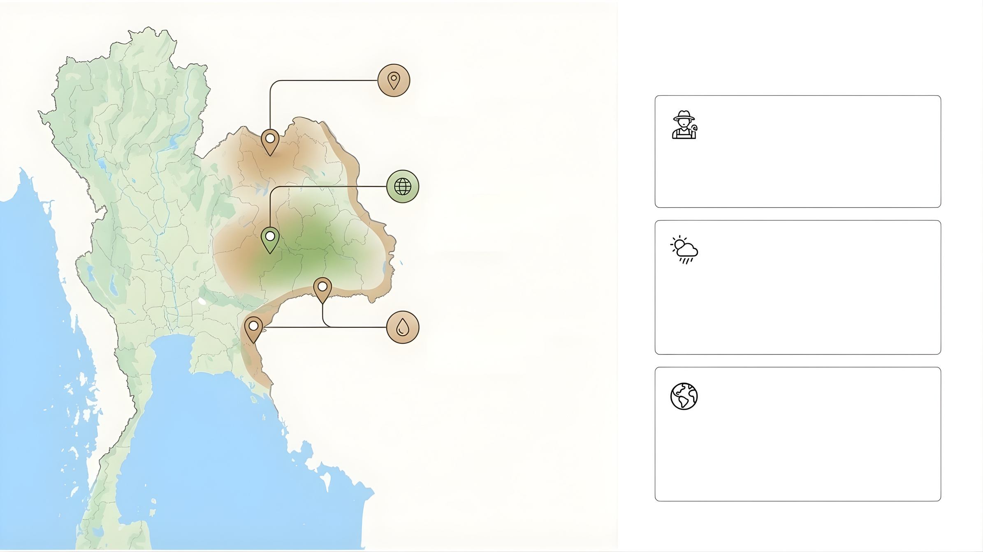
The Threat Matrix
Lowland Rainfed
Dominance:
KDML 105 & RD6
Socio-Economic
Aging farmers, rising labor costs,
extreme land fragmentation.
Global Position: One
of the world's largest
lowland rainfed
producers
Climate Extremes
Severe vulnerability to drought,
flooding, and salinity; escalating
heatwaves.
Vulnerability Zones:
Drought & Salt
Prone Areas
Environmental
High burden of greenhouse gas
emissions (methane) from
traditional flooded paddy fields.

Slide 6


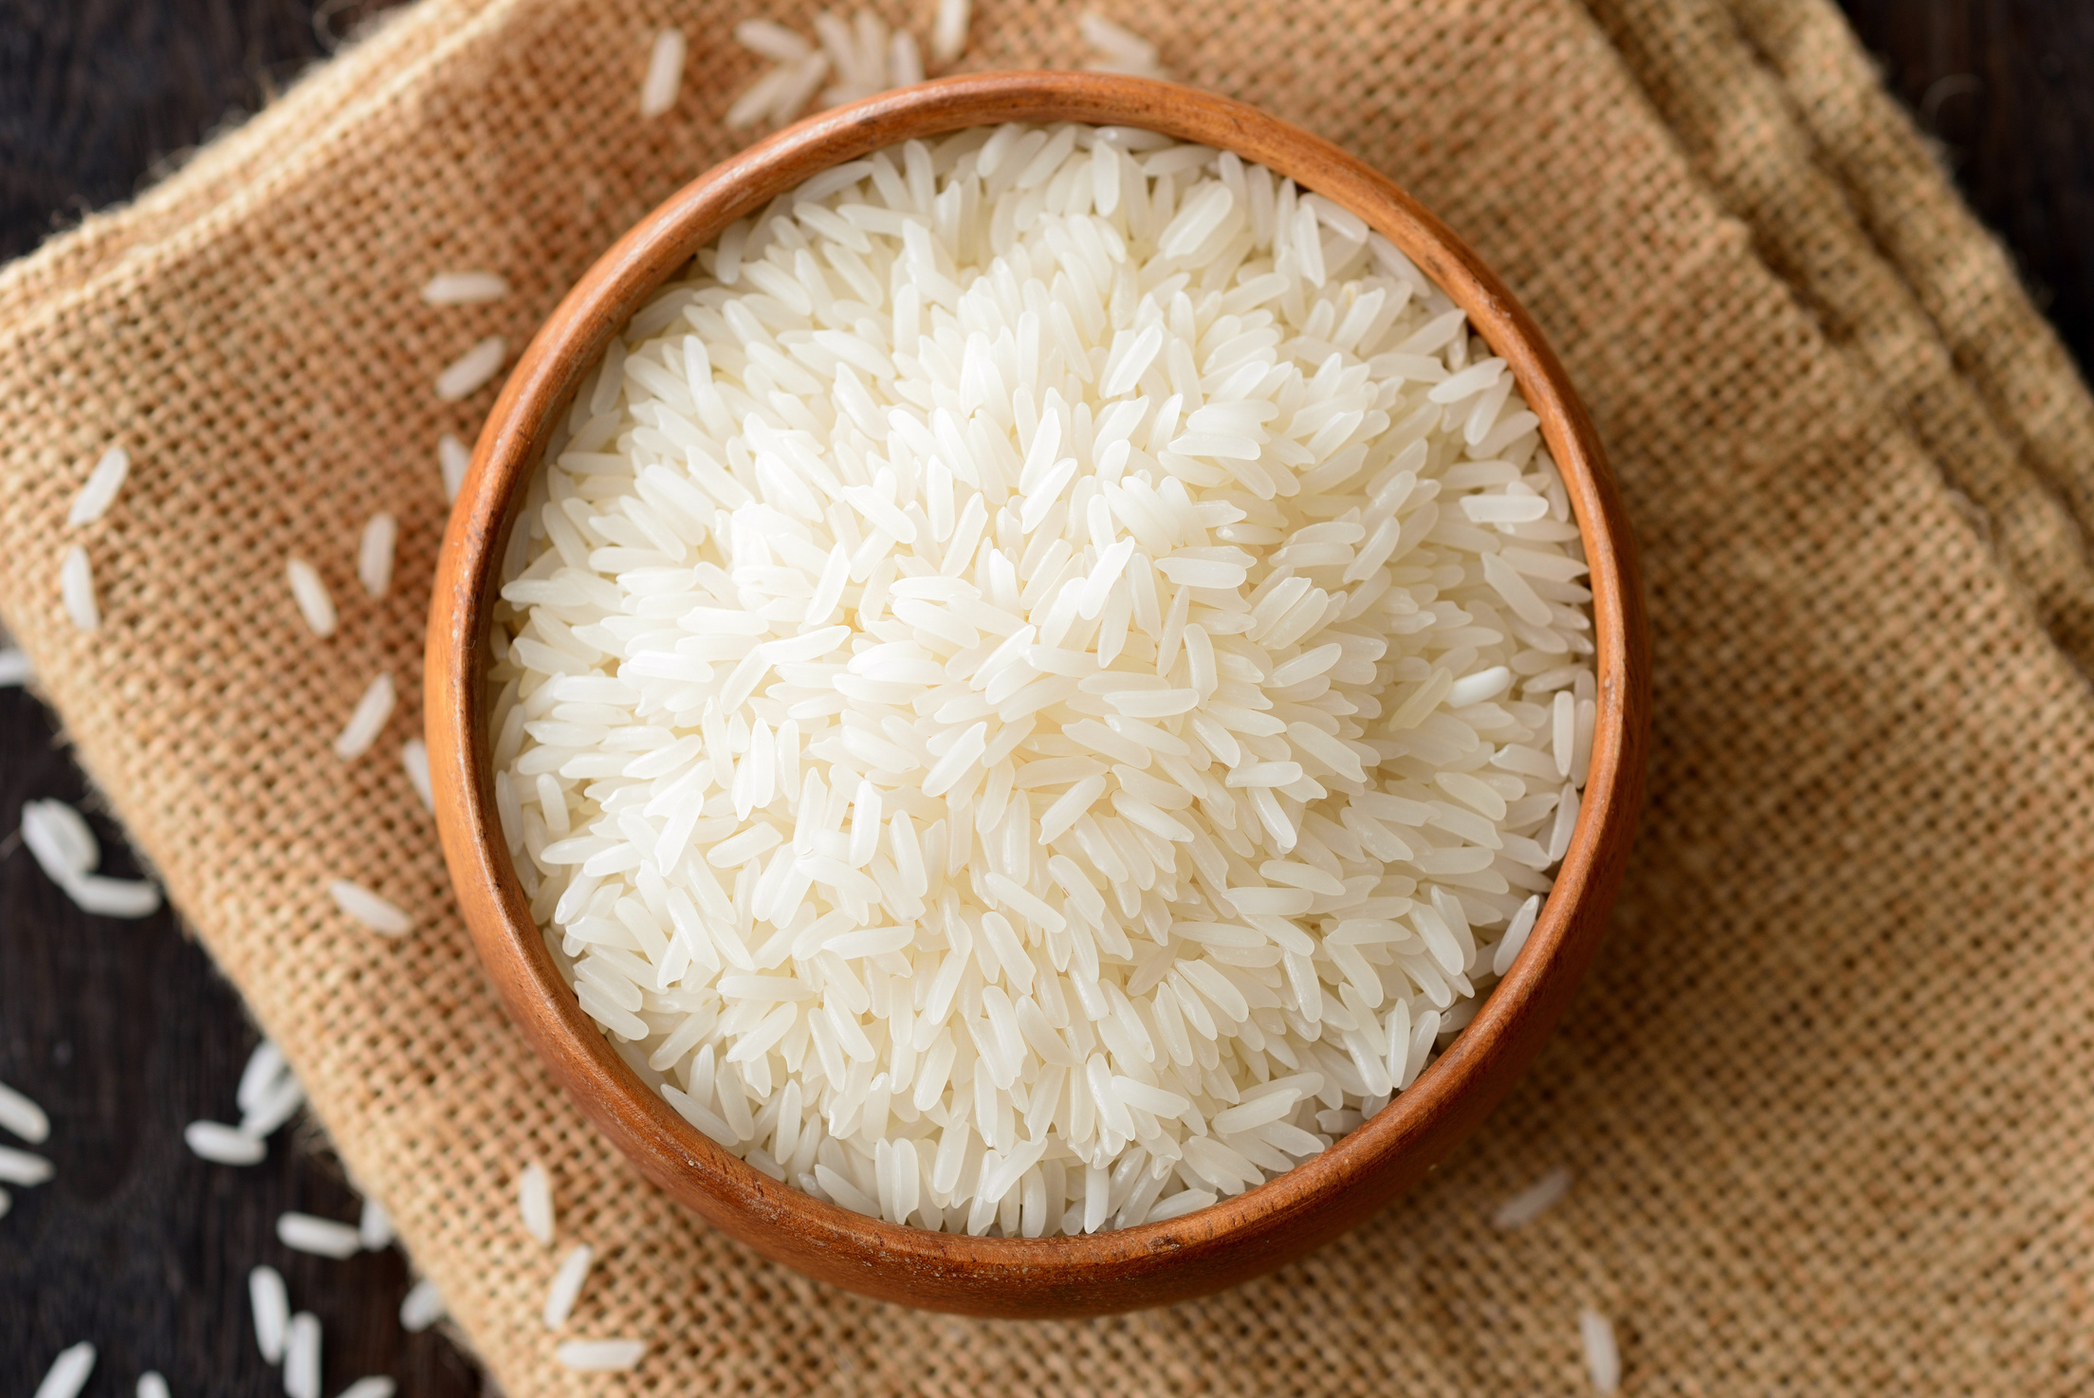





The Economic Backbone:
Major Rice Varieties and Their Vulnerabilities
Thai Hom Mali
(KDML105)
RD6 Variety
• The dominant glutinous
rice cultivar, serving as a
vital staple for domestic
consumption.
•The world-renowned
premium aromatic rice
driving Thailand's export revenues.
Critical Vulnerabilities
Photoperiod Sensitivity: Both elite varieties rely heavily on specific seasonal daylight changes to flower.
Climate Vulnerability: High economic reliance on a few traditional varieties amplifies the risk of catastrophic crop failure.

Slide 7
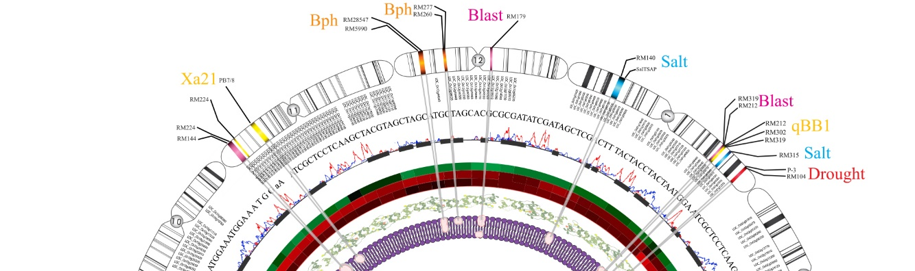

The Paradigm Shift:
Conventional vs Modern Breeding (MAS)
Conventional Breeding
Marker-assisted selection
DNA
OMICS TECHNDLOGY
• Conventional Timeline: Traditional cross-breeding
requires 10-15 years of field observation.
• Modern Shift (MAS): Direct genotypic screening
at the seedling stage.
• Phenotypic Guesswork: Relies heavily on visual
selection across multiple vulnerable seasons.
• Precision & Speed: Drastically reduces breeding
cycles while pinpointing 100+ specific markers.
• Holistic Integration: Leveraging OMICS technology
to build multi-trait varieties systematically.

Slide 8

Engineered Resilience:
Breeding for Multiple Resistances
• Abiotic Stressors: Targeted tolerance to severe
flooding, prolonged drought, and soil salinity.
• Bacterial Defenses: Engineered inherent immunity
against Bacterial Leaf Blight and Leaf Streak.
• Fungal Resistance: Incorporating broad-spectrum,
durable resistance to devastating Rice Blast.
• Insect Shielding: Utilizing specific resistance genes
(e.g., Bph3, Bph32) to repel Planthoppers.
• Ecosystem Balance: Genetic defenses significantly
reduce reliance on chemical pesticide interventions.

Slide 9
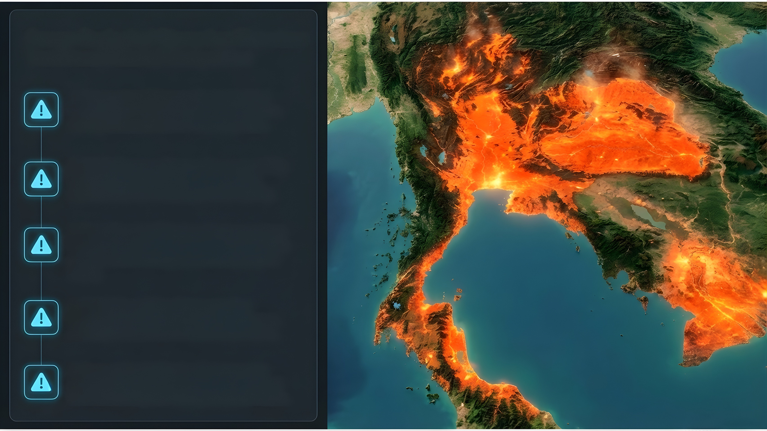
Severe Ecological Disruption Threatens Traditional Rainfed Ecosystems
1. Temperature Extremes: Projected global
warming of 1-4°C fundamentally threatens the
viability of lowland rainfed rice ecosystems.
2. Abiotic Stresses: Farmers face exponentially
increasing frequencies of severe droughts,
unpredictable flash flooding, and soil salinity.
3. Biotic Threats: Rising baseline temperatures
dramatically accelerate the spread of destructive
pests (Brown Planthopper) and diseases (Leaf
Blight).
4. Yield Vulnerability: Extreme weather
anomalies routinely disrupt pollination phases,
resulting in drastic reductions in crop outputs.
5. Geographical Shifts: Traditional growing
zones for premium cultivars like Thai Hom Mali
face severe, long-term ecological destabilization.

Slide 10
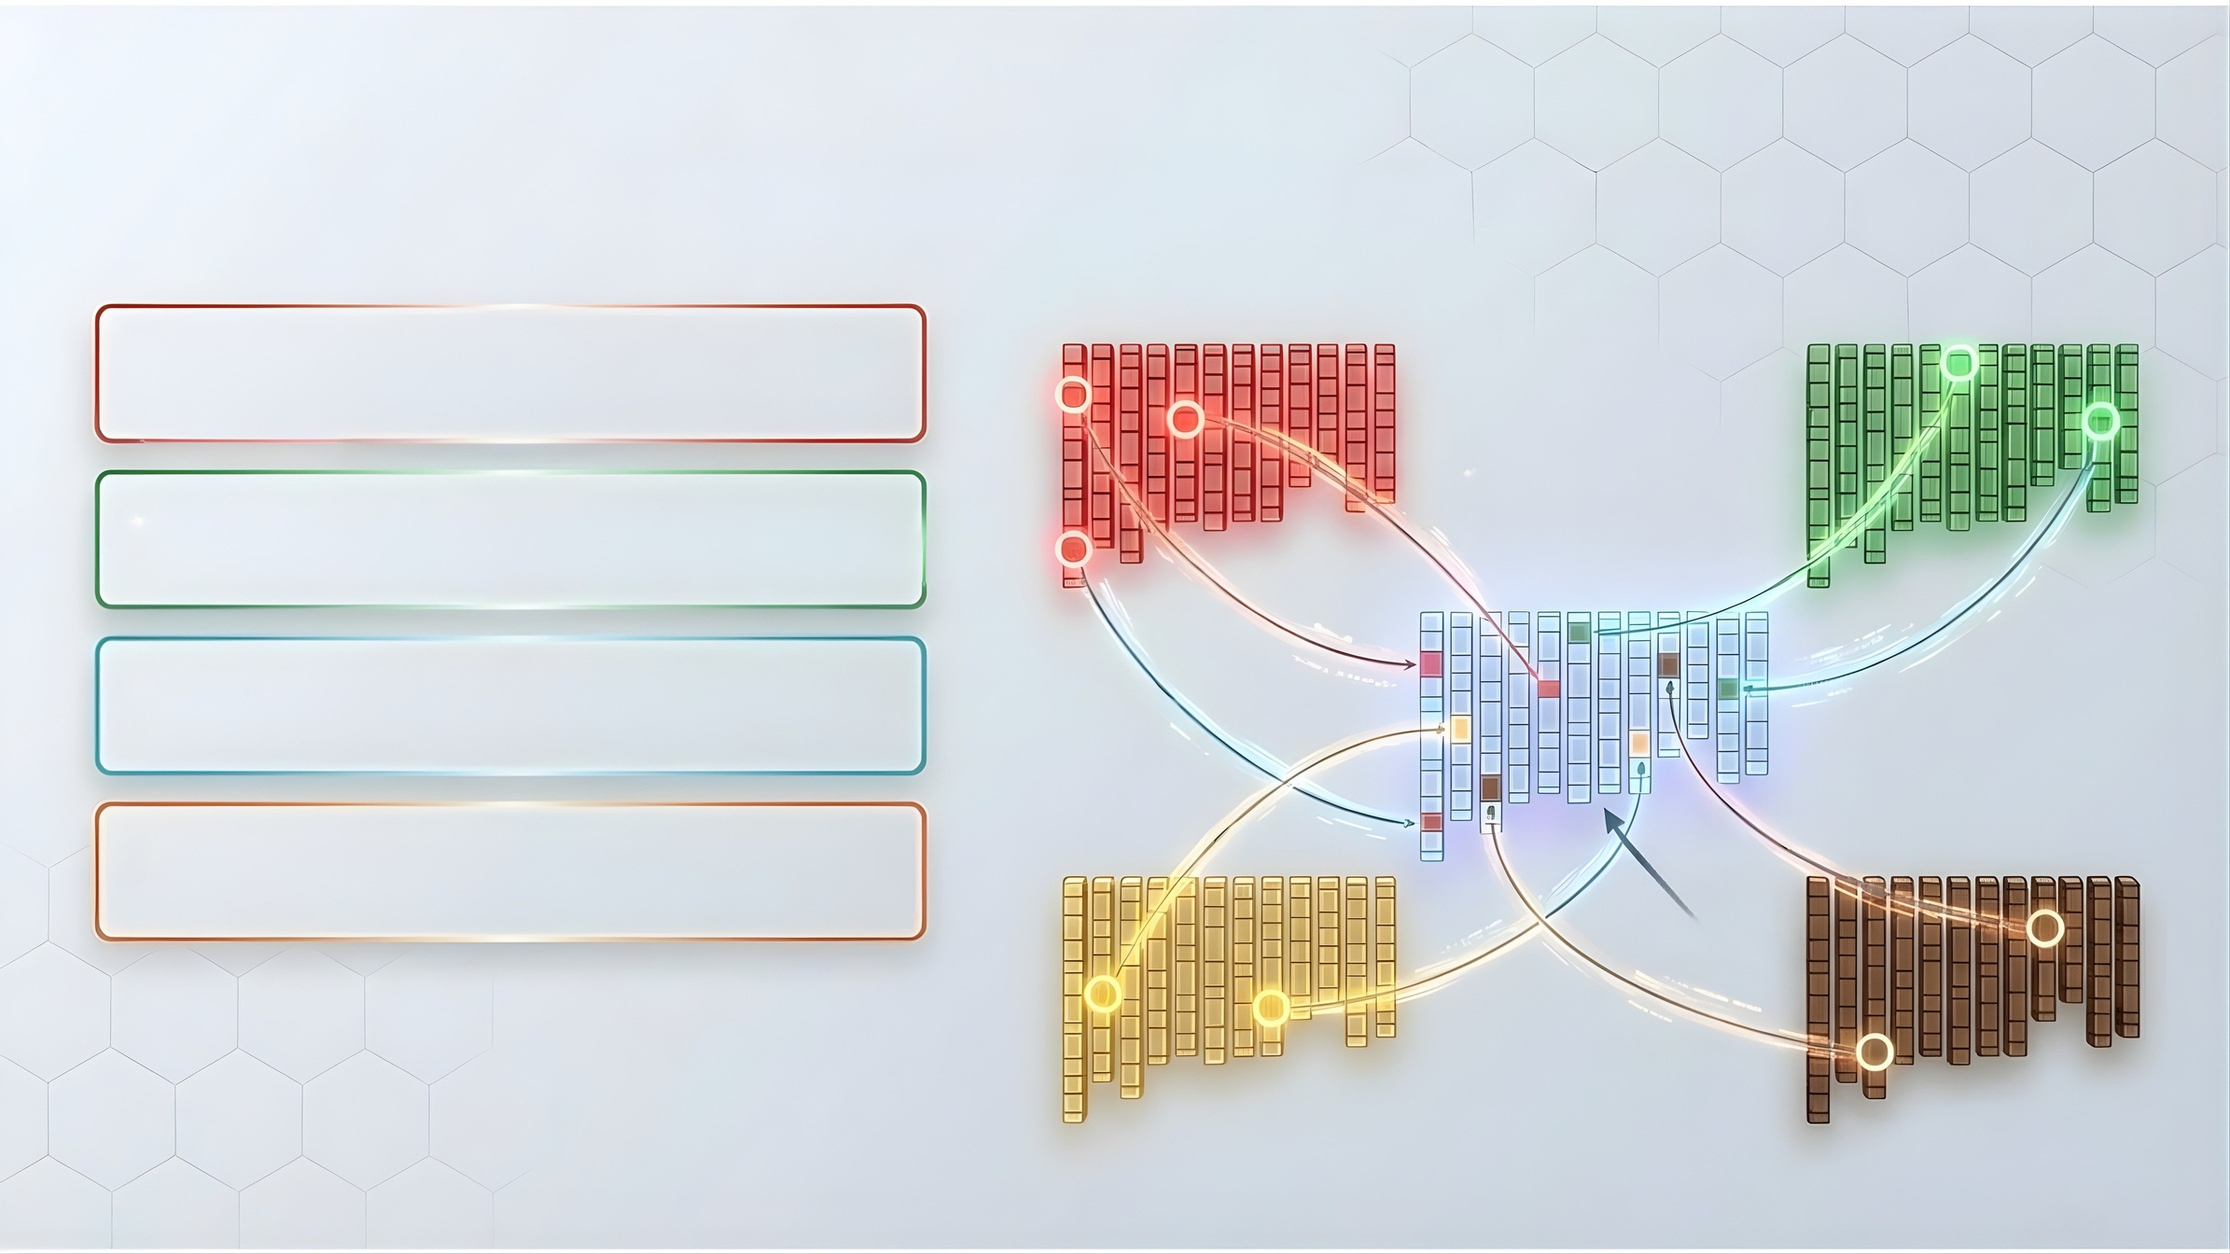
The Current Pipeline:
Gene Pyramiding for Super Rice Breeding
Grain Number
Grain Size
  Gene Pyramiding: Stacking multiple beneficial Quantitative Trait Loci (QTLs) into a single elite genetics background.
  Agronomic Optimization: Simultaneously maximizing grain number, physical size, and overall yield architecture.
NIL-A1
Elite
Variety
NIL-C1
NIL-A1
NIL-C2
  NIL Integration: Deploying Near-Isogenic Lines to precisely transfer target genes without unwanted traits.
NIL-A3
  The Super Rice Goal: Achieving absolute maximum yield potential without sacrificing baseline grain quality.
NIL-B1
QTL analysis
NIL-D2
RILS
NIL-B2
NIL-D1
Soil Stress Tolerance
Salt Tolerance

Slide 11

The Dual Mandate:
Combating Malnutrition & Climate Change
Nutrient-Dense Focus
Climate-Ready Traits
Eradicating 'hidden hunger'
by enhancing micronutrients
(Fe, Zn) and antioxidants in
staple crops.
Ensuring robust yield
stability despite severe
heatwaves and erratic
monsoon shifts.
Zn
Fe
Anti
Low Carbon Rice
Sustainable Security
Selecting specialized traits
that actively reduce
methane emissions (e.g.,
SUSIBA2 integration).
Empowering global food
security while actively
lowering the agricultural
ecological footprint.

Slide 12

Traditional Cultivation Practices Magnify
the Agricultural Carbon Footprint
Methane Production
Nitrous Oxide Release
Sustained anaerobic conditions in continuously
flooded fields heavily stimulate methanogenic
bacterial activity.
An over-reliance on synthetic, nitrogen-based
fertilizers triggers potent and continuous
N2O emissions.
Organic Decomposition
Systemic Inefficiency & Burning
Decaying plant matter trapped in submerged,
oxygen-deprived soil severely accelerates
volatile gas release.
Traditional open-air burning of rice straw
releases massive CO2 amounts, while
inadequate water controls magnify the sector's
environmental impact.

Slide 13
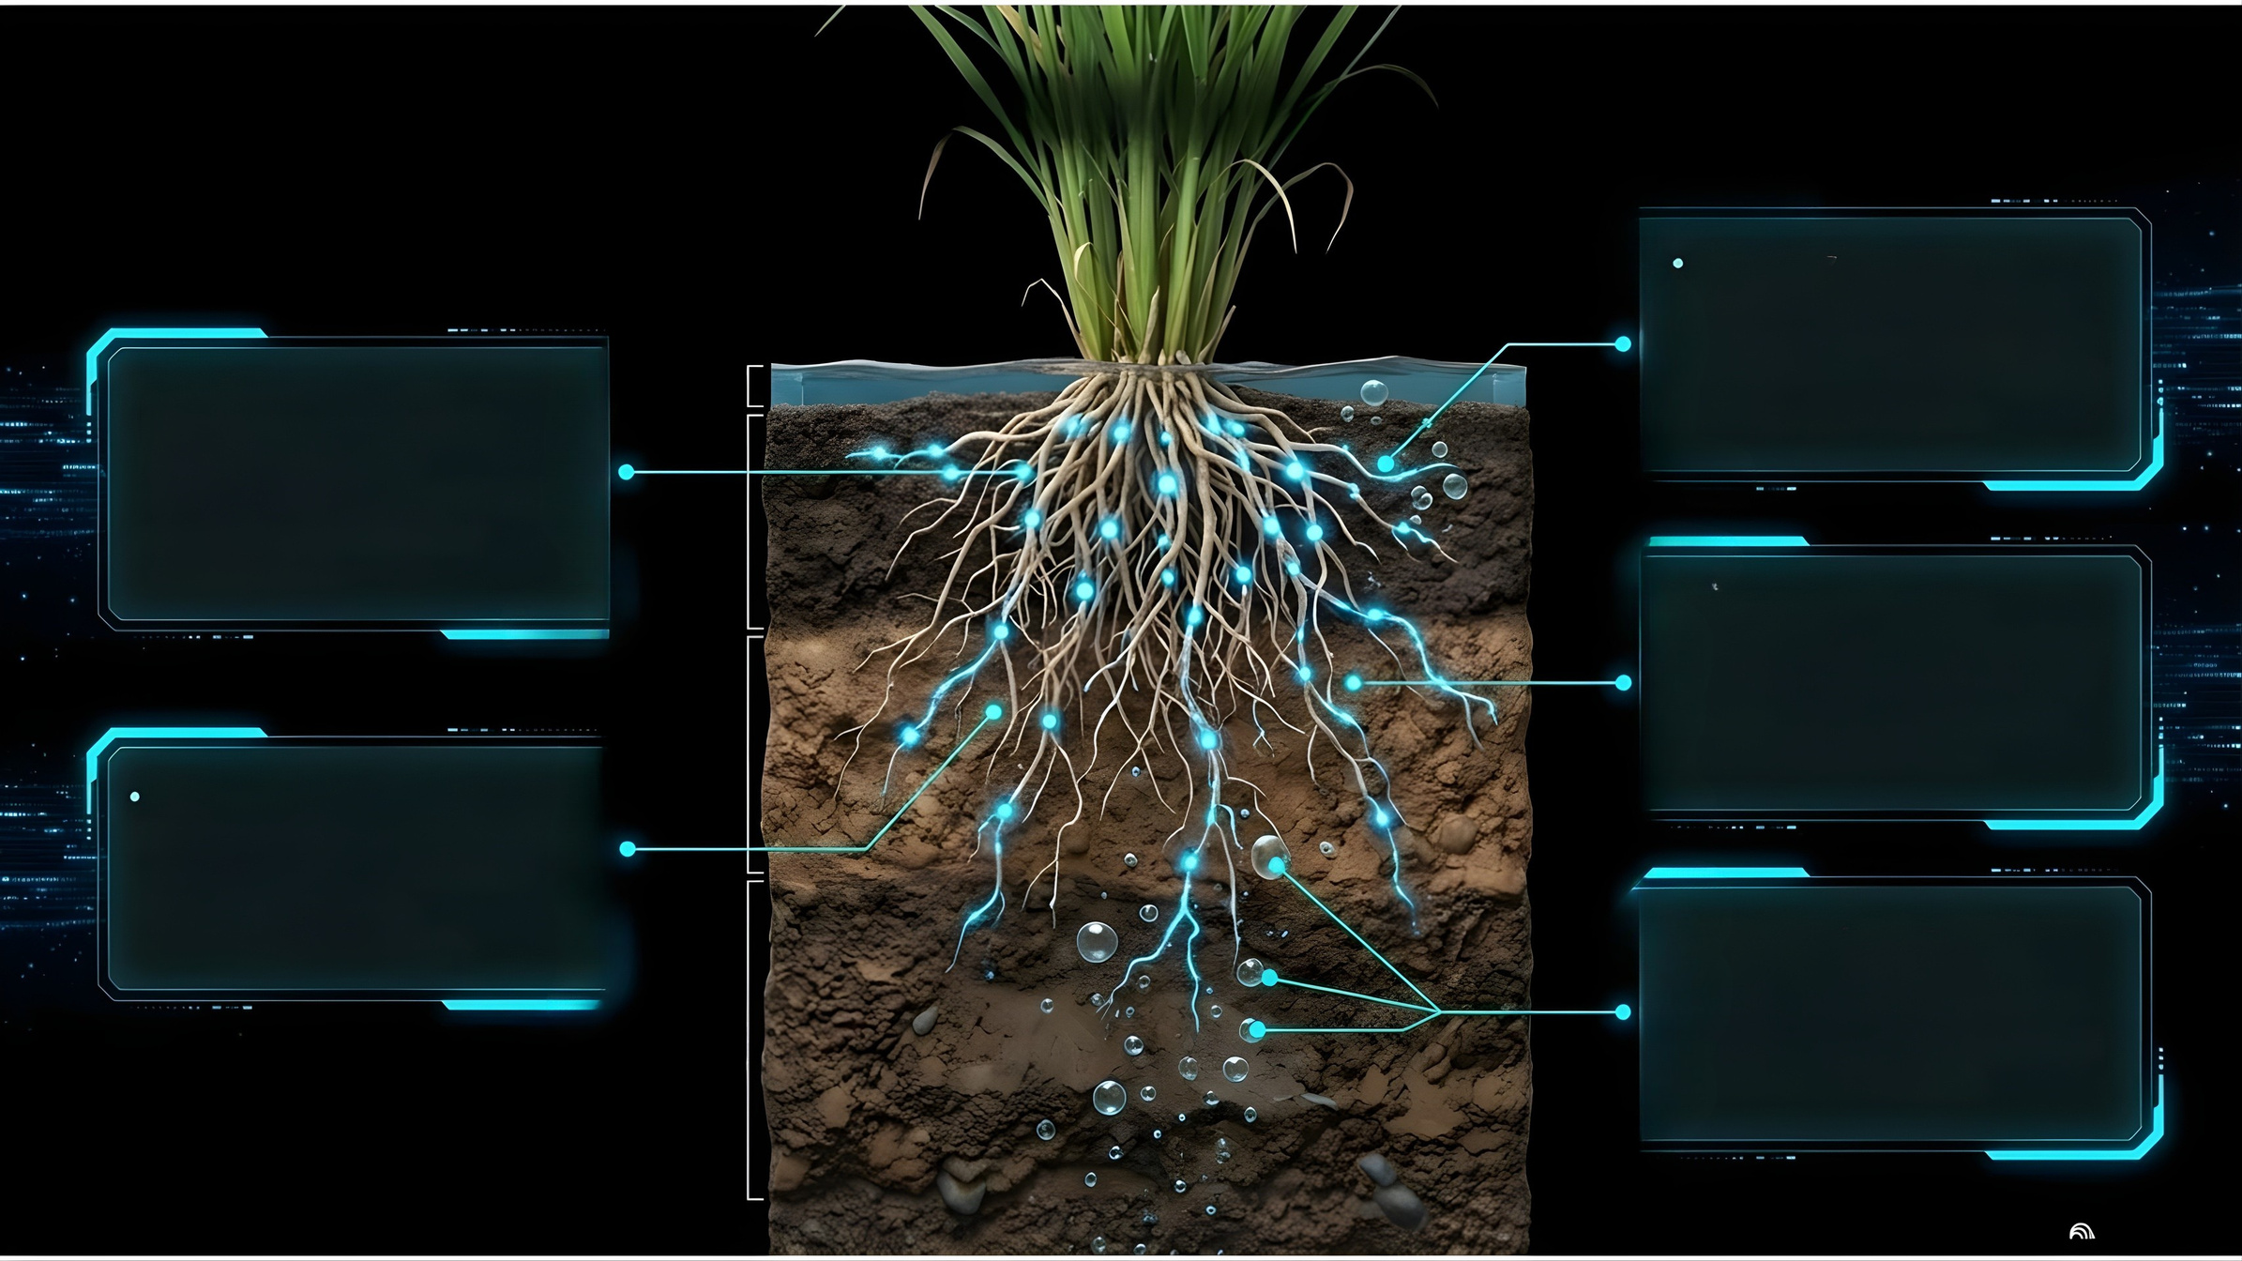

Engineered Root Systems Drive the Low Carbon Rice Initiative
Nutrient Management:
Engineering advanced root
systems requires significantly
less nitrogen, directly slashing
nitrous oxide outputs.
Emission Mitigation:
Developing climate-ready varieties specifically optimized for Alternate Wetting and Drying (AWD) water management.
CHO
Shorter Life Cycles:
Accelerating harvest timelines
limits the duration agricultural
fields remain submerged in
anaerobic conditions.
Optimized Physiology:
Breeding traits for low stomatal
density maximizes resource
use efficiency while
maintaining high yields.
Eco-Friendly Branding:
Positioning Thai rice as a
premium, low-carbon choice
for environmentally conscious
international markets.

Slide 14

Accelerated Technologies:
High-Throughput Genotyping
3
Thermosensitivity
3
Agronomic
traits
KASP Markers
34
Utilizing hundreds of highly specific markers for targeted, single-gene selection.
Nutrient use
efficiency
8
Disease
resistance
8
MassArray Systems
Deploying rapid 30-40 marker sets to instantly evaluate cooking quality and complex stress profiles.
17
Unprecedented Accuracy
Tracking over 100 specific genes and 50+ QTLs with pinpoint, molecular precision.
Early Elimination
Discarding non-viable genetic candidates at the seedling stage, saving years of field testing.

Slide 15

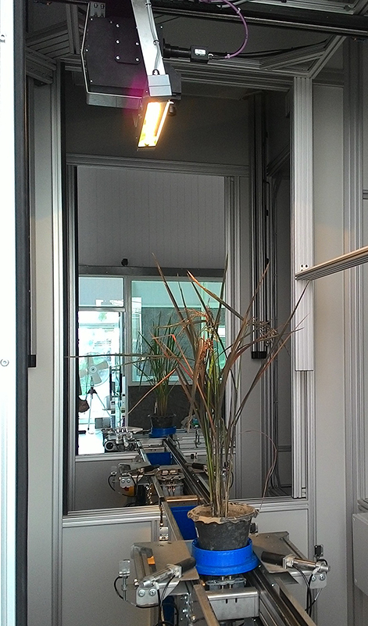
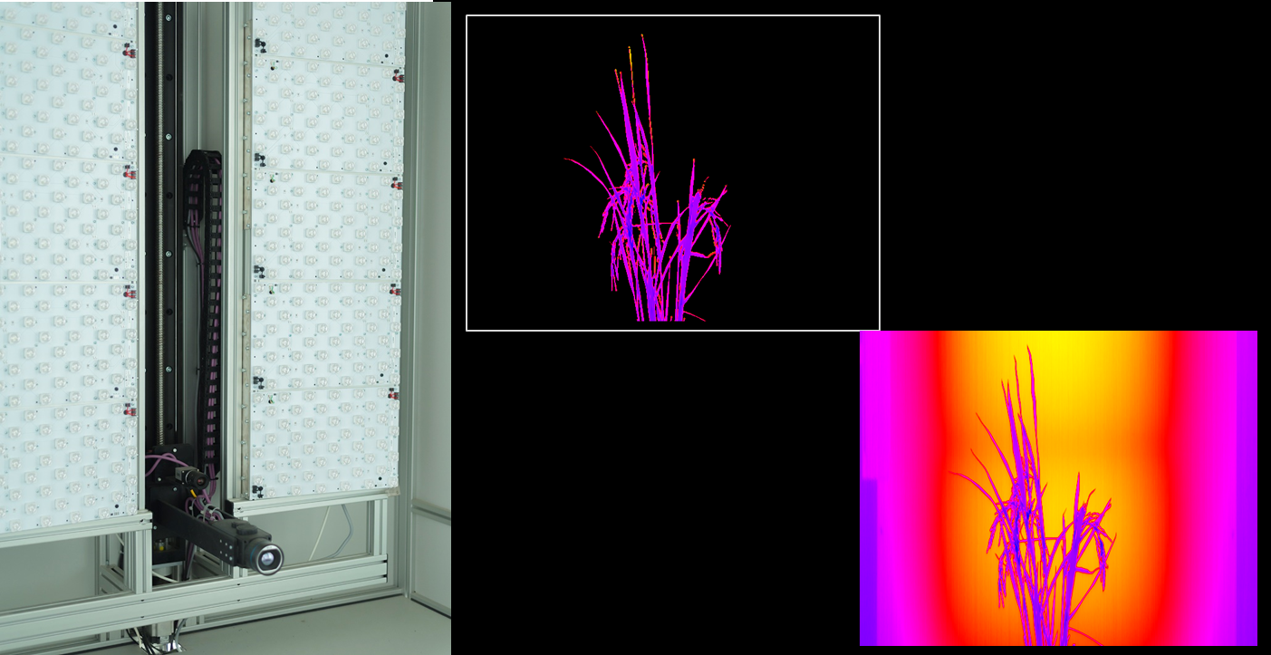

Accelerated Technologies:
High-Throughput Phenotyping
Thermal Imaging: Utilizing FLIR cameras to
map precise canopy temperatures and detect
invisible, early-stage heat stress.
Hyperspectral Sensors: Analyzing light
reflectance across hundreds of bands to
measure critical chlorophyll and moisture levels.
Non-Destructive Testing: Evaluating total
plant health, biomass, and stomatal response
without harming the specimen.
Real-Time Monitoring: Capturing dynamic,
minute-by-minute plant responses to simulated
droughts and heatwaves.

Slide 16
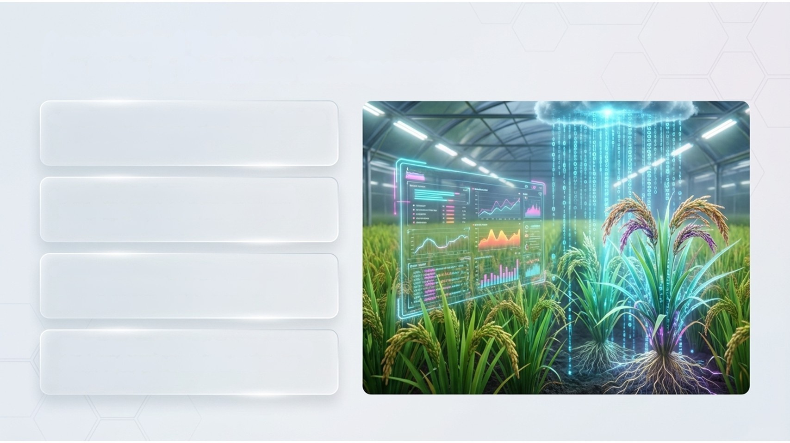
Accelerated Technologies:
Big Data & Database Management
• Centralized Intelligence: Integrating decades
of complex genomic, phenotypic, and
environmental field data.
• Predictive Analytics: Utilizing advanced
algorithms to model the success rates of
intricate, multi-gene crosses.
• Bridging the Gap: Connecting underlying
genetic potential (genotype) directly with
physical expression (phenotype).
• Risk Reduction: Guiding strategic breeding
decisions through actionable data rather
than trial-and-error.

Slide 17

Case Study 1: The Nutritional
Profile of Riceberry

Slide 18
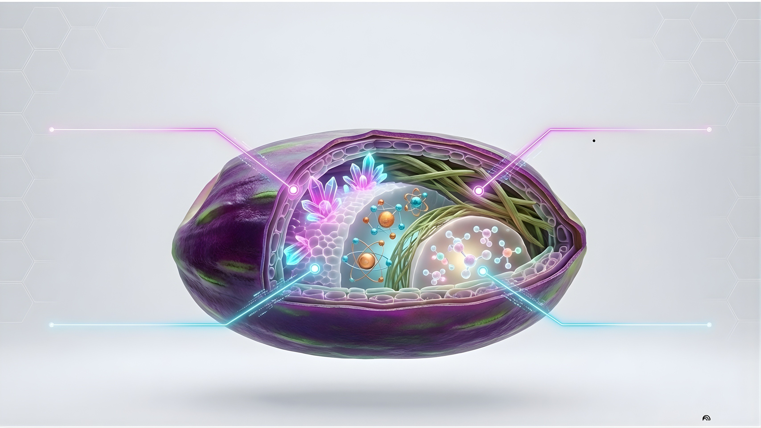
Case Study 1: The Nutritional
Profile of Riceberry
Potent Antioxidants
Dietary Fiber
•Exceptionally rich in natural
polyphenols, anthocyanins,
and high overall antioxidant
capacity.
High bran fiber content
supporting digestive
health and sustained,
slow-release energy.
Zn
Fe
Vital Micronutrients
Vitamin Complex
• High density of essential
Iron (Fe) and Zinc (Zn).
• Packed with essential Vitamin E Omega 3 Folate

Slide 19
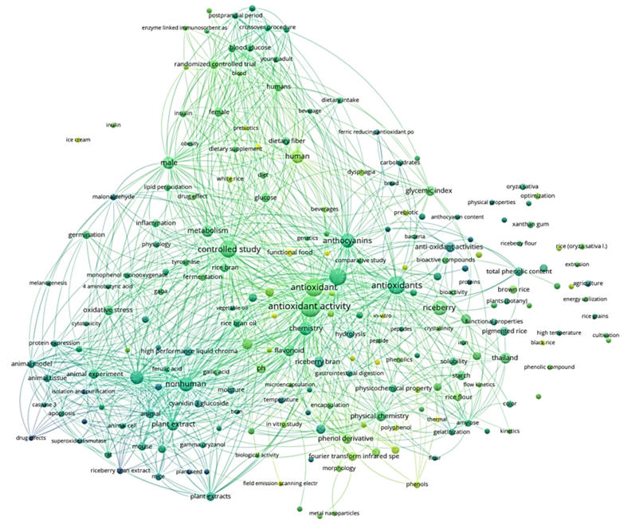
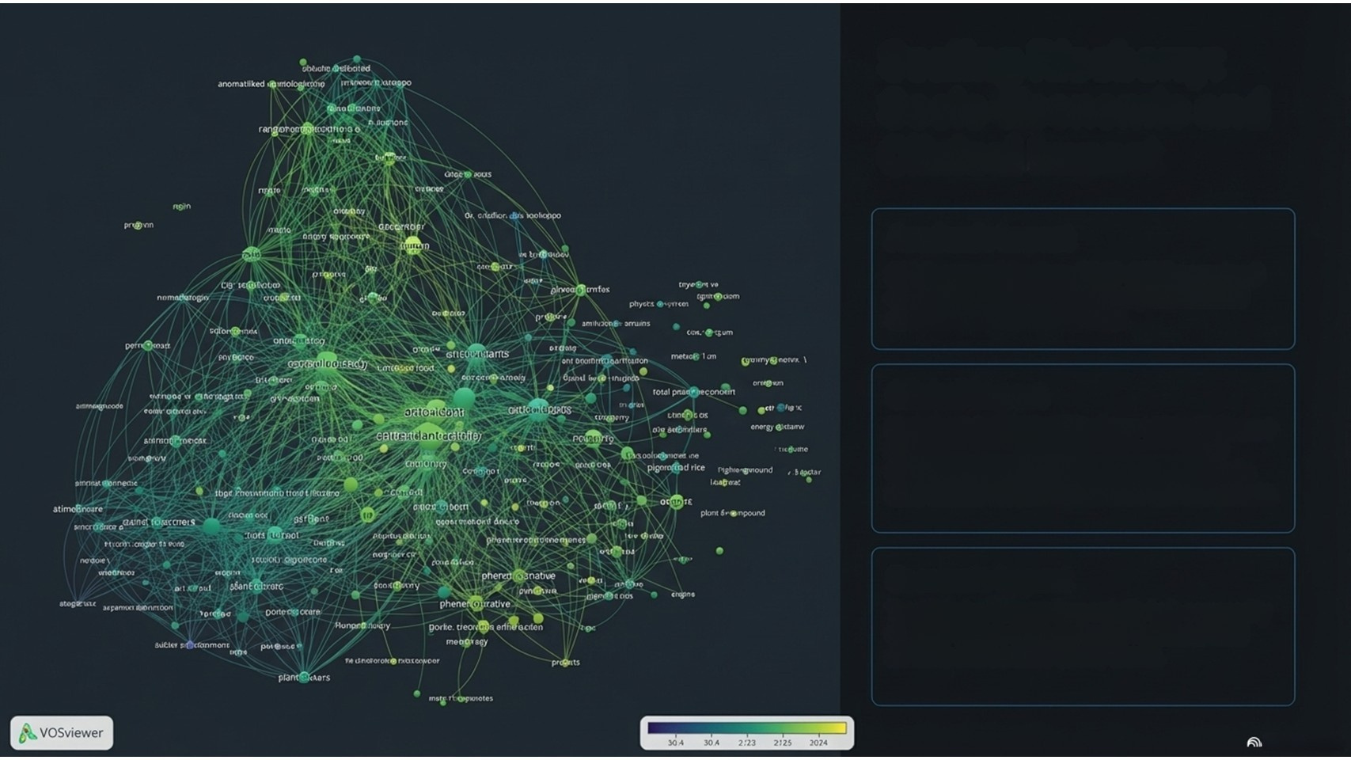


Scaling Riceberry:
Socio-Economic and
Clinical Impact
Academic Impact
203 Scopus publications (2015-2025) spanning 5
distinct research clusters from physicochemical
analysis to human clinical trials.
Clinical Impact
Evolution into '3G Rice' (Riceberry + Hom Malaiman +
Pinkaset 4). Clinical trials demonstrate a low
Glycemic Index (52) and significant reductions in
BMI, visceral fat, and hepatic fat in OB+T2D cohorts.
Economic Impact
Transitioning farmers from volatile bulk commodity markets to high-value, protected functional food markets with certified Quality Marks.

Slide 20


Case Study 2: Introducing Pink+4
(Climate-Ready White Rice)
Dobac
Yield+
Next-Gen Cultivar: A newly developed,
climate-ready white rice variety engineered
from an elite pedigree (Pink+4#78A03).
Database-Driven Success: A direct, tangible
output of the modern MAS and phenomics
selection pipeline.
Blast
Resistance
Broad Resistance Matrix: Built-in, stacked
immunity to Rice Blast, Brown Planthopper
(BPH), and Leaf Blight.
Submergence
Tolerance
Agricultural Security: Designed to drastically
reduce financial and crop loss risks for
farmers operating in volatile climates.

Slide 21

Case Study 2: Pink+4's Metabolic and Structural Innovations
Metabolic Health
Specifically bred for a Low Glycemic Index
(GI) and Load (GL), transforming white rice
into a health-conscious choice.
Low Glycemic Index
Blood Sugar Response
Stomatal Mutant Technology
Incorporates a genetically modified, low
stomata density to drastically conserve
internal water reserves.
Standard
White Rice
Drought Defense
Optimized transpiration allows the plant
to survive and thrive during severe,
prolonged dry spells.
The Future Standard
Irrefutable proof that maximum yield, human
health benefits, and extreme climate readiness
can seamlessly coexist in a single seed.

Slide 22
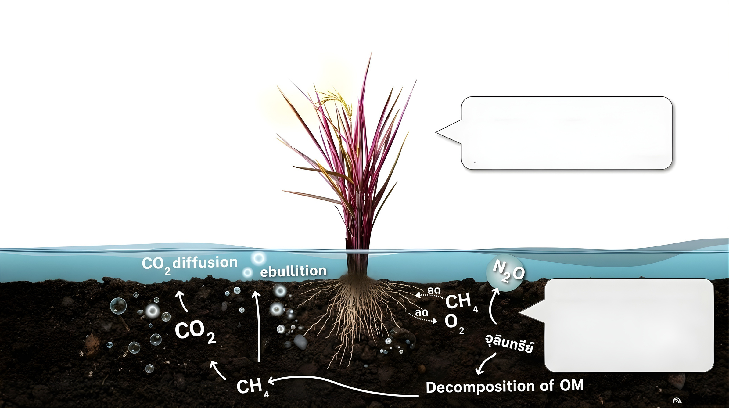
The Next Model: 'Rainbow Rice'
50 % Weight
50 % Weight
Leaf
Grain
Nutrient-dense foliage optimized with high chlorophyll, anthocyanin, and carotenoids.
Engineering low stomatal density to reduce transpiration during extreme heat.
Starch 0 %
Starch 70-80 %
Fibre 70-80%
Fibre < 10 %
Minerals
N, K, Ca, Mg, Fe, Se
Minerals
P, K, Mg, Ca, Zn
Pigments
High chlorophyll, Anthocyanin, Carotenoid
Pigments
Anthocyanin
(Pigmented rice)
The Soil/Carbon Nexus
Low-carbon rice systems. Root
architectures designed to minimize
anaerobic methane production
and interact cleanly with the soil
microbiome, directly combatting
greenhouse gas emissions.

Slide 23
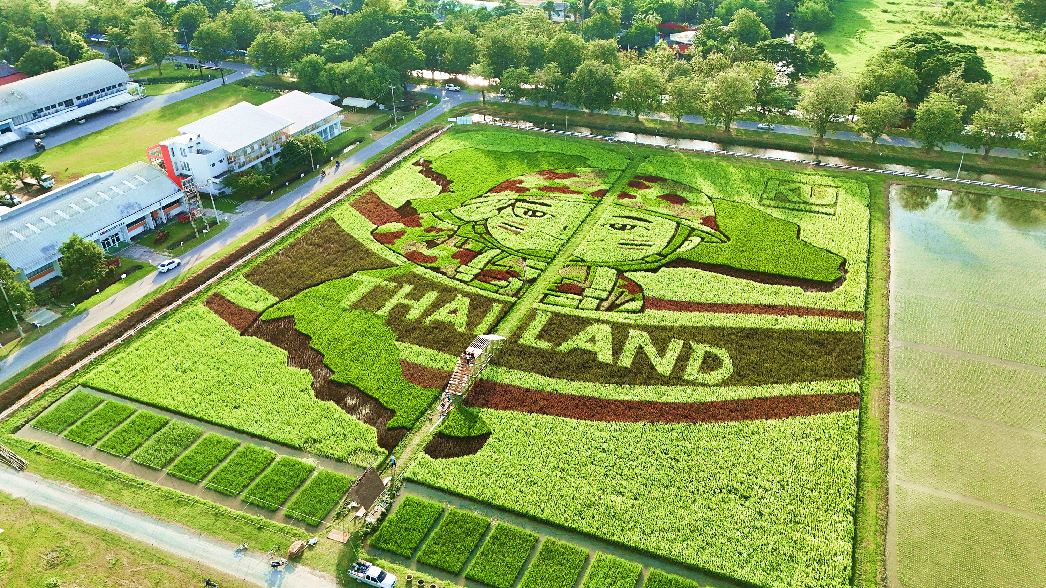
'Rainbow Rice’
Ricefield art 2025

Slide 24

Thai Rice Strategy for the Future
Transitioning to a
Precision-Driven
Bio-Economy

Slide 25

Infrastructure and Capacity
Facilities
Human
Capital
Innovation
Ecosystem
Digital Traceability
Architecture:
Building national
track-and-trace
logistics systems
alongside
satellite-monitored
precision farming
platforms.
Centralized
Diagnostic Hubs:
Deploying 'One-Stop
Service' government
laboratories to provide
rapid, affordable
DNA verification and
pesticide residue
testing.
Next-Gen
Human Capital:
Launching intensive
'Rice School'
curriculums with
academic
institutions
to transform
traditional labor into
tech-literate
"Young Smart
Farmers."
Pre-Commercial
Pilot Plants:
Backing dedicated
testing facilities to
help startups refine
and scale high-value
processed rice
products prior to full
industrial
commercialization.
Intellectual Property
Ecosystem:
Strengthening patent
registration pipelines
and Geographical
Indication (GI)
frameworks for
premium, functional
crop varieties.

Slide 26

The Evolution of Value
Traditional Volume
Precision Value
The Technology Paradigm Shift:
Thailand is pivoting away from a traditional,
volume-based agricultural model.
The Technology Paradigm Shift:
Aggressively pivoting to a precision,
technology-driven bio-economy.
From Production to Market-Led:
Moving on from the legacy philosophy
of 'produce before selling'.
From Production to Market-Led:
A hyper-targeted strategy driven by
global demand data and high-margin
segments like medical foods.
The Ultimate Goal
The 'Thai Rice Strategy for the Future' secures unwavering global competitiveness, economic resilience, and total supply chain sustainability.

Slide 27

Regional Imperatives: Unifying
ASEAN Genomic and Climate Data
•Transnational Database: Architect and launch a
unified ASEAN platform for real-time genomic and
climate-data sharing.
• Joint Climate Protocols: Regionally standardize and
enforce carbon footprint measurements alongside
Alternate Wetting and Drying (AWD) practices.
• Cross-Border Resilience: Execute joint breeding
programs to permanently secure regional food security
against shared, catastrophic climate threats.
• Market Harmonization: Strictly align grain quality
and organic certification standards to multiply ASEAN'S
global export negotiating power.
• Pest Mitigation Network: Establish an automated,
regional early-warning system capable of halting
transboundary pest and disease outbreaks.

Slide 28

Transforming Agriculture
from High-Volume to High-Value
Accelerated Breeding
is the Catalyst
Climate Adaptation
is Urgent
Advanced genetics are the only
mechanism capable of unlocking
both high-value nutraceuticals
and absolute climate resilience
simultaneously.
Rapid mitigation of GHG emissions
and abiotic stress tolerance are
non-negotiable requirements for
ecological survival.
Collaboration
Drives Scale
Socio-Economic Uplift
The ultimate strategic objective
is transforming the entirety of
Thai agriculture from a high-volume/low-margin
commodity into a high-value/
sustainable powerhouse.
Systemic success requires
tightly linked. aggressively funded
Public-Private Partnerships
aligned with grassroots NGOs.

Slide 29
The ASEAN Imperative: Opportunities & Systemic Challenges
The Opportunity (The Yield)
The Challenge (The Friction)
• Transitioning national output from
volume-based bulk commodities to high-
value, nutrient-dense functional foods.
• Overcoming severe capital requirements
for maintaining advanced genotyping
and phenotyping infrastructure.
•Deploying climate-ready, low-carbon
varieties to secure regional food systems
against extreme heat and flooding.
• Scaling complex genomic tools from
isolated academic centers to national
agricultural extension programs.
• Elevating aging farmer incomes through
premium quality marks, organic
integration, and direct health impacts.
• Navigating exceptionally slow and rigid
regulatory hurdles for the release of
multi-trait, highly engineered varieties.
“ASEAN synergy requires transparent sharing of bioinformatics data, genetic
resources, and clinical trial results to systematically accelerate the region's breeding timeline.”

Slide 30




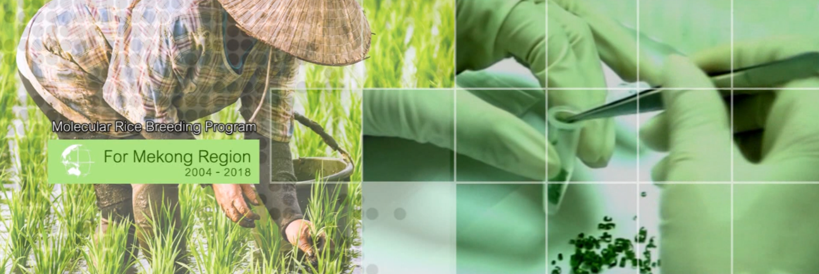

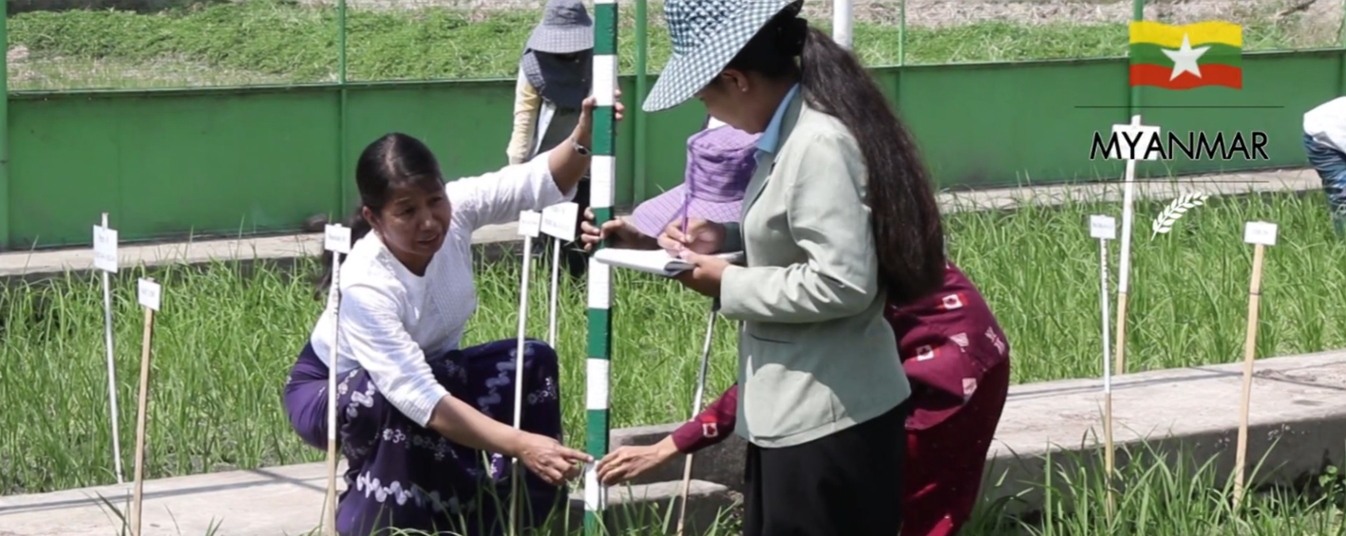
Molecular Rice Breeding Program for the Mekong Region — Thailand, Myanmar, Laos, and Cambodia — through the organization of hands-on training workshops and research sites, with the aim of developing human resources and fostering collaborative research.
The project support from the Rockefeller Foundation, Kasetsart University, and BIOTEC, National Science and Technology Development Agency (NSTDA).

Slide 31


20 Years of Molecular Breeding Partnerships and an Alumni Network Spanning the Mekong"
The Rice Science Center operates at an international level, running a Molecular Rice Breeding Program for the Mekong Region since 2004. Through this long-standing regional initiative, the Center has cultivated a multinational alumni network of researchers and scientists spanning member countries
Laos
Myanmar
Philippines
RSC-KU
Cambodia
Indonesia

Slide 32





The Thailand Rice Science Research Hub of Knowledge
“Bring together experts to share information on Rice”
21 Countries
50
Partner
Institutions
Collaborating
60 Agencies
https://thailandricehub.org

Slide 33

Thailand Rice Science Research Hub of Knowledge
The Continuous Innovation Engine
Frontier
Research
Rice
Breeding
Advancing in-depth rice science (biochemistry, physiology, bioinformatics) and developing comprehensive germplasm databases to accelerate precision breeding.
"Breeding-by-Design" to create climate-resilient, high-yield varieties, alongside specialized rice for medical diets (e.g., diabetes, kidney disease) and industrial use.
Global capacity building
and field deployment generate
real-world data and train
next-generation scientists,
directly feeding back into and
accelerating our frontier research.
The Thailand Hub of Rice is a
perpetual motion machine
for global food security.
Capacity
Building
Product
Development
Innovating health-focused, nutrient-dense products and expanding industrial applications to maximize the added value of Thai rice.
https://thailandricehub.org
Fostering robust national and global expert networks, organizing impactful research conferences, and driving comprehensive knowledge-transfer training.

Slide 34



4th International Conference on Rice for The Future
Location: Bangkok, Thailand
Date: November 23-24, 2026
We warmly invite you to join us at this international conference, where leading experts and researchers converge to shape the future of global food security.
https://thailandricehub.org

Slide 35
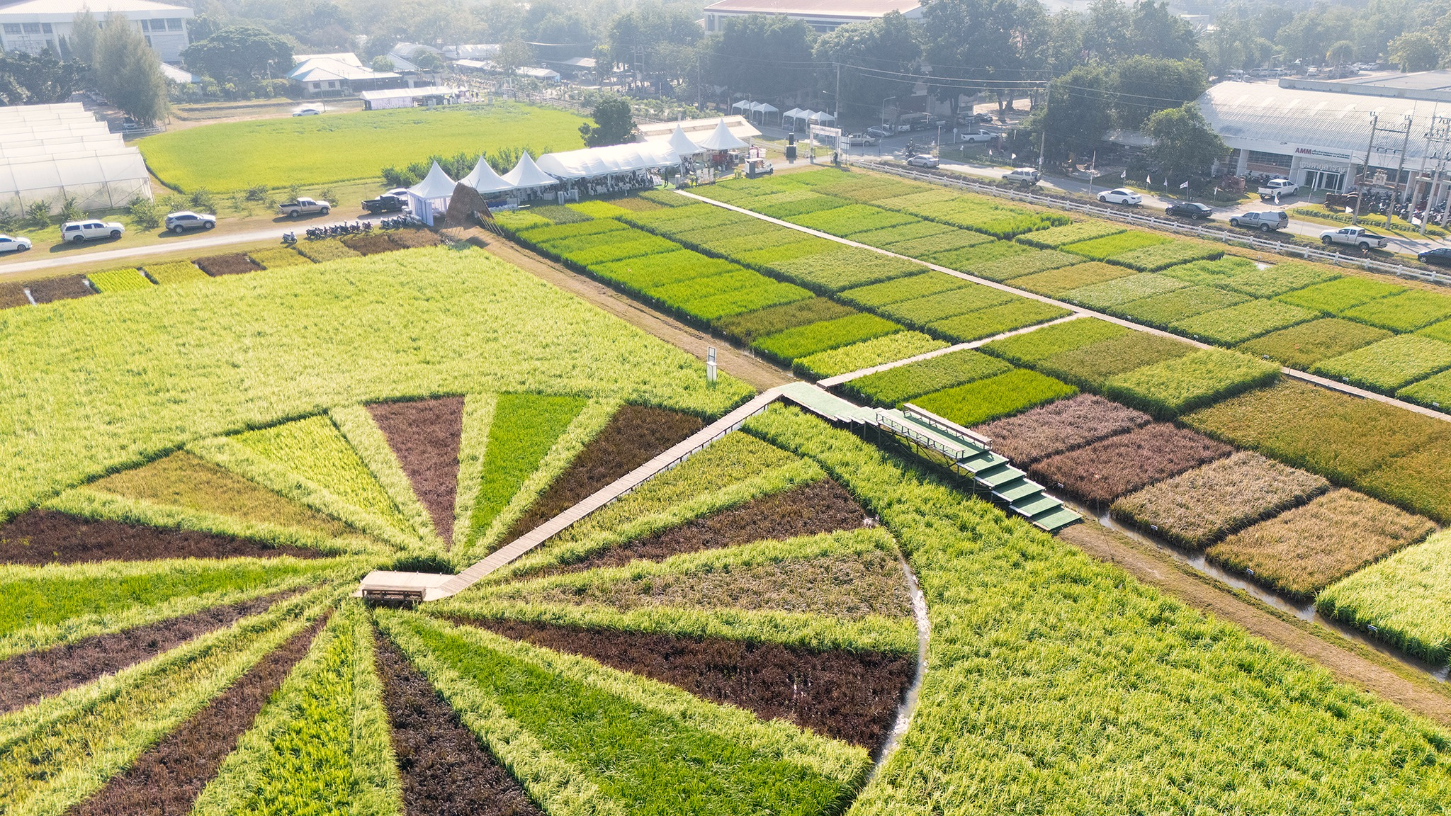
Cultivating the Future of Global Food Security
Thank you

