Slide 1
Accelerated Breeding for
Climate Resilience in Rice
`
“From Potential to Impact in Southeast Asia”
International Rice Research Institute

Slide 2
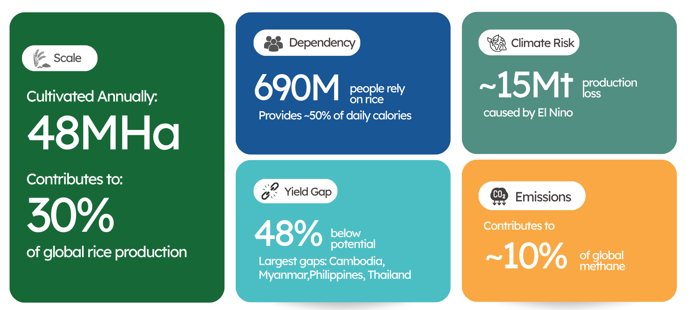
Southeast Asia: A Critical but Vulnerable Rice System
Sources: IRRI (2024); Stuart et al., Nature Food (2022); CSIS (2024); IPCC AR6 (2021)​

Slide 3
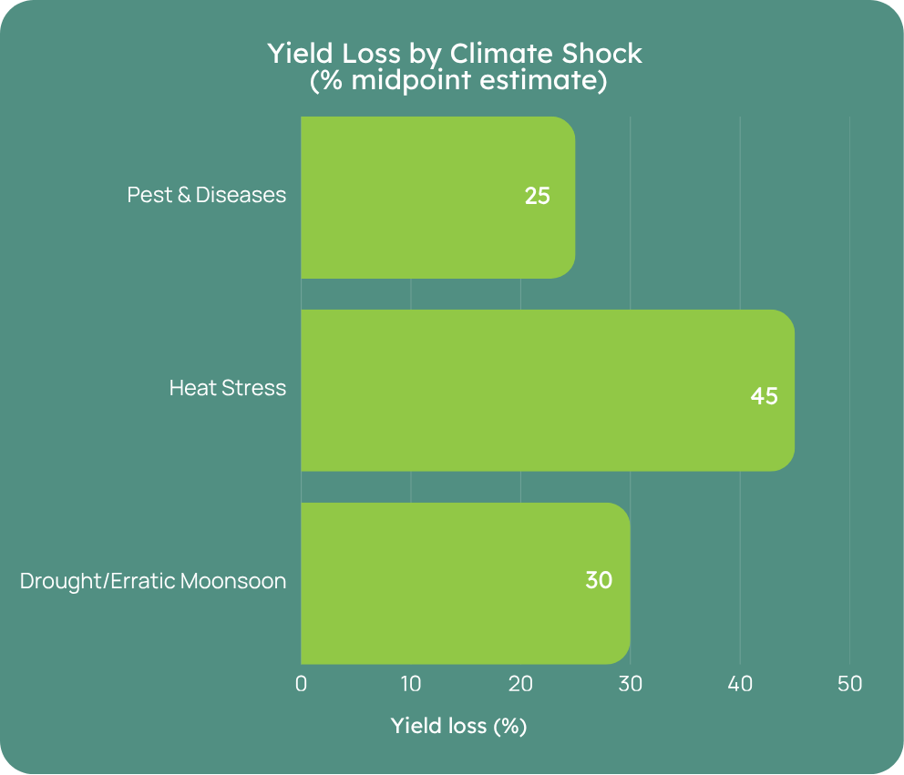
Climate Risk is Multi-Dimensional and Increasing
Rice crops are increasingly exposed to drought, heat stress, flooding, and salinity.
Increasingly, co-occurring stresses
→ Production instability
→ Resource pressure
Sources: IPCC AR6 (2021); IRRI Climate Research (2024); Farooq et al. (2011)

Slide 4
The New Breeding Reality: Competing Objectives
Climate Resilience
Productivity (yield, stability, disease resistance)
Quality, nutrition and markets
➔ Must be delivered together – Not sequentially

Slide 5
Why Accelerated Breeding is Now Essential
Climate change is accelerating
Systems are becoming more complex
Traditional breeding cycles are too slow
Required responses:
Faster cycle times
Better prioritization
More representative testing and more traits earlier in breeding cycle
Use of technology to achieve the above, not to enhance traditional breeding approaches

Slide 6
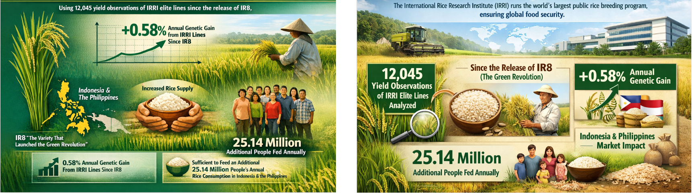
IRRI's notable impact in Southeast Asia

Slide 7
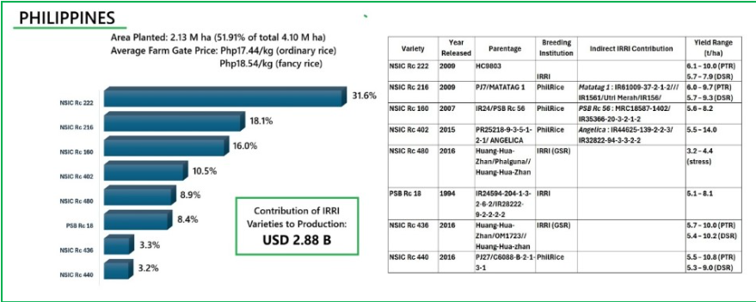
Increasing yield under increasing climate and system complexity
Case Study 1: IRRI-bred Rice Varieties Impact in the Philippines
ASEAN rice systems under increasing pressure. Climate variability and diverse ecosystems Uneven adoption of improved varieties Need for faster, market-responsive breeding | IRRI delivers impact at scale: 468 varieties released (1967–2024), 40% IRRI-bred Top 8 varieties cover ~52% of rice area ~90% with IRRI genetic contribution US$2.88B contribution to rice production (2022)
Breeding
Targeting
Delivery
Impact
How IRRI innovations deliver impact
High-yielding rice varieties
Market segment–driven breeding
Integration into National Systems
Scaling and adoption

Slide 8
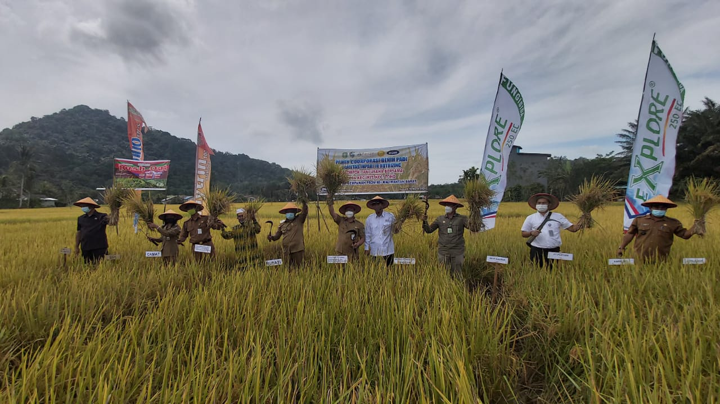
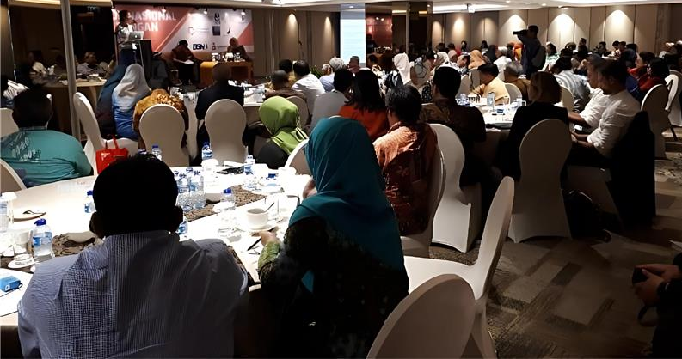
Beyond Yield: Delivering Nutritional and Market Value
Case Study 2: Scaling IRRI-bred Zinc-Biofortified Rice in Indonesia
Stunting driven by zinc deficiency remains a major public health challenge in Indonesia Limited dietary zinc intake in rice-based diets High stunting prevalence in vulnerable regions Need for nutrition-sensitive staple food solutions | Progress so far: Inpari IR Nutri Zinc developed by International Rice Research Institute and partners (released 2019) 200,000ha cultivated across 160 regions in Indonesia ~25% higher grain zinc (34.4 ppm) with no yield penalty

Slide 9
Beyond Yield: Delivering Nutritional and Market Value
Zinc-biofortified rice
Low glycemic index rice
Premium grain quality traits
➔ Quality traits are core breeding targets, including in the context of breeding for climate resilience

Slide 10
Direct-Seeded Rice
As a climate-smart solution

Slide 11
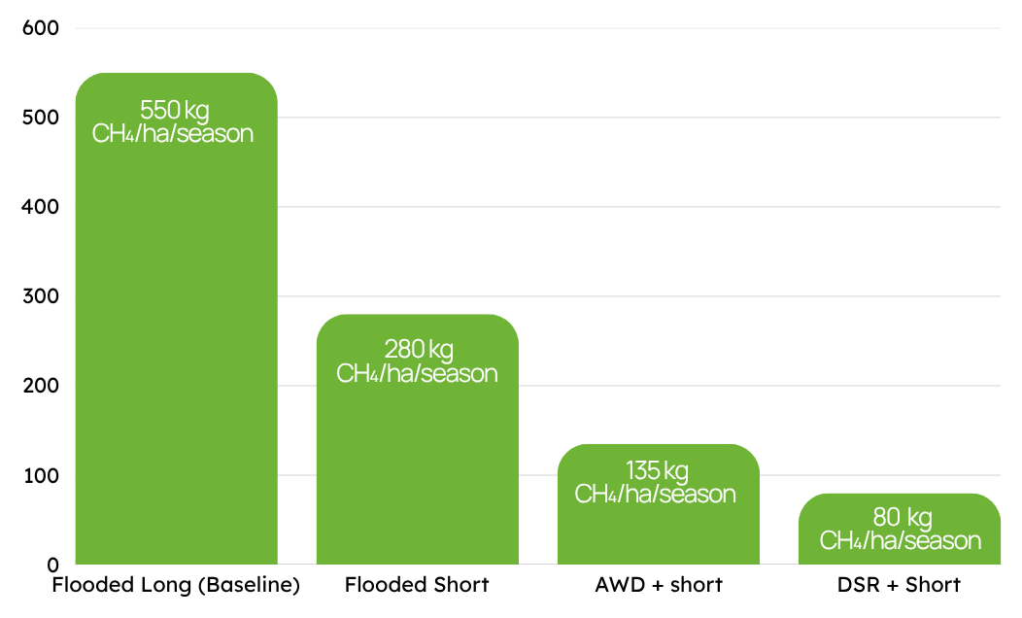
Impacts of DSR in Southeast Asia
Methane, Water & the Short-Duration Advantage​
Regional Adoption
Philippines DSR uptake (2016–17); expanding to Thailand, Vietnam, Myanmar
30-40%
DSR combined with short-duration rice cuts methane emissions by up to 85%, qualifying for Verra VCS carbon credits.
Water Savings
Less water than transplanted rice; vital as drought frequency rises
35%
Labor Reduction
Eliminates manual transplanting; addresses farm labor shortages
50%
Methane Mitigation
Less water than transplanted rice; vital as drought frequency rises
10-90%
Mechanization
Of global rice area; enables mechanized and drone-based seeding
~30%
Sources: PhilRice (2023); IRRI (2019); Yadav et al., Circ. Econ. Sustain. (2022); World Bank (2024); IRRI AcceLER (2025)​
Sources: IRRI (2024); Yadav et al., Circ. Econ. Sustain. (2022); ADB Methane Webinar (2023)​

Slide 12
DSR offers a scalable pathway to more resilient and resource-efficient rice systems in Southeast Asia and neighboring regions
Strategy Breakdown
AWD / DSR suitable area
~72 Mha
Irrigated systems
with drainage control
Area with Partial AWD possible
~10 Mha
Semi-drainable;
short-season varieties
Flooded/ Non-drainable Area
~45 Mha
Rainfed, flood-prone,
no drainage infrastructure
Sources: FAOSTAT (2023); Pathak et al. (2020) Environ. Monit. Assess.; IRRI AWD Database; National rice area statistics; Author estimates based on irrigation infrastructure surveys
Notes:
60-70% of suitable area has still not made the change. They cannot do so successfully without adapted varieties

Slide 13
Breeding for DSR
Dedicated breeding pipelines
Yield gains over elite checks
Example traits:
Anaerobic germination
Early vigor
Weed competitiveness
Lodging tolerance
Drought tolerance (AWD)

Slide 14
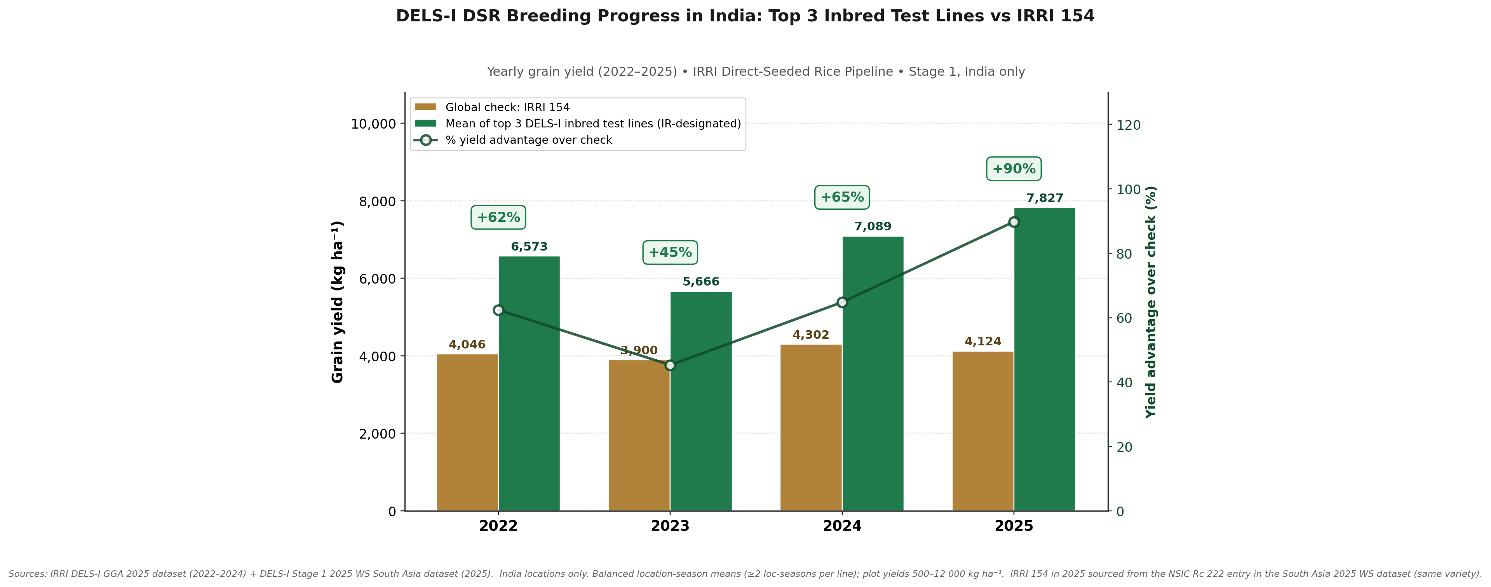
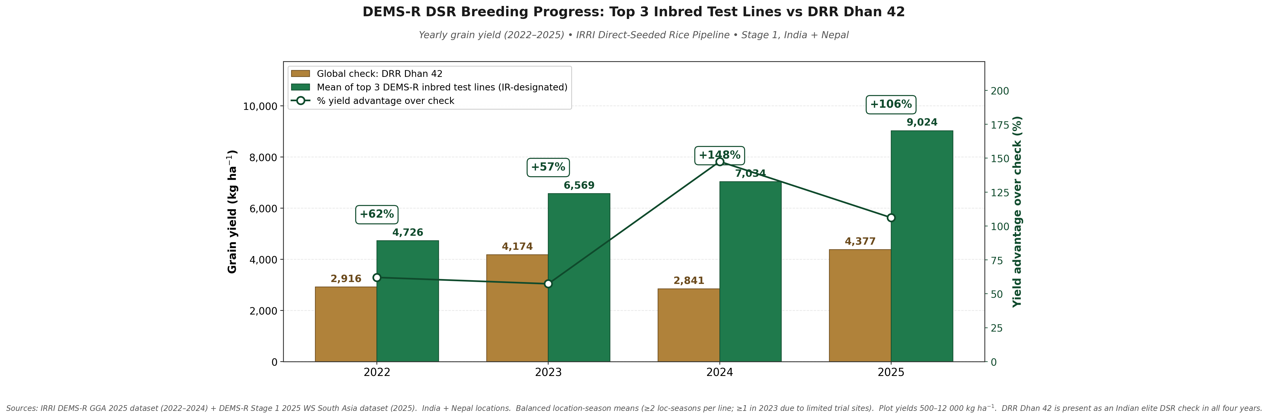
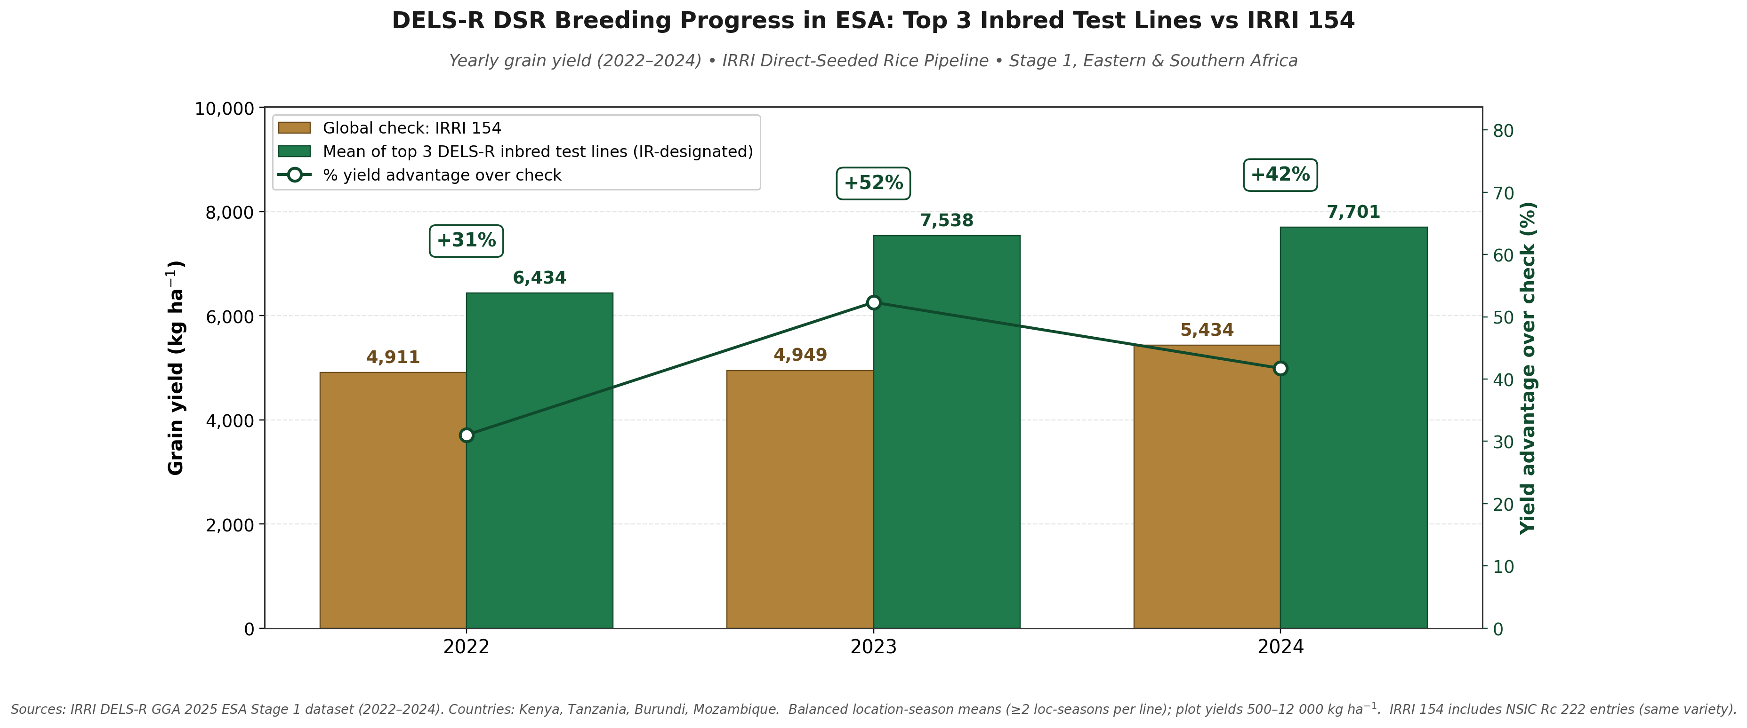
Direct-Seeded Rice Breeding Progress Across Three IRRI Pipelines
Steady, compounding yield gains over elite checks — DELS-I & DEMS-R in South Asia, DELS-R in Eastern & Southern Africa
DELS-I · South Asia (India)
DEMS-R · South Asia (India + Nepal)
DELS-R · Eastern & Southern Africa
Irrigated DSR 2022–2025
Rainfed DSR 2022–2025
Rainfed Lowland DSR 2022–2024
●
Why this matters for South & Southeast Asia
✚
Stacked traits — not just yield
▲
Cost of inaction for SEA
DSR is the region's fastest, least labour-intensive path to sustain rice output under water scarcity, rising wages, and methane pressure. These pipelines deliver cultivars bred specifically for dry-seeding, not re-purposed puddled-transplanted types — giving farmers a realistic alternative that does not trade yield for sustainability.
Top test lines combine the yield gains shown here with resistance to blast, BLB, brown planthopper, gall midge and stem borer, plus DSR-critical traits: uniform anaerobic germination, strong early vigour, weed-competitive seedling growth, lodging tolerance, and early–medium maturity for timely sowing windows.
Without sustained investment in DSR-specific breeding, SEA will be forced to keep leaning on transplanted cultivars that fail under dry-seeding — losing 30–100%+ yield potential already demonstrated here, forfeiting water and labour savings, and ceding adaptation leadership to other regions. The opportunity closes quickly as climate pressure intensifies.

Slide 15
Genome editing
Unlocking difficult traits to speed up multi-trait-integration

Slide 16
IRRI Gene Editing: From Labs to Farmer’s field
Target Traits in the context of agri- food system
Sustainable, healthier, and inclusive
Resistance to emerging diseases
(bacterial, fungal, virus )
Salinity, flood & heat tolerance, and Nutritive traits
Improved nitrogen remobilization
Enabling ecosystem
Editing Tools:
CRISPR :
Promoter editing Prime editing
IP-Freedom to operate is critical
Multiplex editing:
Trait stacking
CRISPR Gene knock out for gain of function - deletion
Strategic Impact:
Balanced regulation, involvement of value chain
Faster trait integration into elite varieties or regionally relevant crop genotypes: Direct Breeding Pipeline integration
Scalable innovations: CGIAR science program, NARS and ARIs partnership, public private partnership, capacity development
16
Notes:
Three pillars of of our ongoing scientific efforts and trainings are:
Accessible IP
Balanced regulation
Value-chain engagement
The overall goal is inclusive innovation for healthier and more resilient rice systems.

Slide 17
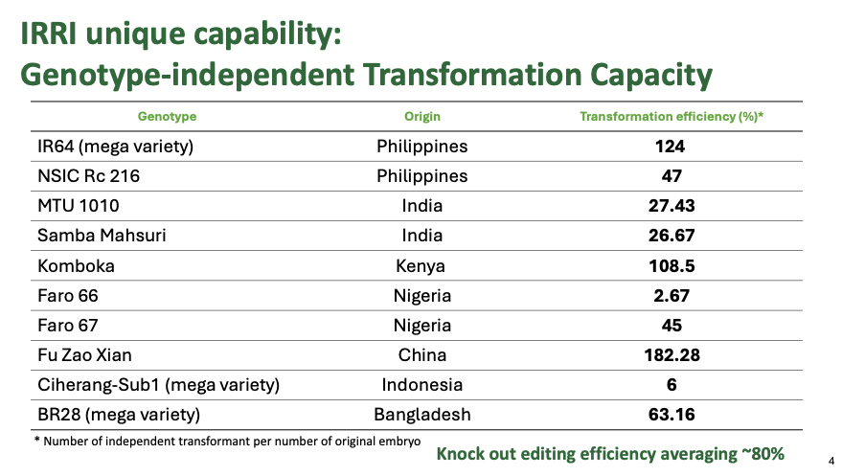
IRRI’s Genome Editing Product Development Pipeline
Product is similar to conventionally bred (post national non-GMO certification)
Regulated as Recombinant DNA research
17
Notes:
Genome editing is no longer a future technology — it is ready to deliver real solutions for farmers. To complement other breeding tool. IRRI already integrating precision editing directly into breeding pipelines to deliver climate resilience, improved nutrition, and sustainable production in farmer-preferred varieties.
IRRI and Indoensia can serve as a regional hub to advance ASEAN on gene editing.
Thank you.

Slide 18
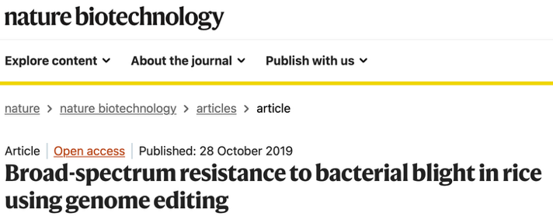
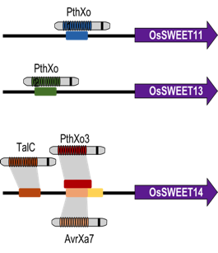

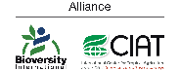





IRRI Gene Edited case study 1: Multiplex promoter editing for broad-spectrum Bacterial leaf blight (BLB) resistance
BLB (kresek) is the major rice disease in Southeast Asia, South Africa, and Africa.
Xa13
Xa25
Xa41
6
Notes:
Bacterial leaf blight is a major disease in Asia and Africa.
We developed transgene-free multiplex promoter edits targeting three SWEET genes at four effector-binding sites, preventing bacterial TAL effector activation.
This provides durable, broad-spectrum resistance while preserving farmer-preferred varieties such as IR64 and Ciherang-Sub1.

Slide 19
A Closer Look at Breeding Innovations
Priorities for IRRI

Slide 20
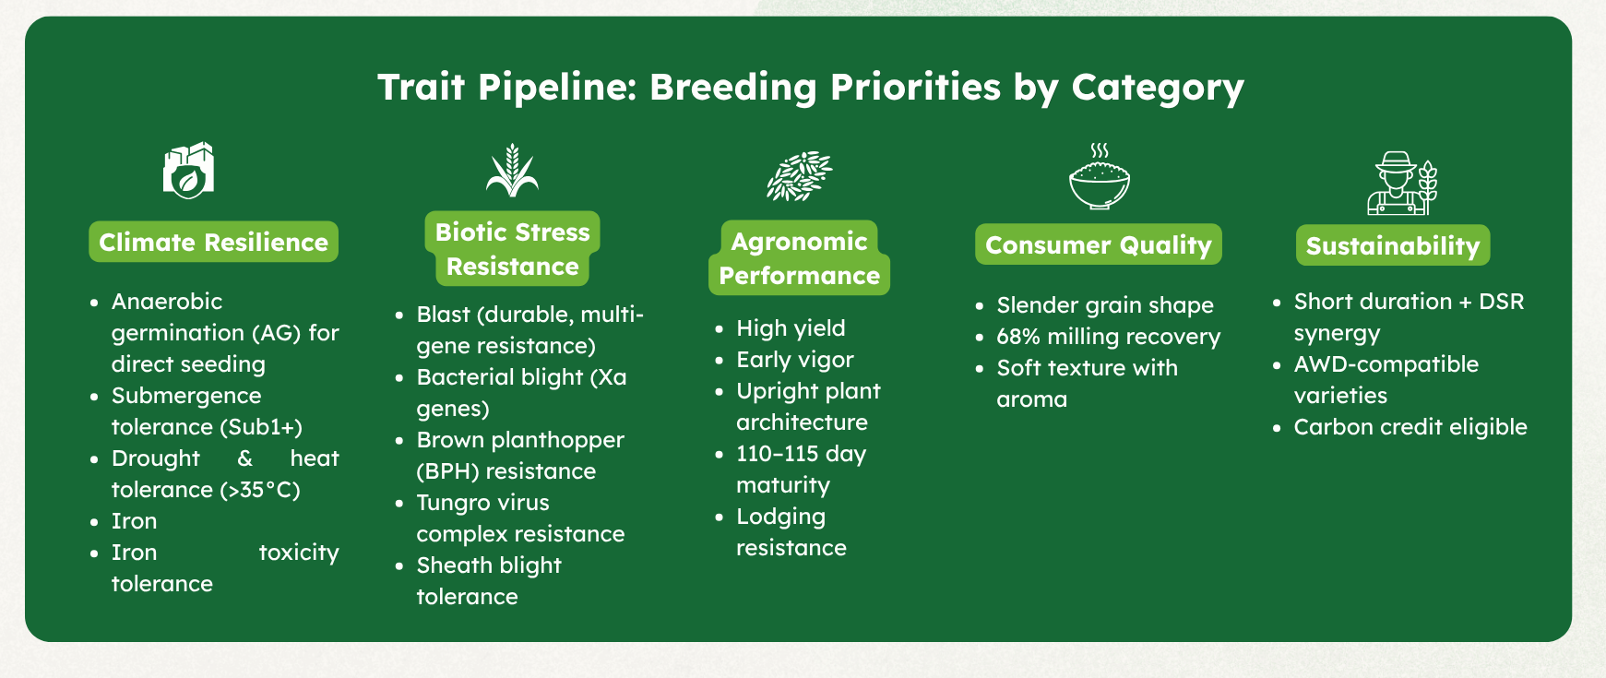
IRRI develops rice varieties with traits that combine climate resilience, biotic resistance, high yield, and consumer-preferred quality.

Slide 21
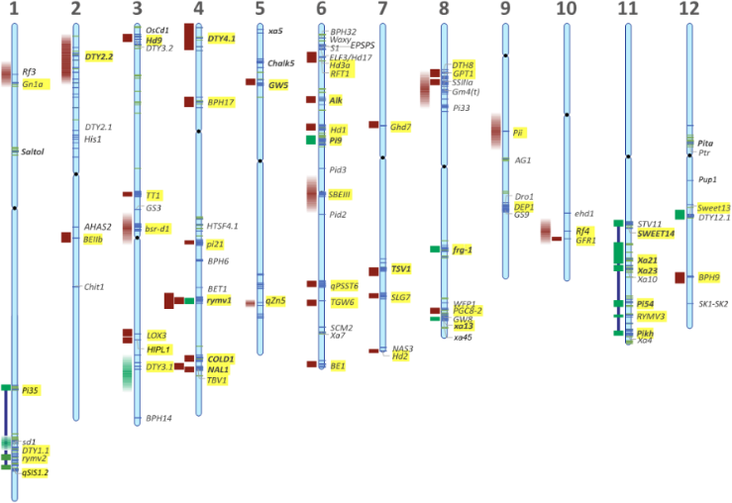
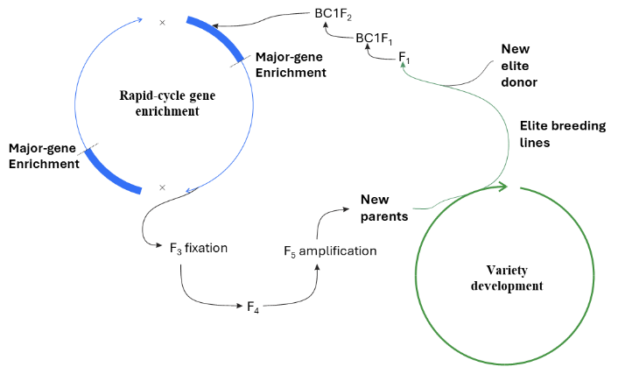
Rapid-cycle Gene Enrichment​
To deploy improved rice varieties faster, IRRI applies trait introgression and rapid-cycle gene enrichment to accelerate breeding cycles and delivery.
Trait Introgression
Introgressing major genes into elite varieties to accelerate rice improvement.
  Accelerated trait introgression by enabling faster accumulation and fixation of high-impact genes in elite rice varieties.

Slide 22
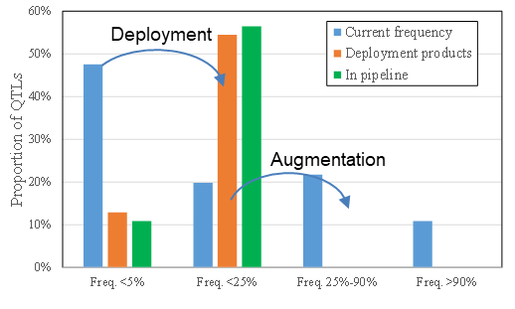
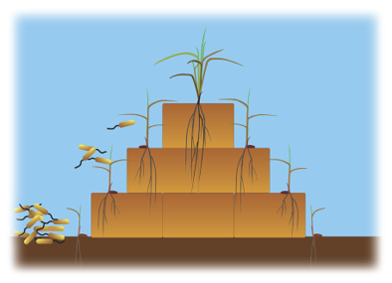
Increasing frequency of high value haplotypes
IRRI has developed rice lines with durable, long-lasting resistance to major pests and diseases, providing field-level protection in ASEAN’s high-risk environments.
Durable resistance for:
Blast (leaf and neck)
Bacterial blight
Tungro virus
Brown planthopper

Slide 23
How we deliver: The modern breeding stack
Speed breeding / rapid recycling
Trait Deployment and Augmentation to increase allele frequencies
Genomic selection
Breeding cycles from 6-7 years to 1-2 years
More representative early selection
Faster and more accurate decisions

Slide 24
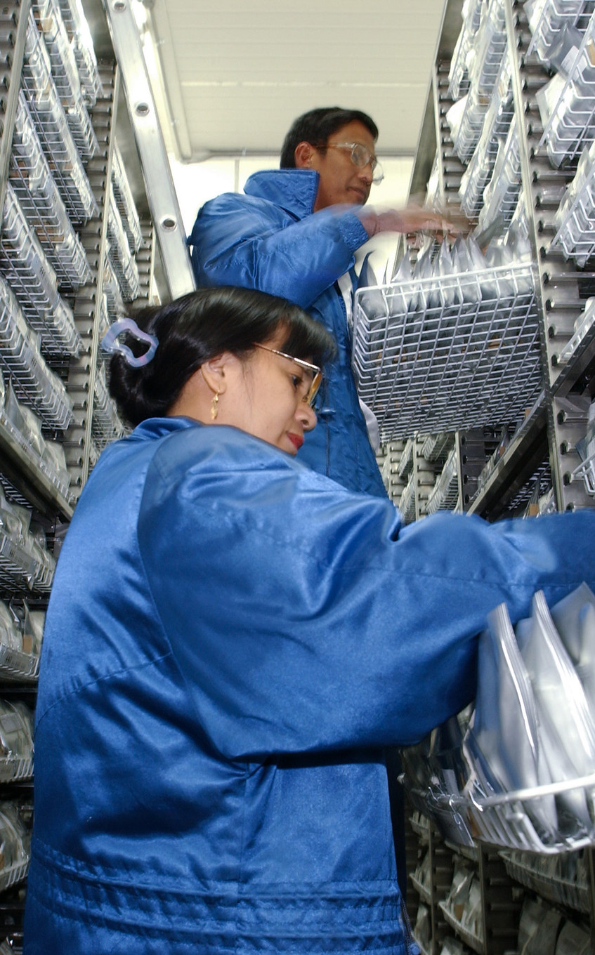
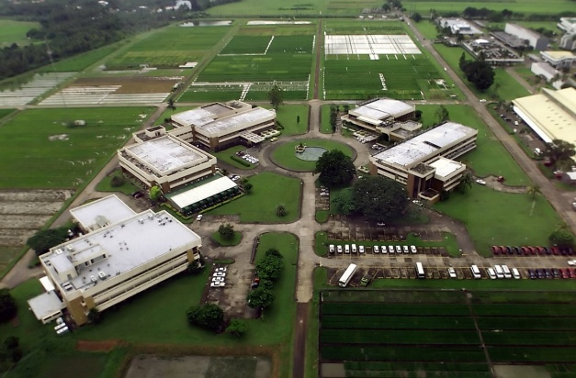

International Rice Genebank (IRG)
Established in 1977, IRG is the oldest and largest rice genebank, housing over 132,000 accessions, including ~5,000 wild species.
It is also the most diverse, representing 134 countries with 22 wild species across 7 genera.
2023 Google Grant
One of 15 global recipients, IRRI uses AI to screen its Genebank for faster delivery of resilient, high-yield rice.

Slide 25
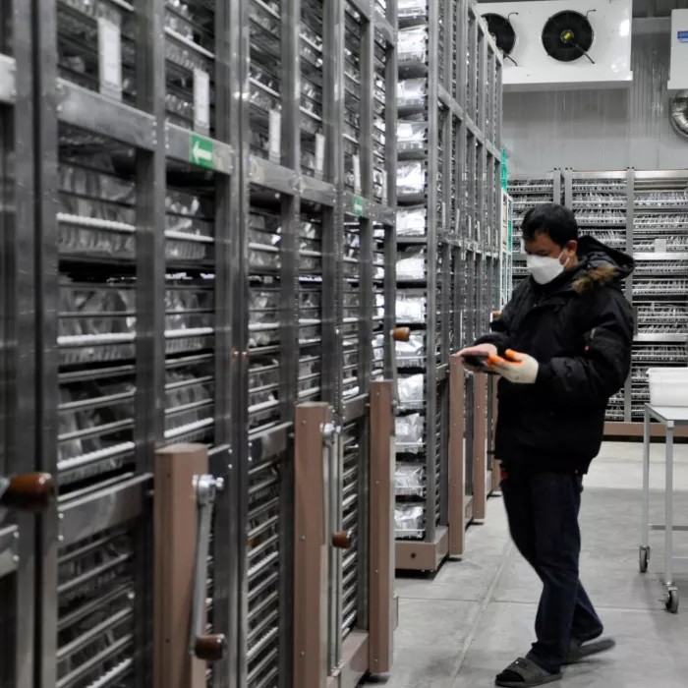
AI-enabled genebank screening
Dramatically accelerates donor discovery, reducing time and cost while expanding screening scale:
Traditional screening - Slow, costly, low-throughput
AI-enabled screening - Rapid, large-scale trait evaluation and more efficient donor identification
Impact
20,000 accessions screened (1977–2023)
60,000 screened (DS2024) → 1,207 tolerant lines identified
1/10 time, 1/16 cost vs conventional methods
➔ Combining world-class trait deployment with the Genebank’s resources = outsized value creation

Slide 26
Rice Breeding Network and Capacity Building Efforts
Partnerships across ASEAN and beyond

Slide 27
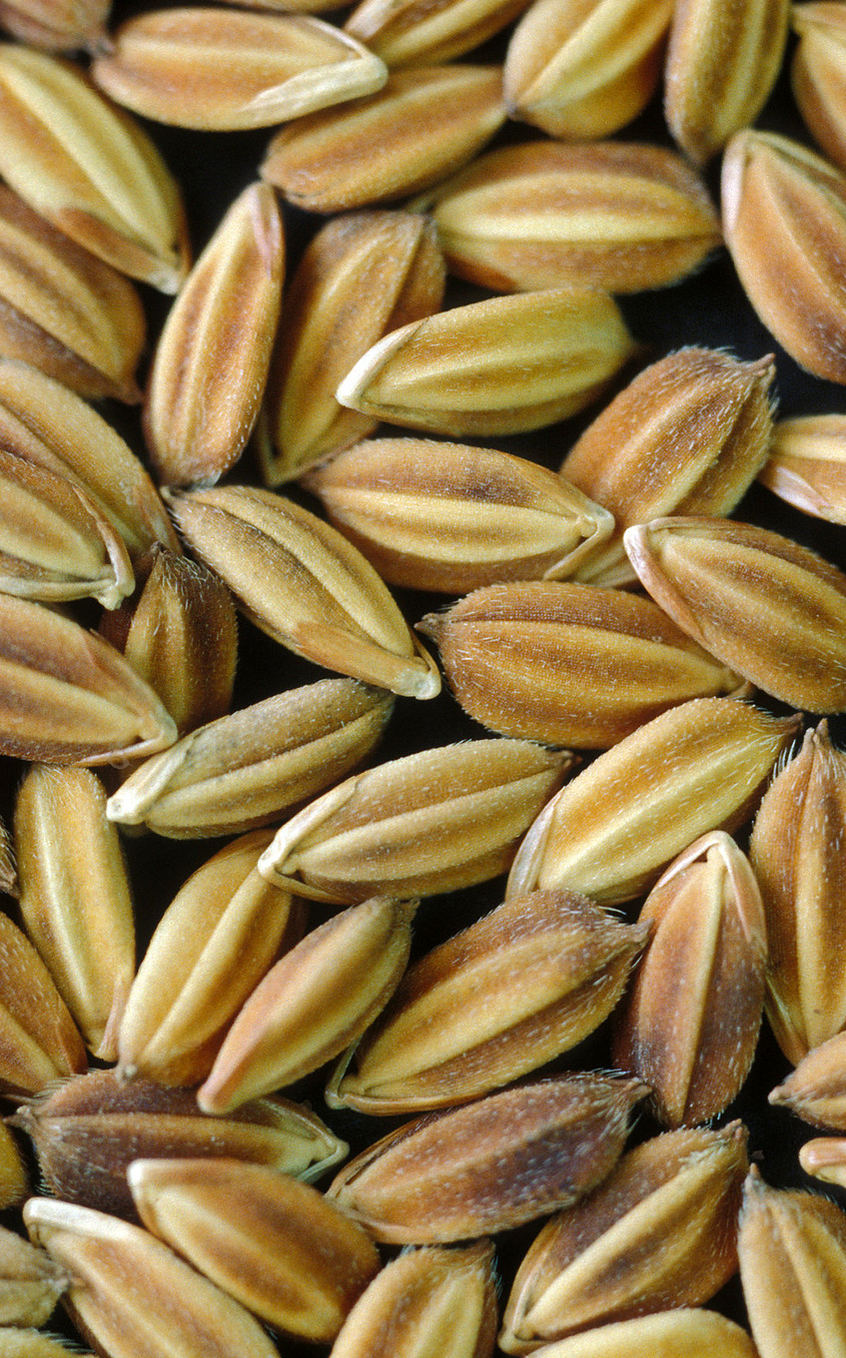
Variety development and scaling through regional development networks
3,038 lines shared to 7 member countries (Cambodia, Indonesia, Lao PDR, Myanmar, Philippines, Thailand and Vietnam)
1 salinity line released in Myanmar; 2 salinity lines given Plant Variety Protection approval for dissemination in the Philippines
144 lines under national testing across 7 member countries
>5,000 lines shared to SEA with traits for abiotic and biotic stress tolerance/ resistance
2018-2024
AFACI Project
2024
Thai Rice Dept
378 lines with blast and BPH resistance traits shared to Thailand for irrigated, submergence, salinity and cold tolerance testing
2021-2023
83 lines with submergence, salinity and bacterial blight tolerance/resistance traits shared to Thailand and 1 high yielding, medium maturing line shared for dissemination to farmers in Brunei
ASEAN RiceNet
2022-2025
2,250 lines shared to the Philippines with early and medium maturity suitable for transplanting and direct seeding methods, with combined salinity+submergence tolerance traits
8 lines nominated for national testing
OneRicePH
Notes:
More than 5,000 lines were shared to Southeast Asian countries through several projects and grants. Some countries were able to release varieties through variety registration or plant variety protection for distribution to farmers in target areas. Others have several lines under national testing with possible varietal release in 2029 or later. Countries with more developed breeding programs such as Thailand and Vietnam utilized these lines in their crossing programs with potential lines still in the early generation.

Slide 28
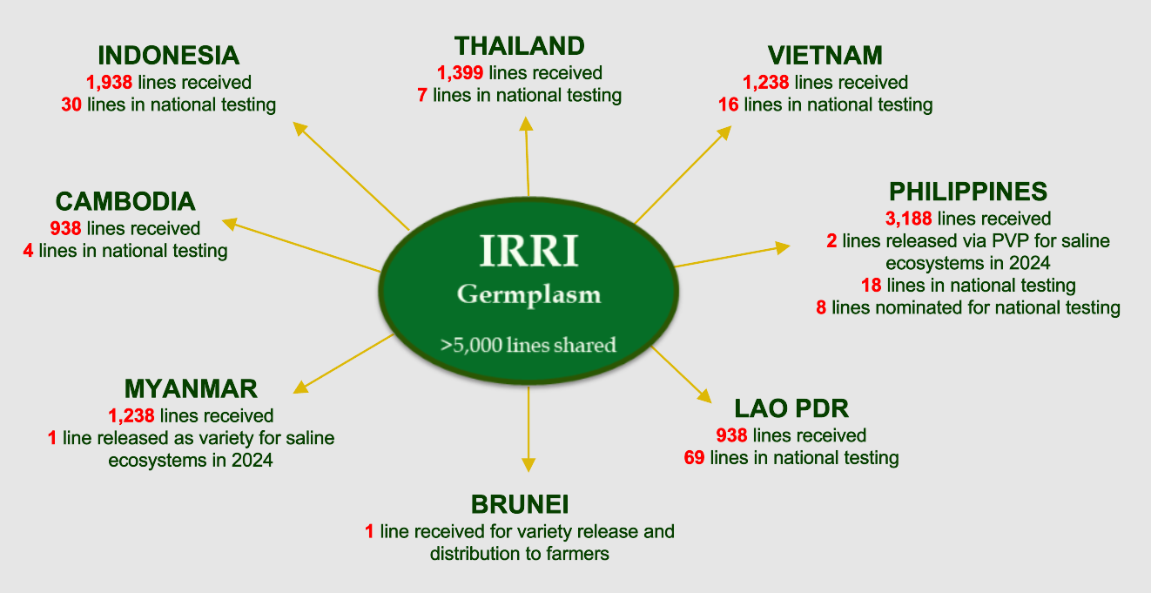
>5,000 lines shared from 2018-2025

Slide 29
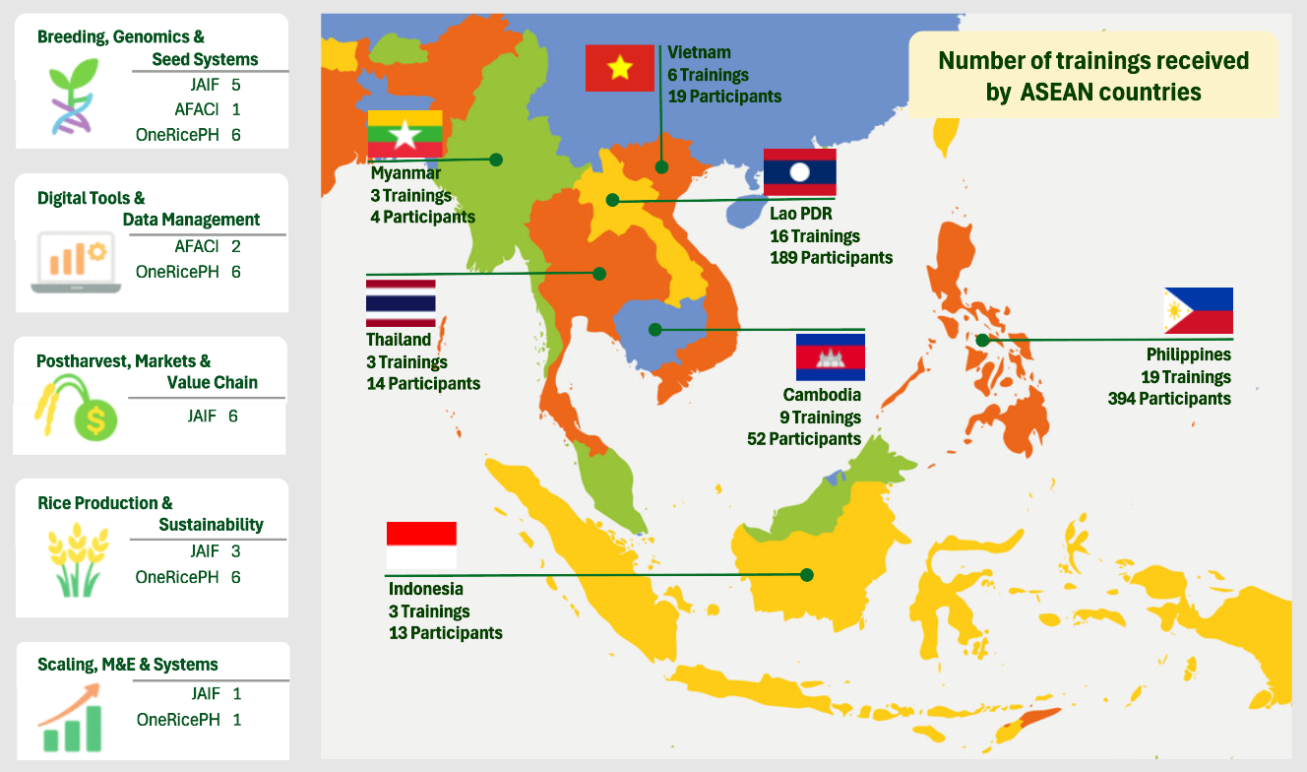
Capacity Development Across SEA
Notes:
Regional Breeding-SouthEast Asia: Capacity Development Activities
Left boxes: Number of trainings supported by 3 main donors (JAIF: Japan-ASEAN Integration Fund; AFACI: Asian Food and Agriculture Cooperation Initiative; and OneRicePH: Philippine Department of Agriculture) under 5 categories
Map: Number of trainings received/attended by ASEAN countries and number of participants trained.

Slide 30
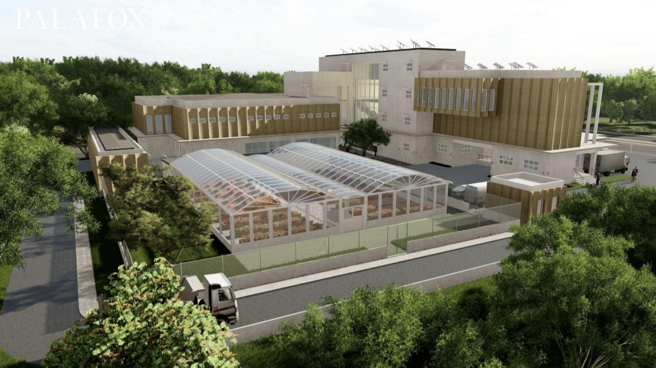
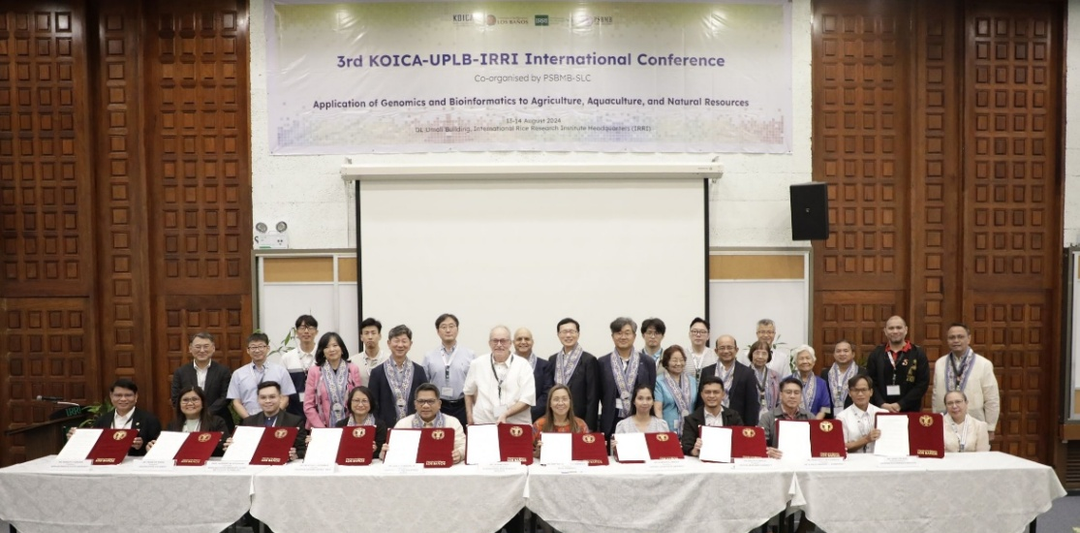
Increased OMICs Capacity Under Development:
Philippine Agricultural Genomics Research Center (AGRC) project funded by KOICA & implemented by IRRI
  Sequencing & Metabolomics equipment, Bioinformatics Server, Tissue Culture & CRISPR facility, Greenhouse with cooling system for integrated research on diverse agri-species including cereals, vegetables, beans, fruits, livestock, insects and microbiome
OMICs Network with CGIAR and 20 Korean/Philippine institutions

Slide 31
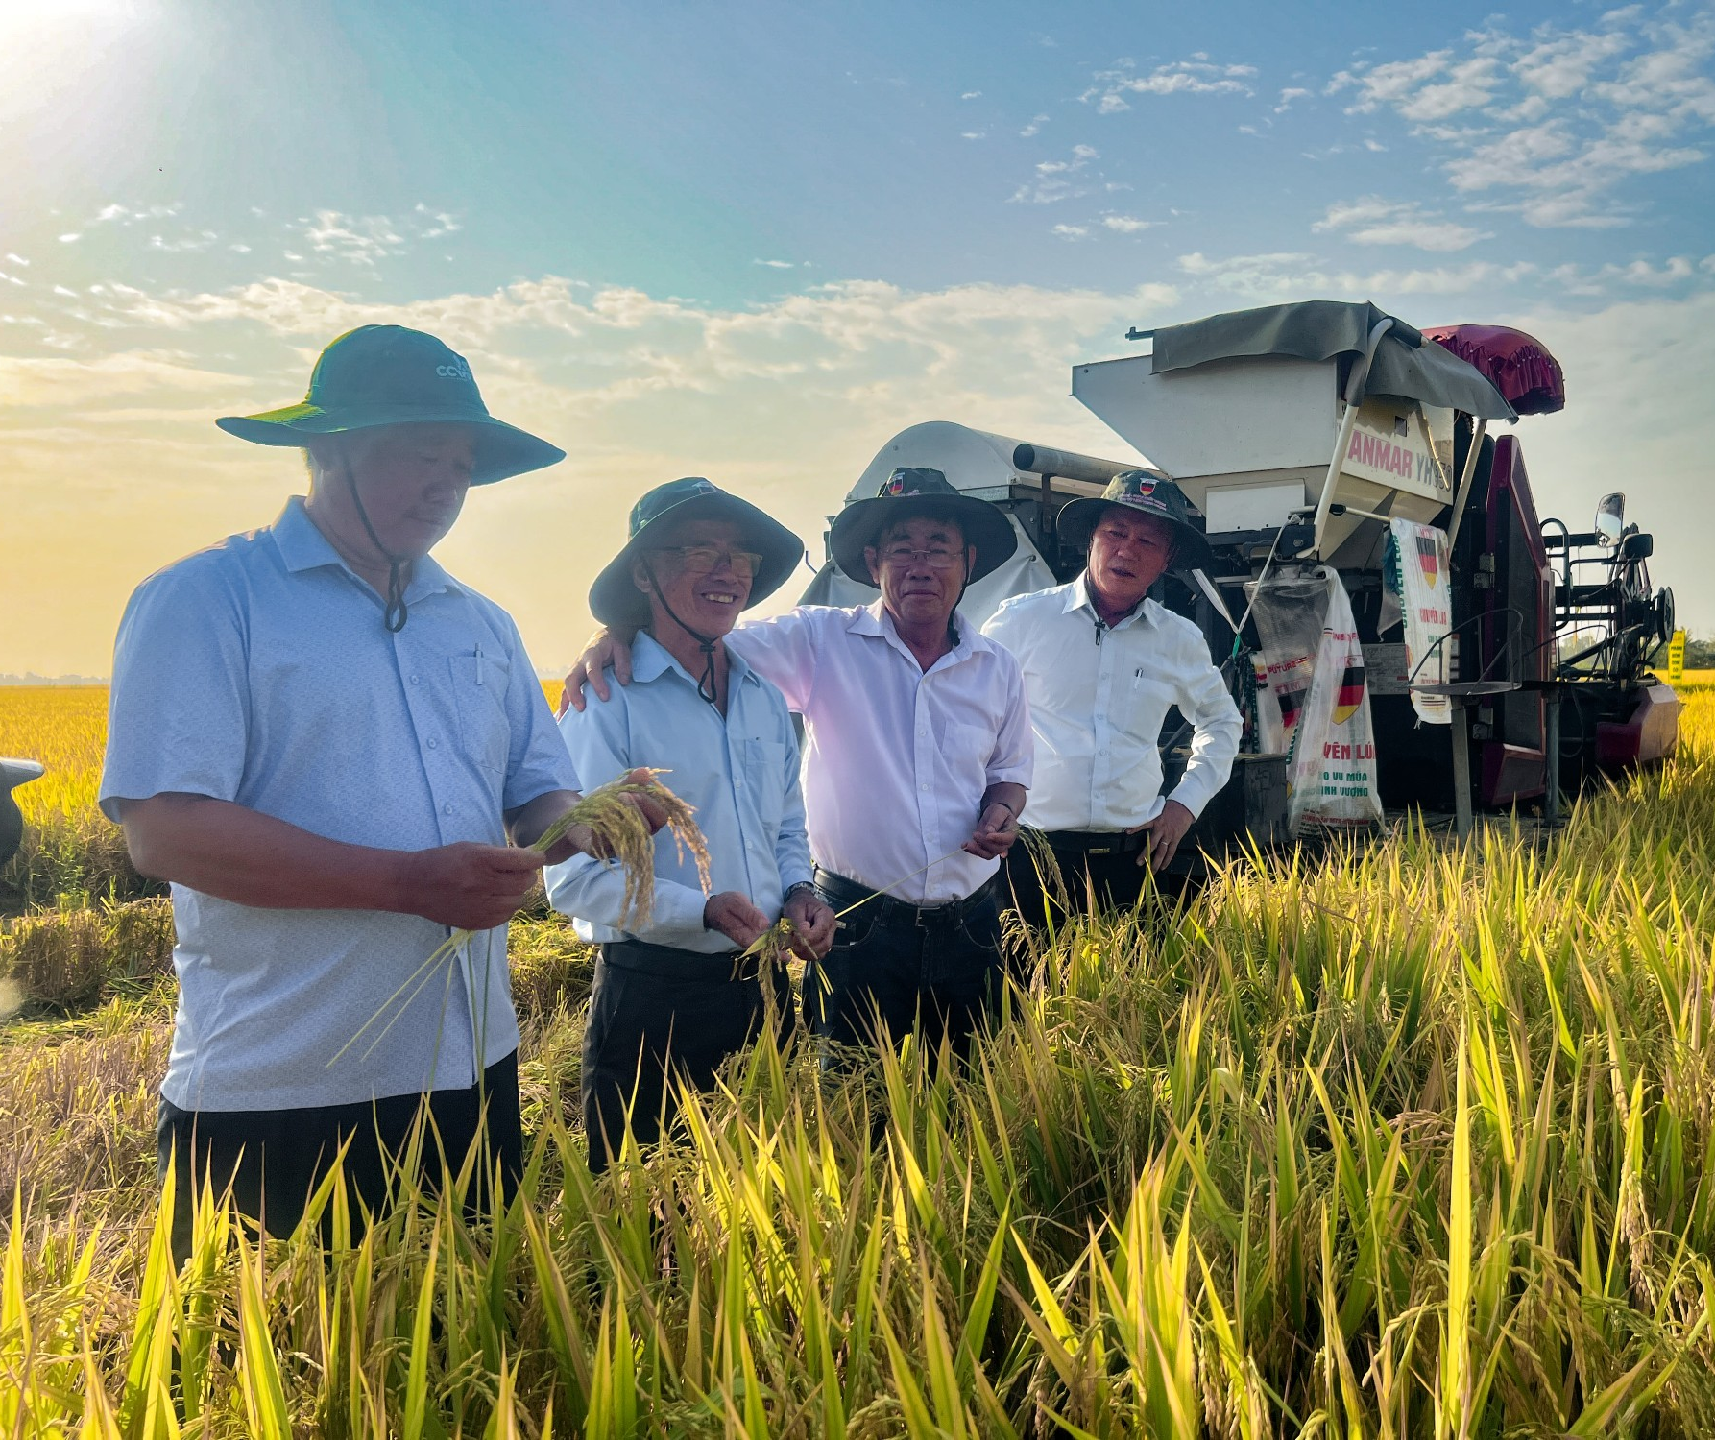
Coordinating Breeding Impact Across Partners
There are overlaps in objectives between countries.
Opportunities exist to combine efforts – also with IRRI’s breeding efforts.
Support to implement modern approaches and access to tools and services.

Slide 32
Steps Ahead
IRRI-ASEAN Partnership Opportunities

Slide 33
Emerging Opportunities for IRRI and ASEAN
High-quality, low-emission, low-input rice for sustainable production and premium markets
Disease- and pest-tolerant rice for stable yields and regional food security
Climate-smart varieties to adapt to flooding, salinity, and heat stress
Scaling priority segments (~4.1 M ha in PH) replicable in other countries
Faster adoption through variety replacement and cross-country sharing
Improved access via stronger seed systems
Innovation through AI, digital tools, and precision breeding

Slide 34
Partnering with IRRI for Breeding
Research – e.g., Trait Discovery
Parent Development
Variety Polishing
Variety Development
Scaling Support
Breeding Modernisation
Breeding Tools and Services

Slide 35
Future Outlook for IRRI's Impact in SEA
There is a lot we can do – the opportunities are vast and many
Funding has changed.
Funding will need to come from the region.
Upside – regional funders will be setting the agenda!
Better integration with National priorities and partners.

