Slide 1

The Power of Crop Diversity

Slide 2
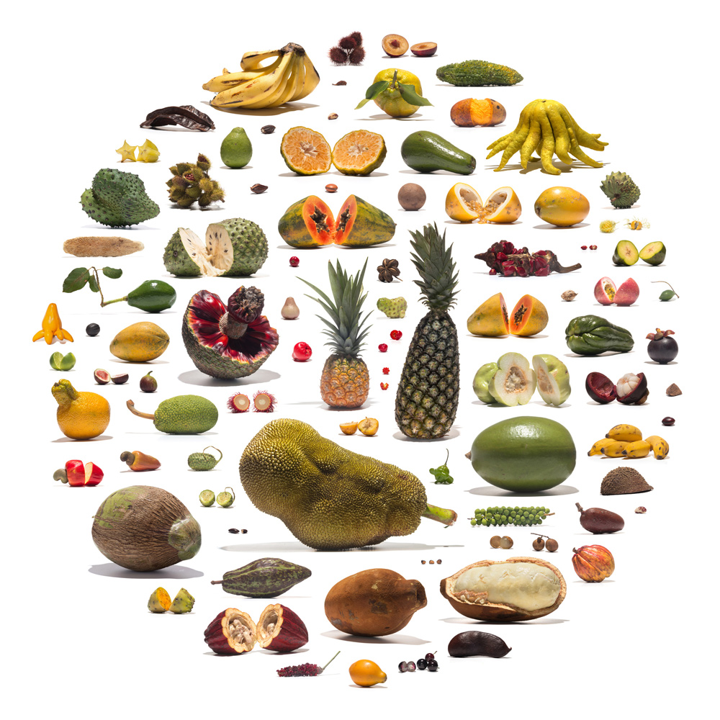
Diversity exists between different crop species
© Uli Westphal, 2016

Slide 3
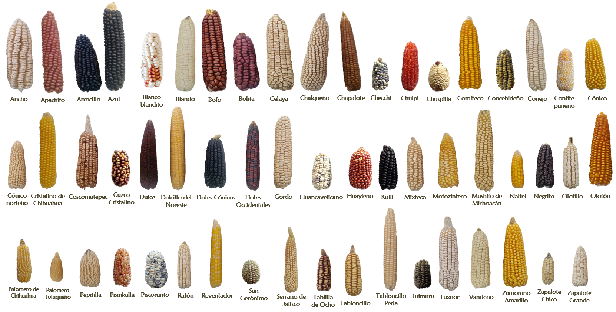
Diversity exists within individual crop species

Slide 4
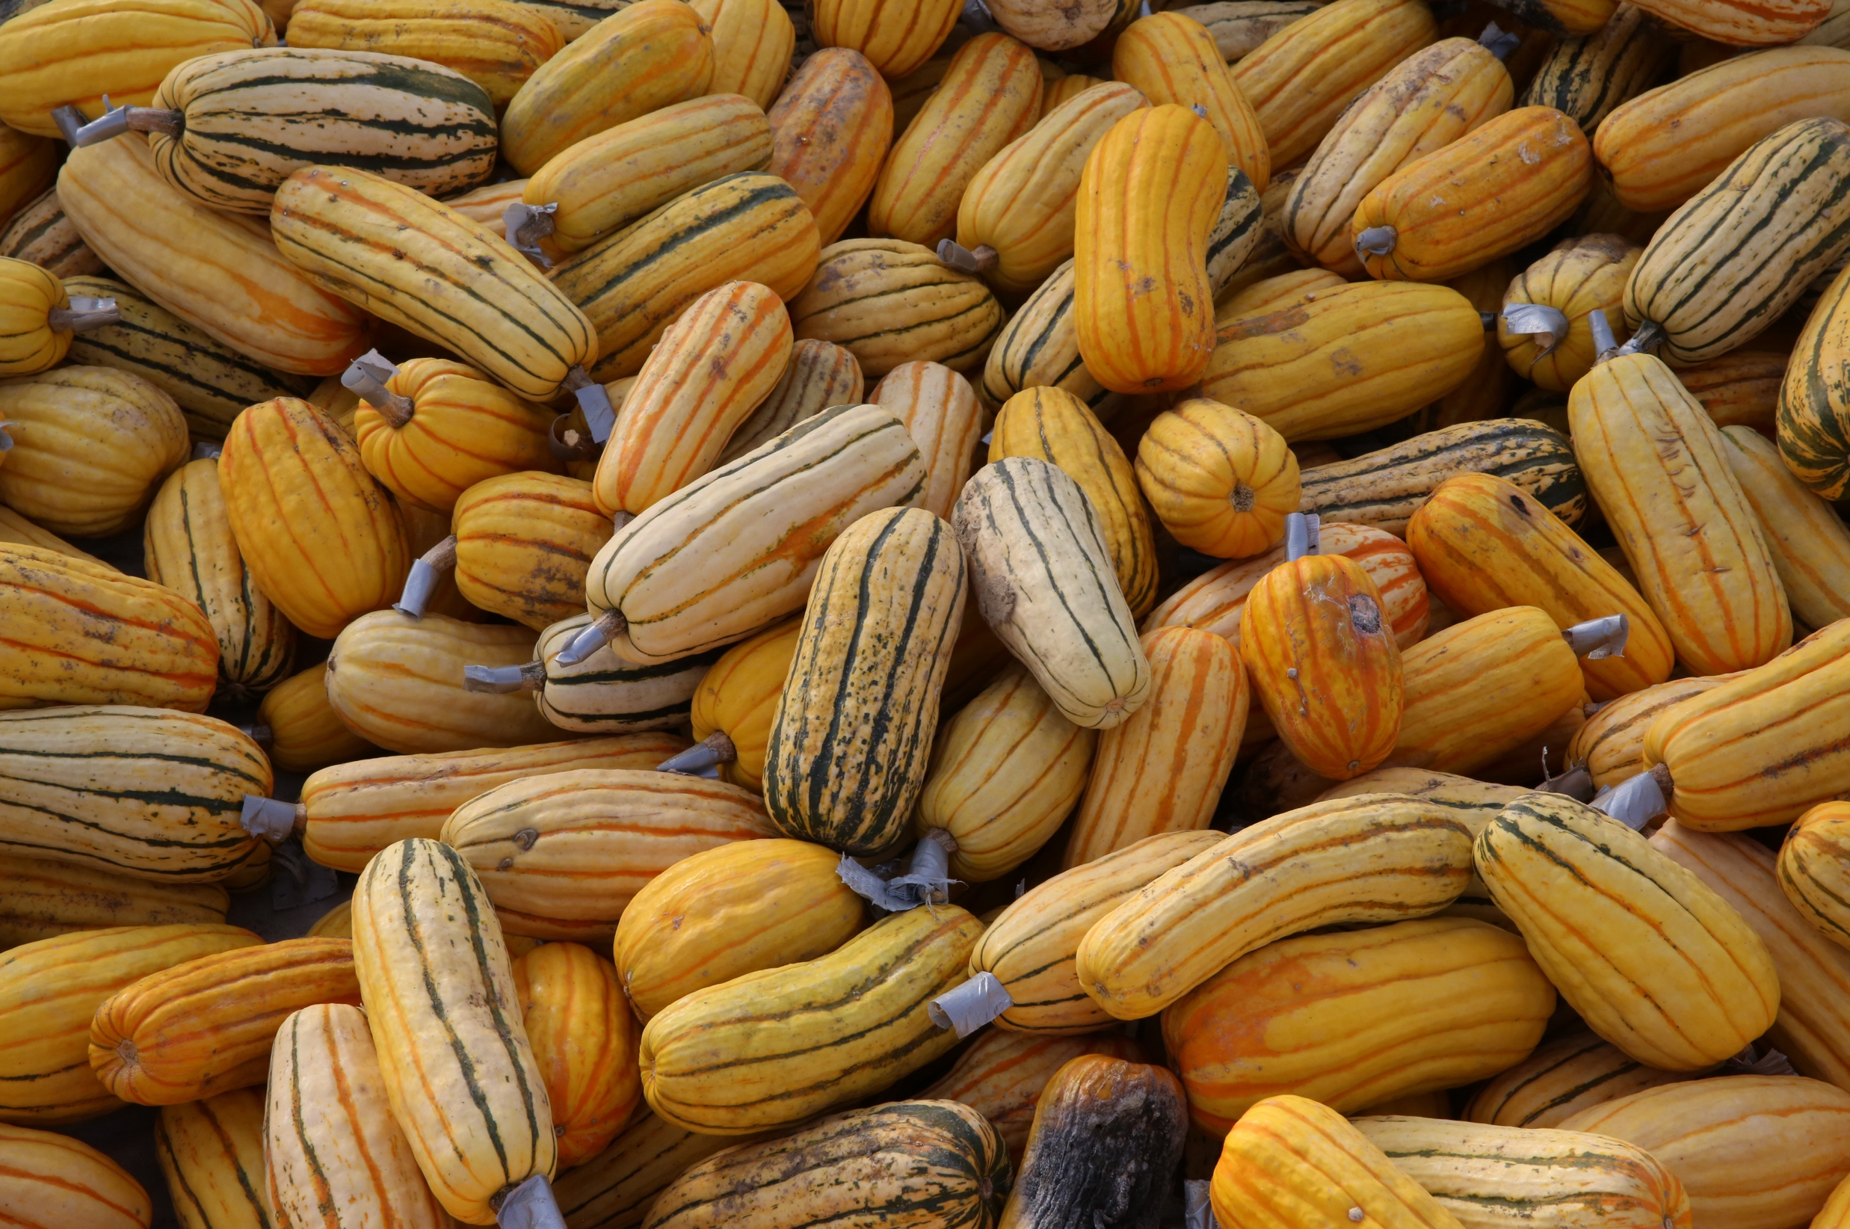
Diversity exists within individual crop varieties

Slide 5
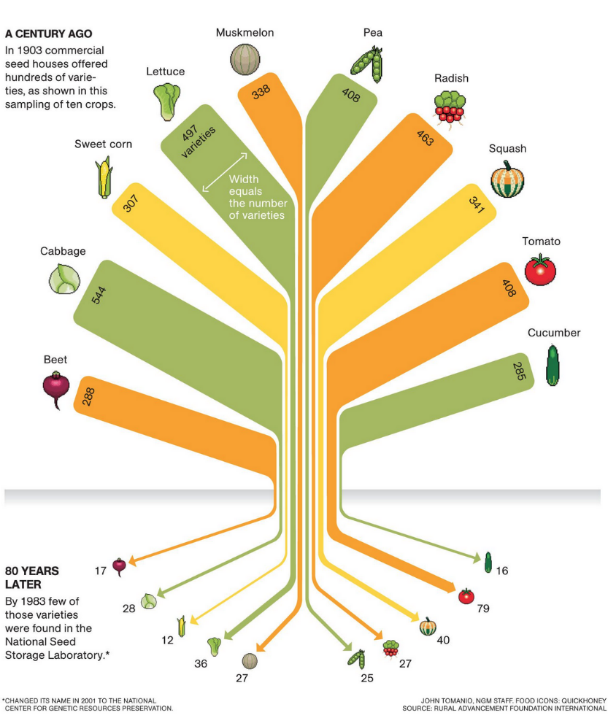
Loss of biodiversity is real
In review of hundreds of scientific papers on genetic erosion almost 80% of studies found evidence of loss.
At least 90% of vegetable varieties in the US have gone extinct since 1903.
      Of the more than 1,000 apple varieties that used to be grown in Europe, only six varieties are the source of apples grown commercially today.
      Of the 125 species of coffee, only two are economically cultivated today: Arabica and Robusta.
Countless other examples of such ‘genetic erosion’ are also reported from other crops.

Slide 6
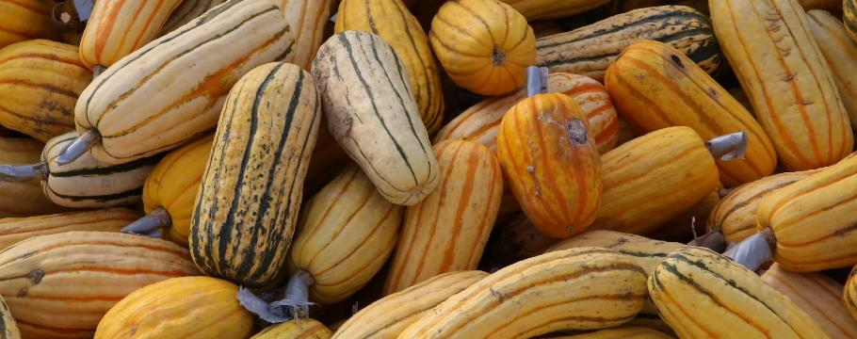
Why crop diversity is crucial for a resilient food supply
Climate change mitigation
Biodiversity
Livelihoods
Climate change adaptation
Nutrition
Less perishable crops
Higher yielding crops
More resource efficient crops
More diverse cultivation
Climate resilient crops
More nutritious crops
Crop Diversity

Slide 7
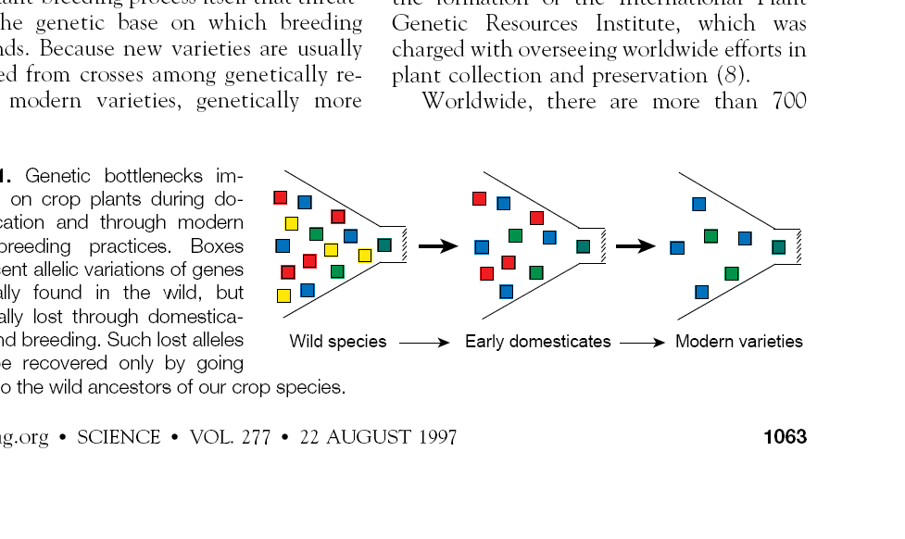
Broadening the Elite Genepool
Plant domestication & crop improvement have resulted in reduced genetic diversity in most of our cultivated crops, thus limiting their potential to adapt to future challenges
Crop Wild Relatives
Landraces
Modern elite varieties
adapted from Tanksley and McCouch, 1997

Slide 8
Broadening the Elite Genepool
Recapture lost beneficial
genetic diversity
Improvement via crop breeding requires access to novel variants of genes for adaptive traits
Crop wild relatives (CWR) & landraces are a potentially valuable source of these variants (alleles)
Crop Wild Relatives
Landraces
Modern elite varieties
adapted from Tanksley and McCouch, 1997

Slide 9
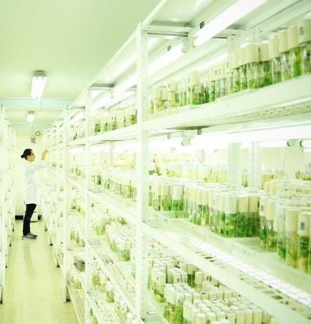

What is a genebank?
Specific genes are what make a crop variety resistant to heat and drought or tolerant of pests and diseases, and are, therefore, the basis of agricultural adaptation.
Genebanks ensure that these genetic materials are safely conserved and available for people to use
Ex situ conservation involves protecting a variety outside its normal location such as a seed bank
Plant breeders and farmers can draw on genebanks in their search for particular traits that they need.

Slide 10
Genebanks are …
Helpers in times of need
Innovation hubs
Repatriation of old species and varieties
Providers of genetic resources as raw material for breeding
Catalysts of food system development
© Uli Westphal, 2016

Slide 11
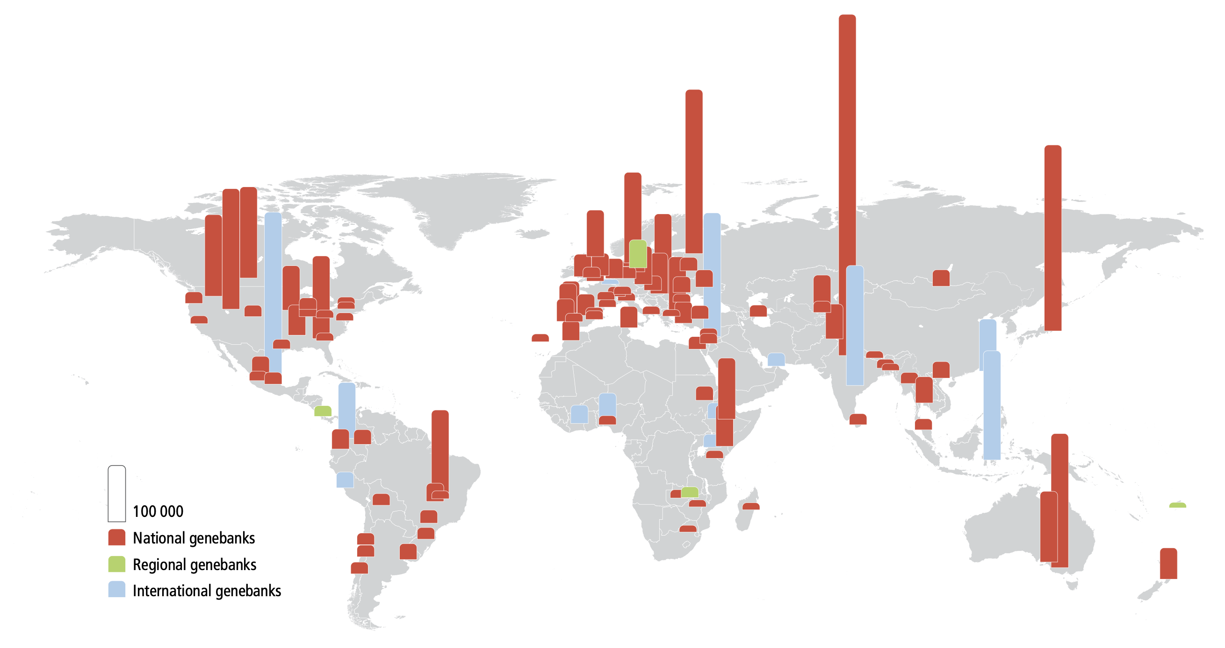
Geographical distribution of national genebanks holding more than 6 000 accessions, regional and international genebanks

Slide 12
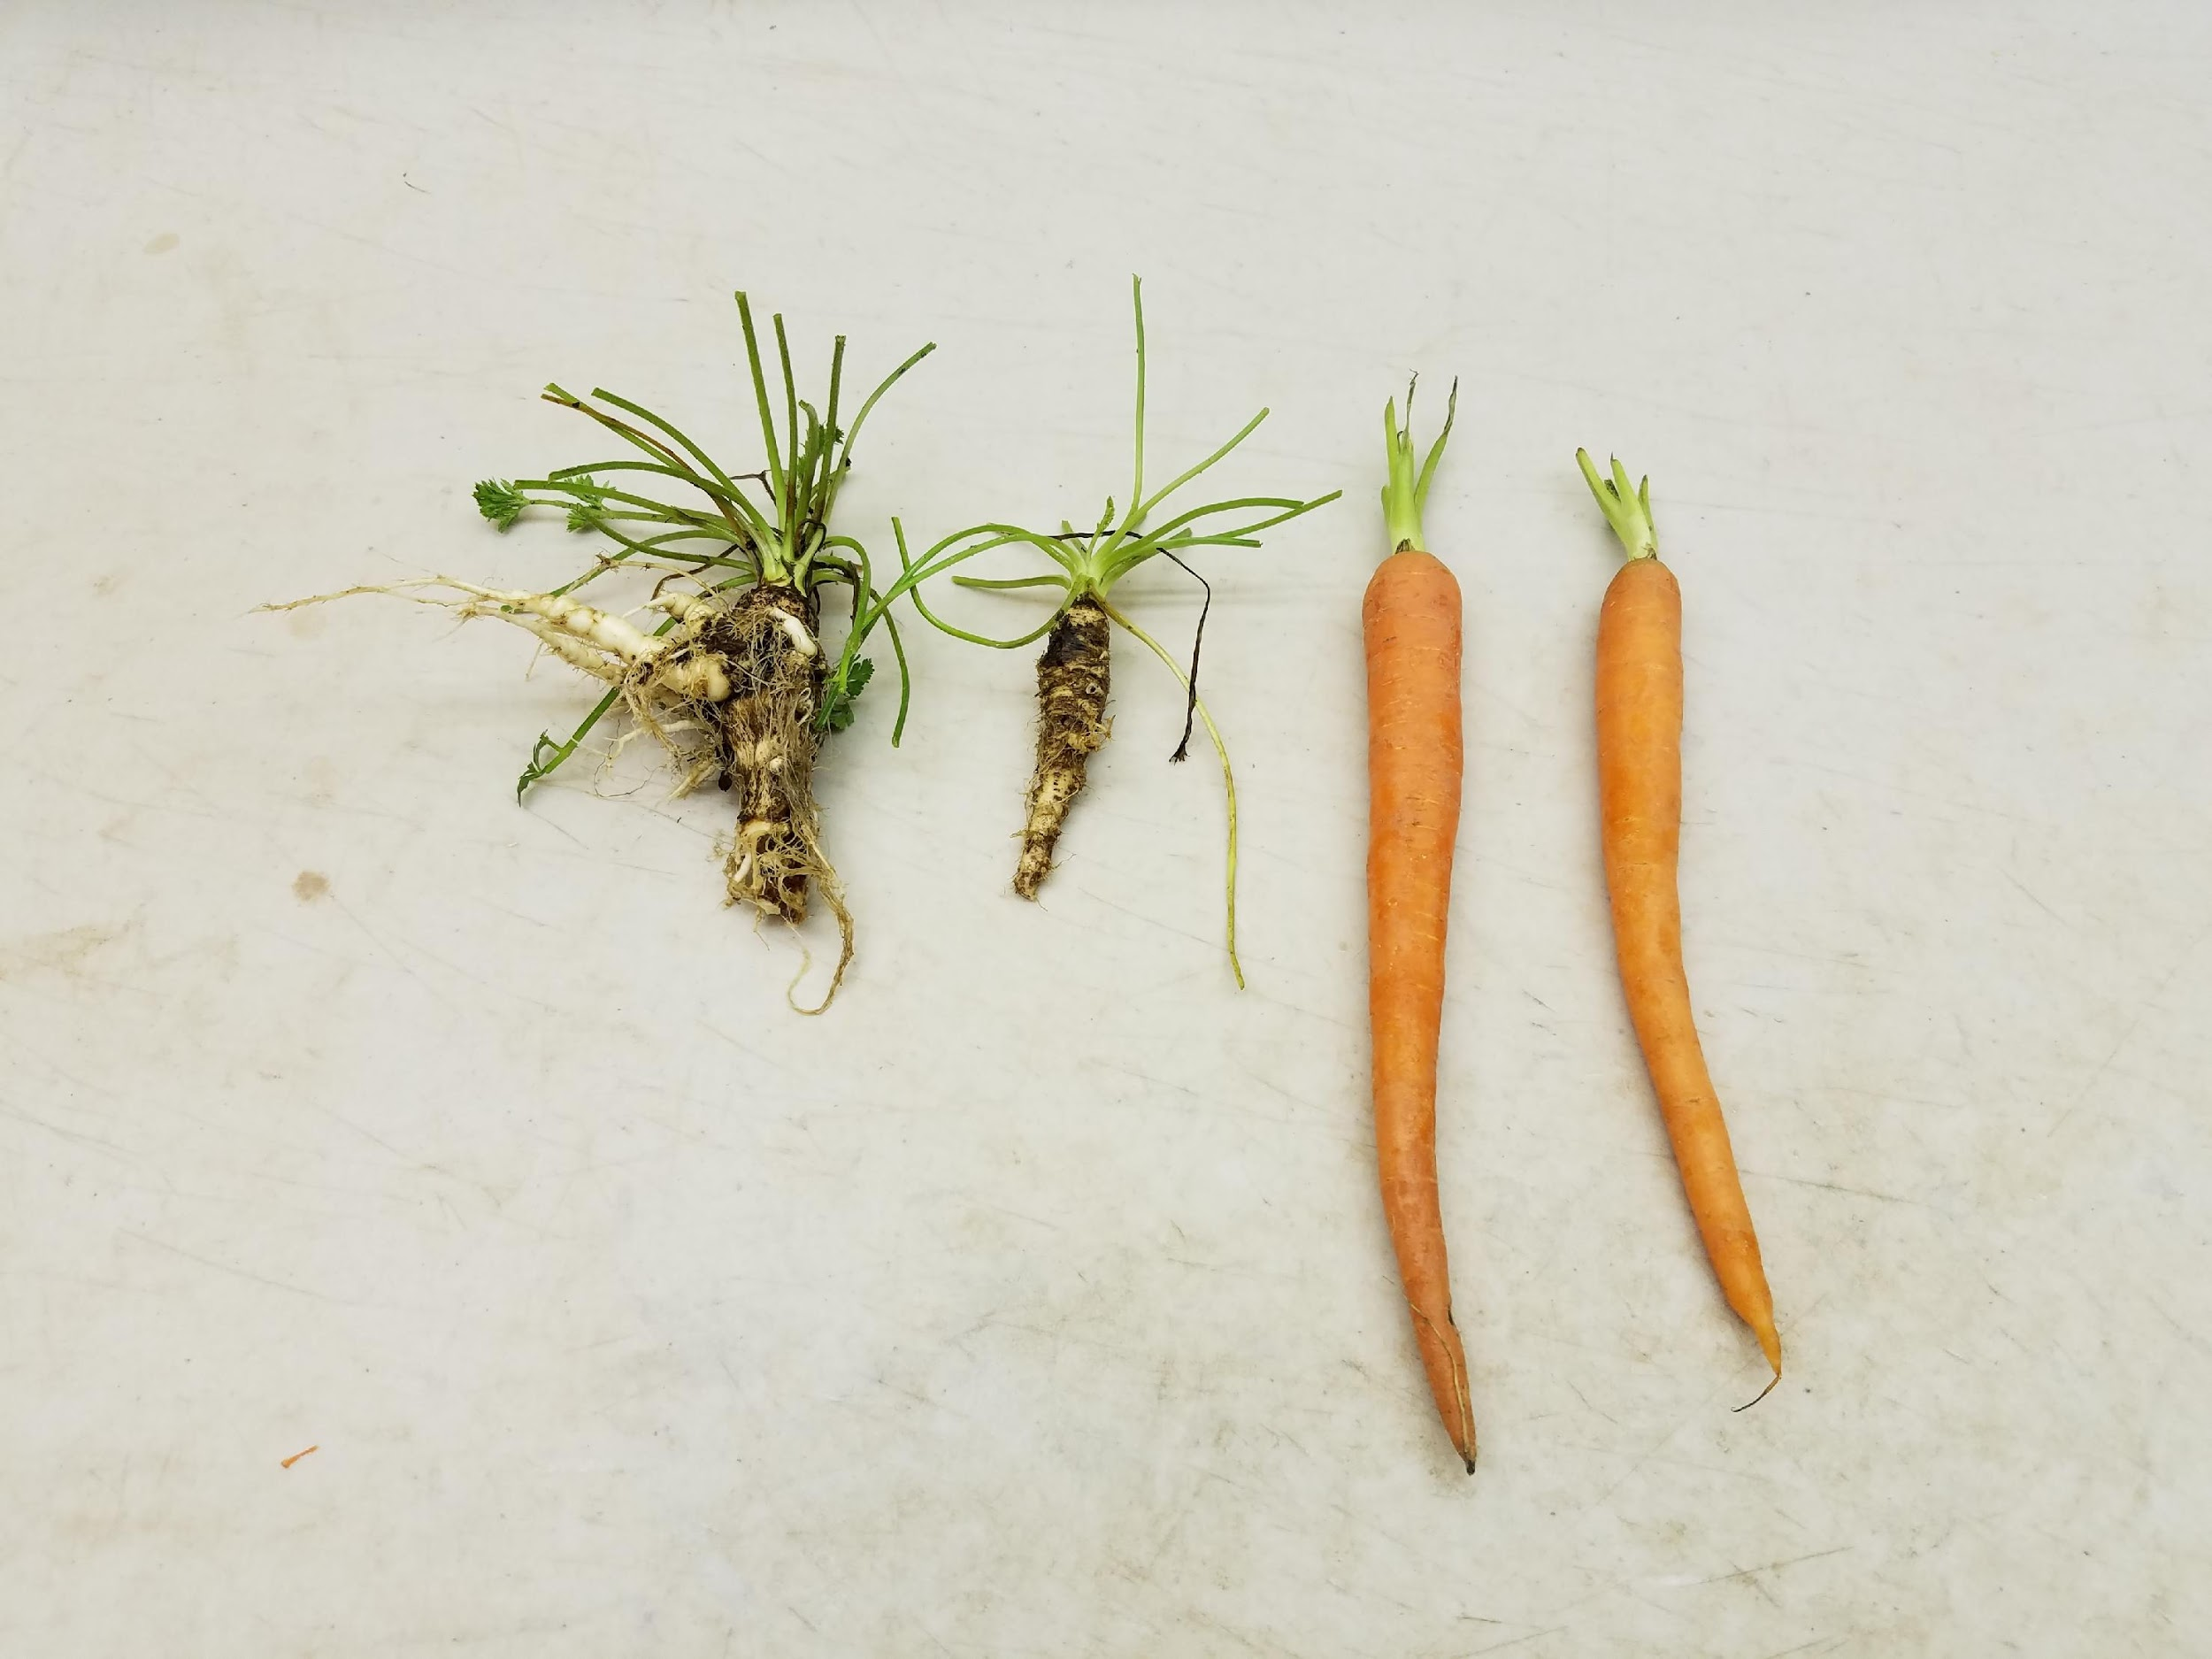
Broadening the Elite Genepool
Pre-breeding
Pre-breeding refers to a wide range of activities designed to
identify beneficial characteristics in CWR, and
transfer beneficial traits into breeding pipelines
CWR
Landraces
Modern elite varieties
Pre-breeding forms a bridge between the genebanks that hold and safeguard CWR, and the breeders and farmers who use them
Long-term efforts and substantial investment in conservation & pre‐breeding are required

Slide 13
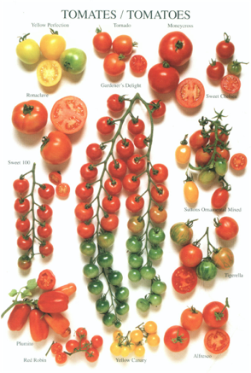
Plant Breeding Flourishes with Global Cooperation…
Breeding new requires the crossing of 50 to 100 different genetic traits from plants in a wide range of countries
Modern breeding is unthinkable without multilateral cooperation
Free global exchange of breeding material is essential
International Plant Treaty a critical global regulatory framework and policy instrument

Slide 14
Genebank Challenges and Opportunities
Many genebanks lack the capacity to effectively guarantee the long-term availability of the diversity in their collections and collections are not safely duplicated
This is due to chronic underinvestment
Thus, crucially important diversity may in fact not be available from genebanks, or may indeed be dead, when it is needed
Even if conservation is adequate, however, many genebanks have not maximized the exploration of their collections so they have limited ability to identify new, interesting diversity with, and for, breeders and farmers
Data on seed accessions is as important as the seeds themselves. Accurate, well-curated data greatly enhances their value and use.
Notes:
A clearer understanding of what is in collections is a game changer

Slide 15
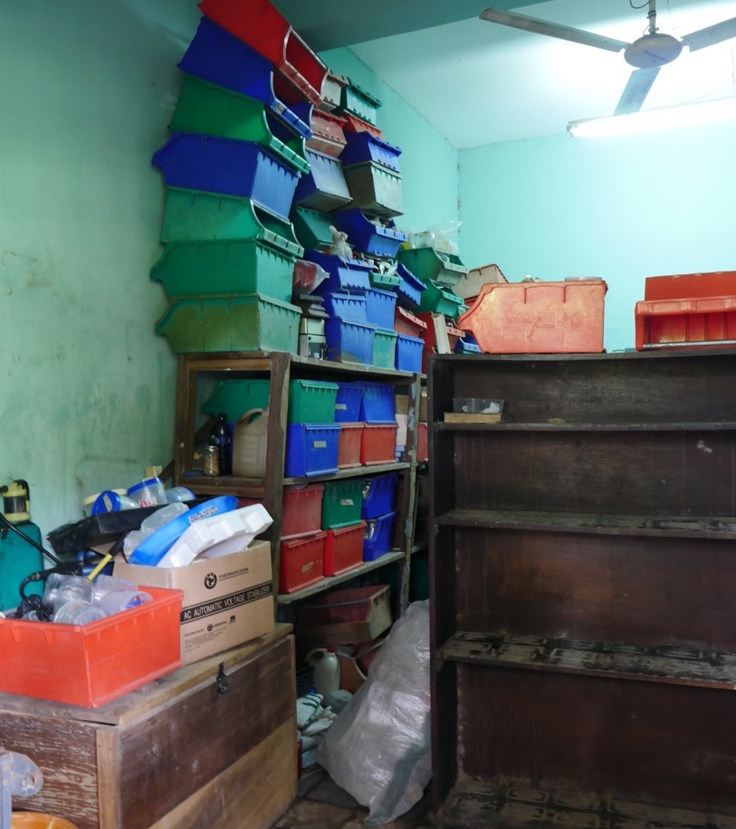
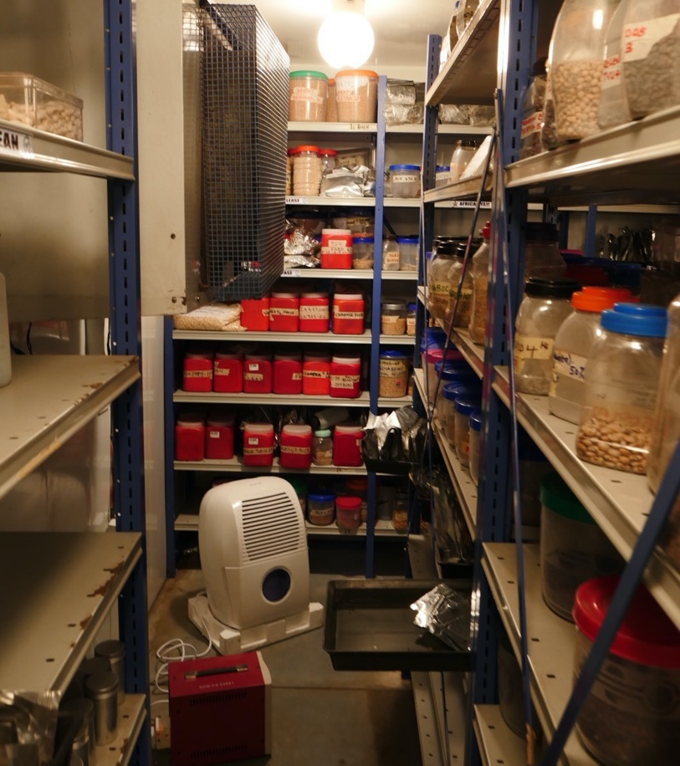

Slide 16
The Crop Trust

Slide 17
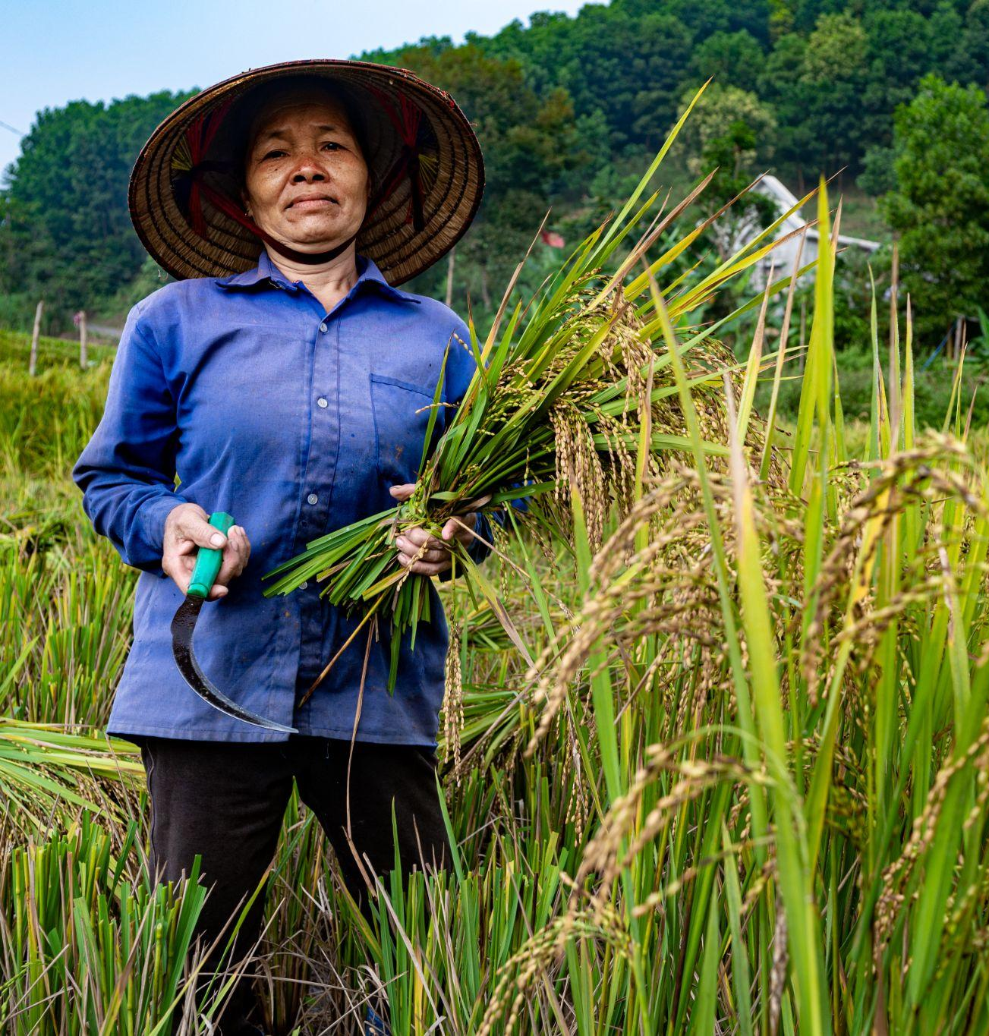

Our Mission
Our Vision
The Crop Trust is an international organization dedicated to conserving and making crop diversity available for use globally, forever and for the benefit of everyone.
Our vision is a world where plant genetic resources for food and agriculture are conserved and available in perpetuity to achieve sustainable agriculture and global food and nutrition security.

Slide 18
Turning Objective into Vision and Mission
Vision
We envisage a world in which crop diversity is permanently conserved and made available in support of sustainable, resilient and healthy agri-food systems.
Mission
We support the conservation of crop diversity held in genebanks.
We promote collaboration among genebanks and their integration into an efficient global system.
We promote the availability of crop diversity to researchers, plant breeders and farmers.
We facilitate capacity building for genebank personnel.

Slide 19
Turning Mission into Concrete Activities
Genebank
Continued efforts to collect threatened crop diversity in fields and crop wild relatives in nature
Essential Operations:
Long-term conservation
Safety duplication
Regeneration &
Characterisation
Monitoring
Data management
Acquisition &
Distribution
Researchers
Breeders
Farmers
Upgrading
Capacity Building

Slide 20
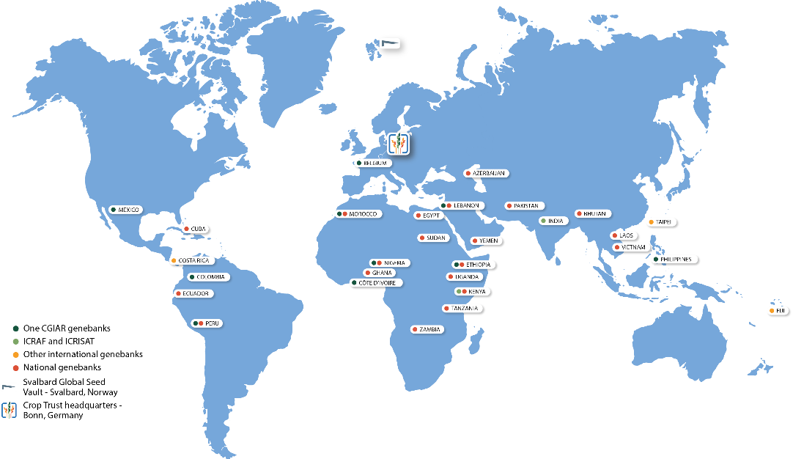
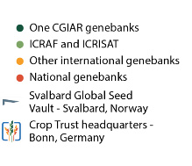
Crop Trust works with over 120 organizations in 48+ countries to conserve crop diversity
The Crop Trust’s work
in support of genebanks globally
Established
2004 under international law
Our main contributors
Governments and Foundations
Policy
International agreement,
backed by 150 countries + EU

Slide 21
The Unique Structure of the Crop Trust
Investment
Proceeds
ENDOWMENT
CONTRIBUTIONS TO THE ENDOWMENT
CORE BUDGET
PROJECT CONTRIBUTIONS
PROJECT BUDGET

Slide 22
Endowment: Contributions, Income, Withdrawals 2003 - 2024
m USD
USD 151 m
USD -91 m
400
Accumulated
withdrawals
Accumulated
net investment income
350
USD 357 m
300
USD 297 m
250
200
Endowment value
(as 31 Dec 2024)
150
Accumulated
donor contributions
100
50

Slide 23
Structure
(Secondary) Donor
Recipient of Project Funds
Functions
Financial Support
Crop Trust as grant-making agency
Technical Support
Crop Trust as technical implementation agency
Crop Trust provides financial/cash contributions, which fall into two categories: long-term (“in perpetuity” from the endowment) and short-term (project-based)
Crop Trust provides a broad range of in-kind/non-cash contributions, which fall into two categories: system-wide services (entire genebank system benefits) and bilateral support (specific genebanks benefit)
Activities
Long-term
Long-term partnership agreements (LPA)
Long-term grants (LTG)
System-wide services
Information Systems
Quality Management Systems
Training Programs
Knowledge Management
Crop Conservation Strategies
Short-term
Emergency grants
Other (e.g. project-related grants
Bilateral support
Support for genebank infrastructure, equipment and operations, as needed by individual genebanks, e.g.:
Collection/acquisition
Characterisation
Documentation
Storage
Safety duplication
Viability testing
Distribution

Slide 24
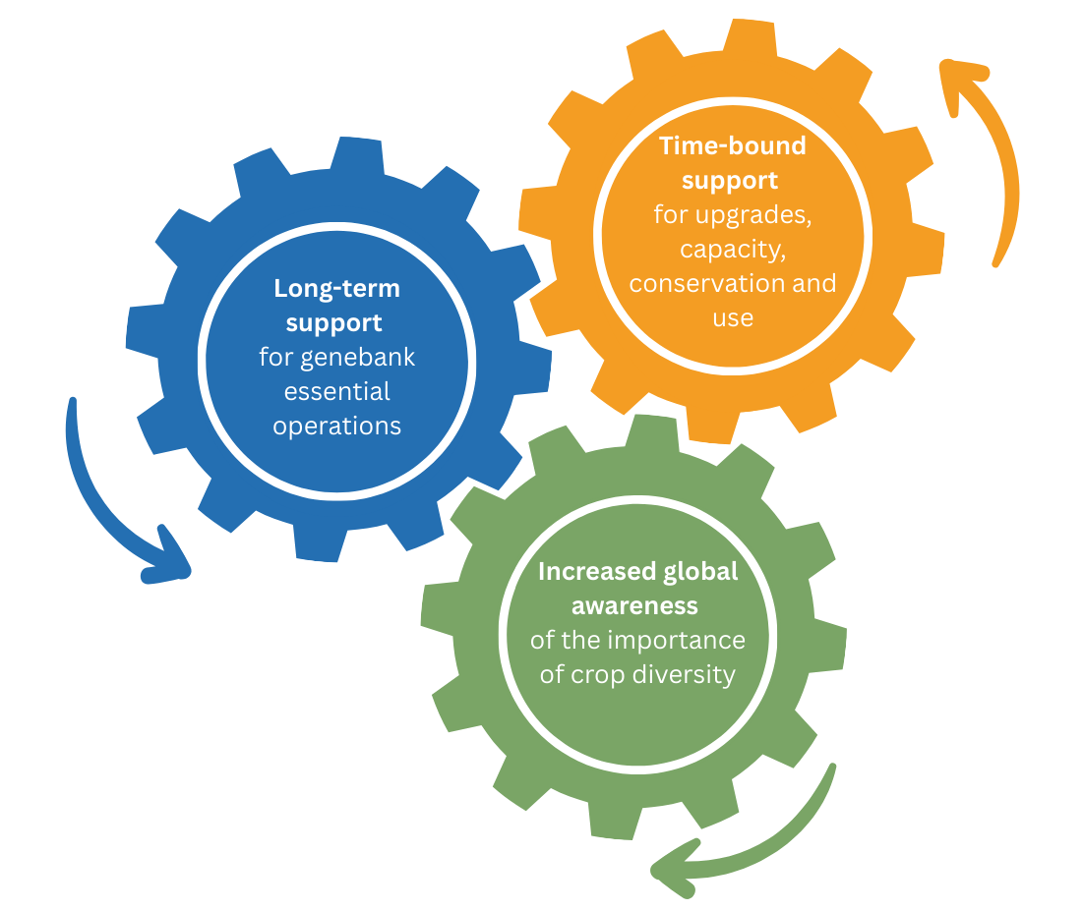
Crop Trust Activities
Emergency Funding for Genebanks
Crop Conservation Strategies
Supporting Safety Duplication / Svalbard Global Seed Vault
Long term funding for genebanks
Orphan/opportunity Crops through the Power of Diversity Funding Facility (PDFF)
Genebank information systems
Biodiversity for Opportunities, Livelihoods and Development (BOLD)
Monitoring and evaluation for genebanks
*
Flagship for Food Security
Training e.g. Genebank Academy
Partnerships for global outreach
Community of practice
Tools and resources
Crop Trust web + social media
*Current activities are displayed. Past time-bound activities can be viewed here
Crop Diversity Days
Crop diversity news
Podcasts

Slide 25
Global system of ex situ conservation
1
Svalbard Global Seed Vault
2
International collections
3
National collections
Community collections, conservation in-situ, on farm
4
Ex situ conservation involves protecting a variety outside its normal location in a controlled environment such as a seed bank or field garden
In situ conservation preserves diversity in its original location

Slide 26
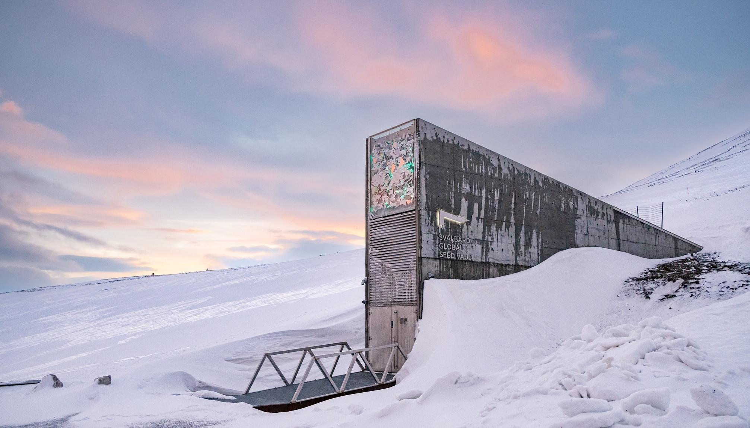
Svalbard Global Seed Vault
Managed by the Government of Norway, NordGen and the Crop Trust
Global back-up facility for genebanks
Seeds stored at -18°C
Over 1.3 million samples from over 100 genebanks and over 6,000 plant species (capacity to store 4.5 million varieties of crops)

Slide 27
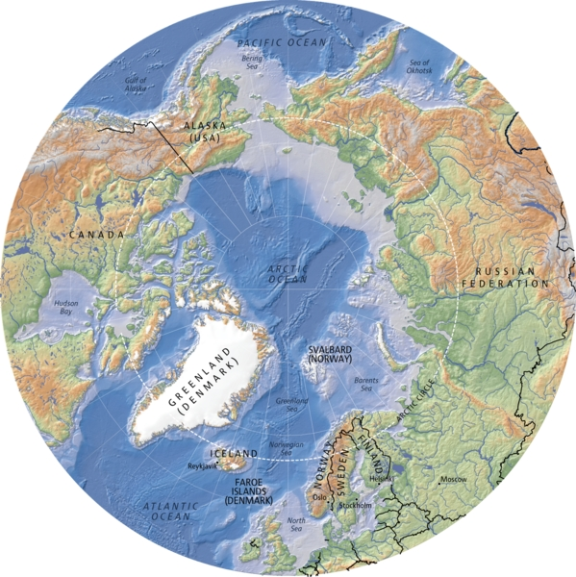
Hugo Ahlenius, UNEP/GRID-Arendal, 2005

Slide 28
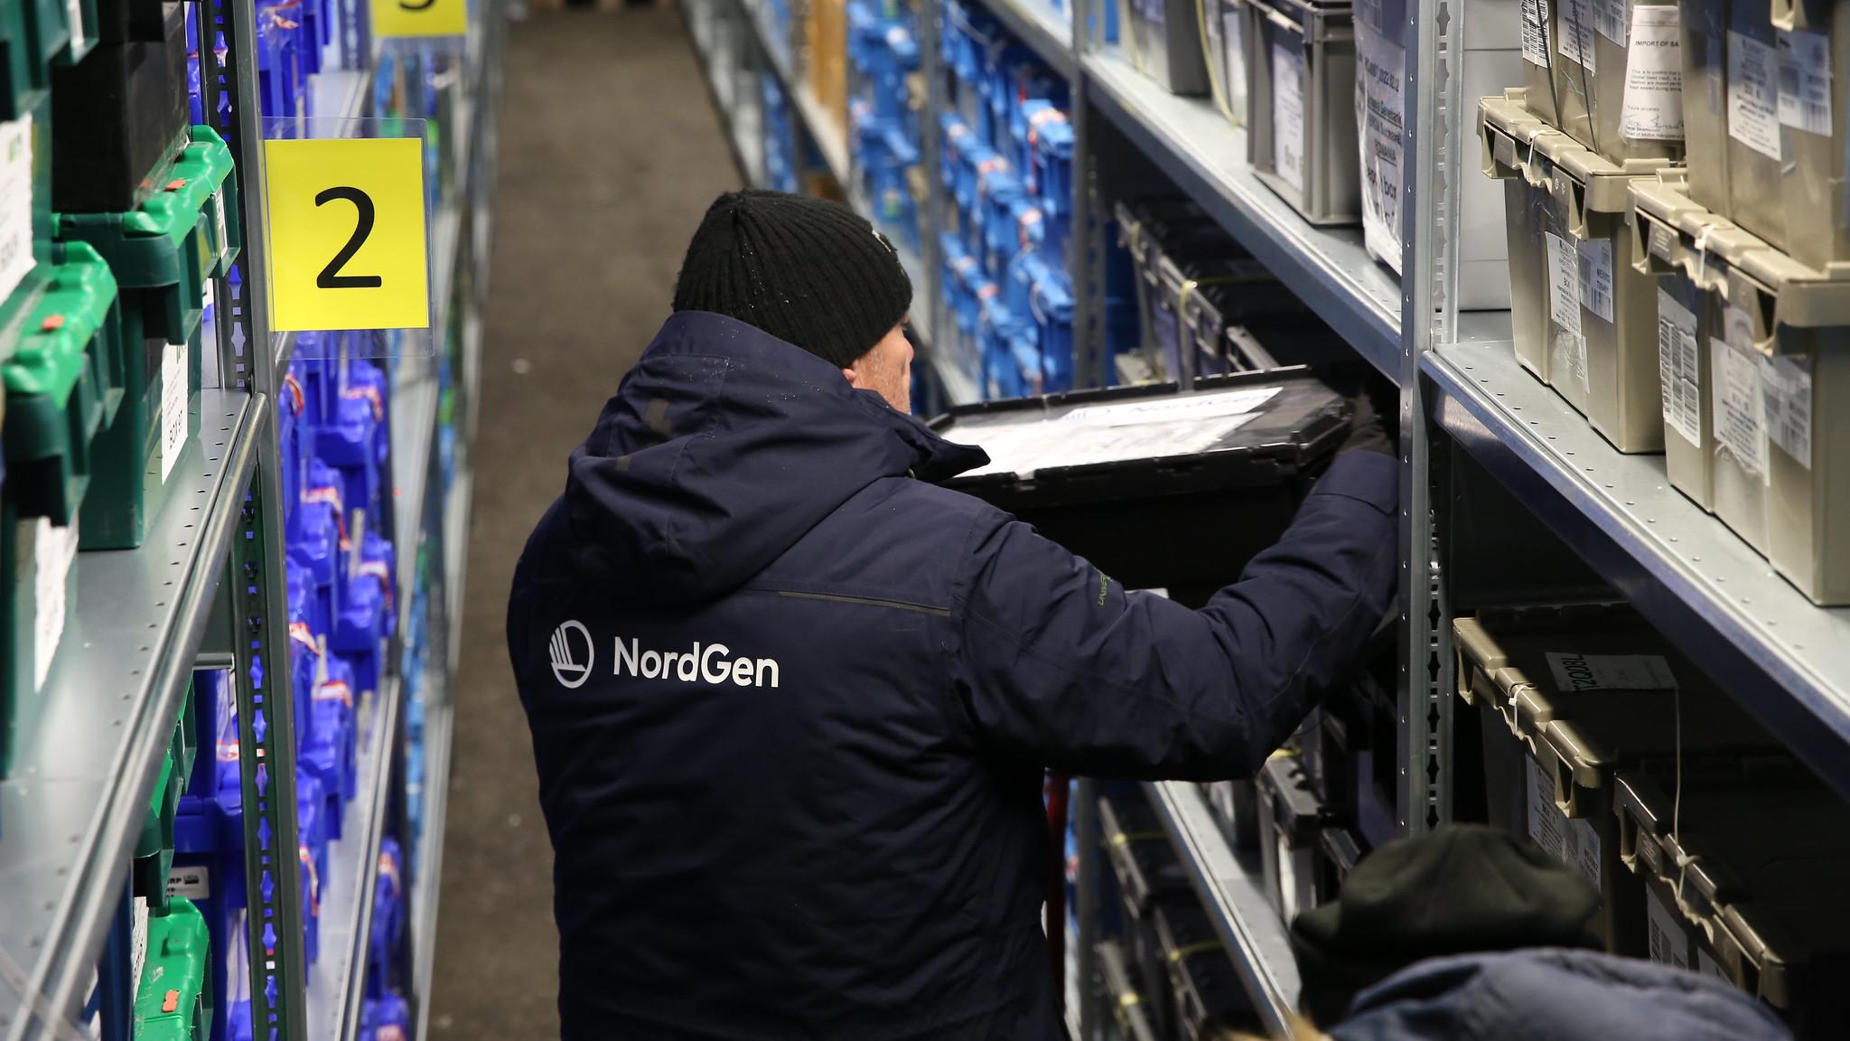
Svalbard Virtual Tour
You can now 'visit' the Seed Vault virtually via Svalbard Global Seed Vault Virtual Tour.
Visit: https://seedvaultvirtualtour.com/

Slide 29


Information Systems
Genebank data and information systems are central to the effective conservation and use of plant genetic resources, and are a key focus of the Crop Trust’s work.
Genesys
Genesys is the global portal for material held in the world's genebanks.
Genesys publishes data from over 500 genebanks in a standardised format for searching, downloading and analysis.
GRIN Global Community Edition
GRIN-Global Community Edition (GGCE) is a system that allows genebank staff to capture and use data in all genebank operations: from the acquisition, management, monitoring and evaluation of material in the collection, to its eventual distribution to clients.

Slide 30

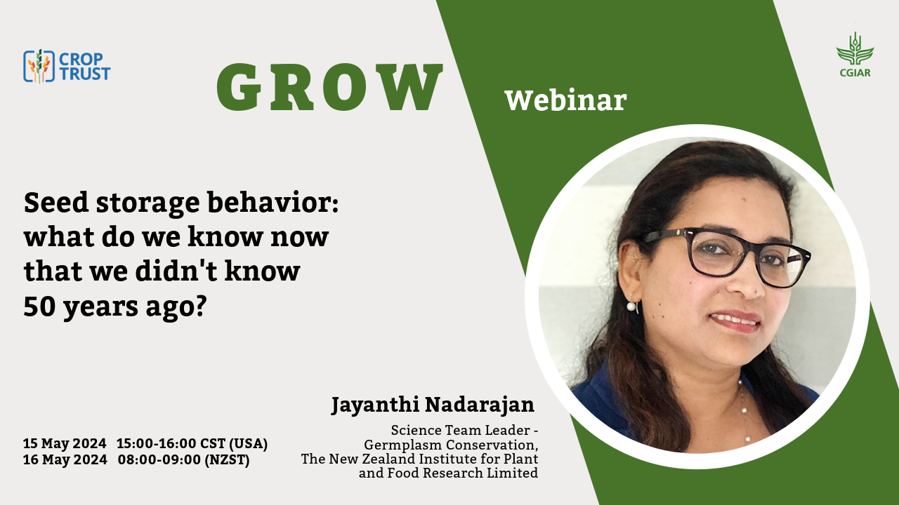
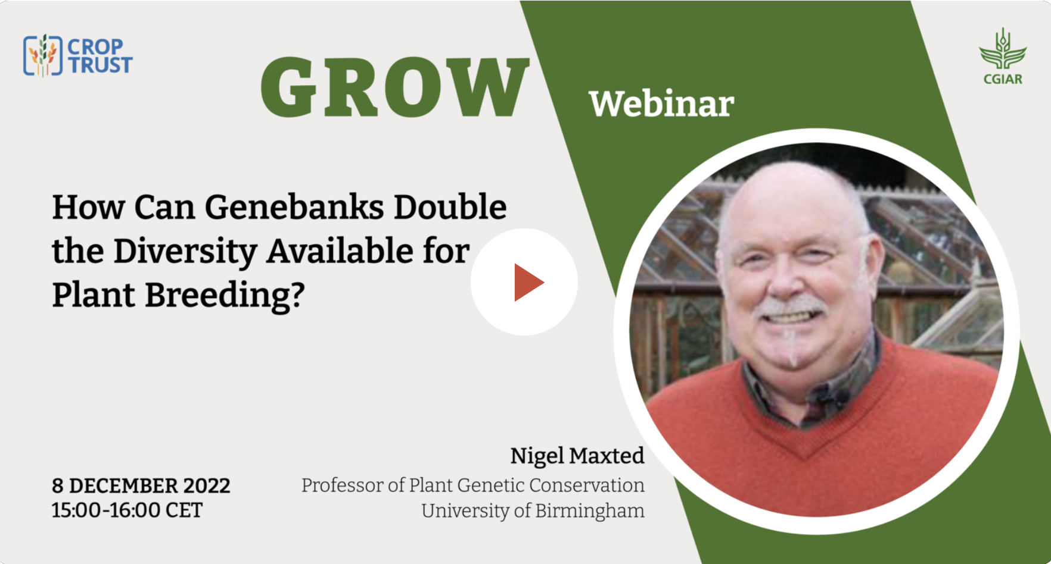
Community of Practice >>>>>GROW Webinars
Genebank Resources on the Web (GROW) webinars provide thought-provoking discussions within the genebank community. The webinar series explores topics ranging from emerging technologies, operational efficiency, collecting to seed longevity, policy and use. GROW aims to tackle difficult questions and provoke discussion on important genebank-related details and themes.
Past webinars are available on the Crop Trust YouTube channel https://www.youtube.com/c/CropTrust

Slide 31

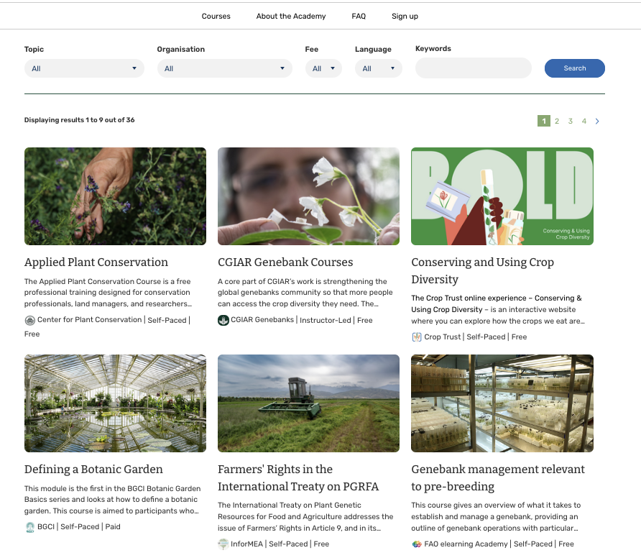
Recently Launched Training!
The Genebank Academy is the Crop Trust online learning platform dedicated to strengthening global capacity in genebank operations, management, and plant genetic resource conservation. Through the platform we aim to provide accessible, high-quality training to professionals, students, and researchers around the world who are working to safeguard crop diversity.
Stay tuned for new courses and resources!

Slide 32
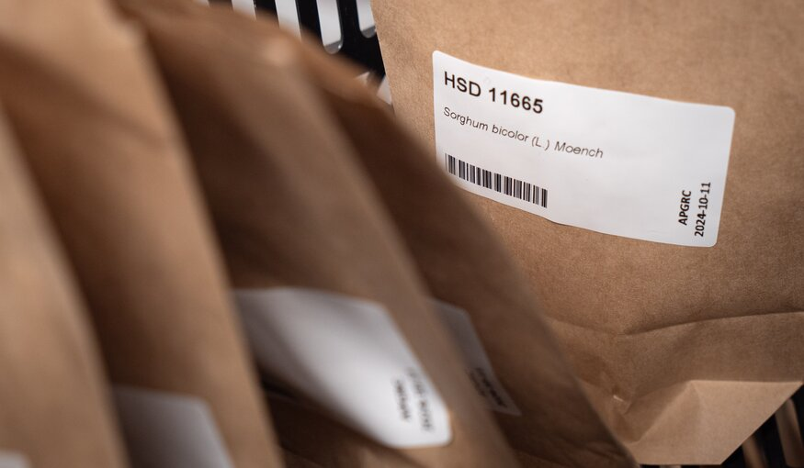
Emergency Funding for Genebanks
Genebanks are not indestructible.
Natural disasters, political crises, pest and disease outbreaks, equipment failure and, most recently, the challenges caused by the global COVID-19 pandemic can place them in jeopardy and trigger catastrophic loss of the invaluable resources they conserve.
The Emergency Reserve for Genebanks provides rapid, short-term and urgent support.
Examples of use:
Seed collections at risk from conflict were rescued in Syria.
Philippines national genebank restored its seed-drying facility, fix building leaks and replace equipment damaged by a typhoon.
National Genetic Resources Center (NGRC) in Yemen received funds for genebanks facing urgent threats to their precious collections of crop diversity.
Solar energy has been provided for Sudan’s back-up collections and support for preparation for shipment and safe duplication in Svalbard Global Seed Vault.
With the support of the Emergency Reserve for Genebanks, a funding facility managed by the Crop Trust and the FAO International Treaty on Plant Genetic Resources, hundreds of seed samples from the Sudanese Genebank were transported to NordGen, where staff there sorted, catalogued, packed and documented them as part of the Sudanese deposit.
Notes:
https://www.croptrust.org/news-events/in-the-media/priceless-samples-from-ukraines-seed-bank-destroyed-in-bomb-attack/

Slide 33

Crop Conservation Strategies (CCS)
Between 2004 and 2019, the Crop Trust has facilitated the development of 26 global crop- and geographically-based conservation strategies by experts round the world.
To stay relevant, these strategies need to be continuously updated with new information on the status of crop diversity collections and the genetic structure within crop genepools.
Information and recommendations from the strategies are used by institutions and policymakers to help ensure that these important crops and their genetic relatives are secured in a cost-effective and sustainable manner for the future of all.

Slide 34
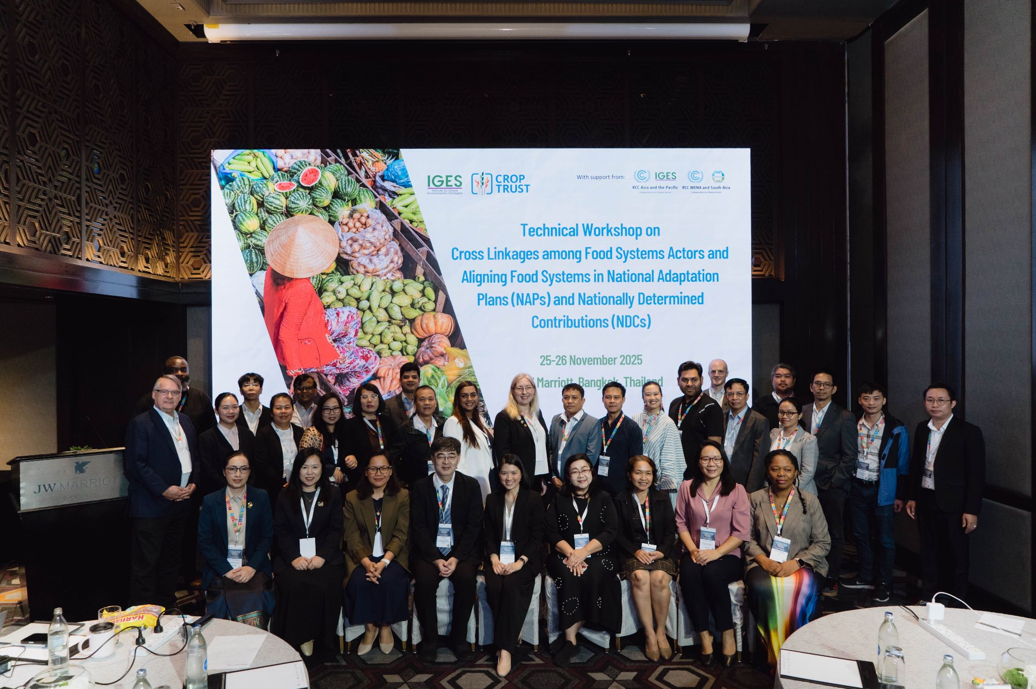
BOLD Bangkok Policy Dialogue
Regional Technical Workshop (Bangkok, 25–26 Nov 2025) under BOLD WP1 with IGES & UNFCCC RCCs
Audience: Genebanks, agriculture, and environment actors from Vietnam, Lao PDR, Pakistan, and Thailand
Focus: Linking food systems with climate policy (NAPs & NDCs)
Objective: Strengthen agrifood systems’ contribution to national climate goals
Outcome: Shared pathways for resilient, sustainable food systems supported by climate frameworks

Slide 35
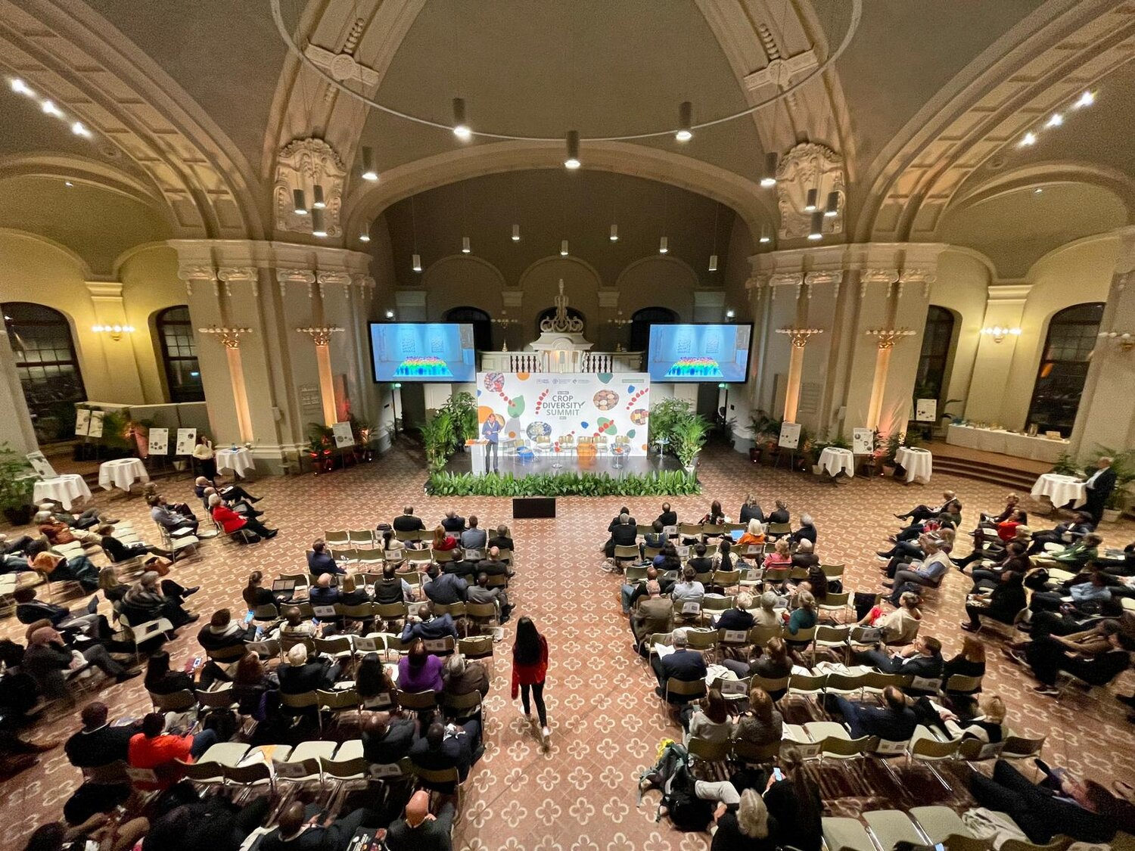
Crop Diversity Days
The Global Crop Diversity Trust (Crop Trust) and the International Treaty on Plant Genetic Resources for Food and Agriculture (International Plant Treaty) host Crop Diversity Days to raise awareness of the global importance of crop diversity for the world, and as a global platform bringing together policymakers, scientists, genebank practitioners, farmers, consumers and other relevant stakeholders to share knowledge and experience, reflect on progress to protect crop diversity, and advocate for increased support.
Crop Diversity Day 2023 in Berlin, Germany. Credits: Crop Trust/MIKA-fotografie

Slide 36

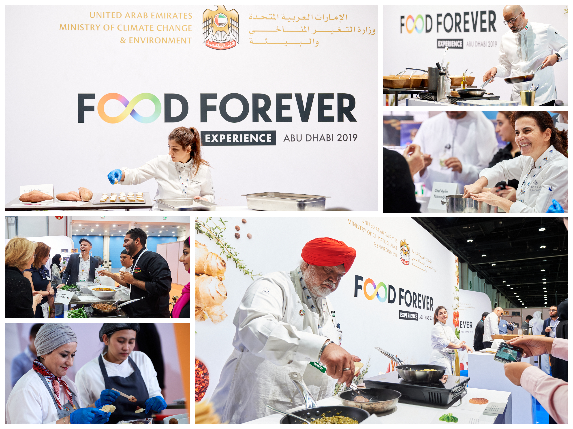
Food Forever Experiences
The Food Forever Experience is an international event series that gives a glimpse of the future of food. By working with innovative chefs to cook lesser known ingredients, we plant the seed for a more diverse, sustainable, and delicious future.
For this tasting series, the Crop Trust is partnering with the Chefs’ Manifesto, a global network of chefs who advocate for the United Nations Sustainable Development Goals (SDGs) through their various platforms.
Past installments of the Food Forever Experiences took us to thirteen cities in eight countries, amongst them Chicago and the Poconos, USA; Cusco, Peru; London, UK; Stockholm, Sweden and Abu Dhabi, UAE. We partnered with more than 80 chefs that featured over 160 different crops. This was all achieve with the support of over 30 partners.

Slide 37
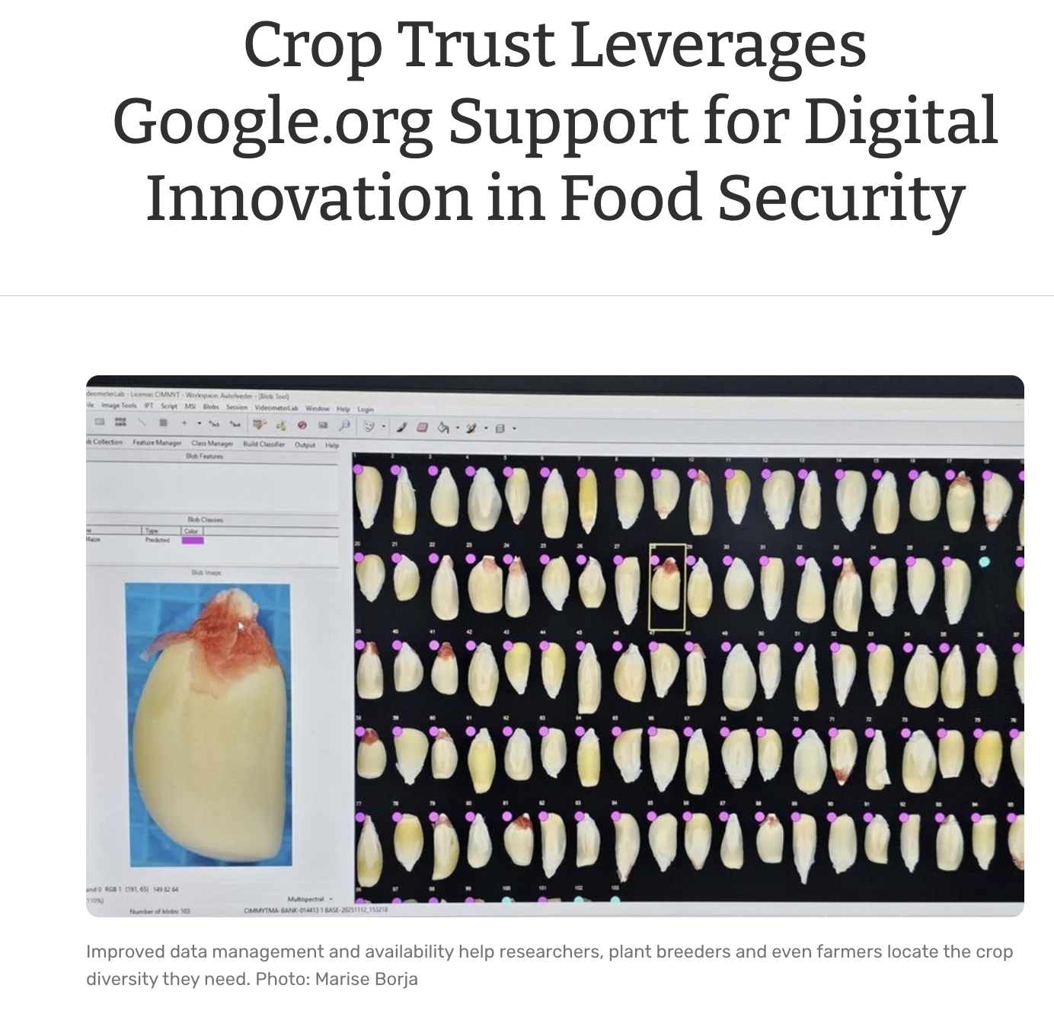
Leveraging private sector funding: Project co-investment
Crop Trust has just embarked on a new USD$2 million project supported by Google to provide improved data management and availability. This will help researchers, plant breeders and even farmers locate the crop diversity they need. And it will help genebanks work together more effectively and efficiently.
The project will also explore how artificial intelligence and other approaches can aid in identifying and tracking threats to crop diversity over space and time. Today, no global system exists to monitor where crop diversity is disappearing from farms and wild ecosystems – or the reasons why such erosion of agricultural biodiversity is happening.
The Crop Trust will assess the feasibility of an early warning system that uses AI and diverse datasets to identify and visualize risks of loss of crop diversity on an interactive map. Genebanks can then respond before valuable and irreplaceable diversity is gone forever.
For more information visit: https://www.croptrust.org/news-events/news/crop-trust-leverages-googleorg-support-for-digital-innovation-in-food-security/

Slide 38
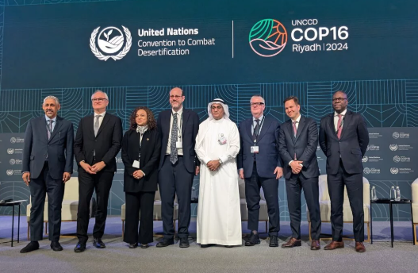
Global Flagship Initiative for Food Security
Launched on Agri-Food Systems Day 2024 at the COP16 UN Desertification Conference in Riyadh, Kingdom of Saudi Arabia. A global coalition of development partners is leading this initiative to address food insecurity, poverty and land degradation, with focus on the Sahel and IGAD (Horn of Africa) regions.
By leveraging innovation and strengthening international cooperation, the Flagship Initiative will deliver lasting, transformative impact for food systems across Africa and beyond.
The Flagship Initiative steps in at a critical moment. We are currently seeing rising global tensions, persistent inflation and declining foreign aid. To ensure food security for the future, now is the moment to advance food supply resilience, through investment and awareness.
The Flagship Initiative works across three pillars:
1. Collaborate Broadly
Engage partners across governments, NGOs, multilateral bodies and communities to advance food security through inclusive, apolitical collaboration.
2. Mobilize the Private Sector
Attract bold, large-scale private sector commitments to drive sustainable, climate-smart food systems.
3. Deliver Impact with Agility
Prioritize high-return interventions that can be rapidly deployed for measurable impact.

Slide 39
Rice

Slide 40
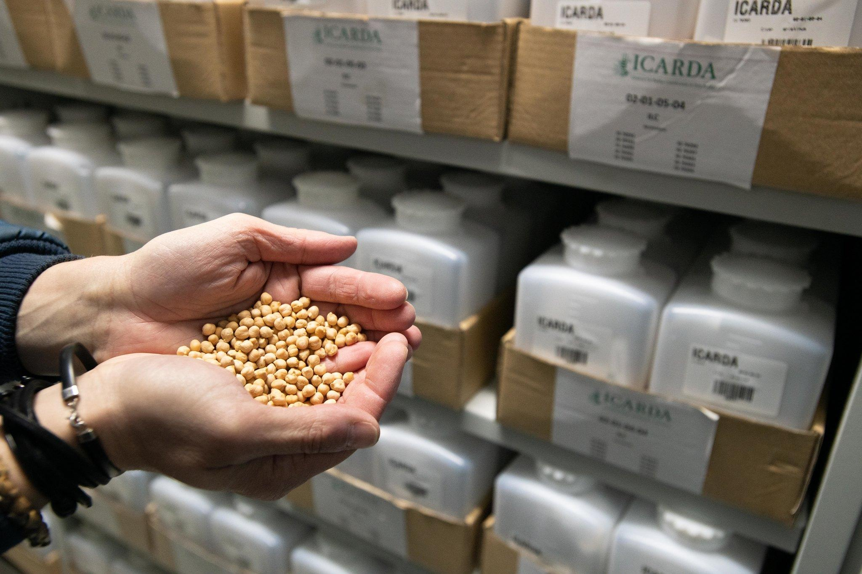
Long Term Funding for the Endowment Fund:
Thanks to the generous contributions from Crop Trust donors, the Crop Trust is able to support genebanks in perpetuity through Long‑term Partnership Agreements including AfricaRice (2025) and IRRI (2018) securing over 150,000 accessions of rice diversity, forever.
Notes:
Talking Points:
International Rice Research Institute (IRRI)
Conserves the world’s largest rice collection: 132,000+ accessions, including landraces, improved varieties, and wild relatives.
AfricaRice
Conserves 21,000+ accessions of mainly African Rice (O. glaberrima)
https://www.croptrust.org/news-events/news/long-term-funding-supports-africarice-genebank-and-the-future-of-rice-diversity/
https://www.croptrust.org/news-events/news/long-term-funding-supports-africarice-genebank-and-the-future-of-rice-diversity/

Slide 41
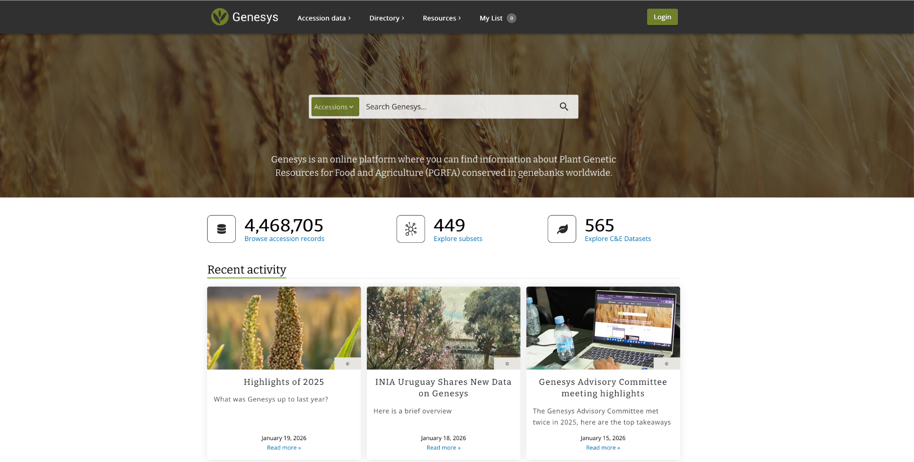

There are more than 275,945 Rice accessions reported on Genesys with IRRI reporting 132,876 accessions and AfricaRice reporting 20,391 accessions.
Notes:
https://www.genesys-pgr.org/c/rice

Slide 42

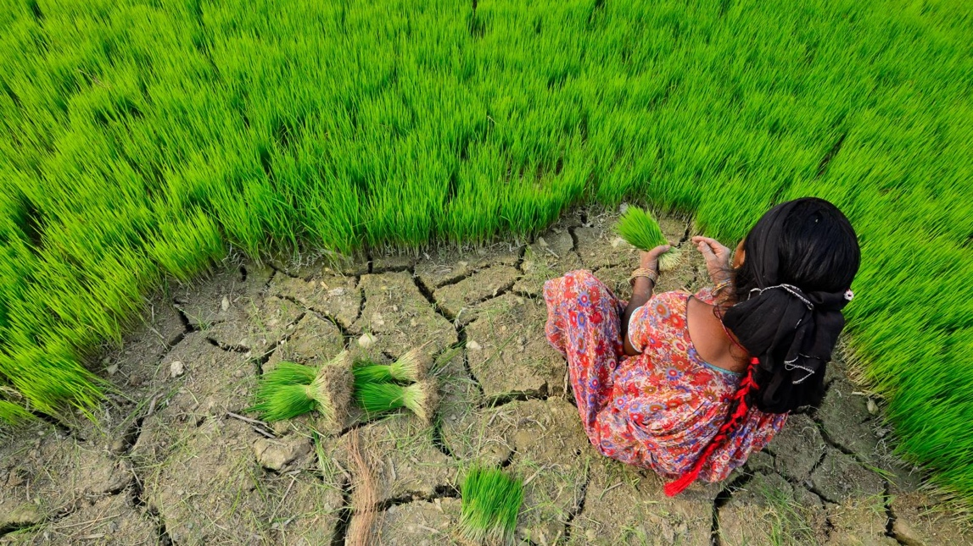
Value from crop varieties
IRRI genebank & varietal improvement in Eastern India
A 10% increase in the genetic contribution of IRRI genebank accession on an improved rice variety is associated with a 27% increase in rice yield.
45-77% of the genetic composition of cultivated varieties came from the genes of IRRI genebank accessions
More info: Villanueva, D., Smale, M., Jamora, N. et al. The contribution of the International Rice Genebank to varietal improvement and crop productivity in Eastern India. Food Sec. 12, 929–943 (2020). https://doi.org/10.1007/s12571-020-01036-9
Notes:
On the average, the COP for all pairwise combinations among these varieties (excluding the COP of a variety to itself) is 0.0973. This means that two varieties have 9.73% identical progenitors in their pedigrees, on the average. This result implies that there is a high diversity among these varieties. Probably, the high diversity among these varieties is the result of crossing germplasms from different country of origins which was shown in the previous section.

Slide 43
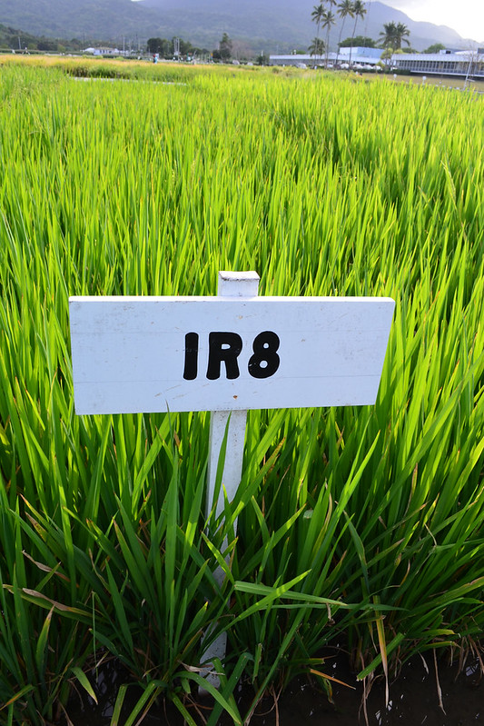
Value from crop varieties
IRRI rice breeding & food security: Philippines & Indonesia
Since the release of IR8, the genetic gains from IRRI lines have increased by 0.58% annually.
The estimated average annual supply increase through producer adoption of IRRI lines in Indonesia and the Philippines was sufficient to feed an additional 25.14 million people’s annual rice consumption
More info: Nalley, L.L., Tack, J., Durand-Morat, A. et al. Linking genetic gains to food security outcomes: An assessment of IRRI’S rice breeding efforts in the Philippines and Indonesia. Food Sec. (2026). https://doi.org/10.1007/s12571-025-01632-7

Slide 44
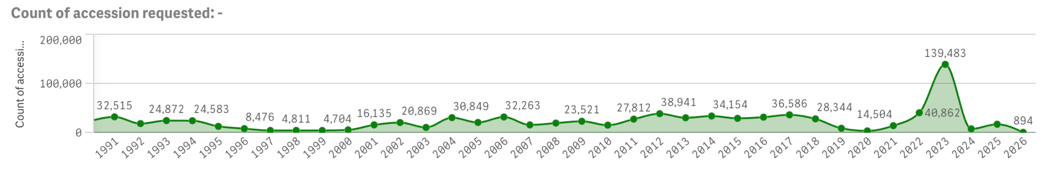
Requests of Plant Genetic Resources for Food and Agriculture (PGRFA) rice accessions
IRRI Genebank Dashboard: requests for IRG accessions
Data as of 4/2/2026
Notes:
https://irgdashboard.irri.org/recipients

Slide 45
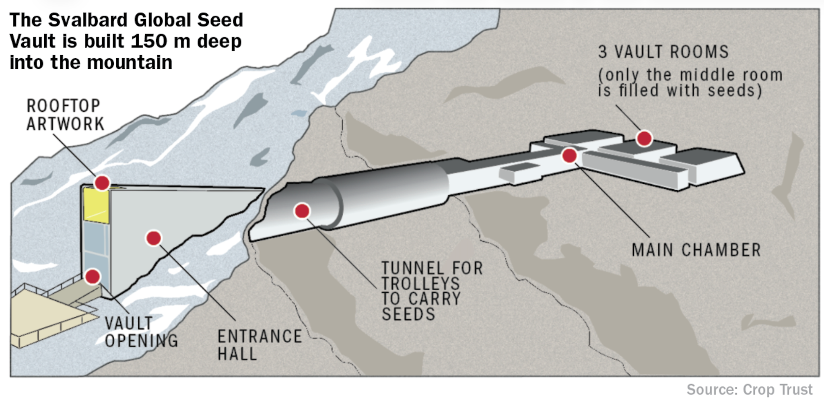
The Svalbard Global Seed Vault
Managed by the Government of Norway, NordGen and the Crop Trust
Global back-up facility for genebanks Seeds stored at -18°C
Over 1.3 million samples from over 100 genebanks including over 200,000 accessions of Rice safety duplicated.
Notes:
Notes:
Deposits to Svalbard:

Slide 46
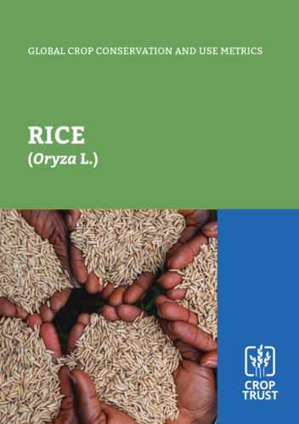
Crop Conservation Strategy: Rice
This report provides an up-to-date overview of the global status of ex situ conservation of genetic resources of rice and its wild relatives, including key metrics on: 
the identity and composition of genebank collections; 
the Multilateral System (MLS) status of accessions in these collections; 
storage, regeneration, and safety duplication status; 
documentation, information systems, and research resources; 
germplasm distribution; and 
varietal registrations and releases.

Slide 47
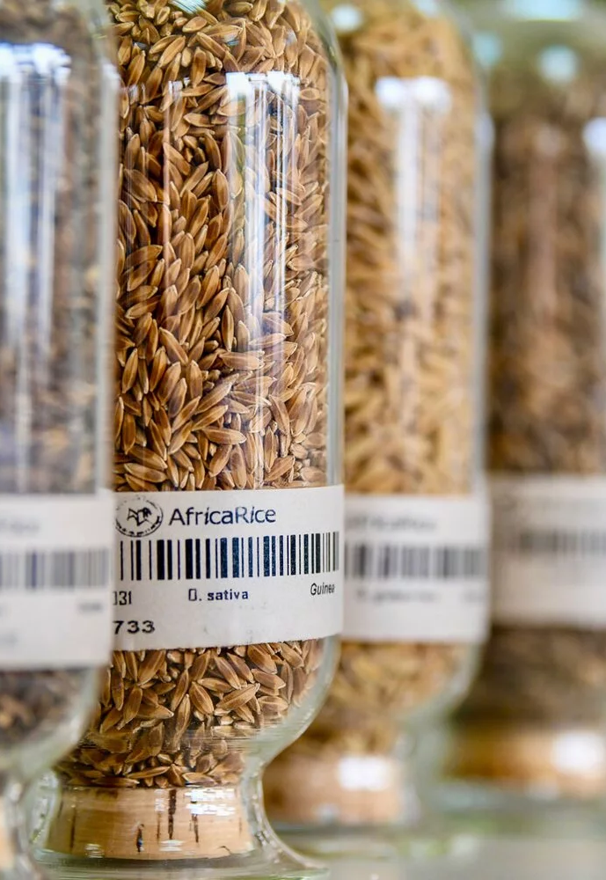
Crop Wild Relative (CWR) Project:
Rice Achievements
The CWR project strengthened the future of both Asian and African rice by collecting 318 wild rice samples from 15 species across 12 countries, working with a global network of 20 partner institutions.
These collections captured valuable traits such as flood tolerance, salinity tolerance, stem borer resistance, and bacterial blight resistance.
The project developed over 1,500 introgressed lines, each fully genotyped to pinpoint the wild genome segments they contain.
Several lines showed strong tolerance to drought, salinity, acid sulfate soils, and performed well in early‑maturity systems, and these have been conserved in the International Rice Genebank for global use.
249 wild samples were secured in the Millennium Seed Bank, and all pre‑breeding data were made openly accessible through the Germinate rice database, ensuring long‑term availability for breeders and researchers worldwide.
Notes:
https://cwr.croptrust.org/crops/asian-rice-african-rice/

Slide 48
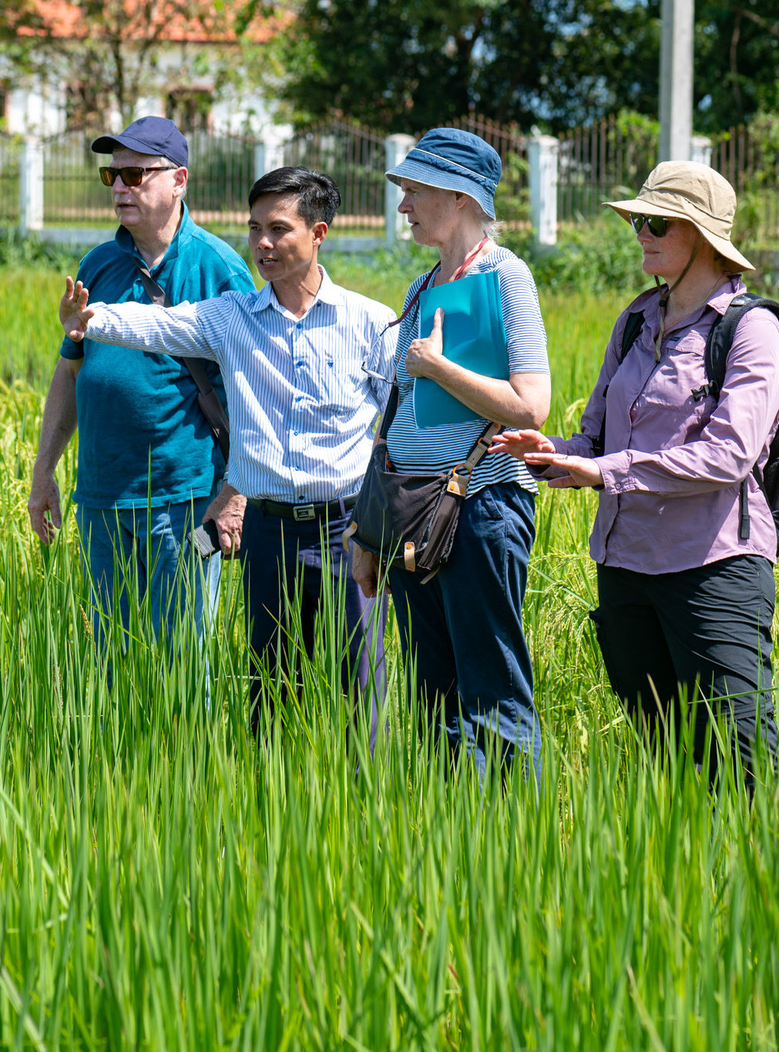
BOLD Project: Rice
Building on the CWR work, the BOLD Rice Project is advancing climate‑resilient, farmer‑preferred rice varieties across Vietnam.
Using participatory breeding, the project is testing wild‑derived lines with strong tolerance to drought, salinity, acid sulfate soils, and major pests and diseases.
These materials are being evaluated with farmers across the Mekong Delta, Central, and Northern regions, supported by 30+ research partners and seed clubs.
Promising lines are moving toward registration, release, and conservation in national and international genebanks, while all data and characterization results are made openly available to strengthen breeding capacity and ensure long‑term impact.
Notes:
https://bold.croptrust.org/crops/rice/

Slide 49
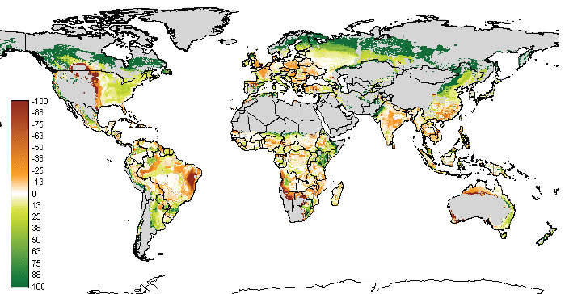
Expected effect of climate change on world cereal production in 2050
One response to mitigate the impact of climate change on agricultural systems is to develop improved varieties that are genetically tolerant or resistant to the new range of abiotic and biotic challenges
(% loss in brown) on World Cereal Production 2050
Nelson et al. (2010), www.ifpri.org
Notes:
Need new rice varieties that:
are well adapted
tolerate increasing inter-climate variability
more extremes & fluctuations

Slide 50
4 Key points
The International Rice Genebank, at the International Rice Research Institute (IRRI) - supported by the Crop Trust Endowment Fund - is a critical global resource for rice breeders.
Reliable access to and availability of rice germplasm is key to regional and global food security.
All national rice genebanks should consider sending active safety duplicates to IRRI - and make them available to the multilateral system (MLS)*.
Data on seed accessions is as important as the seeds themselves. Accurate, well-curated data greatly enhances their value and use.
*For more information about MLS, see:
https://www.fao.org/plant-treaty/areas-of-work/the-multilateral-system/faqs-mls/en/

Slide 51
Thank you!
Dr Julianne Biddle, Asia-Pacific Partnerships Lead
Julianne.Biddle@croptrust.org

