Slide 1
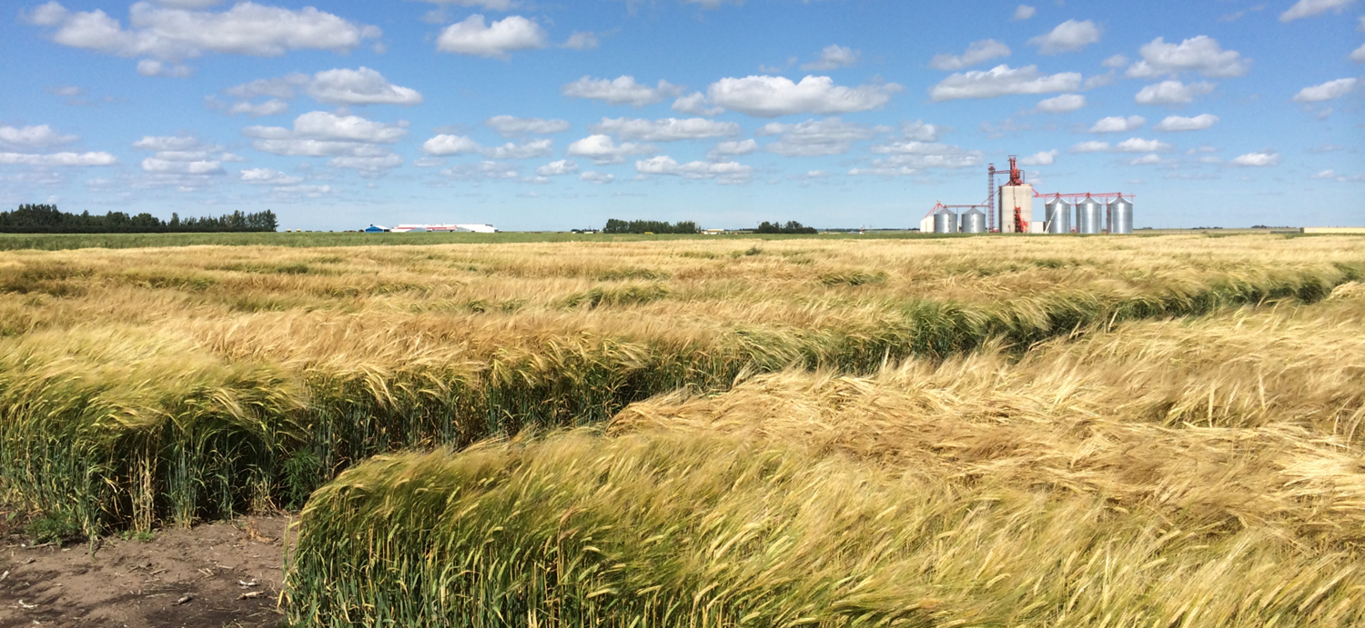

Gene Editing and UAV-based
Phenotyping for Accelerated Breeding
A.D. Beattie
April 13, 2026

Slide 2
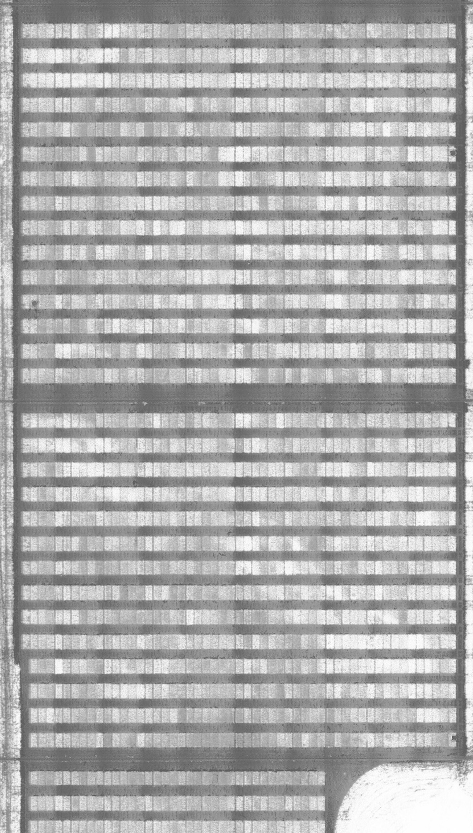
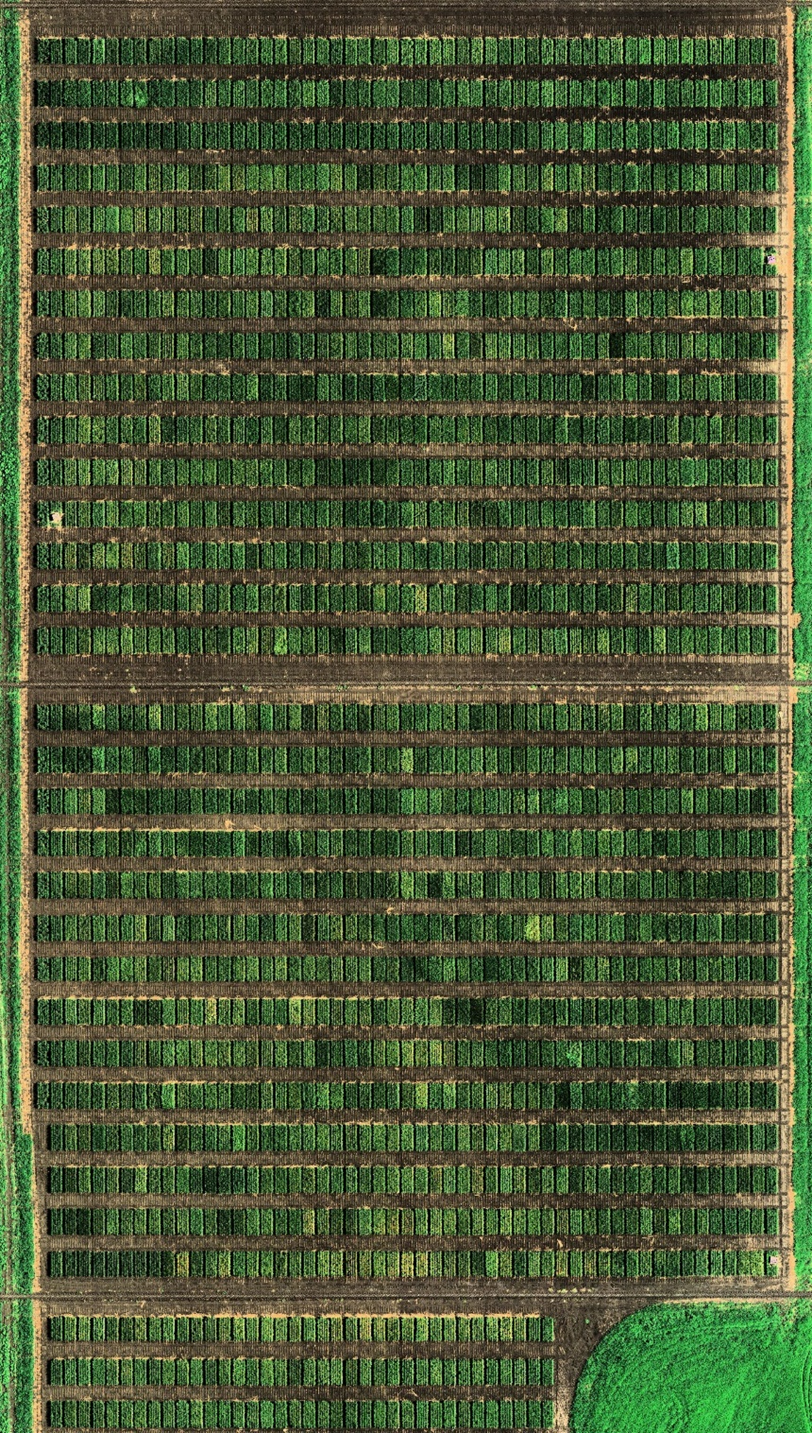
UAV Phenotyping
Rapid
Multiple timepoints
Flexible
Sensors
  Visible (RGB)
  NIR
  LiDAR
Feature extraction
  Spectral summaries
  Spectral indices
  Textures

Slide 3
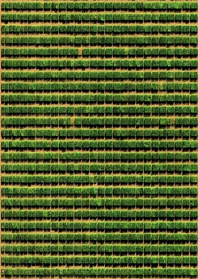
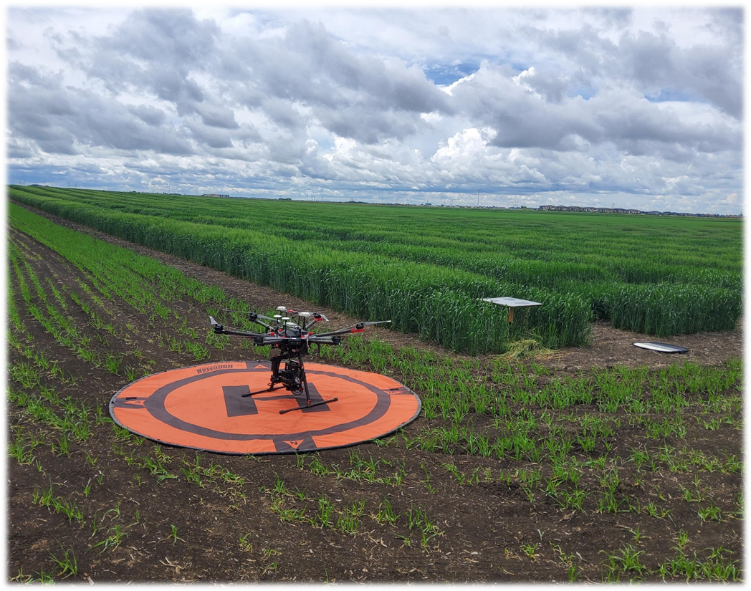
UAV Phenotyping to Predict Biomass
DJI Matrice 400 Drone
Micasense Altum-PT sensor (RGB, NIR, RedEdge)
Zenmuse L23 (LiDAR)
$75,000 (CAD)
Five flights per season
Two sites/year, 4 years

Slide 4
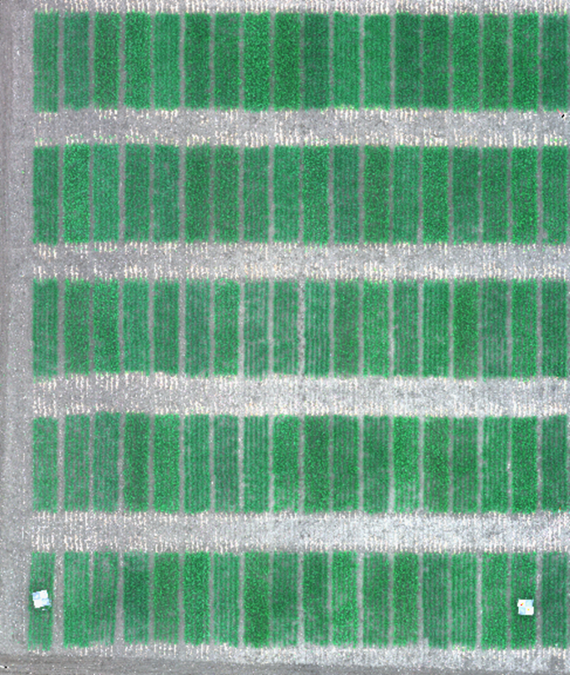
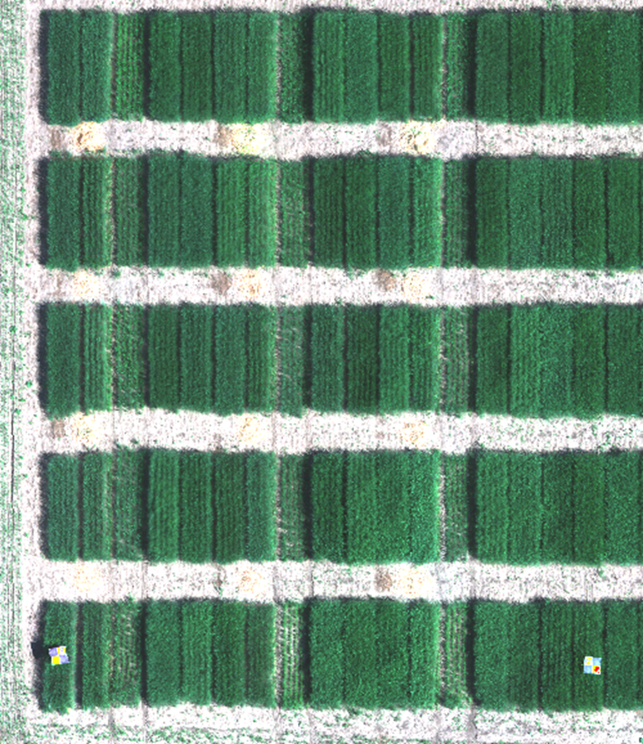
UAV Phenotyping to Predict Biomass
June 12
July 3

Slide 5
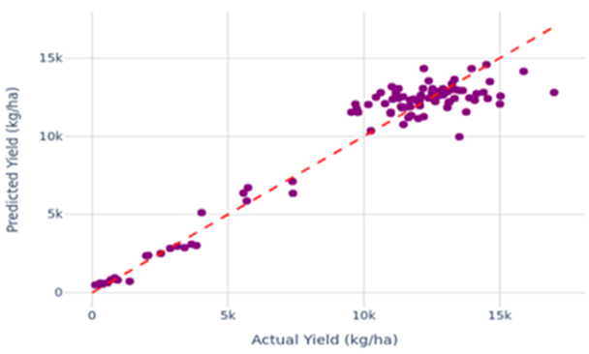
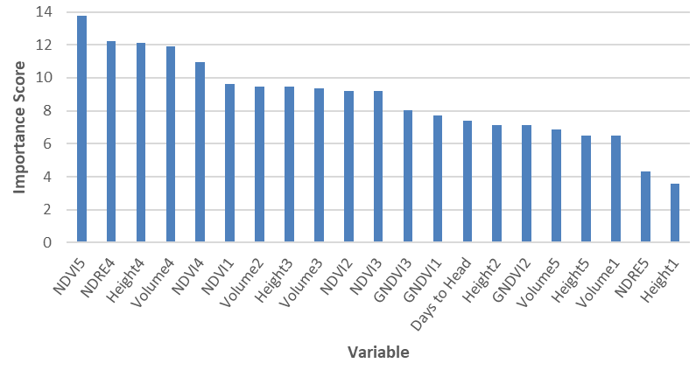
UAV Phenotyping to Predict Biomass
NDVI = (NIR-Red)/(NIR+Red)
NDRE = (NIR-RedEdge)/(NIR+RedEdge)
GNDVI = (NIR-Green)/(NIR+Green)
1= stem elongation, 2=early boot, 3=full heading, 4=soft dough, 5=hard dough
Notes:
NDVI: Normalized Difference Vegetation Index; measures canopy greenness
NDRE: Normalized Difference Red Edge; penetrates deeper to pick up chlorophyll variation, good for mid-late season growth, detect nitrogen status
GNDVI: Green NDVI; (GNDVI): Uses green band instead of red, sensitive to chlorophyll content

Slide 6
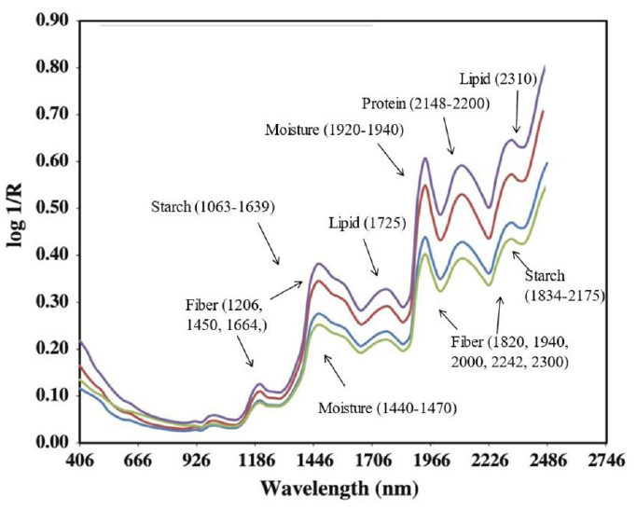
NIT/NIR Phenotyping
Rapid
Relatively inexpensive
High predictive ability
Low samples volumes (30-50 g)
Non-destructive (in some cases)
(Du et al. 2022)

Slide 7
NIR to Predict Forage Quality
1,781 samples collected from 3 sites over 5 years
  samples sent to Cumberland Valley Analytical Services to measure crude protein, ADF, NDF, NDFD (30hr time point), starch, total digestible nutrients (TDN) - $80/sample
  samples scanned with Foss XDS NIR
Correlation between lab and NIR-predicted values.
 | Protein (%) | ADF (%) | NDF (%) | NDFD 30 (%) | Starch (%) | TDN (%)
Oat | 0.99 | 0.89 | 0.89 | 0.92 | 0.98 | 0.85

Slide 8
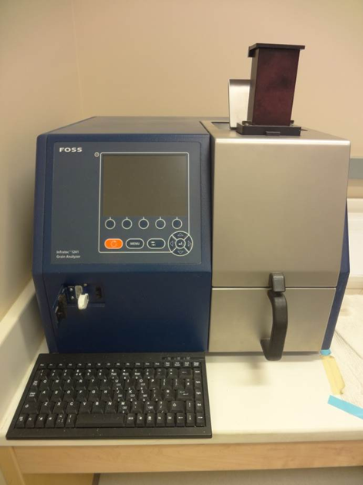
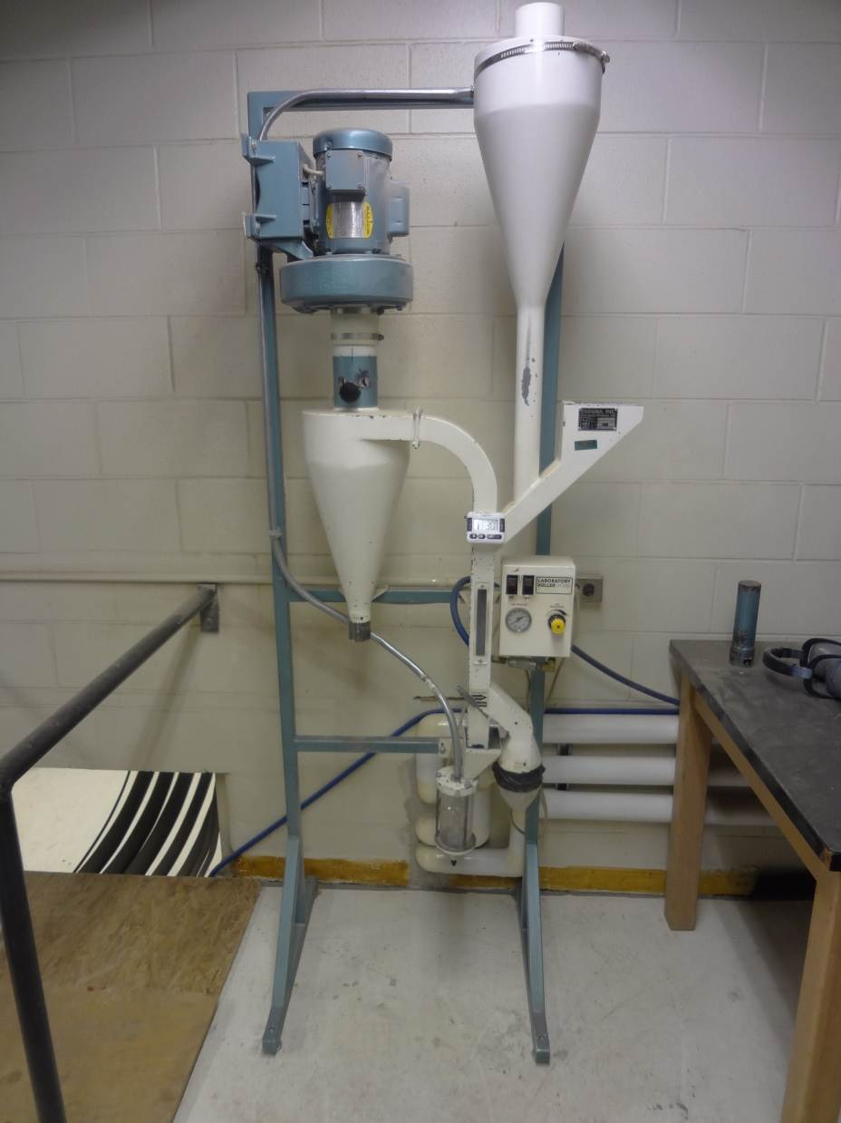
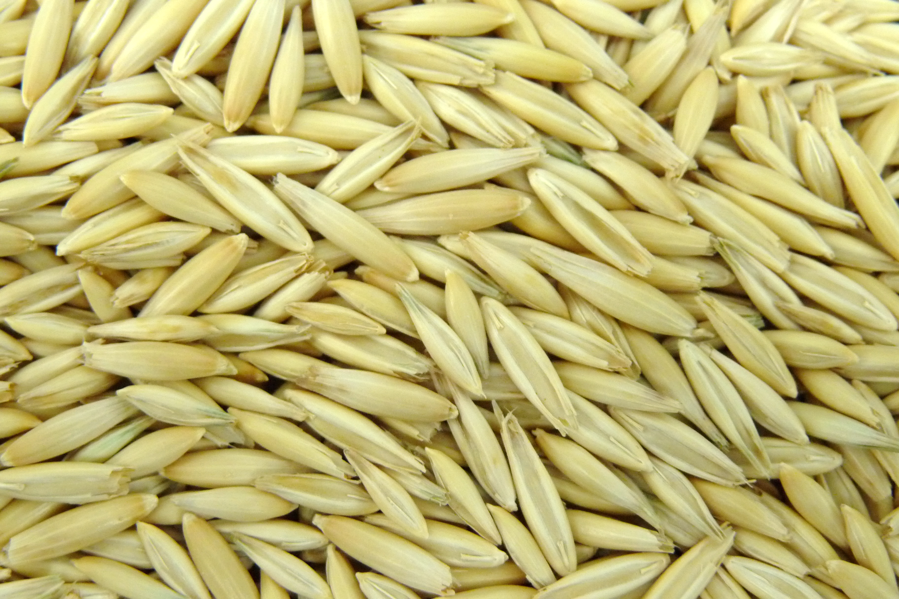
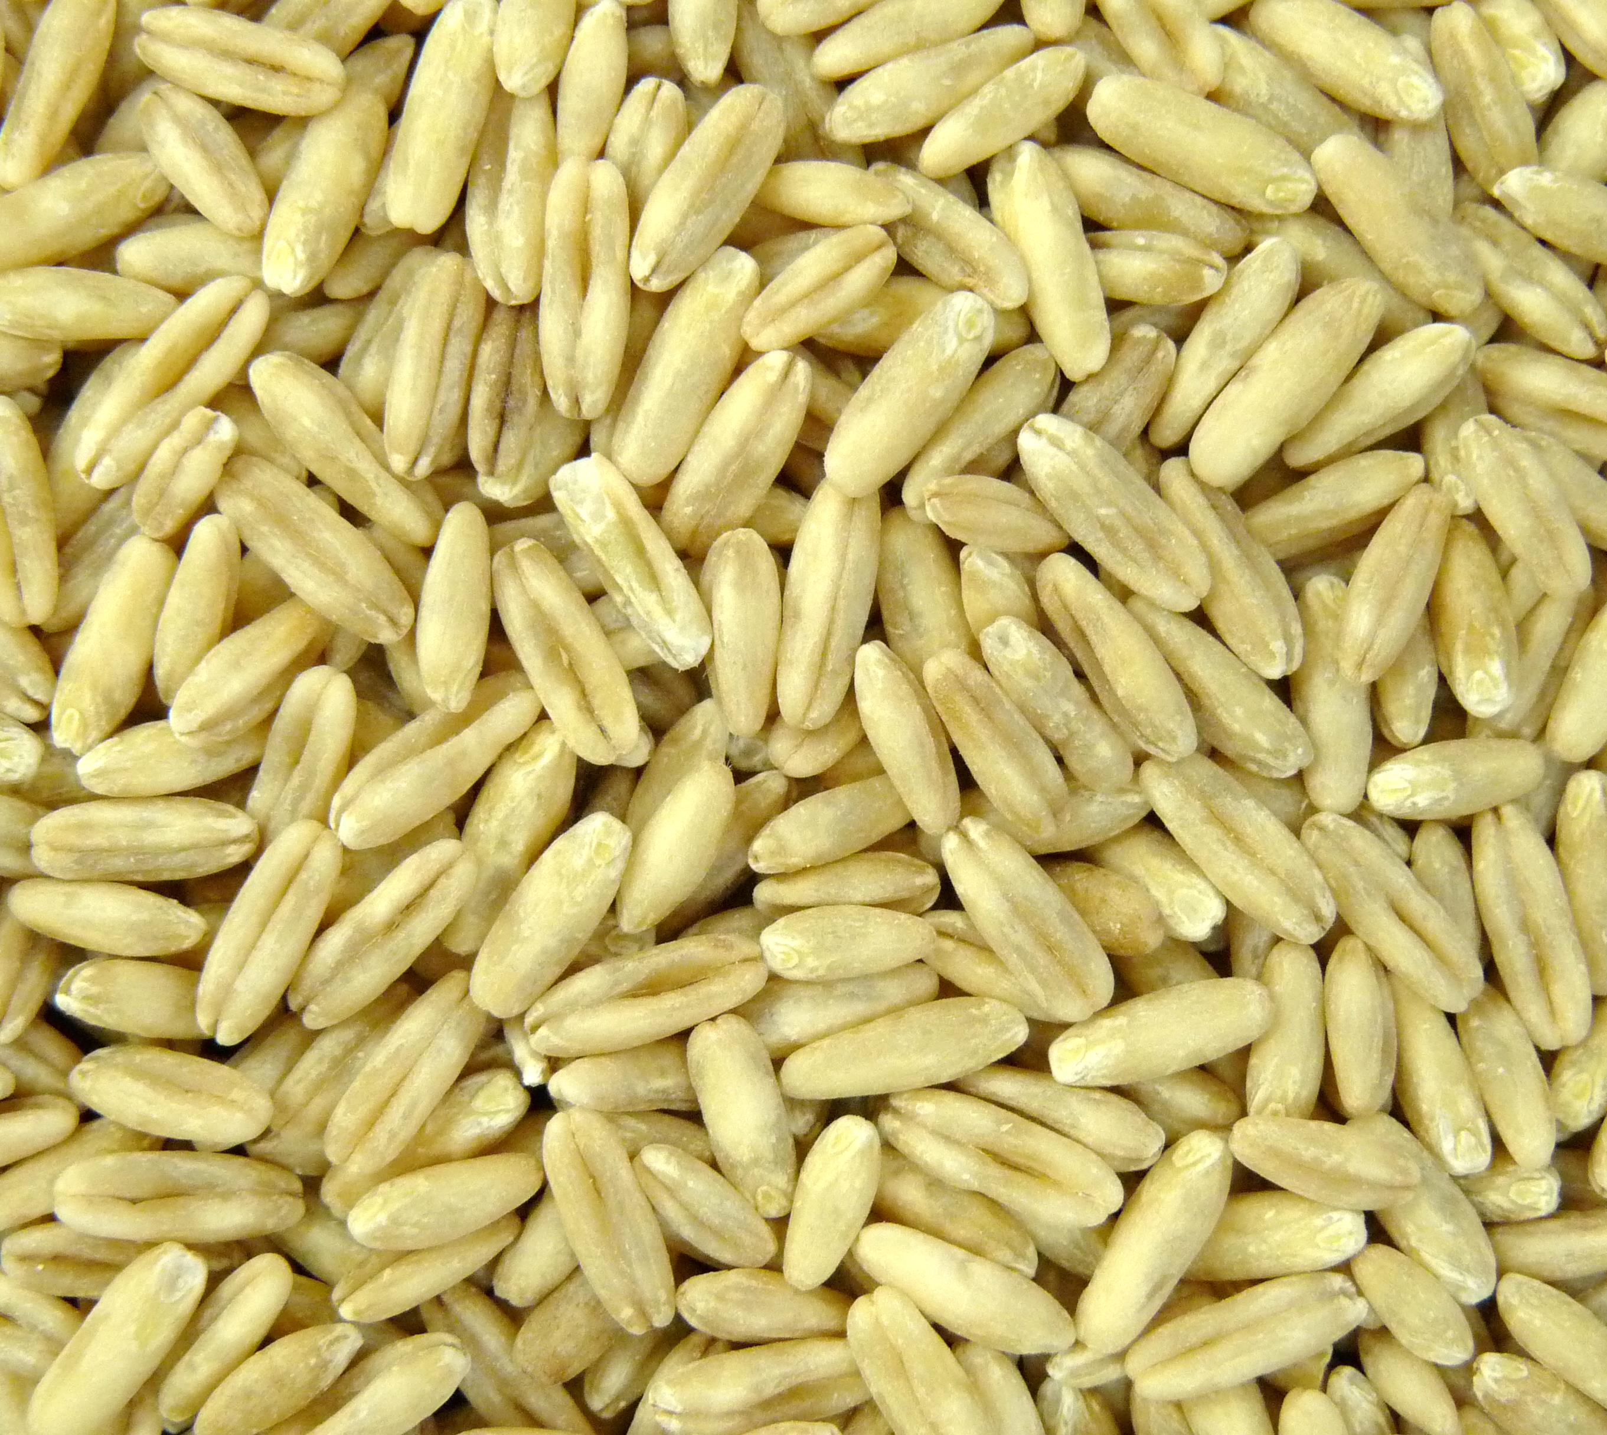
NIT/NIR to Predict Grain Quality

Slide 9
NIT/NIR to Predict Grain Quality
Also used to predict protein, fat and beta-glucan (r = 0.85 - 0.95)
Sample cost and throughput:
  Protein: $1.5/sample x 100 samples/day
  Fat: $5/sample x 50 samples/day
  Beta-glucan: $3/sample and 100 samples/day
  NIT/NIR: <$1/sample x 200 samples/day
$70,000 (CAD) for Foss Infratec 1241 NIT Grain Analyzer; $75,000 (CAD) for Perten FT-9700 NIR Analyzer; $130,000 (CAD) for Foss DS2500 NIR

Slide 10
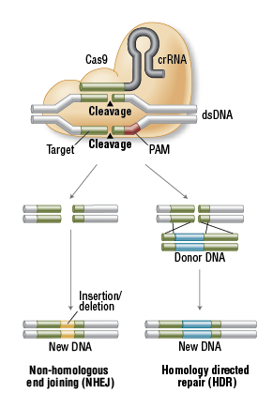
CRISPR-Based Editing
“Targetted mutagenesis”
High degree of expertise
Expensive
Genotype specific
Regulatory issues?
  Canada/US – OK (with conditions)
  EU – not allowed
Cas9: CRISPR associated nuclease
crRNA: aka “guide RNA” or “scaffold”
PAM: protospacer adjacent motif (NGG)

Slide 11
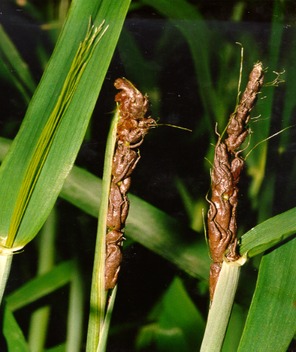
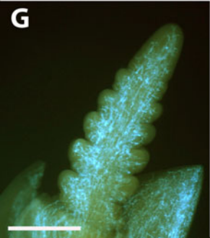

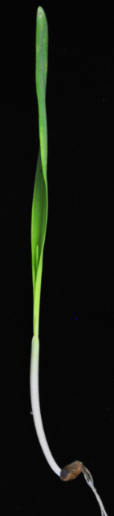
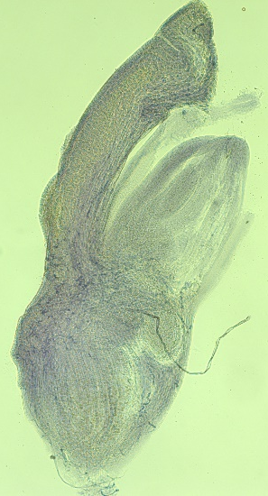
CRISPR-Based Gene Identification
.
.
.
.
.
.
.
.
.
.
.
.
.
.
.
.
Wunderle et al. 2012
Replacement of seeds by teliospores
Colonization of inflorescence primordium
Teliospore infection during flowering stage
Infect growing point
Mycelia reside within embryo

Slide 12
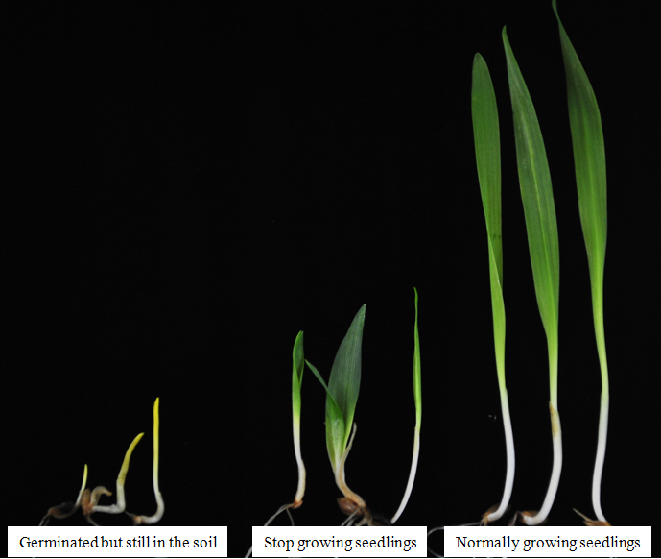
CRISPR-Based Gene Identification
Un8 WT
(R)
un8
(S)

Slide 13
CRISPR-Based Gene Identification
Barley
Chr. Arm 1 HL
Predicted protein
Predicted protein
0.065 (3)
Un8SNP1
Un8SNP4
Predicted protein
0.108 (5)
8487
TR306 (R)
×
Harrington (S)
48060
1*
0.151 (7)
Un8SNP7
Un8
Reverse transcriptase
HI1406
0751D06 F6/R6
Cytidylyltransferase
0.043 (2)
1406
TR09398 (R)
×
TR07728 (S)
Un8SNP4
Retrotransposon protein
0751D06 F6/R6
Purple acid phosphatase
0.108 (5)
Un8
Predicted protein
0498L15 F8/R8
0.238 (11)
0498L15 F3/R3
0.022 (1)
3602
0.086 (4)
10924
Auxin-induced protein
17452
5
Predicted protein
1.492 (69)
Cell wall protein
13742
Predicted protein
0.108 (5)
LRR protein
21217
Protein Kinase (candidate)
0.432 (20)
0498L15 F8/R8
Predicted protein
Un8SNP6

Slide 14
CRISPR-Based Gene Identification
ATG
TAG
5' UTR
Kinase I
Kinase II
CN91953
TR09398
AC Metcalfe
CDC Fraser
Un8 (R)
S
.
.
L
V
E
E
E
S
N
N
N
T
I
I
I
A
V
V
V
D
Y
Y
Y
Q
H
R
H
Q
L
L
L
S
T
T
T
R
H
H
H
E
R
R
R
H
Y
Y
Y
G
V
V
V
R E N I Y QQ S R E A H G
CN49986
H. spontaneum
un8 (S)
Bowman
Morex
CN72631
(H. spontaneum)
CDC Austenson

Slide 15
CRISPR-Based Gene Identification
ATG
TAG
5' UTR
Kinase I
Kinase II
326 bp
346 bp
Un8 Guide RNA
PAM
TR09398 Wild-Type (WT)
GAATGCTCAGACGATGGTCTTGGAGCACGCCAGCAATGG
GAATGCTCAGACGATGG--T | 2 bp
GAATGCTCAGACGAT--TCT | 2 bp
GAATGCTCAGACGA---TCT | 3 bp
GAATGCTCAGAC-----TCT | 5 bp
GAATGCTCAGA------TCT | 6 bp
GAATGCTCA--------TCT | 8 bp
GAATGCTCAGACGATGG------AGC | 6 bp
GAATGCTCAGACG----------------------ATGG | 22 bp
TR09398 Knock-Out(KO) Mutants
38.5%

Slide 16
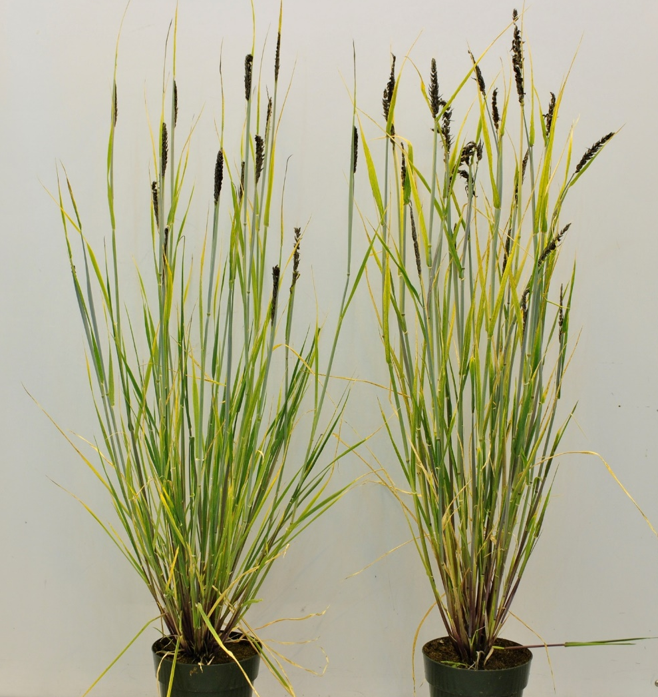
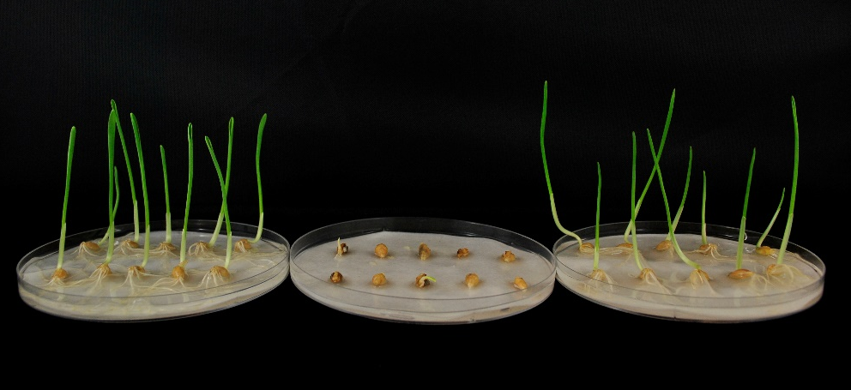
CRISPR-Based Gene Identification
Un8-WT TTGACGAGAATGCTCAGACGATGGTCTTGGAGCA
Un8-KO TTGACGAGAATGCTCAGACGAT--TCTTGGAGCA
CDC Austenson
(S)
TR09398 – WT
(R)
TR09398-KO
CDC Austenson
TR09398-KO

Slide 17
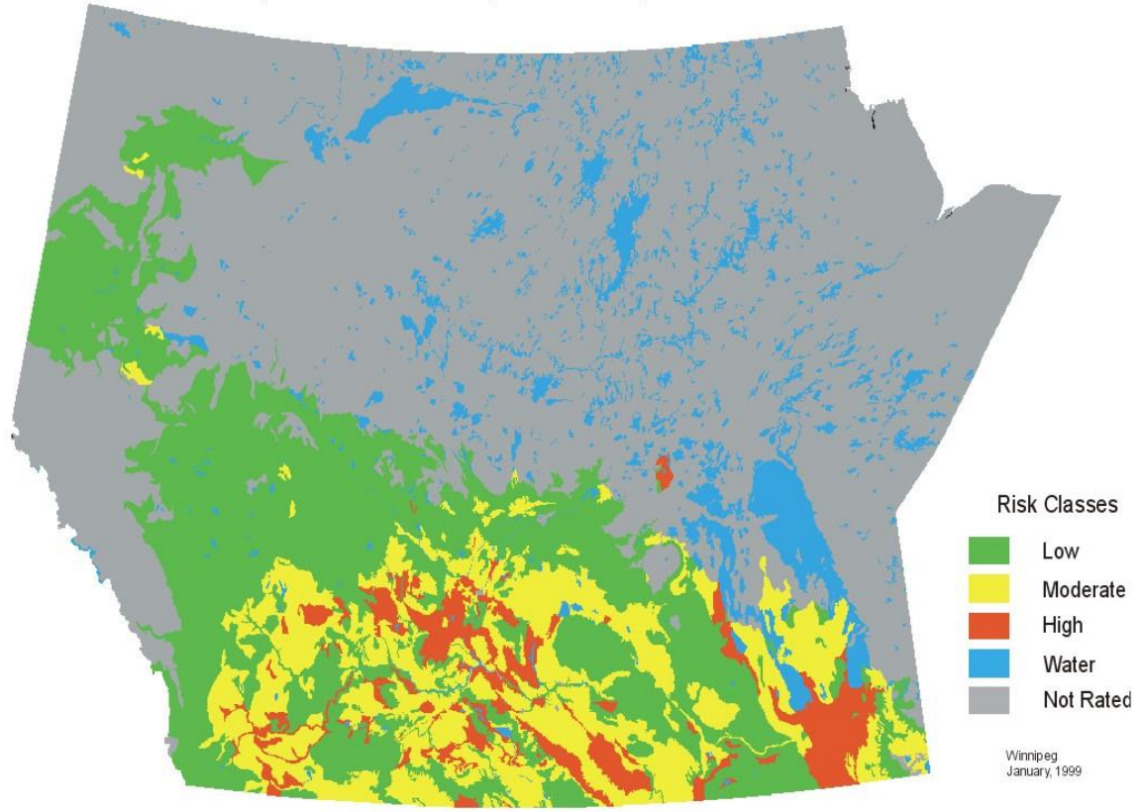
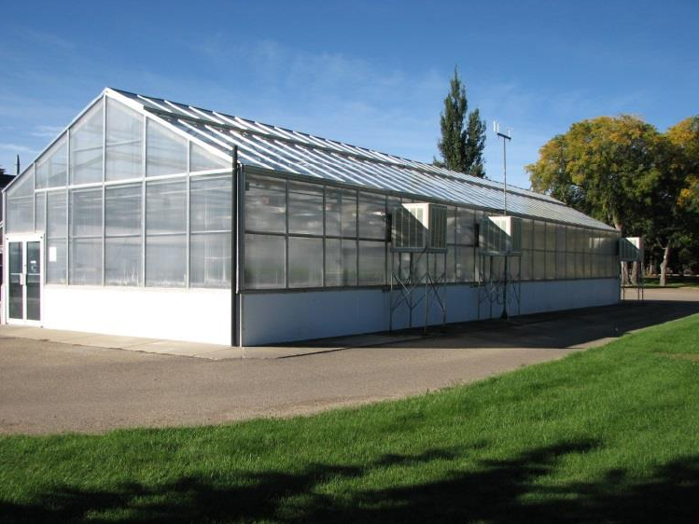
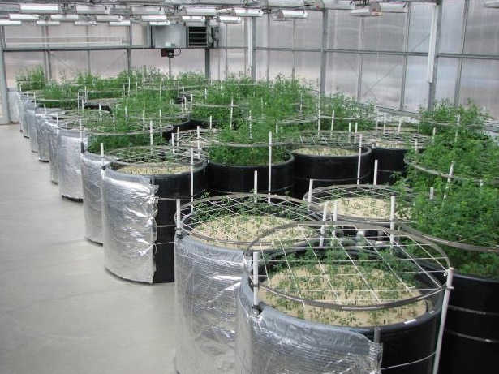
Better Salinity Tolerance in Barley
30% of acres display salinity or at risk to become saline
AAFC Salt Lab (Swift Current):
  Mimic prairie soils (CaCl₂, MgSO₄, NaSO₄, NaCl)
  Range of salt stress (slight: 1.6 dS/m²; moderate: 10 dS/m²; severe: 20 dS/m²)
Wall et al. (2015)

Slide 18
CRISPR-Edited GABA-T
Gamma amino butyric acid (GABA)
  Derived from glutamate
  Neurotransmitter
  Health benefits related to reduced blood pressure
  Also, a stress signaling molecule in plants linked to salinity tolerance
GABA transaminase (GABA-T) metabolizes GABA
GABA-T knock-outs/null mutants show enhanced levels of GABA

Slide 19










Funding Partnerships

Slide 20






Funding Partnerships

