Slide 1

Genomic Selection in Plant Breeding
Bill Biligetu
  Crop Development Center, University of Saskatchewan
www.usask.ca/cgsr
Notes:
founded in 1907

Slide 2
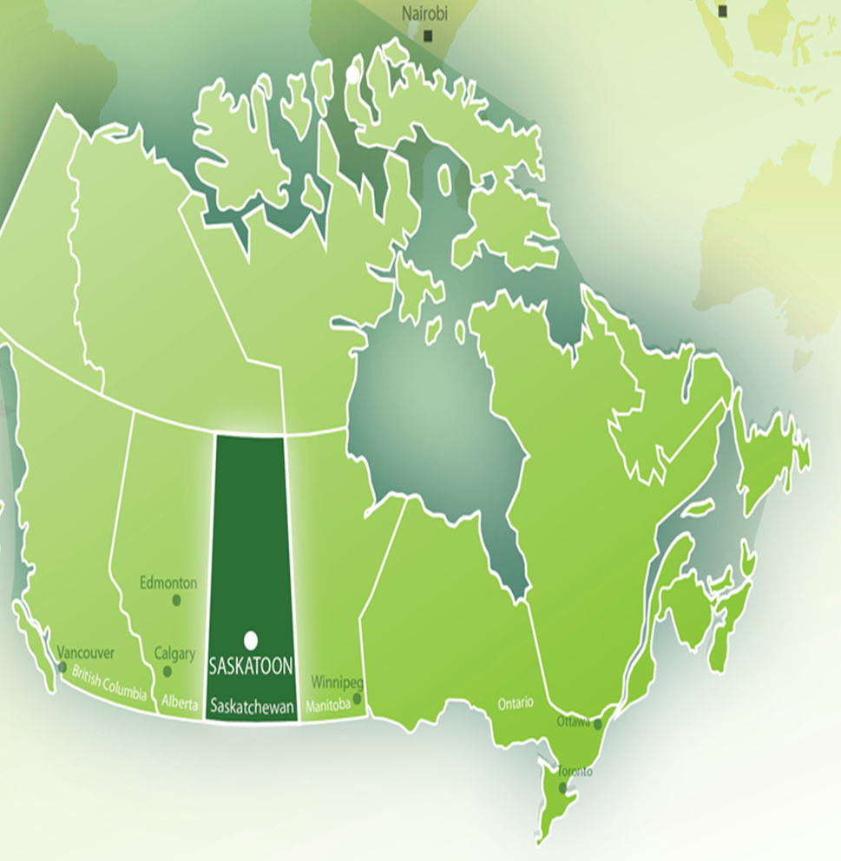

University of Saskatchewan
  Saskatoon
  Established in 1907
  Over 100 areas of study
  World leader in agriculture science

Slide 3

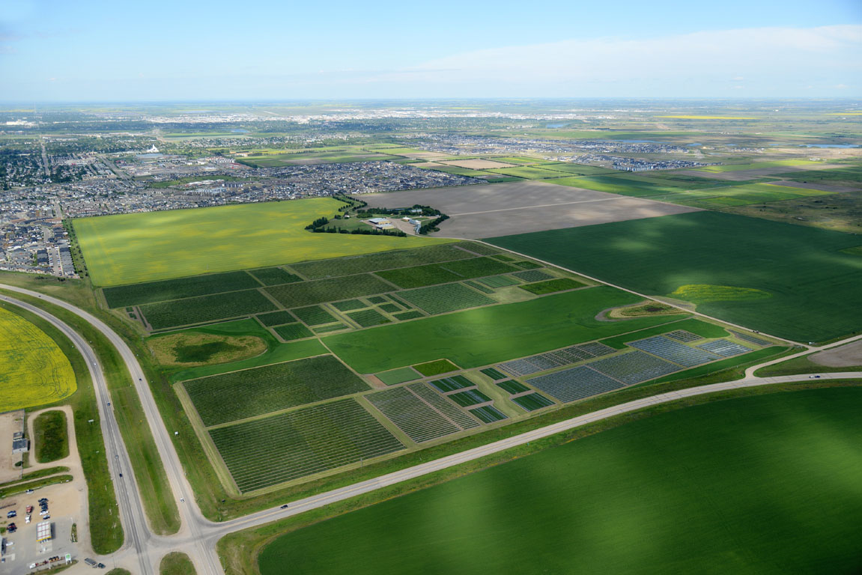
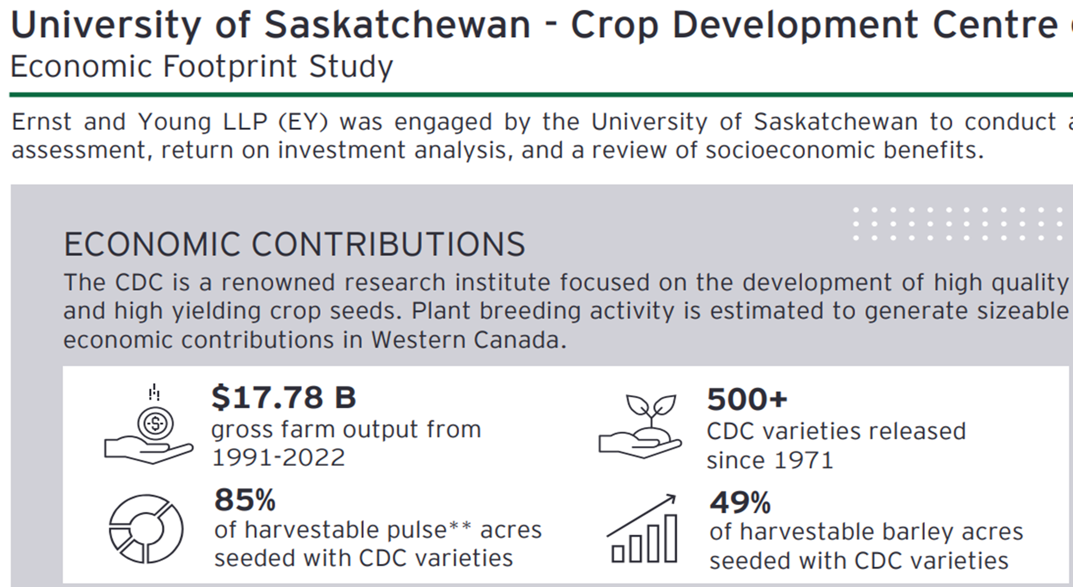
Crop Development Center/Depart. Plant Sci
Crop Development Centre (CDC): in 1971
Integrated with the Depart. of Plant Science
7 crop breeding programs + 1 pre-breeding + 2 pathology
Over 500 cultivars on more than 40 species

Slide 4
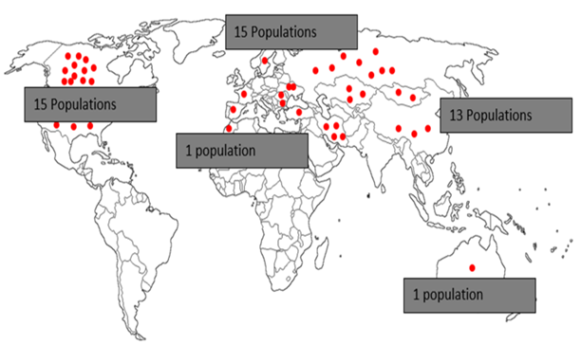
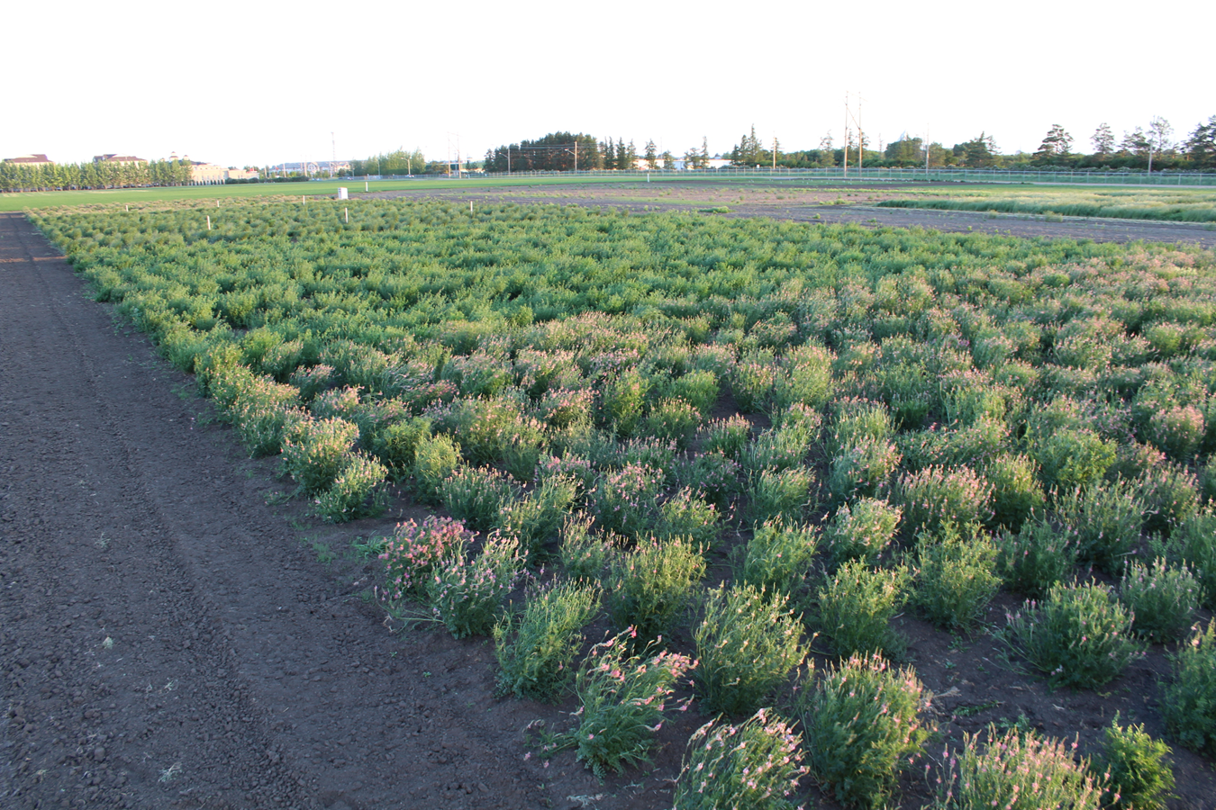
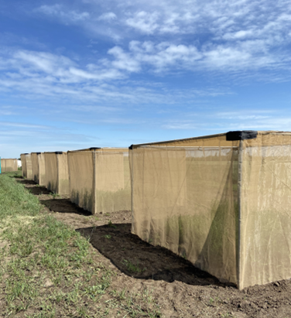
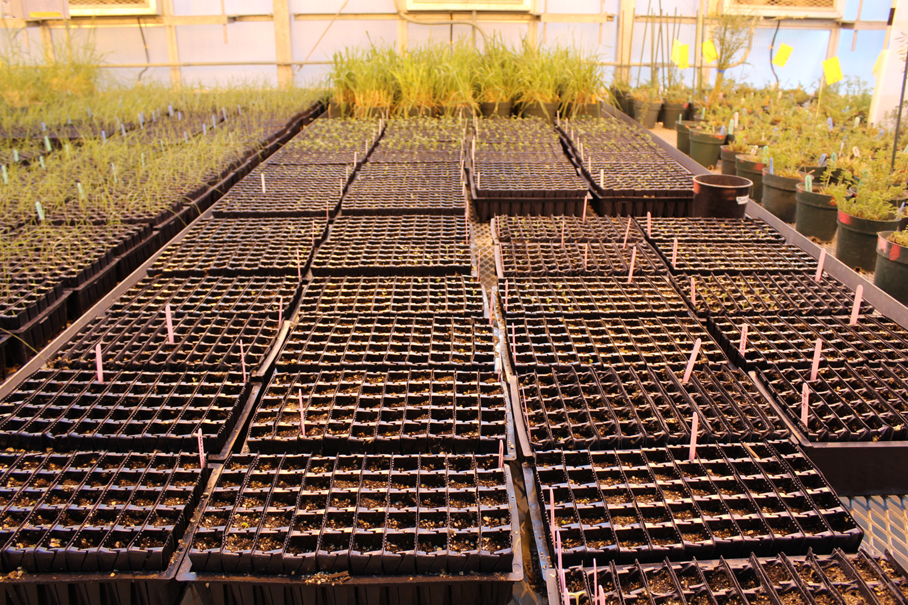
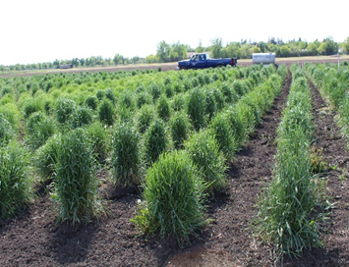
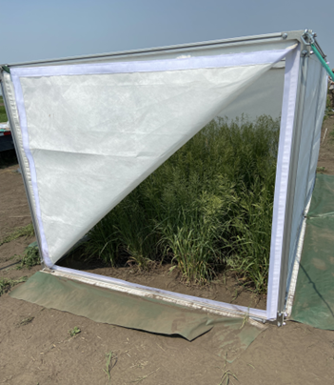
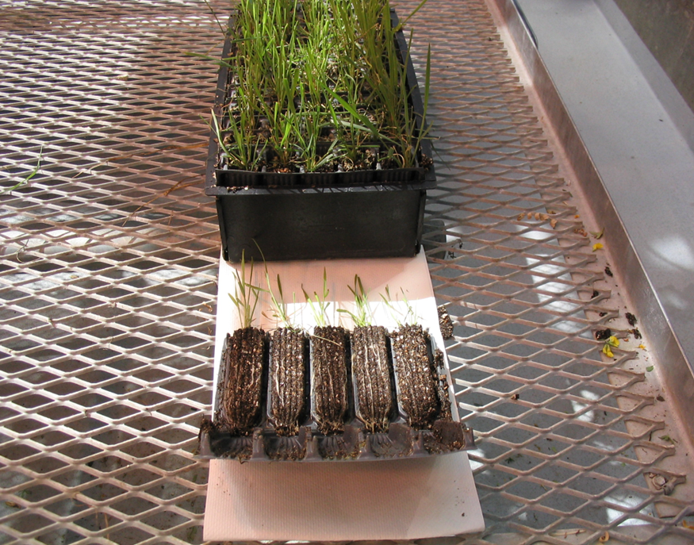
CDC perennial forage breeding
Isolated crossing

Slide 5
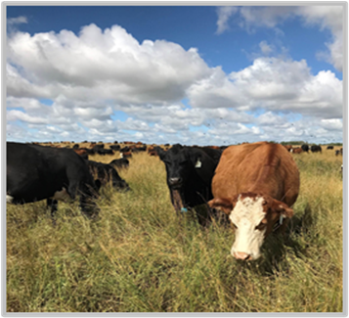
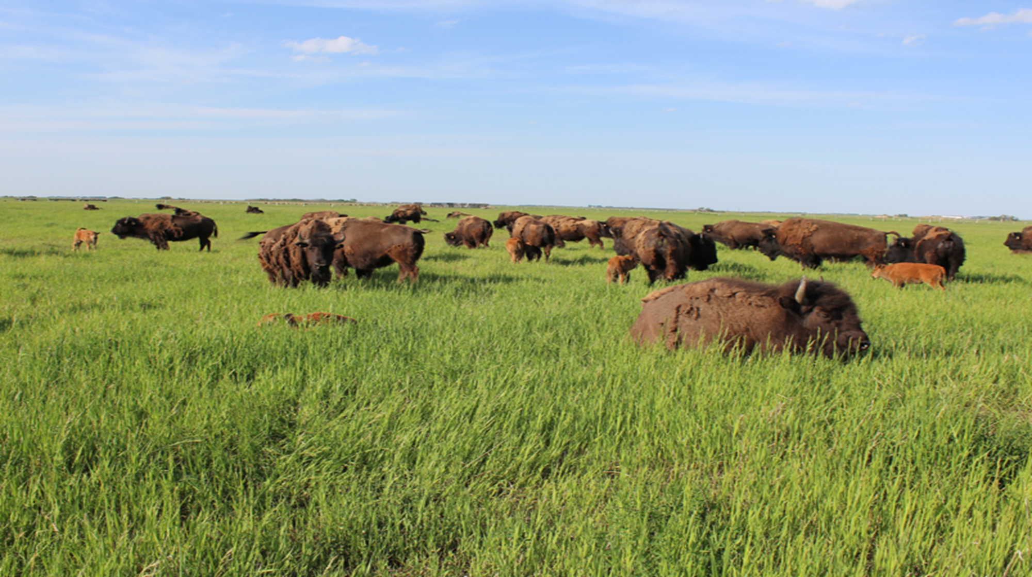
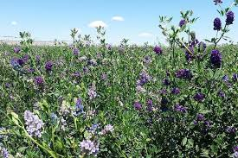
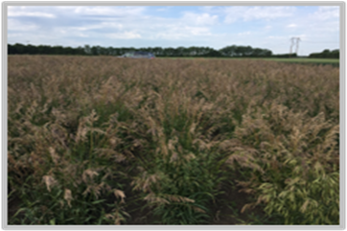
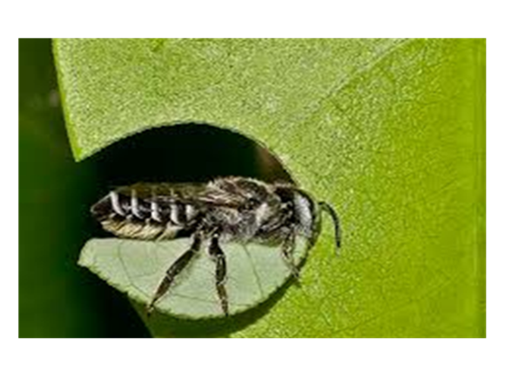
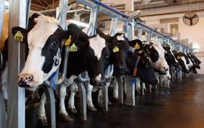
Forage crop varieties support various industries
Beef sector
Emerging Bison industry
Alfalfa and grass seeds
($130-180 millions)

Slide 6
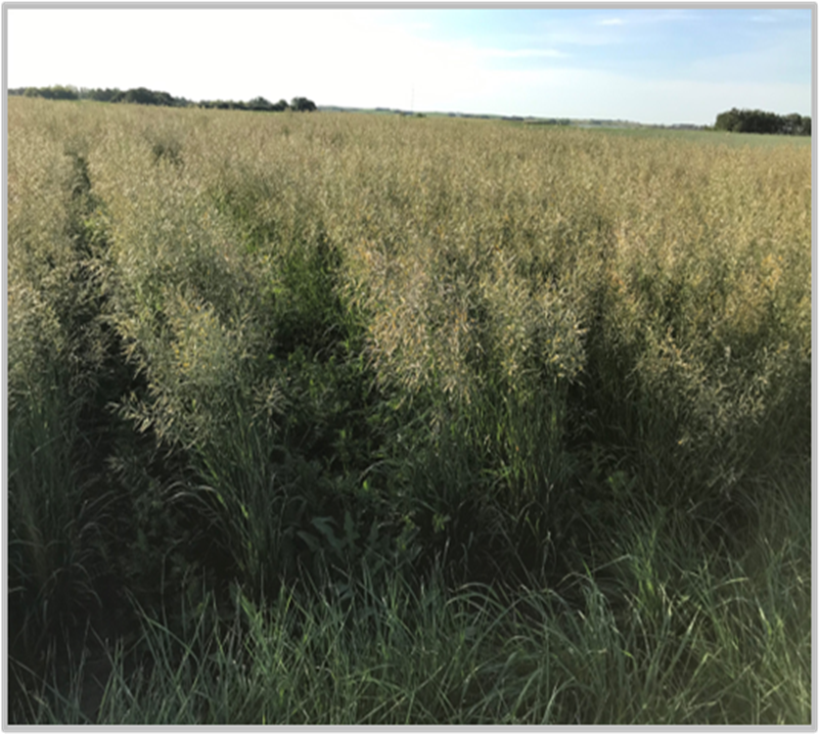
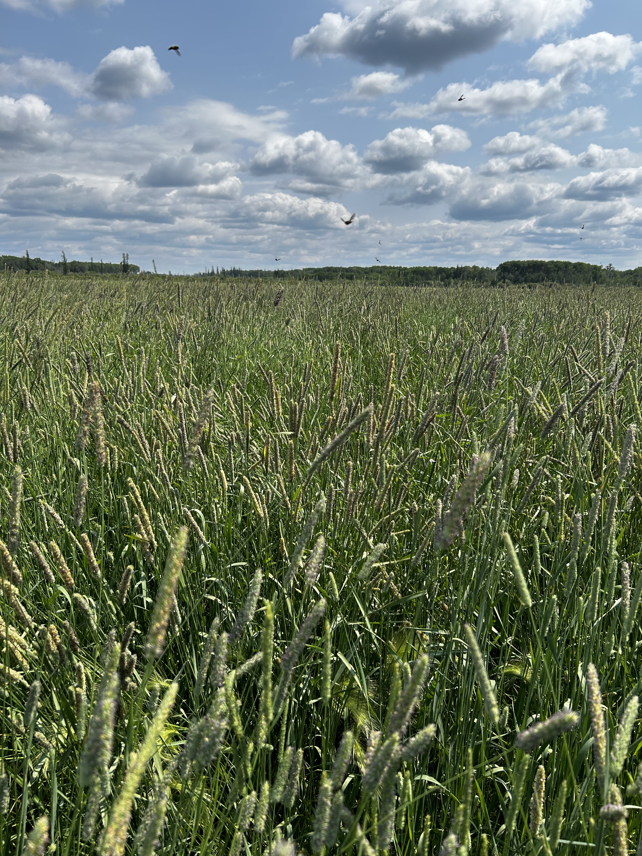
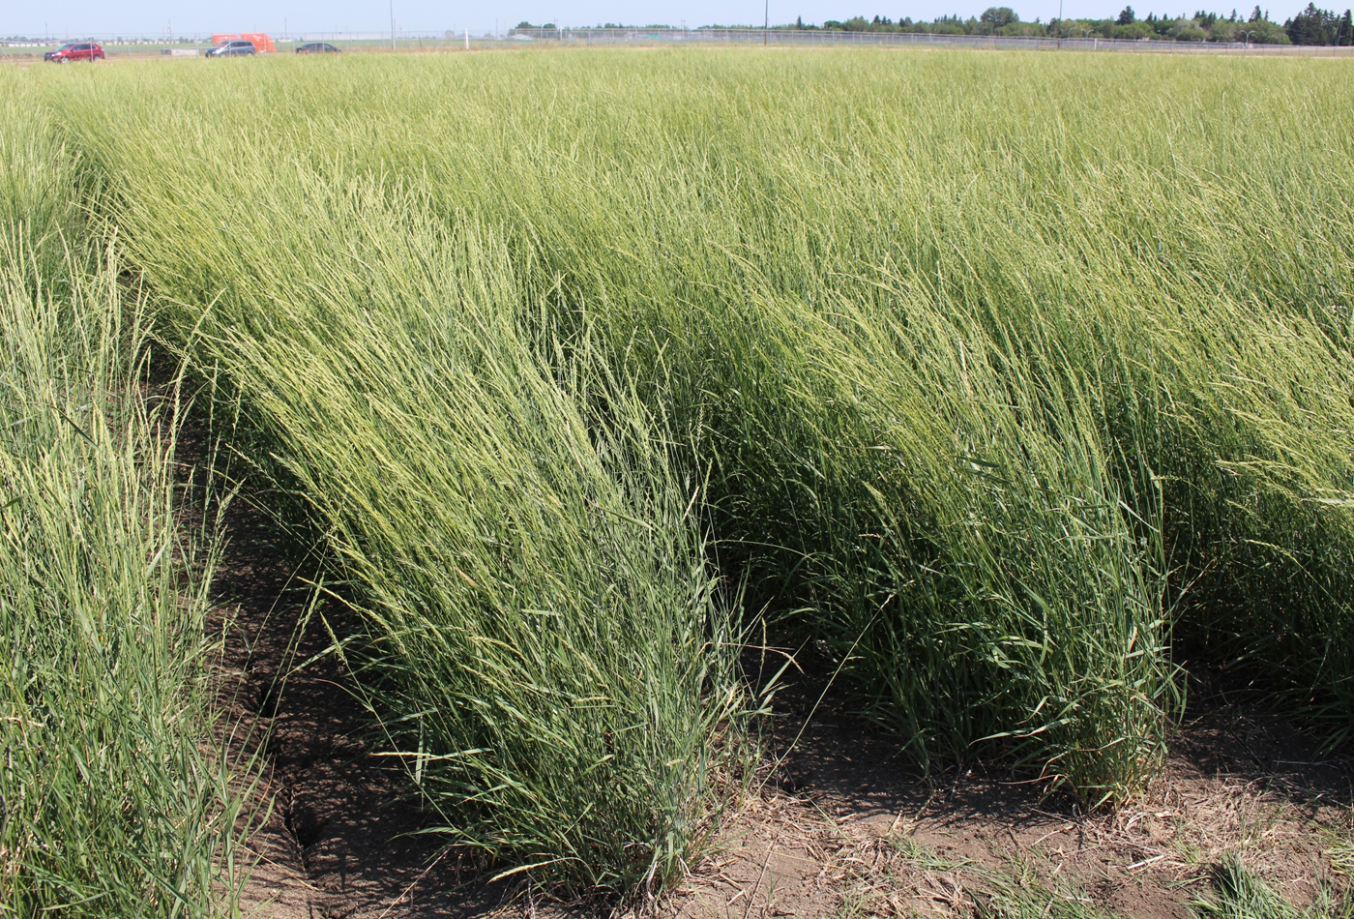
CDC Forage breeding program ( 1922-2026)
‘CDC Torsion’
Meadow brome (2020)
‘CDC Tiznow’
Timothy (2022)
CDC Salt King
Hybrid wheatgrass (2022)

Slide 7
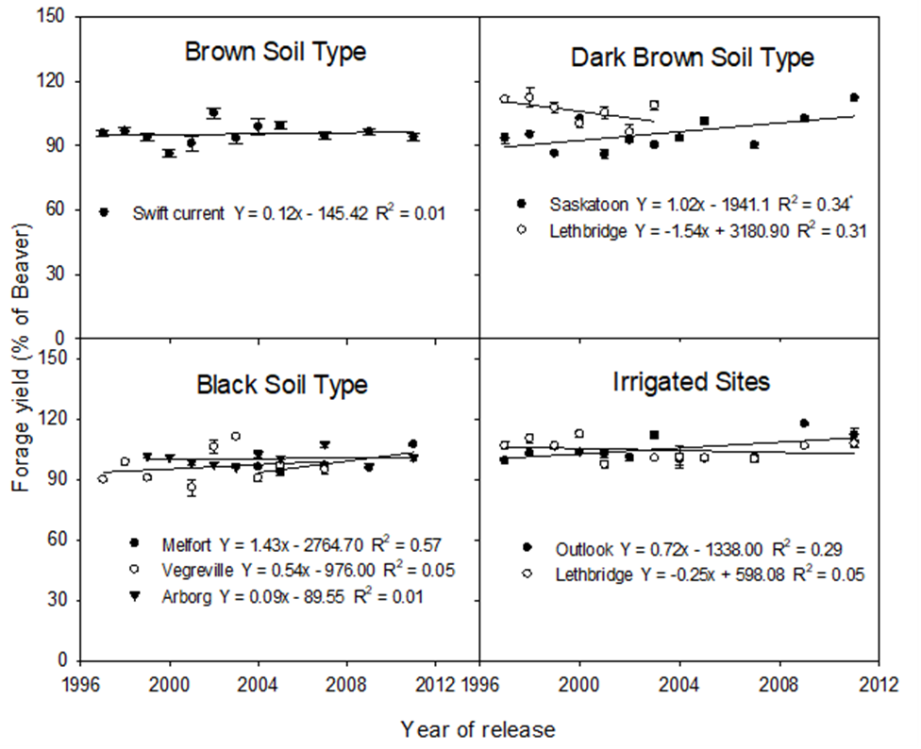
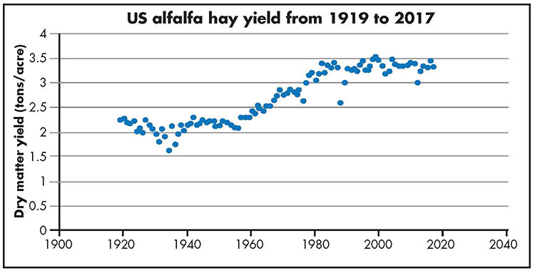
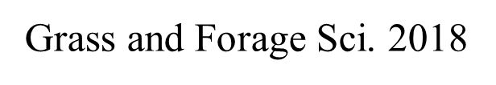
How to make a breakthrough in yield?
Alfalfa Hay yield
Brummer and Putman 2018, Hay & Forage Grower

Slide 8
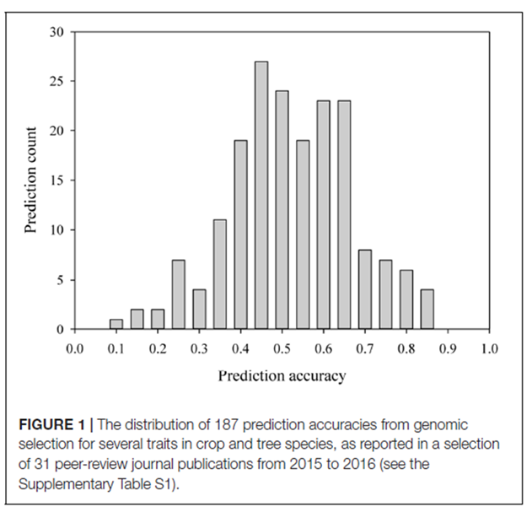
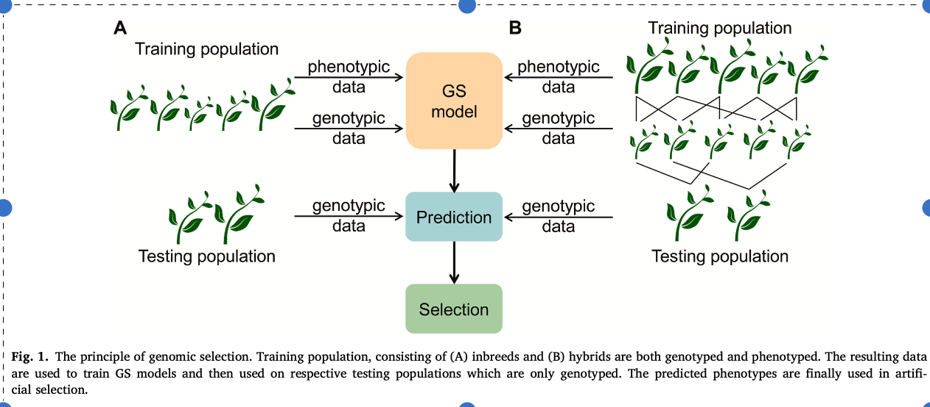
Genomic selection
Tong and Nikoloski 2021 J of Plant Physiology

Slide 9
Factors to consider in genomic selection
Genetic heritability of trait ( plant height, yield)
Genetic diversity of the training populations
  could eliminate elite lines if not included
Markers are distributed throughout the genome
Marker density:
  Marker function: linkage disequilibrium (LD) with each QTL
  LD decay rate:
Training size to Test size - ?
Prediction Models
Precision phenotyping of traits for training

Slide 10
Size of training population
Heritability of the target trait
Adding more related materials between test to training
Training population is much smaller for a closely related population
Hybrid parent selection – can be smaller
  Effective GS models built with a training population 2%–13% of the whole population (Guo et al. 2019)

Slide 11
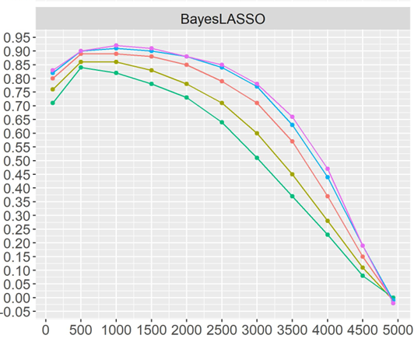
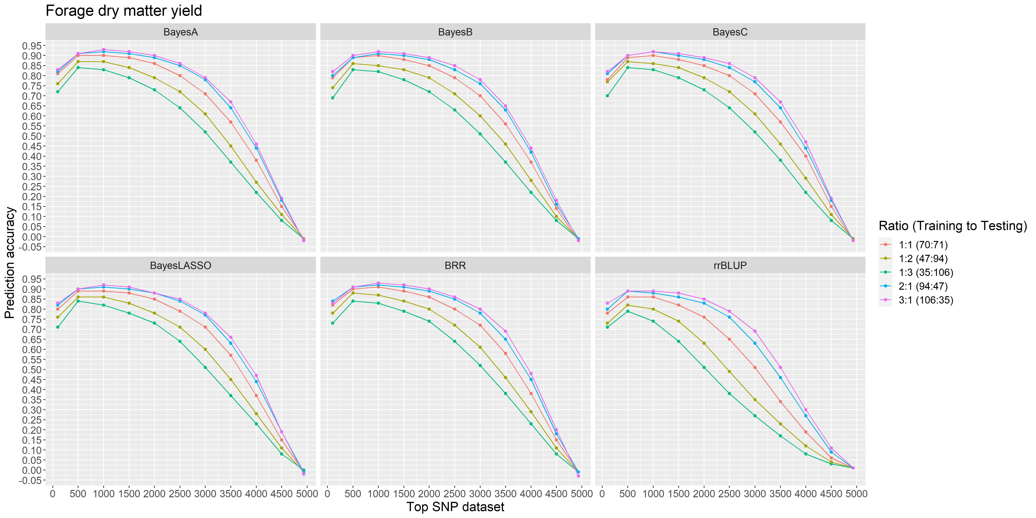
Training to test set ratio : alfalfa forage yield
Prediction accuracy
Wang and Biligetu. 2024. The Plant Genome

Slide 12
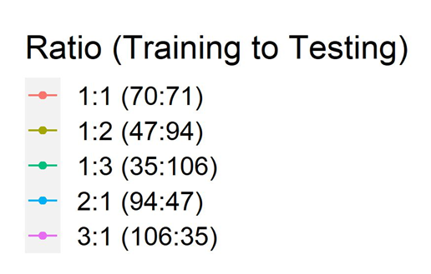
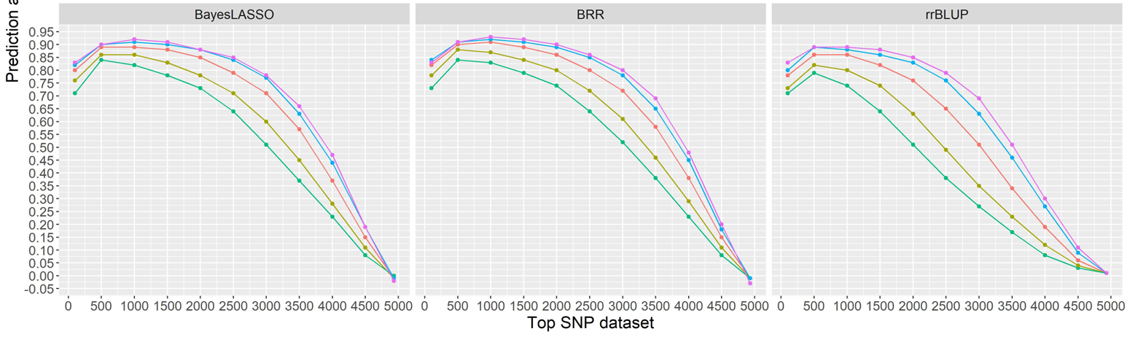
Number of Markers: alfalfa forage yield
Total +4500 SNPs
Blast against NCB gene bank
Grouped 11 based on functions
100 – most significant genes related
500 SNPs
1000 SNPs
…..
All markers
Wang and Biligetu. 2024. The Plant Genome

Slide 13
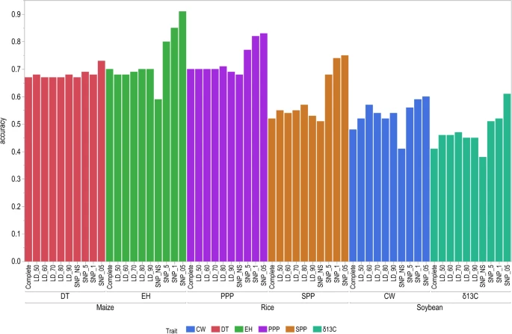
Marker function
Maize:
Ear height (EH)
Rice:
Seeds per
plant (SPP)
Soybean:
wilting
(CW)
No increase in accuracy among the non-significant subset of markers
Increased with the increase of significant markers
1. SNP-NS
2. SNP-5
(P =0.5)
3. SNP-1
(P =0.1)
4. SNP05
(P =0.05)

Slide 14
Number of SNPS seems not important
LD decay rate is important for each trait, but…
575 rice hybrids genotyped with 2,054,293 SNPs indicated that the predictive ability reached a plateau at 5K SNPs (Y. Xu et al.2018. Rice)
363 elite rice breeding lines revealed that there was no significant difference in the predictive ability when using 7142 SNPs or 73,147 SNPs. (Spindel et al. 2015 PLoS Genet)
We did a simulation study using Angus cattle and soybean – found function of markers are more important than marker density ( Fu et al. 2016)

Slide 15
Statistical models for GS
Parametric methods
  Genomic best linear unbiased prediction (GBLUP)
    The GBLUP method assumes all markers following the same genetic variance
    Fast, and more suitable for highly polygenic traits
  Bayesian methods (BayesA, BayesB, BayesC, BayesCp, BayesR and Bayesian LASSO, etc.)
  Additive effect
Semi (Non)-parametric methods
  Reproducing kernel Hilbert space (RKHS)
  Non-linear model
  Effective for capturing non additive effects (Dominance, epistasis)
  Predictive ability of 0.248, vs. GBLUP (0.195, P < 0.01) for F2 wheat

Slide 16
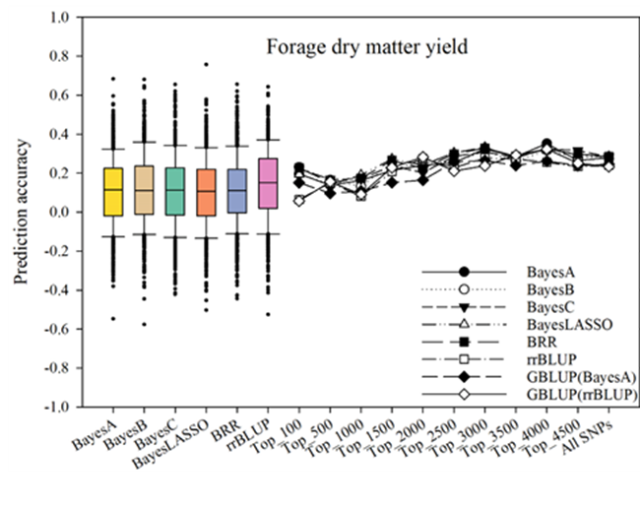
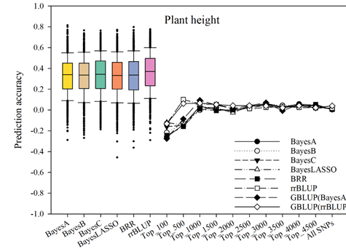

Statistical models for GS
G×E interaction
multi-trait
multi-environment

Slide 17
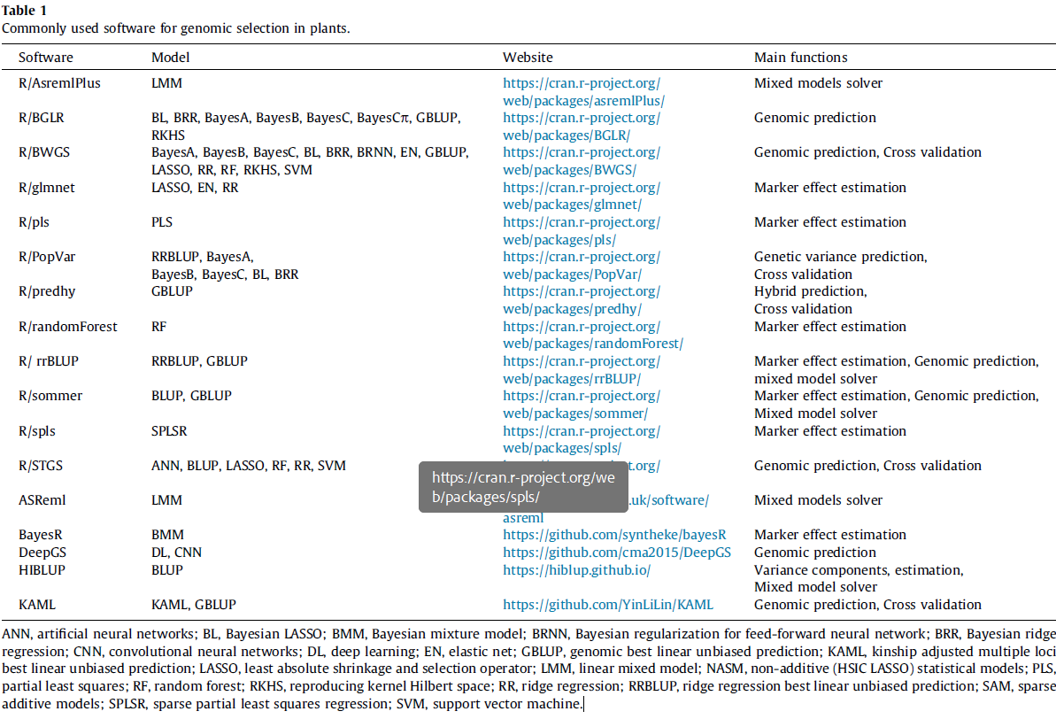
Statistical models for GS
The Crop Journal 9 (2021) 669–677

Slide 18
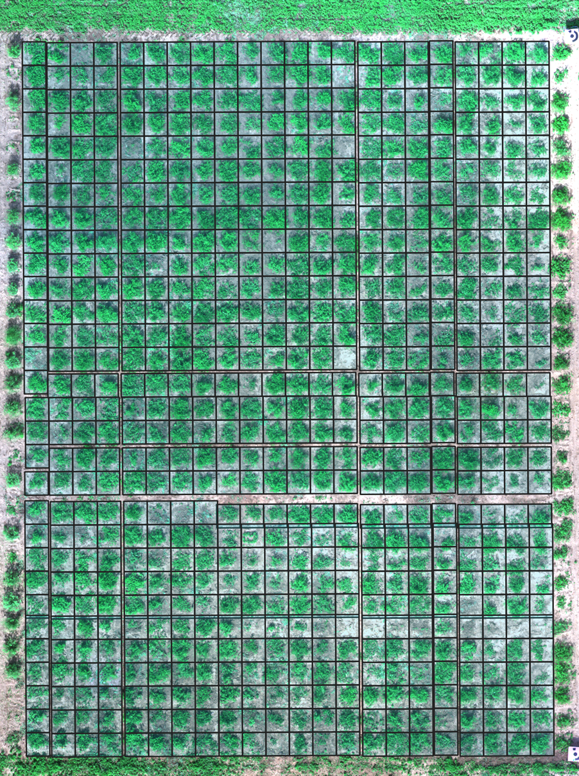
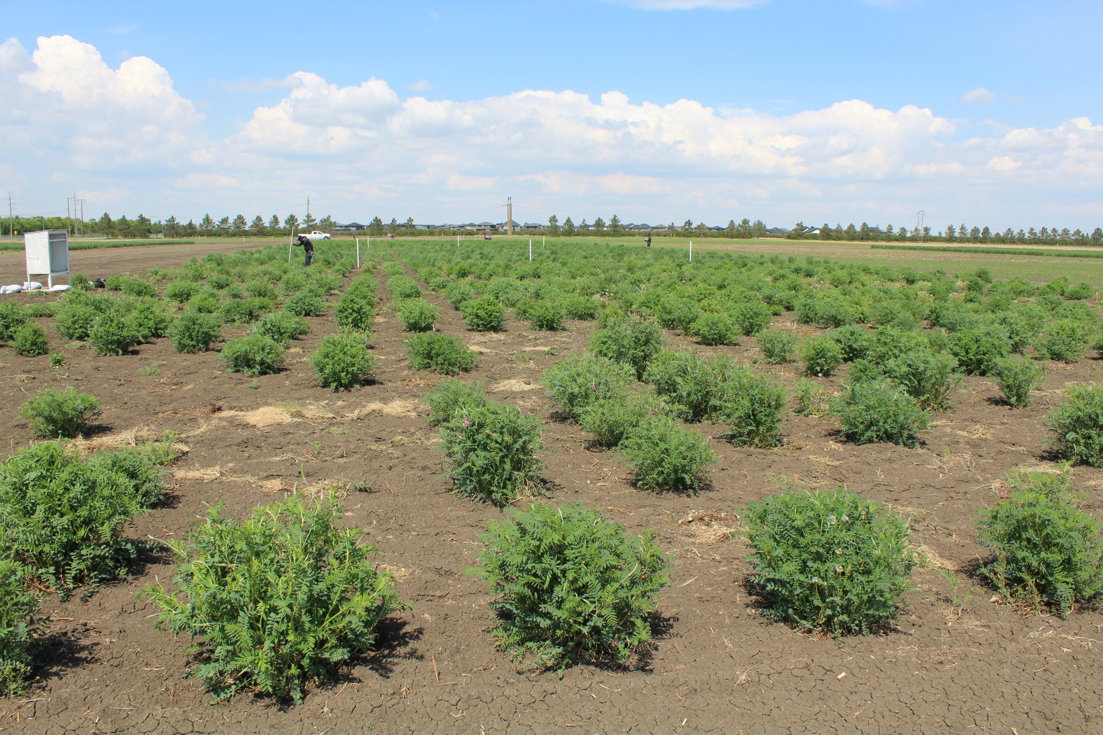
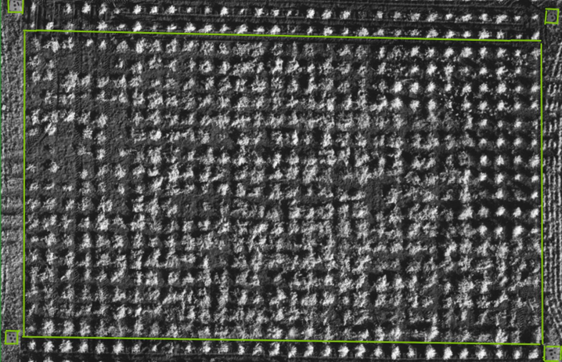

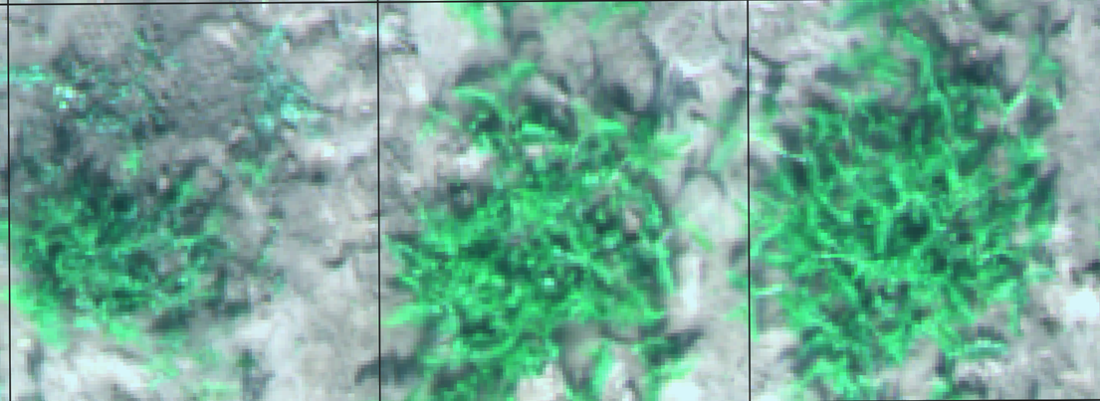
Precision phenotyping
UAVs) - multi-spectral Camera phenotyping
Orthomosaic map
Various software were used
NDVI Green Area
NDVI canopy volume
Plant height NDVI

Slide 19
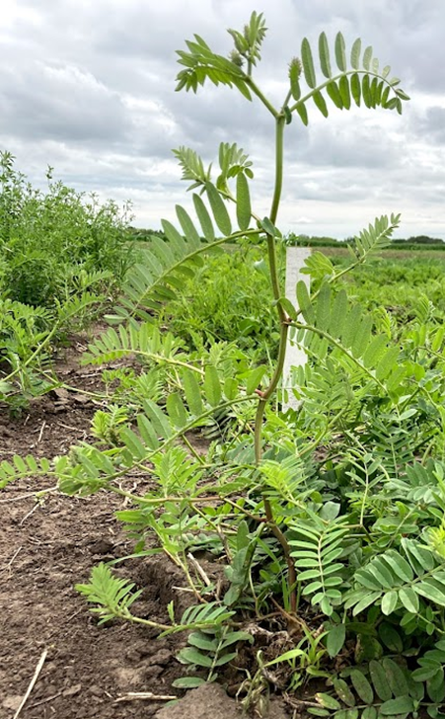
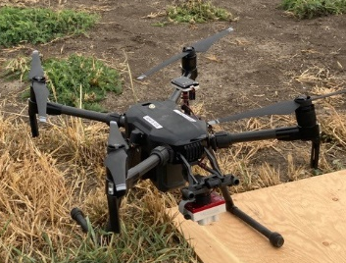
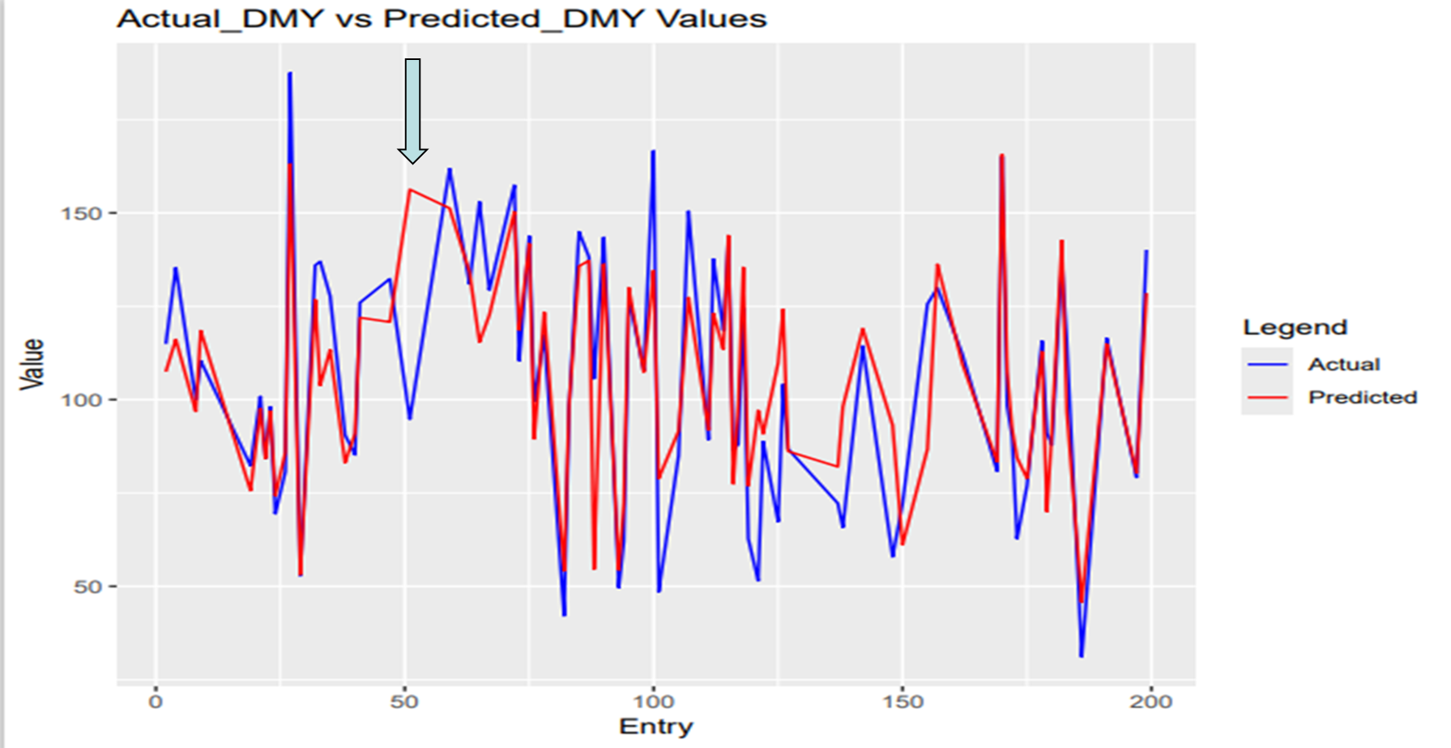
Prediction phenotyping is critical for GS
Forage yield
Max Stem Length 0.69 ***
1st Harvest (June 30 2020/2021)
Forage yield
NDVI Green Area 0.92 ***
1st Harvest (June 30 2020/2021)

Slide 20

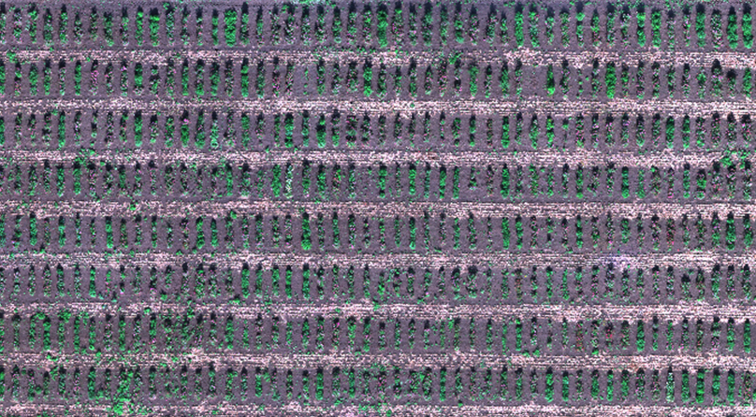
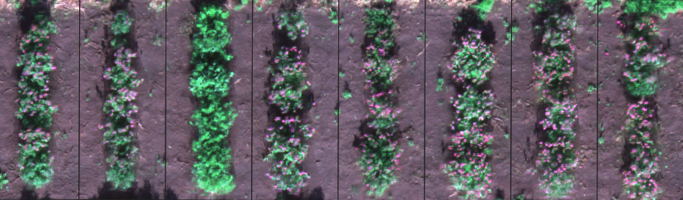
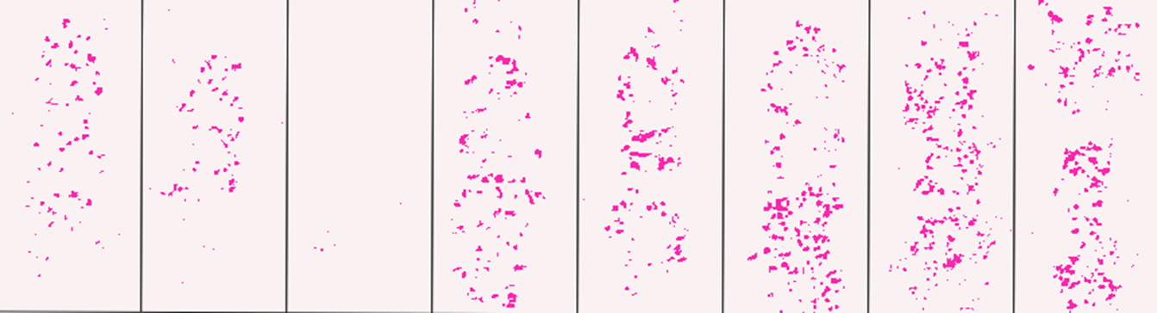
Unmanned Aerial vehicle use in red clover flower count
Raw image
Flower pixels only

Slide 21
Alfalfa genomic selection: Linkage development
50 alfalfa cultivars (2015)
Two spaced nurseries at Saskatoon and Swift Current (2018-2022), all plants were sequenced in 2019
Seeded small field crossing block (2016)
Forage yield, plant height, fiber selection in 2023 (based on genomic model, and conventional method)
Selected 500 random seeds – cloned using stem cuttings (2017-18)

Slide 22
20% overlapping

Slide 23
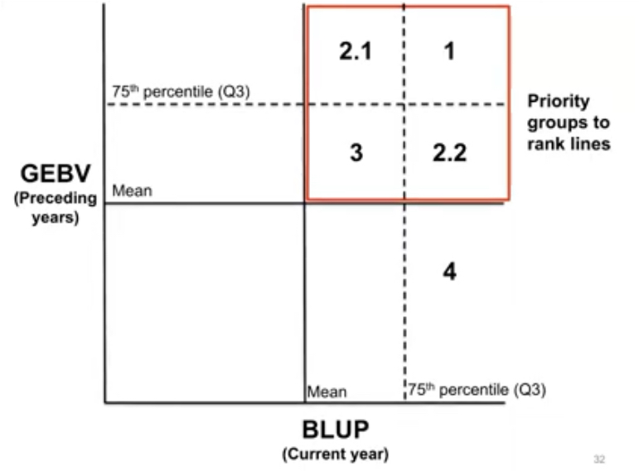

Slide 24
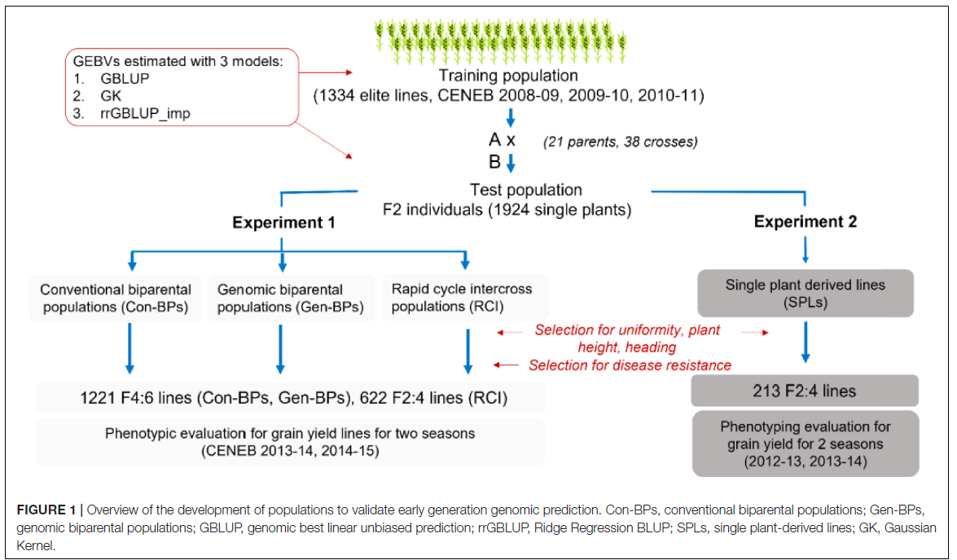
GEBV, plant type, and disease
reaction.
50 F4
50 F4
Bonnett et al. (2022) Response to Early Generation Genomic Selection for Yield in Wheat.
Front. Plant Sci. 12:718611. doi: 10.3389/fpls.2021.71861

Slide 25
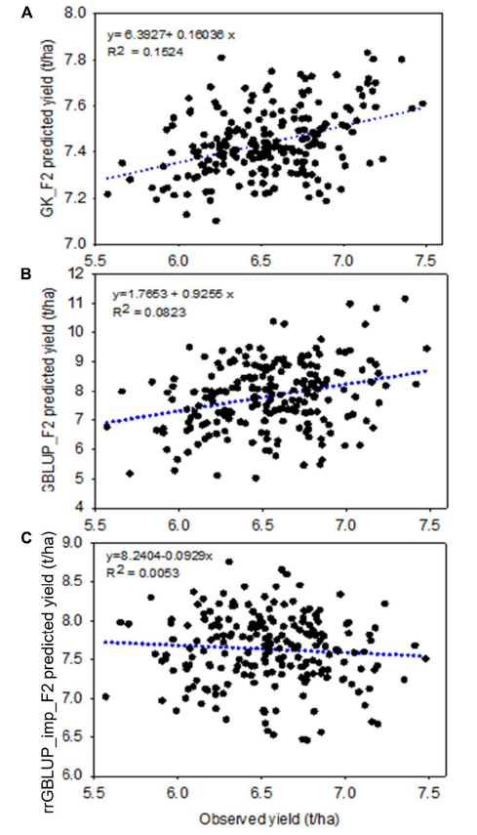
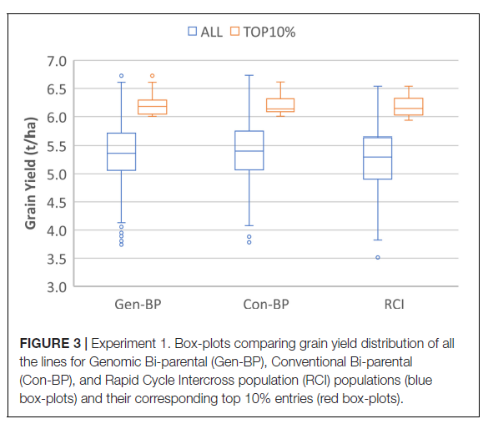

Slide 26
Key Take Aways
Informative markers are more important than density of markers
Prediction Models will be species specific and trait specific
Larger Training set is needed for low related populations
Bi-parental populations may be able to reply small training set
GS – phenotypic selection can compliment each other
Elite lines can not be selected because of lack of genomic information in the training set
Precision phenotyping is critical

Slide 27
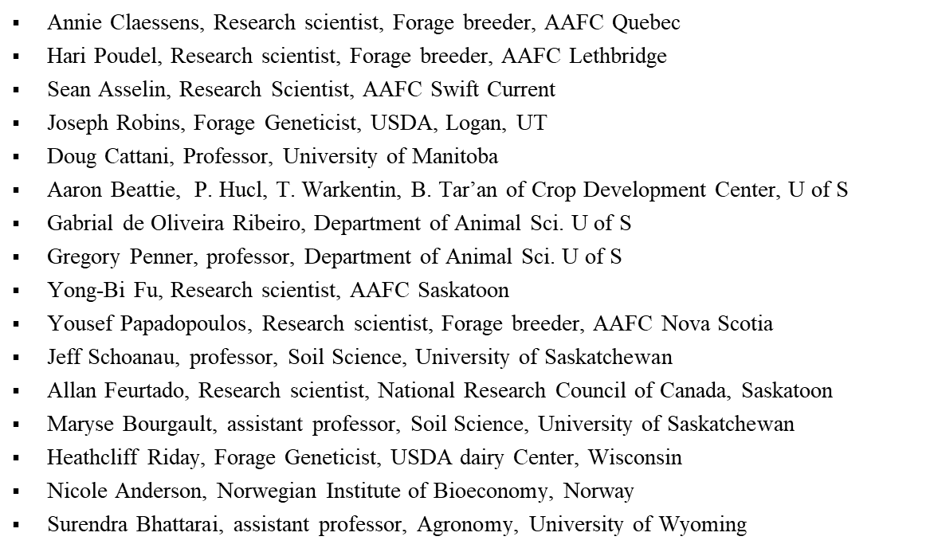
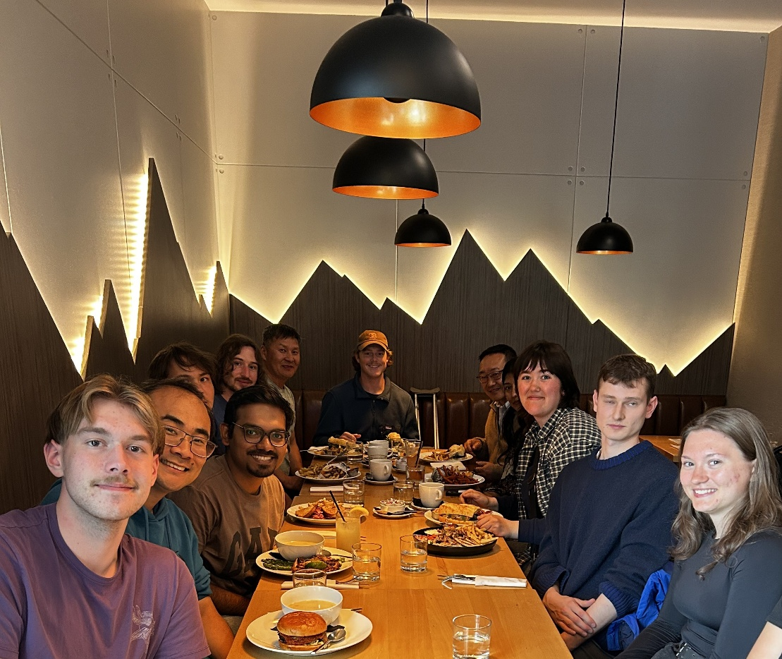
Collabortors and CDC Forage Breeding program Team

Slide 28



















Acknowledgements
RDAR

